Slide 1
Lecture : 1 Introduction to Community Nutrition
By dr. umer farooq

Slide 2
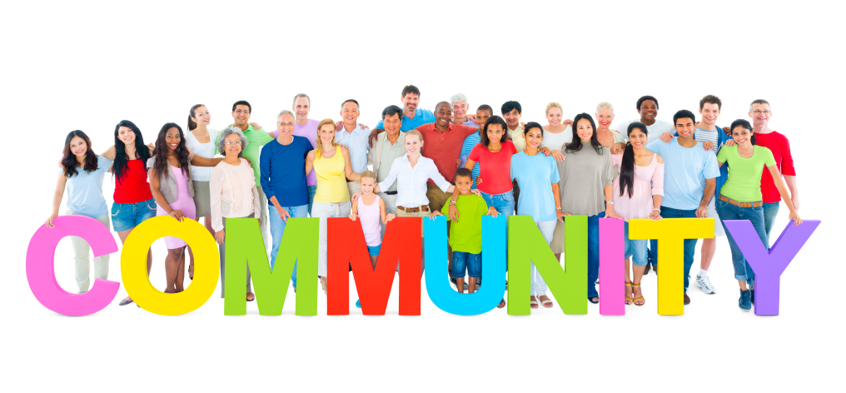
Community
A community is a small or large social unit (a group of living things) who have something in common, such as norms, religion, values, or identity.
Communities often share a sense of place that is situated in a given geographical area (e.g. a country, village, town, or neighborhood) or in virtual space through communication platforms.
The word "community" derives from Latin communis, "shared in common".

Slide 3
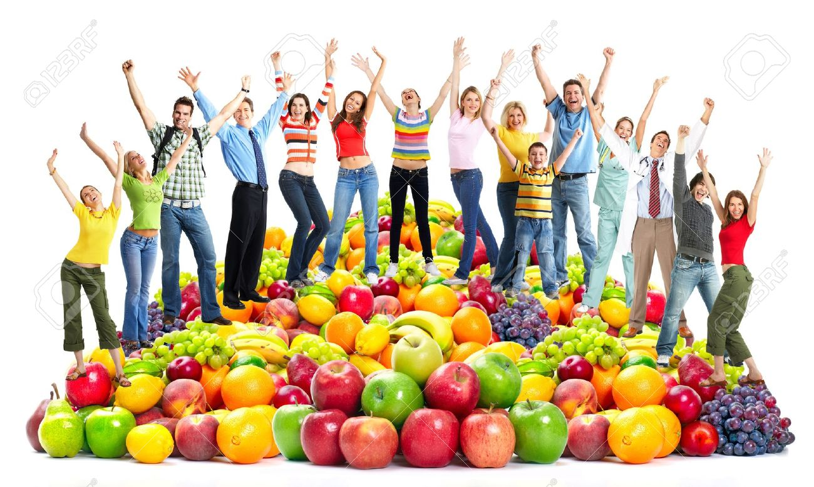
Community Nutrition
Discipline that works to prevent disease and improve health, nutrition, and well-being of individuals in communities
Community nutrition encompasses individual and interpersonal-level nutritional interventions focused on creating changes in knowledge, attitudes, behavior and health outcomes either individually or in small groups within a community setting

Slide 4
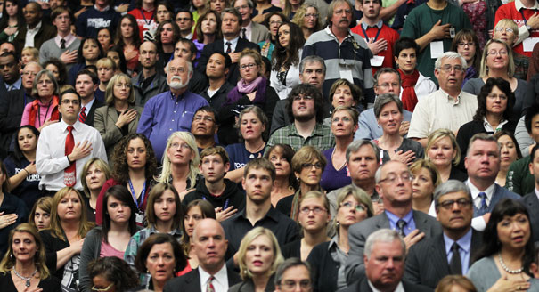
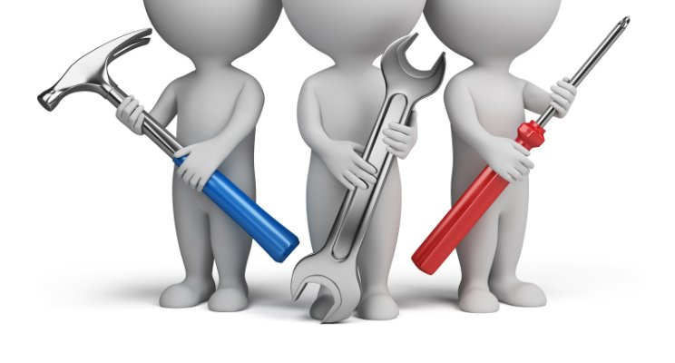
3 focus areas of community nutrition
People (individuals who will benefit from nutrition programs and services)
Policy (course of action by public authorities to solve problems- accomplished through law, regulations and programs)
Programs (instruments used for behavior changes to improve nutritional status & health)

Slide 5
Community nutritionists
Community nutritionists are professionals trained in the delivery of preventive and therapeutic nutrition services within community settings.
These individuals have training in :
Nutrition throughout the life-span
Nutrition education and counseling
Program development
These are registered dietitians or licensed dietitians/nutritionists

Slide 6
Skills required to be a community nutritionist
Develop community-wide programs addressing specific problem areas
Be able to address the needs of individuals depending on age, race, ethnicity, etc.
Use scientific methods to remediate public health problems

Slide 7
Functions of Community Nutritionists
The main functions of community nutritionists include :
Conducting and evaluating nutrition education and counseling for small groups and individuals
Planning, implementing, and evaluating primary and secondary prevention interventions
Providing therapeutic and rehabilitation nutrition services
Administering programs
Participating in care coordination or providing case management

Slide 8
Examples:
1. Conducting food demonstrations/classes for individuals enrolled in the Supplemental Nutrition Assistance Program (SNAP).
2. Training peer counselors and promotors to promote breastfeeding.
3. Conducting in-service education for school foodservice personnel.
4. Developing nutrition education activities for the school classroom.
5. Providing technical assistance/consultation to health providers on case management for nutrition and dietetics-related issues.
6. Participating in an interdisciplinary team conducting home visits.

Slide 9
Levels of Prevention
Community nutrition and dietetics professionals are also members of a community and are public health agency professionals who provide nutrition services that emphasize community health promotion and disease prevention.
They deal with the needs of individuals through primary, secondary, and tertiary preventions

Slide 10
1.Primary prevention involves designing activities to prevent a problem or disease before it occurs
Primary prevention includes Health Promotion and Specific Protection
Health Promotion includes the following
Provision of adequate Nutrition to individuals. Additional requirements of pregnancy, growth and adolescence are also catered for.
Health and Nutrition counselling to parents and communities
Provision of adequate housing and living conditions
Marriage Counselling

Slide 11
Specific Protection can be provided through following means
Specific immunization
Use of specific nutrient
Chemoprophylaxis
Protection against occupational hazards
Protection against accidents
2.Secondary prevention involves planning activities related to early diagnosis and prompt treatment, including screening for diseases
3.Tertiary prevention consists of designing activities to treat a disease state or injury and to prevent it from progressing further. It includes disability limitation and rehabilitation

Slide 12
Rehabilitation : It is the combined and coordinated use of medical, social, educational and vocational measures for training or retraining the individual to the highest possible level of functional ability
Types :
Medical Rehabilitation (Restoration of Function)
Vocational Rehabilitation (Restoration of the capacity to earn livelihood)
Social Rehabilitation (Restoration of Family and Social Relationship)
Psychological Rehabilitation (Restoration of personal dignity and confidence)

Slide 13
Primordial Prevention :
It is the prevention of chronic diseases by identifying risk factors and taking action for their prevention. The aim of primordial prevention is to modify lifestyle.
Example :
We can screen a healthy population for identification of risk factors for ischemic heart disease and on the basis of results of screening test, we may get number of persons having risk factors positive. At this stage although they have not yet developed ischemic heart disease, but we can advise them to eliminate risk factors, so that they may not develop IHD.

Slide 14
THANK YOU

