Slide 1
Web Systems & Technologies
Chapter 13 - Exploring JavaScript

Slide 2
JavaScript and HTML Text
JavaScript is a client-side scripting language that runs entirely inside the web browser.
JavaScript has direct access to all the elements in a web document.
JavaScript brings a dynamic functionality to the websites.
To call it up, you place it between opening <script> and closing </script> HTML tags.

Slide 3
Example 13-1. “Hello World” displayed using JavaScript
<html>
<head><title>Hello World</title></head>
<body>
<script type="text/javascript">
document.write("Hello World")
</script>
<noscript>
Your browser doesn't support or has disabled JavaScript
</noscript>
</body>
</html>
Notes:
$paper =array(“Copier”, Inkjet”, “Laser”, “Photo”);

Slide 4
JavaScript and HTML Text
document.write simply outputs the supplied string to the current document, where it is displayed.
newline serves as statement terminator in JavaScript.
Unlike with PHP, there is no trailing semicolon (;)
However, you may place a semicolon to the end of every statement.
<noscript> and </noscript> pair of tags are used when you wish to offer alternative HTML to users whose browser does not support JavaScript or who have it disabled.

Slide 5
Using Scripts Within a Document Head
Put the script in the <head> section to execute it immediately when a page loads.
It ensures that scripts are ready to use immediately by any other script sections in the document that rely on them.

Slide 6
Including JavaScript Files
Include JavaScript code files from your website or from anywhere on the Internet.
The script files must not include any <script> or </script> tags. Putting them in the JavaScript files will cause an error.
Example syntax to include another file:
<script type="text/javascript" src="script.js"></script>
<script type="text/javascript" src="http://someserver.com/script.js"></script>

Slide 7
Using Comments
Single-line comment
// This is a comment
Multiline comments
/* This is a section
of multiline comments
that will not be
interpreted */
You cannot nest multiline comments, so make sure that you don’t comment out large sections of code that already contain multiline comments.

Slide 8
Semicolons
JavaScript generally does not require semicolons if you have only one statement on a line.
Therefore, the following is valid:
x += 10
You must separate more than one statements on a line with semicolons, like this:
x += 10; y -= 5; z = 0
Leaving the final semicolon is valid as the newline terminates the last statement.

Slide 9
Variables
Unlike PHP’s $, no particular character identifies a variable in JavaScript.
JavaScript variables use the following naming rules:
A variable may include only the letters a-z, A-Z, 0-9, the $ symbol, and the underscore (_).
No other characters, such as spaces or punctuation, are allowed in a variable name.
The first character of a variable name can be only a-z, A-Z, $, or _ (no numbers).
Names are case-sensitive. Count, count, and COUNT are all different variables.
There is no set limit on variable name lengths.

Slide 10
String Variables
JavaScript string variables should be enclosed in either single or double quotation marks:
greeting = "Hello there"
warning = 'Be careful'
A single quote within a double-quoted string or a double quote within a single-quoted string can be used.
greeting = "'Hello there' is a greeting"
warning = '"Be careful" is a warning'

Slide 11
String Variables
Must escape a quote of the same type by using the backslash character:
greeting = "\"Hello there\" is a greeting"
warning = '\'Be careful\' is a warning’
String variable can be assigned to another variable:
newstring = oldstring
String variable can be used in a function:
status = "All systems are working" document.write(status)

Slide 12
Numeric Variables
Creating a numeric variable is as simple as assigning a value, like these examples:
count = 42
temperature = 98.4
Like strings, numeric variables can be read from and used in expressions and functions.

Slide 13
Arrays
JavaScript array can contain string or numeric data, as well as other arrays.
The following syntax creates an array of strings:
toys = ['bat', 'ball', 'whistle', 'doll']
To create a multidimensional array, nest smaller arrays within a larger one. To create a two-dimensional array containing the colors of a single face of a scrambled Rubik’s Cube, you could use the following code:
face = [['R','G','Y'], ['W','R','O'], ['Y','W','G']]

Slide 14
Arrays
The previous example could also be written like this:
top = ['R', 'G', 'Y']
mid = ['W', 'R', 'O']
bot = ['Y', 'W', 'G']
face = [top, mid, bot]
To access last element of second array use the following syntax (because array elements start at position 0):
document.write(face[1][2])
//outputs the letter O for orange

Slide 15
Arithmetic Operators

Slide 16
Assignment Operators

Slide 17
Comparison Operators

Slide 18
Logical Operators

Slide 19
Variable Incrementing and Decrementing
The following forms of post- and pre-incrementing and decrementing are also supported by JavaScript:
++x
--y
x += 22
y -= 3

Slide 20
String Concatenation
JavaScript uses the plus sign (+) for string instead of the . (period) operator:
mc = 3
document.write("You have " + mc + " messages.")
Output from this line of code will be:
You have 3 messages.
String can be appended to another string using compound assignment:
name = "Bill"
name += " Gates"

Slide 21
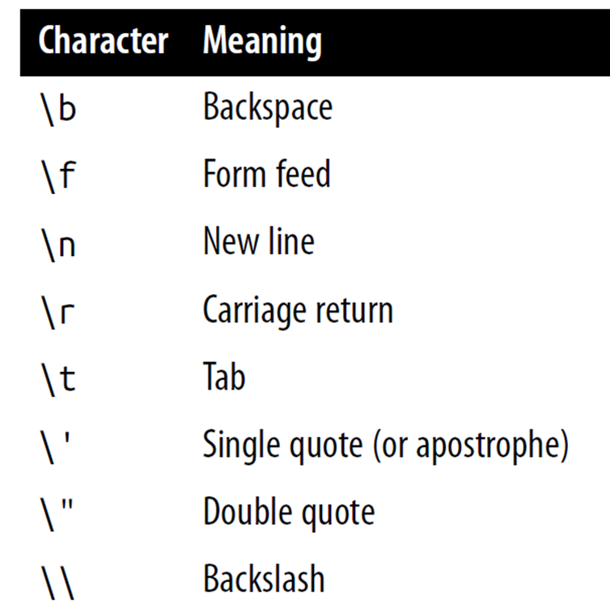
Escaping Characters
Escape characters are used to insert various special characters such as tabs, newlines, and carriage returns.
Example - using tabs in a string:
txt = "Name\tAge\tClass"

Slide 22
Variable Typing
JavaScript is a very loosely typed language.
type of a variable is determined only when a value is assigned and can change in different contexts.
Use typeof operator to check a variable’s type.

Slide 23
Example 13-3. Setting a variable’s type by assignment
<script>
n = '838102050' // Set 'n' to a string
document.write('n = ' + n + ', and is a ' + typeof n + '<br>')
n = 12345 * 67890; // Set 'n' to a number
document.write('n = ' + n + ', and is a ' + typeof n + '<br>')
n += ' plus some text' // Change 'n' from a number to a string
document.write('n = ' + n + ', and is a ' + typeof n + '<br>')
</script>
The output from this script looks like this:
n = 838102050, and is a string
n = 838102050, and is a number
n = 838102050 plus some text, and is a string

Slide 24
Functions
JavaScript functions are used to separate out sections of code that perform a particular task.
Example 13-9. A simple function declaration
<script>
function product(a, b)
{
return a*b
}
</script>
This function takes the two parameters, multiplies them together, and returns the product.

Slide 25
Global Variables
Every part of a script have access global variables.
Global variables are:
Variables defined outside of any functions
Defined within functions without the var keyword
Examples:
a = 123 // Global scope
var b = 456 // Global scope

Slide 26
Local Variables
Parameters passed to a function automatically have local scope.
Arrays are exception and are passed to a function by reference.
Modifying any elements in an array parameter will change the elements of the original array.
To define a local variable that has scope only within the current function use the var keyword.
Example:
<script>
function test()
{ a = 123 // Global scope
var b = 456 // Local scope
}
</script>

Slide 27
Example 13-6. Checking the scope of the variables defined in the function test
<script>
test()
if (typeof a != 'undefined’)
document.write('a = "' + a + '"<br>’)
if (typeof b != 'undefined’)
document.write('b = "' + b + '"<br>')
function test()
{
a = 123
var b = 456
}
</script>
// output a = "123" as only the variable a was given global scope

