Slide 1
Topic : Biotechnology for metal and radionuclide removal and recovery

Slide 2
Introduction :
Soil , aquatic sediments , waste streams and bodies of water are contaminated with metal , metalloids , cyanides and radioactive compounds
Sources of these compounds are mining operations , refining ores, sludge spread on land , metal plating and use of biopesticides and preservatives
The substance of concern is ionic mercury, lead , chromium, cyanide , selenium , arsenic , nickel , copper , nitrate etc

Slide 3
In contrast to different hydrocarbons metals cannot be destroyed by microorganisms
Metals can be modified like immobilization , change in valency by these means microorganisms can remediate metals
Their removal and recovery is done by following methods :
Bioremediation
Bioleaching
Biosorption

Slide 4
Bioremediation :
It is a process in which living microorganisms are used to remove the environmental pollutants or prevent pollution
Microbial bioremediation uses microorganisms to break down contaminants by using them as a food source.
Phytoremediation uses plants to bind, extract, and clean up pollutants such as pesticides, petroleum hydrocarbons, metals, and chlorinated solvents.
Mycoremediation uses fungi’s digestive enzymes to break down contaminants such as pesticides, hydrocarbons, and heavy metals.

Slide 6
Techniques :
Contaminants can be removed or reduced with varying bioremediation techniques that are in-situ or ex-situ
Bioremediation techniques are classified based on the treatment locality.
in-situ techniques : treats polluted sites in a non-destructive manner and cost-effective
ex-situ techniques : commonly require the contaminated site to be excavated which increases costs

Slide 7
In situ techniques :
Bioventing :
Bioventing is a process that increases the oxygen or air flow into the unsaturated zone of the soil, this in turn increases the rate of natural in-situ degradation of the targeted hydrocarbon contaminant
An aerobic bioremediation, is the most common form of oxidative bioremediation process where oxygen is provided as the electron acceptor for oxidation of petroleum, polyaromatic hydrocarbons (PAHs), phenols, and other reduced pollutants
Oxygen is generally the preferred electron acceptor because of the higher energy yield and because oxygen is required for some enzyme systems to initiate the degradation process

Slide 8
b) Biostimulation:
Bioremediation can be carried out by bacteria that is naturally present in the environment or adding nutrients, this process is called biostimulation
c) Biosparging:
Biosparging is the process of groundwater remediation as oxygen, and possible nutrients, is injected. When oxygen is injected, indigenous bacteria are stimulated to increase rate of degradation

Slide 9
II. ex situ technique :
Biopiles:
Biopiles, similar to bioventing, are used to reduce petroleum pollutants by introducing aerobic hydrocarbons to contaminated soils
b) Windrows :
Windrow systems are similar to compost techniques where soil is periodically turned in order to enhance aeration

Slide 10
c) Landfarming:
Landfarming, or land treatment, is a method commonly used for sludge spills
This method disperses contaminated soil and aerates the soil by cyclically rotating

Slide 11
2. Bioleaching :
The process of extracting metals from ores or waste by using microorganisms to oxidize the metals, producing soluble compounds
Two process are involved:
Direct bioleaching
Indirect bioleaching

Slide 12
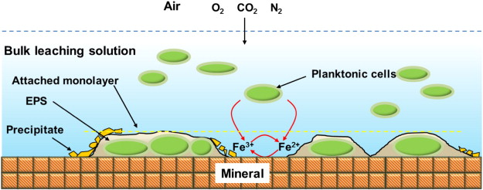

Slide 13
Procedure :
Bioleaching can involve numerous ferrous iron and sulfur oxidizing bacteria
As a general principle, Fe³⁺ ions are used to oxidize the ore
This step is entirely independent of microbes
The role of the bacteria is the further oxidation of the ore, but also the regeneration of the chemical oxidant Fe³⁺ from Fe²⁺
For example, bacteria catalyze the breakdown of the mineral pyrite (FeS₂) by oxidizing the sulfur and metal (in this case ferrous iron, (Fe²⁺)) using oxygen
This yields soluble products that can be further purified and refined to yield the desired metal

Slide 14
Commonly used microorganisms :
Mesophiles
Moderately thermophilic bacteria
Extremophiles

Slide 15
3. Biosorption
The ability of biological materials to accumulate heavy metals from wastewater through metabolically mediated or physio-chemical pathways of uptake
Though using biomass in environmental cleanup has been in practice for a while, scientists and engineers are hoping this phenomenon will provide an economical alternative for removing toxic heavy metals from industrial wastewater and aid in environmental remediation

Slide 16
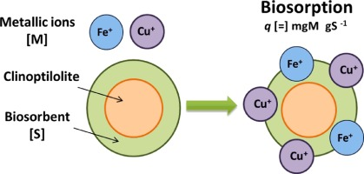

Slide 17
Difference from bioaccumulation:
Though bioaccumulation and biosorption are used synonymously, they are very different in how they isolate contaminants:
Biosorption is a metabolically passive process, meaning it does not require energy, and the amount of contaminants a sorbent can remove is dependent on kinetic equilibrium and the composition of the sorbents cellular surface
Contaminants are adsorbed onto the cellular structure.
Bioaccumulation is an active metabolic process driven by energy from a living organism and requires respiration

Slide 18
Common biosorbents :
Some common biosorbents are:
Plants
Algae
Fungi
Bacteria

