Slide 1
International efforts in conservation of biodiversity
Genetic resources and conservation
BS Biotechnology (6th Semester)
University of Sargodha

Slide 2
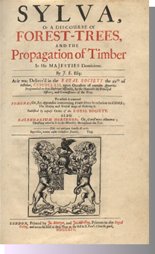
Conservation of Biodiversity
The history of conservation can be traced back to John Evelyn’s work “Sylva”, presented as a paper to the Royal Society in 1662. Published as a book two years later, it was one of the most highly influential texts on forestry ever published.
Timber resources in England were becoming dangerously depleted at that time, and Evelyn advocated the importance of conserving the forests by managing the rate of depletion and ensuring that the cut down trees get replenished.

Slide 3
Conservation of Biodiversity
During the 18th century, scientific forestry methods were developed for conservation. These methods were first applied rigorously in British India from the early-19th century.
Concerns over teak (hard timber used for shipbuilding, teak was important for Royal Navy) depletion were raised as early as 1799 and 1805 when the Navy was undergoing a massive expansion during the wars; this pressure led to the first formal conservation Act, which prohibited the felling of small teak trees.
The first forestry officer was appointed in 1806 to regulate and preserve the trees necessary for shipbuilding

Slide 4
Conservation of Biodiversity
International Union for Protection of Nature (IUPN) was established in 1948 in France. At the time of its founding, IUPN was the only international organisation focusing on the entire spectrum of nature conservation. In 1956, Its name was changed to International Union for Conservation of Nature and Natural resources (IUCN)
IUCN was one of the few environmental organisations formally involved in the preparations of the United Nations Conference on Human Environment (Stockholm, 1972).

Slide 5
Conservation of Biodiversity
Conservation of biological diversity and sustainable use of its components came into the limelight in 1972 (United Nations Conference on Human Environment; Stockholm). The United Nations Environment Program (UNEP) was created as a result of this conference.
In 1973, UNEP identified conservation of biodiversity as a priority area, hence there was need to get the legal mandate for conservation of world resources.
United Nations Conference on Environment and Development (UNCED) also known as Earth Summit was a major United Nations conference held in Rio de Janeiro in 1992.

Slide 6
United Nations Conference on Environment and Development (UNCED)/Earth Summit
The issues addressed included
systematic scrutiny of patterns of toxic component production
alternative sources of energy to replace the use of fossil fuels
new reliance on public transportation systems in order to reduce vehicle emissions, congestion in cities and the health problems caused by polluted air and smoke
the growing usage and limited supply of water

Slide 7
United Nations Conference on Environment and Development (UNCED)/Earth Summit
Moreover, important legally binding agreements were opened for signature:
Convention on Biological Diversity (CBD)
196 ratified parties signed this convention.
Objectives of CBD
1-The conservation of biological diversity
2-The sustainable use of the components of biological diversity
3-The fair and equitable sharing of the benefits arising out of the utilization of genetic resources

Slide 8
United Nations Conference on Environment and Development (UNCED)/Earth Summit
Framework Convention on Climate Change (UNFCCC)
197 ratified parties signed this convention. UNFCCC aims to control the greenhouse gas concentrations in the atmosphere at a level that would prevent dangerous anthropogenic interference with the climate system.
United Nations Convention to Combat Desertification (UNCCD)
197 ratified parties signed this convention. UNCCD aims to improve the living conditions for people in drylands, to maintain and restore land and soil productivity, and to mitigate the effects of drought.

Slide 9
International Union for Conservation of Nature (IUCN)
Established in 1948. the driving force behind the creation of IUCN was UNESCO.
IUCN is an international organization working in the field of nature conservation and sustainable use of natural resources
It is involved in data gathering and analysis, research, field projects, advocacy, and education.
IUCN's mission is to "influence, encourage and assist societies throughout the world to conserve nature and to ensure that any use of natural resources is equitable and ecologically sustainable".

Slide 10
International Union for Conservation of Nature: History
International Union for Protection of Nature (IUPN) was established in 1948 in France. At the time of its founding, IUPN was the only international organisation focusing on the entire spectrum of nature conservation. In 1956, Its name was changed to International Union for Conservation of Nature and Natural resources (IUCN). This was also called as World Conservation Union from 1990 to 2008.
IUCN was one of the few environmental organisations formally involved in the preparations of the United Nations Conference on Human Environment (Stockholm, 1972).

Slide 11
International Union for Conservation of Nature: Objective
to promote nature conservation and the ecologically sustainable use of natural resources.
Through its member organizations, the IUCN supports and participates in
environmental scientific research
promotes and helps implement national conservation legislation policies, and practices
operates or manages thousands of field projects worldwide

Slide 12
International Union for Conservation of Nature: Themes
Business and Biodiversity
Climate change
Ecosystem Management
Environmental law
Governance and Rights
Science and Economics
Global policy
Protected Areas
Gender
Nature based solutions
Forests
Marine and Polar
World heritage
Water
Species

Slide 13
International Union for Conservation of Nature: How it works
UCN is a democratic Union that brings together the world’s most influential organisations and top experts in a combined effort to conserve nature and accelerate the transition to sustainable development.
It harnesses the experience, resources and reach of its more than 1,300 Member organisations and the input of more than 15,000 experts.
All of the IUCN’s work is guided by a global program, which is adopted by member organizations every four years at the IUCN World Conservation Congress.

Slide 14
International Union for Conservation of Nature: How it works

Slide 15
International Union for Conservation of Nature: Red List
The IUCN Red List of Threatened Species™ is the world's most comprehensive inventory of the global conservation status of plant and animal species.
It uses a set of quantitative criteria to evaluate the extinction risk of thousands of species.
These criteria are relevant to most species and all regions of the world.
The IUCN Red List is an authoritative indicator of the health of the world’s biodiversity.

Slide 16
International Union for Conservation of Nature: Red List
a powerful tool to inform and catalyse action for biodiversity conservation and policy change,
critical to protecting the natural resources we need to survive.
provides information about range, population size, habitat and ecology, use and/or trade, threats,
provides information about conservation actions that will help inform necessary conservation decisions.

Slide 17
International Union for Conservation of Nature: Red List
IUCN Red list categories
The IUCN Red List Categories define the extinction risk of species assessed.

Slide 18
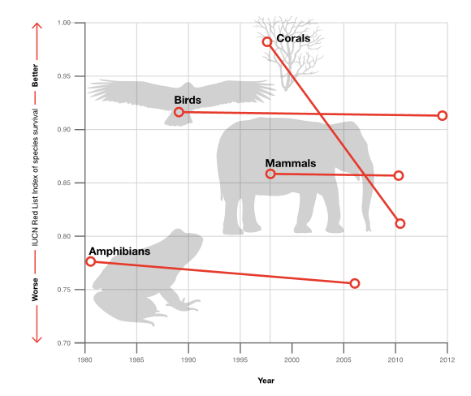
International Union for Conservation of Nature: Red List
IUCN Red list Index
The IUCN Red List Index (RLI) reveals trends in the overall extinction risk of species and provides an indicator that is used by governments to track their progress in achieving targets that reduce biodiversity loss.
The RLI is available for groups in which all species have been assessed at least twice. Currently, the Index is available for five groups : birds, mammals, amphibians, corals and cycads

Slide 19
International Union for Conservation of Nature: Red List
IUCN Red List data are used for a variety of purposes:
International agreements use IUCN Red List data to guide decision making and as an indicator of the status of nature.
Government agencies rely on IUCN Red List data to guide policies such as National Parks regulations
Zoos use The IUCN Red List Categories to educate the public about species' status
Scientists use IUCN Red List data as a primary data source in their analyses and publications
Teachers and students use IUCN Red List data in college projects
Journalists use IUCN Red List data to inform their articles

Slide 20
World Wide Fund for Nature
The World Wide Fund for Nature (WWF) is an international non-governmental organization founded in 1961
Its mission is to conserve nature and reduce the most pressing threats to the diversity of life on Earth.
Its is working in the field of wilderness preservation, and the reduction of human impact on the environment

Slide 21
World Wide Fund for Nature: History
In 1961, a limited number of organizations around the world—such as the International Union for the Conservation of Nature and Natural Resources (IUCN) and The Conservation Foundation—were trying to meet conservation needs, but were desperately short of funds.
The first call for broad support was the Morges Manifesto, signed in 1961 by 16 of the world’s leading conservationists, including biologist and African wildlife enthusiast Sir Julian Huxley, IUCN vice president Sir Peter Scott and director-general of the British Nature Conservancy E. M. Nicholson.
The decision was made to establish World Wildlife Fund as an international fundraising organization to work in collaboration with existing conservation groups and bring substantial financial support to the conservation movement on a worldwide scale.

Slide 22
World Wide Fund for Nature
WWF has five million supporters worldwide
It is working in more than 100 countries
It is supporting around 3000 conservation and environmental projects.
Notes:
Bequest: The act of giving personal property or money such as stocks, bonds, jewelry and cash left to an individual or organization through the provisions of a will or estate plan.

Slide 23
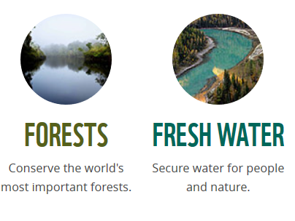
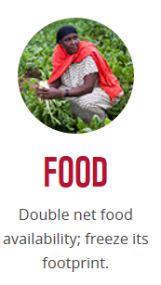
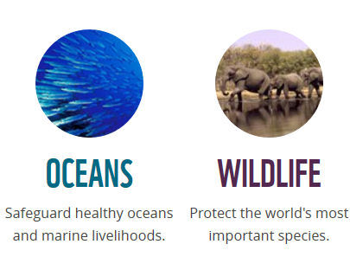
Goals of WWF

Slide 24
WWF

Slide 25
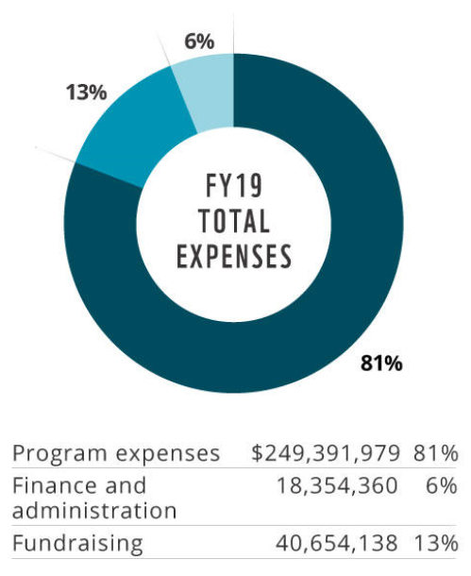
World Wide Fund for Nature: Finances

Slide 26
Convention on International trade for endangered species (CITES)
The Convention on International Trade in Endangered Species of Wild Fauna and Flora (CITES) is an international treaty to prevent species from becoming endangered or extinct because of international trade.
Under this treaty, countries work together to regulate the international trade of animal and plant species and ensure that this trade is not detrimental to the survival of wild populations.
Any trade in protected plant and animal species should be sustainable, based on sound biological understanding and principles.

Slide 27
Convention on International trade for endangered species (CITES)
In the early 1960s, international discussion began focusing on the rate at which the world’s wild animals and plants were being threatened by unregulated international trade.
The CITES Convention was drafted as the result of a resolution adopted in 1963 at a meeting of the IUCN. The text of Convention was agreed upon at a meeting of representatives of 80 countries in 1973. CITES can into force in 1975.
Today, 182 countries and the European Union implement CITES, which provides varying degrees of protection to over 35,000 species of animals and plants.

Slide 28
Convention on International trade for endangered species (CITES): How it works
The species covered by CITES are listed in three Appendices, according to the degree of protection they need.
Appendix I includes species threatened with extinction. Trade in specimens of these species is permitted only in exceptional circumstances.
Appendix II includes species not necessarily threatened with extinction, but in which trade must be controlled in order to avoid utilization incompatible with their survival.
Appendix III contains species that are protected in at least one country, which has asked other CITES Parties for assistance in controlling the trade.

Slide 29
CITES permits/certificates
Appendix I
An import, export and re-export permit issued by the Management Authority of the State of import or export is required.
In the case of a live animal or plant, it must be prepared and shipped to minimize any risk of injury, damage to health or cruel treatment
Appendix II
An export permit or re-export certificate issued by the Management Authority of the State of export or re-export is required.
No import permit is needed unless required by national law

Slide 30
CITES permits/certificates
Appendix III
An export permit issued by the Management Authority of that State is required.
This may be issued only if the specimen was legally obtained and, in the case of a live animal or plant, if it will be prepared and shipped to minimize any risk of injury, damage to health or cruel treatment.

