Slide 1
Structural Engineering Lec#3
Engr. Muhammad Mubashir Ajmal
Department of Civil Engineering, University of Sargodha, Sargodha

Slide 2
Text Book
“Structural Analysis” by R.C. Hibbeler
Department of Civil Engineering, University of Sargodha, Sargodha

Slide 3
List of Content
Bridge Engineering
Structural Engineering
Department of Civil Engineering, University of Sargodha, Sargodha

Slide 4
Introduction
Bridges are defined as structures which provide a connection or passage over a gap without blocking the opening or passageway beneath.
They can be over streams, canals, rivers, creeks and valleys or roads and railways passing beneath.
Bridges are now being provided across ocean bodies and for linking a number of islands as in Japan.
Department of Civil Engineering, University of Sargodha, Sargodha

Slide 5
Introduction
World’s longest sea crossing: Hong Kong-Zhuhai bridge having spans 55 Km
Department of Civil Engineering, University of Sargodha, Sargodha

Slide 6
Introduction
The bridge crossing carrying a road or railway over another road or railway is called a grade separator or fly over.
The bridge structure can be for passage/carriage of persons, cattle, vehicles, water or other material carried across in pipes or conveyors.
When they are used for carriage of water, they are called aqueducts
Department of Civil Engineering, University of Sargodha, Sargodha

Slide 7
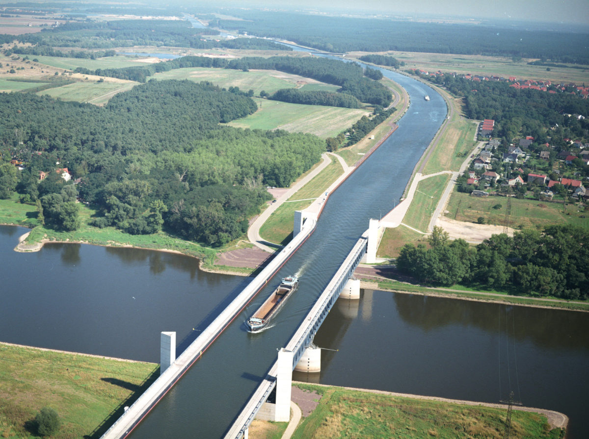
Introduction
Magdeburg Water Bridge, the World’s Longest Navigable Aqueduct (918 m)
Department of Civil Engineering, University of Sargodha, Sargodha

Slide 8
Components of Bridge
Superstructure:
This includes slab, girder, truss etc.
This is also called as decking.
This bears the load passing over it and transmits the forces caused by the same to the substructure
Department of Civil Engineering, University of Sargodha, Sargodha

Slide 9
Components of Bridge
Bearings:
The bearings transmit the load received from the decking on to the substrurcture and are provided for distribution of the load evenly over the substructure material.
These also allow for longitudinal movement of girders due to longitudinal forces of moving loads and temperature variation
Department of Civil Engineering, University of Sargodha, Sargodha

Slide 10
Components of Bridge
Substructure:
Piers and Abutments:
These are vertical structures supporting deck/bearing provided for transmitting the load down to the bed/earth through foundation.
Abutment, in addition retain earth behind.
Department of Civil Engineering, University of Sargodha, Sargodha

Slide 11
Components of Bridge
Substructure:
Wing walls and Returns:
These are provided as extension of the abutments to retain the earth of approach bank which otherwise has a natural angle of repose
Department of Civil Engineering, University of Sargodha, Sargodha

Slide 12
Components of Bridge
Substructure:
Foundation:
This is provided to transmit the load from the piers or abutments and wings or returns to the strata
This is to be provided sufficiently deep so that it is not affected by the scour cased by the flow in the river
Department of Civil Engineering, University of Sargodha, Sargodha

Slide 13
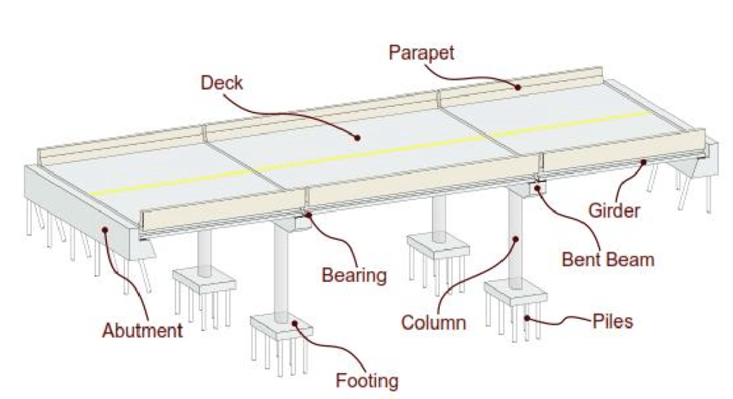
Components of Bridge
Components of a bridge
Department of Civil Engineering, University of Sargodha, Sargodha

Slide 14
Classification of Bridges
There are many ways of classification of bridges and the different considerations on which they can be classified are:
Material of construction
Form of superstructure
Types of span
Position of roadway or railway w.r.t. main girder
Headway requirement
Permanent or temporary nature
Department of Civil Engineering, University of Sargodha, Sargodha

Slide 15
Classification of Bridges
Materials for Construction:
Timber
Iron and steel
Pin-jointed
Rivetted
Bolted
welded
Concrete
Reinforced concrete
Prestressed concrete
Department of Civil Engineering, University of Sargodha, Sargodha

Slide 16
Classification of Bridges
Form of Superstructure:
Arches (steel arches up to 500m and concrete arches up to 300 m)
Slabs (up to 9 m)
Girders (10 to 60 m)
Trusses (30 to 375m simply supported)
Suspension (500 to 2000 m)
Cable-stayed bridges (300 to 600 m)
Department of Civil Engineering, University of Sargodha, Sargodha

Slide 17
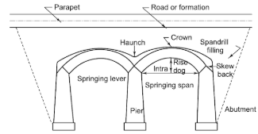
Classification of Bridges
Arch Bridge
Department of Civil Engineering, University of Sargodha, Sargodha

Slide 18
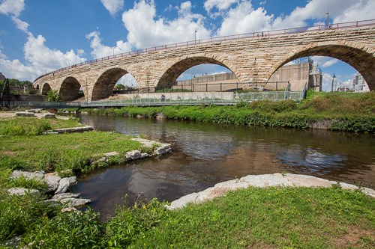
Classification of Bridges
Arch Bridge
Department of Civil Engineering, University of Sargodha, Sargodha

Slide 19
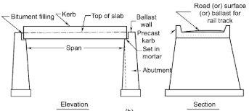
Classification of Bridges
Slab Bridge
Department of Civil Engineering, University of Sargodha, Sargodha

Slide 20
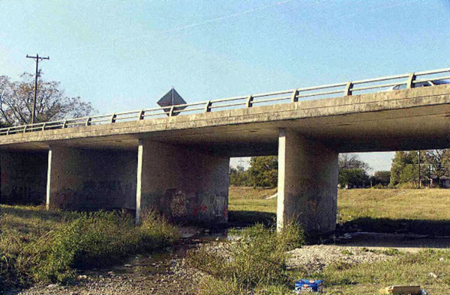
Classification of Bridges
Slab Bridge
Department of Civil Engineering, University of Sargodha, Sargodha

Slide 21
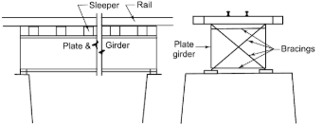
Classification of Bridges
Girder Bridge
Department of Civil Engineering, University of Sargodha, Sargodha

Slide 22
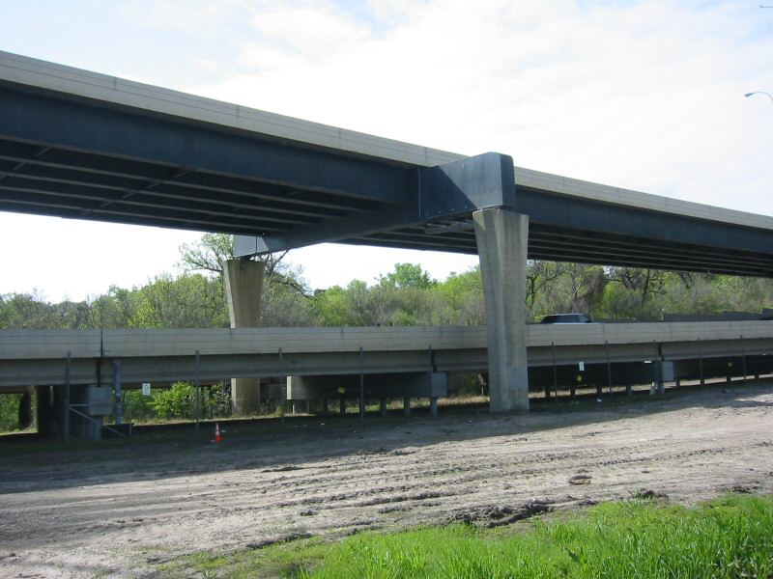
Classification of Bridges
Girder Bridge
Department of Civil Engineering, University of Sargodha, Sargodha

Slide 23
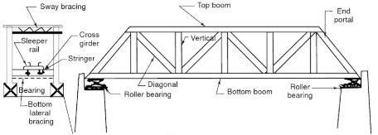
Classification of Bridges
Truss Bridge
Department of Civil Engineering, University of Sargodha, Sargodha

Slide 24
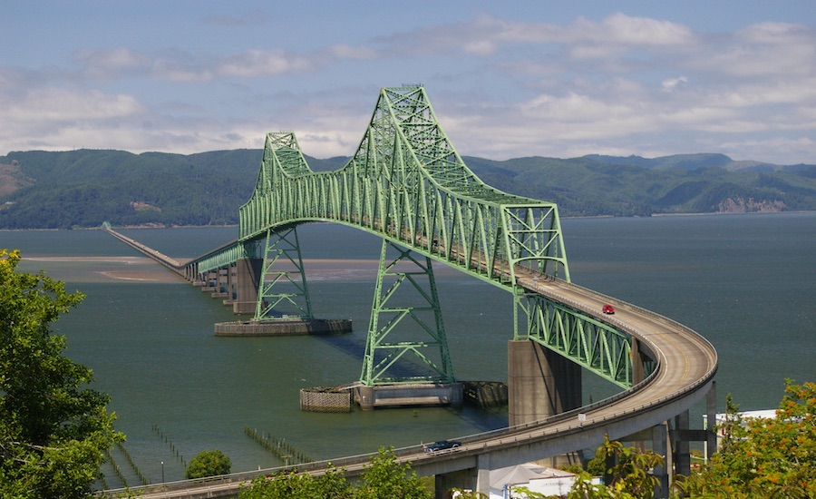
Classification of Bridges
Truss Bridge
Department of Civil Engineering, University of Sargodha, Sargodha

Slide 25
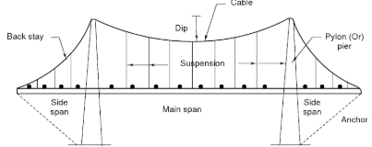
Classification of Bridges
Suspension Bridge
Department of Civil Engineering, University of Sargodha, Sargodha

Slide 26
Classification of Bridges
Suspension Bridge
Department of Civil Engineering, University of Sargodha, Sargodha

Slide 27
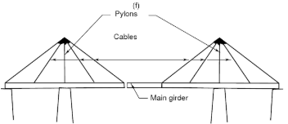
Classification of Bridges
Cable-Strayed Bridge
Department of Civil Engineering, University of Sargodha, Sargodha

Slide 28
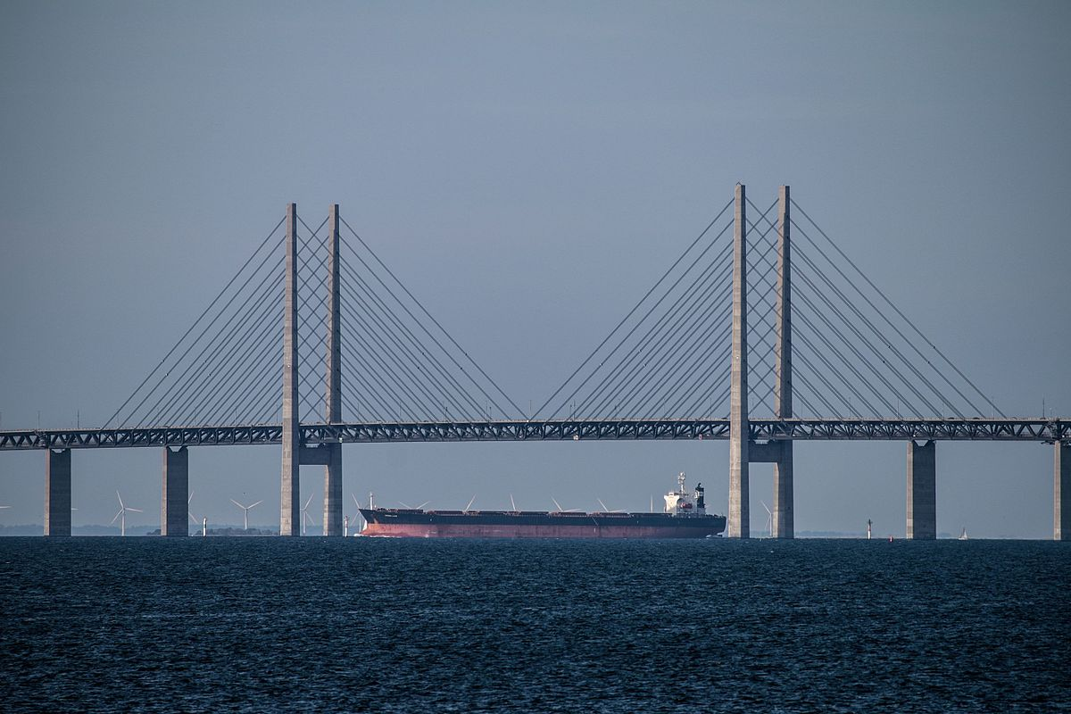
Classification of Bridges
Cable-Strayed Bridge
Department of Civil Engineering, University of Sargodha, Sargodha

Slide 29
Classification of Bridges
Classification by Types of Span:
Small Span (up to 15m)
Medium Span (up to 50m)
Large Span (up to 150m)
Extra Large Span (over 150m)
Department of Civil Engineering, University of Sargodha, Sargodha

Slide 30
Classification of Bridges
Position of Roadway/Railway w.r.t. Main Girders:
Main structure below the deck line
Main structure above the deck line
Main structure coincides with the deck line
Department of Civil Engineering, University of Sargodha, Sargodha

Slide 31
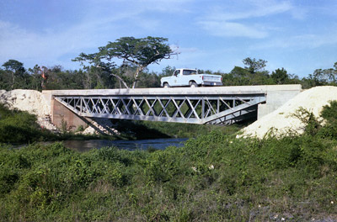
Classification of Bridges
Main structure below the deck line
Department of Civil Engineering, University of Sargodha, Sargodha

Slide 32
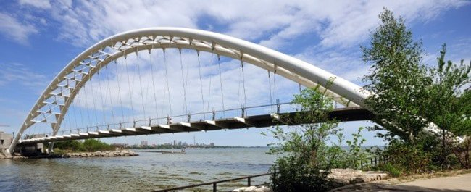
Classification of Bridges
Main structure above the deck line
Department of Civil Engineering, University of Sargodha, Sargodha

Slide 33
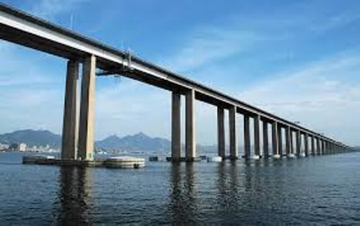
Classification of Bridges
Main structure coincides the deck line
Department of Civil Engineering, University of Sargodha, Sargodha

Slide 34
Classification of Bridges
Clearance Requirement Consideration:
Normally bridges have to be provided in such a way that they are clear of the high flood level
Where there is navigation, the bottom of the superstructure has to be kept sufficiently high to permit the boats and ships to pass under
Department of Civil Engineering, University of Sargodha, Sargodha

Slide 35
Classification of Bridges
Causeway:
It may be found that in some cases the high flood in the stream is occasional and the normal flow is very little or the bed is dry most of the time
In such cases, causeways are provided which are nothing but a paved road formed between retaining walls on either sides.
Submersible Bridge:
A submersible bridge is a type of movable bridge that lowers the bridge deck below the water level to permit waterborne traffic to use the waterway.
Department of Civil Engineering, University of Sargodha, Sargodha

Slide 36
Classification of Bridges
Submersible Bridge
Department of Civil Engineering, University of Sargodha, Sargodha

Slide 37
Classification of Bridges
High Level Bridges:
These are provided in such a way that they can pass the design flood discharge with sufficient head room.
There may be cases where ships may have to pass through them requiring very high clearance
Department of Civil Engineering, University of Sargodha, Sargodha

Slide 38
Department of Civil Engineering, University of Sargodha, Sargodha

