Slide 1
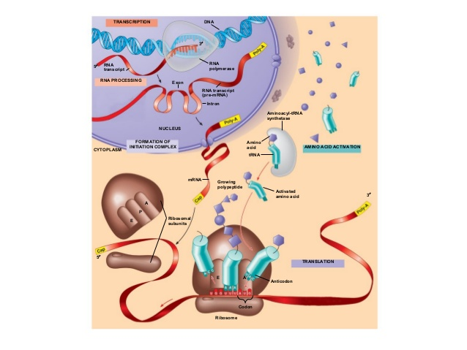
TOPIC: Translation History in Prokaryotes & Eukaryotes

Slide 2
TRANSLATION
Definition:
Translation is the process in which a sequence of nucleotide triplets in a messenger RNA give rise to a specific sequence of amino acids during the synthesis of polypeptide chain or protein.
Translation process occurs in cytosol and requires the involvement of protein. Synthesizing units –Ribosomes, Mrna, t-RNA Amino acids,Aminoacyl-RNA synthetase and several other proteins. The mRNA &the Genetic code: -Features of prokaryotic & eukaryotic mRNA-The genetic code &its features -Wobbling & the genetic code. -Amino acid activations & t-RNA loading -Specificity & fidelity of amino acylation reaction

Slide 3
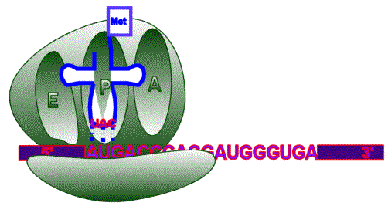
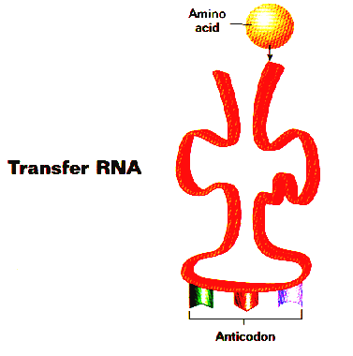
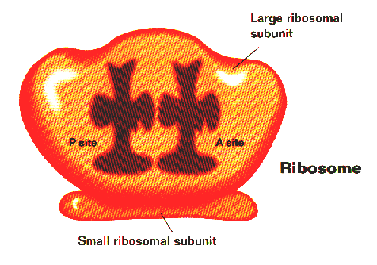
Making a protein
mRNA from nucleus Through cytoplasm to the ribosome
mRNA start codon AUG signals beginning of protein
Transfer RNA (tRNA)
Brings amino acids to the ribosome so it can build proteins
It has Anticodons
3 nucleotide sequence
complementary to the mRNA
codon
Ribosomal RNA (rRNA)
Makes up ribosomes

Slide 4
Initiation Attachment of intiator t-RNA (Met t-RNA) to start codon on m-RNA and assembly of ribosomal subunits . Translation initiation requires: -Ribosomal brought to m-RNA - Ribosome properly aligned over start codon -P Site of ribosome containing charged t-RNA

Slide 5
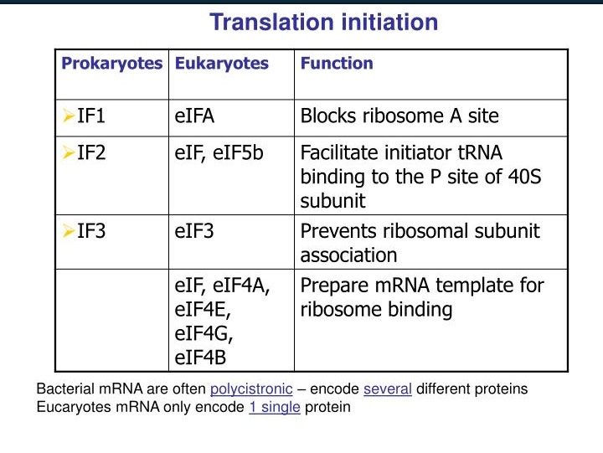
The initiation factors differing in prokaryotes and eukaryotes

Slide 6
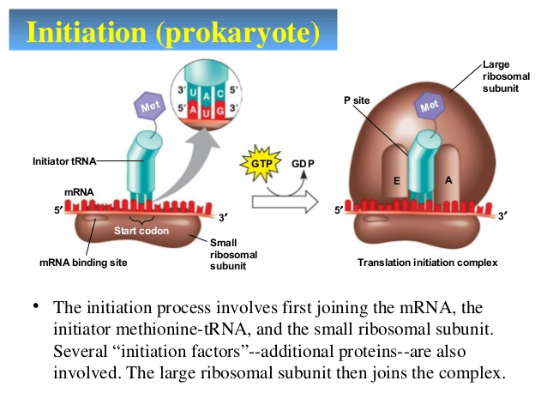
Translation initiation in prokaryotes

Slide 7
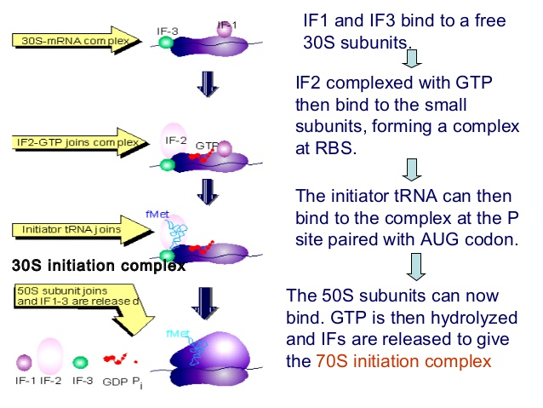

Slide 8
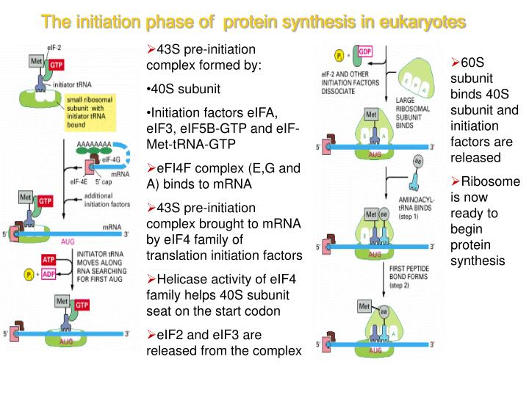
Initiation in eukaryotes Most of differences between prokaryotes
and eukaryotes occurs in intiation stage
where a great number of eIFs and
a scanning process are involved in eukaryotes. The eukaryotic initiator t-RNA
does not become N-formylated. m-RNA binding to ribosomes is facilitated by the 7-methyl guanosine cap.

Slide 9
Elongation with the formation of 70s intuition complex,the elongation cycle can begin. -The protein synthesis elongation in prokaryotes and eukaryotes is quite similar. -The factors EF-Tu EF-Ts EF-G have direct eukaryotic equilents called Eef1 alpha eEF1beta Y Eef2.

Slide 10
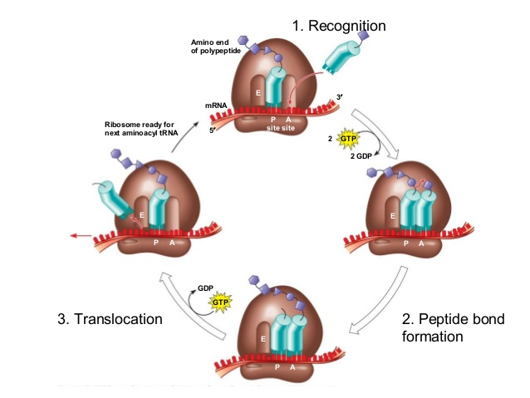
Elongation requires -placement of charged t-RNA in the A site -Peptide bond formation -Translocation Elongation factors EF-Tu, EF-G and EF-Ts
The three steps of elongation 1.charged t-RNA is deliverd as a complex with EF-Tu and GTP. 2.Peptidyl transferase (50 ribosomal subunit) makes a peptide bond by joinig the two adjacent amino acid without input of the more energy. 3.Translocase (EF-G), with energy from GTP ,moves the ribosome one codon along the m-RNA ,ejecting the uncharged t-RNA and transferase the ribosome peptide from the m-RNA.

Slide 11
Translocation -In prokaryotes the discharged t-RNA leaves the ribosome via another site the E –site. -In eukaryotes the discharged t-RNA is expelled into the cytosol directly. -EF-G (translocase) and GTP binds to ribosome and discharged t-RNA is ejected from the P-site in an energy cosuming step. -The peptidyl-t-RNA is moved from A-site to the P-site & m-RNA moves by one codon relative to the ribosome.

Slide 12
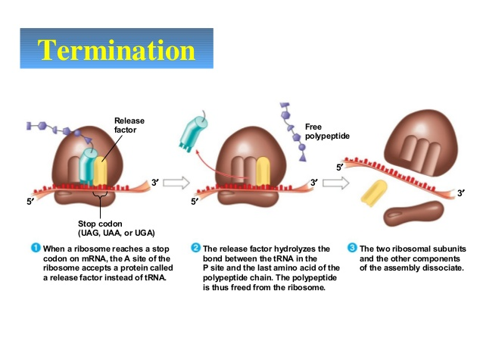
TERMINATION: when one of three stop codon enters into A-site No t-RNA molecules binds to these codons so the peptide bond and t-RNA in the p-site become hydrolysed realisng the polypeptide into the cyto plasm.

Slide 13
Termination in Prokaryotes Protein factprs called release factors interact with stop codon and cause release of polypeptide chain. -RF1&RF2 recognize the stop codon with the help of RF3 -The release factors makes the peptidyl- transferase to transfer the polypeptide to the water thus ,protein is released. -Release factor & EF-G remove the uncharged t-RNA and release m-RNA.

Slide 14
Termination in Eukaryotes Eukaryotes use only one release factor e RF which requires GTP recognize all three termination codons Termination codon is one of three9UAG,UAA,UGA) that cause protein termination.

Slide 15
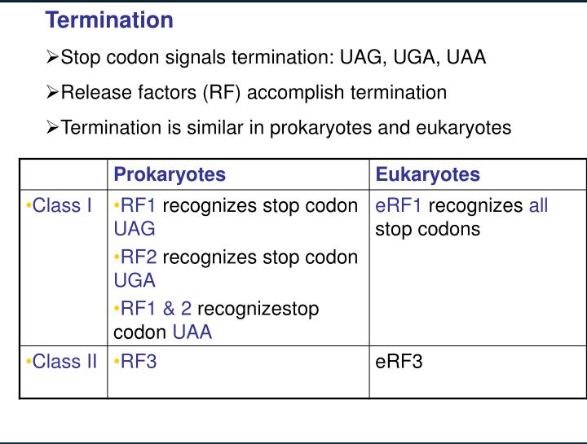

Slide 16
Folding and Posttranslational Processing In order to achieve its biologically active form, the new polypeptide must fold into its proper three-dimensional conformation. Before or after folding, the new polypeptide may undergo enzymatic processing,
including removal of one or more amino acids (usually from the amino terminus); addition of acetyl, phosphoryl, methyl, carboxyl, or other groups to certain amino acid residues; proteolytic cleavage; and/or attachment of oligosaccharides or prosthetic groups.

Slide 17
THANKU

