Slide 1
In vitro germplasm conservation
Dr. Saeed Rauf

Slide 2
Germplasm
Collection of wild relatives, landraces, obsolete cultivar, mutants, advanced lines, and elite varieties of any species
Collection of genetic resources of any species
Collection of total genes and their alleles present in a species

Slide 3
Germplasm conservation
Germplasm resources are plant materials used by breeders to introduce novel variations in their breeding material
Germplasm resources may be
Seed
Pollen
Cultured cell
Vegetative propagules

Slide 4
Need for germplasm conservation
Loss of genetic diversity due to genetic erosion
Diversify human food consumption
Alternative source of vitamins, fatty acids, mineral contents
Reduce species extinctions
Improve functions of natural ecosystem
Aesthetic value

Slide 5
Mode of conservation
Invitro Invivo
Pollen
Ovule
Callus
Meristems
Conservation
Insitu
Ex-situ

Slide 6
Insitu
On site conservation of wild and sister species, and land races
Improve aesthetic value
Improve functional diversity of ecosystem
Conservation of genetic resources

Slide 7
Exsitu
Off-site conservation
Botanical garden
Maintenance of elite germplasm by plant breeders
Seed banks
Field gene banks
Invitro conservation of plants material

Slide 8
In vitro methods
Invitro methods include storage of somatic embryo, callus, pollens and ovules
Advantages
Large quantities of gene pool stored
Storage of odd ploidy level
Pathogen free environment
Absence of natural selection
Free from natural hazards, erratic rain falls, storms, or earth quake
Season free utilization and appraisal of germplam

Slide 9
Method of storage
Minimal media and growth retardant
Low oxygen environment
Controlled dessication
Cryo-preservation
Cold storage

Slide 10
Cryopreservation
Storage at very low temperature
Dry ice -79°C
Low temperature freezers -80°C
Liquid nitrogen -196°C

Slide 11
Long term conservation of meristem or shoot tip
Technique of cryopreservation
The cryopreservation of plant cell culture followed the regeneration of plants broadly involves the following stages
Development of sterile tissue culture.
2. Addition of cryoprotectant and pretreatment
3. Freezing
4. Storage
5. Thawing
6. Reculture

Slide 13
Meristematic Tissues
Cryotubes packing
Loading at 25 ⁰C
Dehydration using
Vetrification solution
For 10 to 120 min
(0 ⁰C or 25 ⁰C)
Immersion in Liquid nitrogen

Slide 14
Meristematic Tissues
30 g L⁻¹ (Sodium alignate)
Encapsulation of samples at
25⁰C
0.1 mol L⁻¹ (Ca Cl₂)
Incubated at 25 for 30 min
Dehydration using
Vetrification solution
For 60 to 360 min
(0 ⁰C or 25 ⁰C)
Packaged mersitematic tissues in
Cryotubes and
Immersion in Liquid nitrogen

Slide 15
Meristematic Tissues
Cryotubes packing
Loading at 25 ⁰C
Dehydration using
Vetrification solution
For 10 to 120 min
(0 ⁰C or 25 ⁰C)
Immersion in Liquid nitrogen

Slide 16
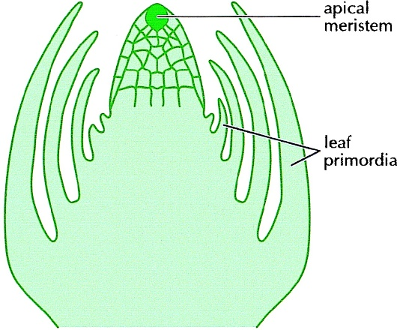
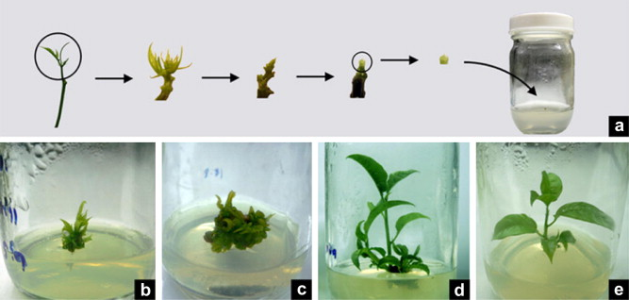
Meristem culture

Slide 17
Development of sterile tissue culture
The selection of plant species and the tissue with particular reference to the morphological and physiological characters largely influence the ability of the explants to survive in cryopreservation .
Any tissue from a plant can be used for cryopreservation e.g. meristems, embryos, endosperm, ovules, seeds, culture plants cells, protoplast, callus.

Slide 18
Addition of cryoprotectant
Cryoprotectant are the compound that can be prevent the damage caused to cells by freezing or thawing.
There are several cryoprotectant which include (DMSO), glycerol, ethylene, propylene , sucrose, mannose, glucose , proline and acetamide. Among these DMSO, sucrose and glycerol are most widely used.

Slide 19
Freezing
The sensitivity of the cell to low temperature is variable and largely depends on the plant species.
Four different types of freezing method are used: Slow freezing method : The tissue is slowly frozen at 0.5-5°C/min from 0°C to - 100°C,and then transferred to liquid nitrogen.
Rapid freezing method : Decrease in temperature up to -300 to -1000°C.
Stepwise freezing method: Intermediate temperature for 30 min. and rapidly cool.
Dry freezing method : Reported that non- germinated dry seeds can survive freezing at low temperature in contrast to water imbibing seeds which are susceptible to cryogenic injuries.

Slide 20
Storage
Maintenance of the frozen cultures at the specific temperature is as important as freezing .
In general the frozen cells/tissues are kept for storage at temperatures in the range of -72 to - 196°C.
Storage is ideally done in liquid nitrogen refrigerator – at 150°C in the vapour phase, or at -196°C in the liquid phase.
The ultimate objective of storage is to stop all the cellular metabolic activities and maintain their viability. For long term storage temperature at -196°C in liquid nitrogen is ideal.

Slide 21
Thawing
Thawing is usually carried out by plunging the frozen samples in ampoules into a warm water (temp 37 – 45°C) bath with vigorous swirling.
By this approach, rapid thawing (at the rate of 5-7.5°C min¯¹) occurs, and this protects the cells from the damaging effects ice crystal formation.
As the thawing occurs (ice completely melts ) the ampoules are quickly transferred to a water bath at temperature 20-25°C.
This transfer is necessary since the cells get damaged if left for long in warm (37-45°C) water bath.

Slide 22
Cellular Damages
Ice crystal damage
Toxic solution effect
Reduction in cell volume
Cell membrane disintegeration

Slide 23
Pre-cultures
Culture of cells in the presences of proline, sugars and alcohols at low temperature
Enhance freezing tolerance
Plant hardening – 1 week 22°C 8 h, -1°C 16 h per day
Sucrose 30-240 g L⁻¹, proline 2-4% proline 3-4 days
Increased water efflux
Prevent ice formation

Slide 24
Cryo-protection
High molecular weight act as osmo-protectants
DMSO commonly used osmo-protectant
Added gradually (30-60 minutes) at 0°C

Slide 25
The important Cryoprotectants
Cryo protectant | Chemical nature | Concentartion % | Remarks
DMSO | (HP) | 5-10 | Reduce dehybdration during freezing
Glycerol | Sugar alcohol (SP) | 5-20 | Reduce dehybdration during freezing
Proline | Amino acid (HP) | 10 | Help in withdrawl of water
Sorbitol | Sugar alcohol (NP) | 10-20 | Help in withdrawl of water

Slide 26
Vitrification
Conversion of highly concentrated solution into glass state at low temperature
Eliminate the need for slow freezing
Meristem dehydrated with plant vetrification solution
Transfer to liquid nitrogen

Slide 27
In-vitro grown shoot culture
Dissection
Shoot apices
1-4 days at 20°C
Preculture
Normal medium or medium supplemented with, say 0.1-0.7 M sucrose
20 min or more at 25°C
Cryoprotection
(2m Glycerol +0.4M sucrose in MS medium or some other cryp protectants)
30-60 min at 0°C
Vitrification

Slide 28
Composition of some of the plant vitrification solution
Plant Vitrification solution | Composition | Remarks
PVS-1 | 22% (w/v) glycerol +15% (w/v) ethylene glycerol +7% (w/v) DMSO in MS medium containing 0.5 M sorbitol
PVS-2 | 30% (w/v) glycerol +15% (w/v) ethylene glycerol +15% (w/v)+ DMSO+13.75% sucrose in MS medium containing
PVS-3 | 50% glycerol+ 50 % sucrose in MS medium
PVS-4 | 35% glycerol +20% ethylene glycol+20.5% sucrose in MS medium

Slide 29
Drop let method
PVS-treated shoot tips 7.5 μl droplets of PVS sterilized aluminium foils
Precultured and osmoprotected shoot tips are placed in 2.5 μl droplets of PVS, 5 drop lets per piece

Slide 30
Encapsulation-Dehydration
Explant encapsulated in alignate and subjected to dehydration
Dehydration tolerance achieved in sucrose 0.7 – 1 M or mixture of sucrose and glycerol

Slide 31
Dehydration
20% moisture showed 60% survival tomato
18-30% moisture increased survival 1.5 -2 folds in sweet potato

Slide 32
Slow growth cultures
Low temperature (4-9 °C) or 15-20 °C
High osmotica 20% sorbitol or sucrose
Low nutritional level
Preculture after 12-36 months

Slide 33
Growth Retardants
ABA (50 µg L-1)
Chloromequat (10-20 mg L-1)
Tri-idobenzoic acid (50 mg L-1)
Daminozide (20 mg L-1)
Ethlene (10 µg L-1)
Acteylsalicylic acid (100 µm L-1)

Slide 34
Low O2 concentration
O2 pressure decrease below 50mm Hg
2 or 4 ml mineral oil at 22°C

Slide 35
High osmoticum
Sucrose (100-171.2 g L-1)
3% sugar +4% sorbitol at 6°C for 1 year

