Slide 3
ECOLOGICAL SUCCESSION
“An orderly and progressive replacement of one community by another till the development of a stable or climax community in a particular area is termed ECOLOGICAL SUCCESSION”.

Slide 4
ECOLOGICAL SUCCESSION
A biotic community normally undergoes continuous changes under the influence of various biotic and abiotic factors.
The communities at any place modify the environment due to their activities.
The modified environment becomes less suitable to the existing community which is replaced by some better suited more complex new community.
The process is repeated leading to serial succession of previously existing community by the new one.

Slide 5
ECOLOGICAL SUCCESSION
The entire series of communities is known as sere, and the individual transitional communities as seral communities or seral stages. The first community to inhabit an area is called pioneer community. It has low biomass and nutrient level.
The succeeding communities are called the transitional communities and the last stable community, the climax community
The climax community has maximum diversity and niche specialization.

Slide 6
TYPES OF ECOLOGICAL SUCCESSION
Xerosere: The sequence of developmental stages of biotic succession on dry habitat like desert is termed as xerosere.
Lithosere: It is the sequence of successional stages on a bare rock.
Psammosere: It is the sequence of successional stages on coastal sand.
Hydrosere: It is the sequence in biotic succession taking place in a water body pond, pool or lake. Such a succession is known as hydrarch succession.

Slide 7
KINDS OF SUCCESSION
There are two main types of succession:
1.Primary succession
2. Secondary succession

Slide 8
KINDS OF SUCCESSION
PRIMARY SUCCESSION
When succession begins on primarily bare area which has not been previously occupied by a community (e.g., a newly exposed rock area, sand dunes, new island, deltas, shore or recent lava flow), it is known as primary succession or prisere.
The first group of organisms (plants or animals) which become established in such an area is termed the pioneer community.

Slide 10
KINDS OF SUCCESSION
SECONDARY SUCCESSION
When community development occurs in a secondarily bare area from where community was removed and where nutrients and conditions for existence are already favourable, e.g., cutover forest, abandoned cropland and ploughed field, it is termed secondary succession.

Slide 11
SECONDARY SUCCESSION
The destruction of previous community can occur due to:
Forest cutting
Forest fire
Submergence due to floods
Severe drought for several successive years
Landslide or earthquake
Heavy overgrazing or harvested crop fields left uncultivated for several years
The secondary succession is usually more rapid because some seeds and underground parts of plants are already present which quickly give rise to a new community as soon as conditions become favourable. The previously occupied territory is more receptive to biotic community development

Slide 12
COMPARE AND CONTRAST PRIMARY AND SECONDARY SUCCESSION

Slide 13
SECONDARY SUCCESSION

Slide 14
SECONDARY SUCCESSION
Fig. The circle of life in secondary succession

Slide 15
Kinds of Ecological Succession
There are two types of ecological succession seen in plants. They are as follows:
Hydrarch succession
Xerarch succession

Slide 16
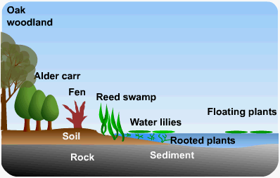
Kinds of Ecological Succession
Hydrarch succession
This kind of succession takes place in areas where the water content is very high as a result the plants grow in availability of too much of water.
Thus, the plants have a tendency to develop so as to minimize the water usage.
We can therefore say that the plants change from hydric conditions to mesic condition.
Hydrosere

Slide 17
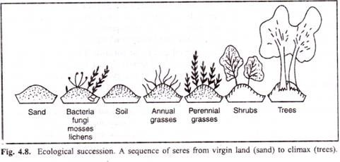
Kinds of Ecological Succession
Xerarch succession
This succession takes place in areas where there is scarcity of water, as a result, plants develop so as to conserve water. Thus, the plants change from xeric to mesic condition. Hence, the general conclusion is both the plant successions move towards attaining mesic conditions.
Xerarch succession

Slide 18
Hydrarch succession
Hydrosere or Hydrarch succession occurs in a pond and its community are converted into a land community. Stages Of Hydrach Succession
Phytoplankton stage
Submerged stage
Floating stage
Reed swamp stage
Sedge Marsh or Meadow stage
Woodland stage
Climax forest

Slide 19
Hydrarch succession
Characteristics of Hydrosere:
In the initial stage, phytoplankton(cyanobacteria), green algae (Spirogyra, Oedogonium) are the pioneer colonizers.
They are consumed by zooplankton (protozoans as Amoeba, Euglena, Paramecium etc.) and fishes.
Gradually these organisms die and increase the content of dead organic matter in the pond.

Slide 20
Xerarch Succession
Xerosere Xerosere or Xerarch succession begins on exposed parent rocks (lithosere) or dry sand (psammosere). A lithosere involves following stages
Crustose Lichen Stage (Pioneers)
Foliose Lichen Stage
Moss Stage
Herbs Stage
Shrub Stage
Forest Stage (Climax Stage)

Slide 21
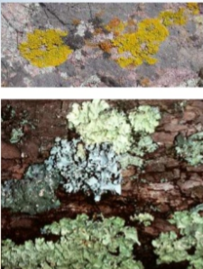
Crustose Lichen Stage (Pioneers)
Crustose are land lifeless structure.
The crustose may have an external protective layer surface on the rock.
Special types of lichens can grow on ,these rocks. The lichens are called crustose lichens.
Its most common species are Rhizocorpon, Rthodina
These lichens can live in extreme conditions. Sometime, their surface becomes wet due to rain and dew-drops. They absorb water during dry season. They cause weathering of the rock. They prepare the land for next stage.

Slide 22
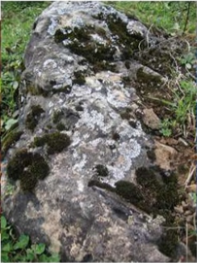
Foliose Lichens Stage:
Now habitat is suitable for foliage lichens. Foliage lichens are leaf like.
They are attached at one point, Their examples are Parmelia and Dermaticarpo.
They produce shade on the crustose lichens. As a result the growth of crustose lichen is reduced or decreased.
They make the soil acidic. Humus is added to it. It makes the rock rough.

Slide 23
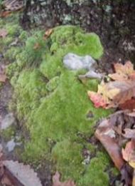
Moss stage
The soil becomes more porous. Litter of the lichens is collect in it. Thus at this stage moss plants added in the area.
The examples of mosses are Polyerichum and Tornda.
The mosses compete with lichens for water. They penetrate much deeper in the soil as compared to the lichens. The lichens become dead.
Thus more humus is added to the soil. Minerals combine with this humus. This environment is now suitable of herbaceous plants:

Slide 24
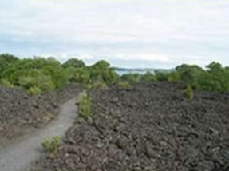
Herbaceous (plant) stage
The soil has a large amount of humus and litter. Thus its water holding capacity is increased.
Thus there is wire availability of moistures, humus and soil for anchorage.
The herbaceous plants are now established there. These plants increase the process of weathering. Evaporation or transpiration takes place. It reduces the temperature.
Now bacteria, fungi and other animals establish there. Some xerophytes grasses also establish there.

Slide 25
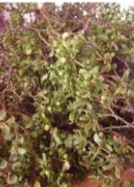
Shrub stage
Soil conditions are now becomes favourable for shrubs. Shrubby plants now start growing such as Rhus and Phytocarpus
They become dense. They cast shadow on herbs so the herbs die.
Thus the herbaceous plants add more humus to the soil. The roots of shrubs penetrate into soil.
They develop wide cracks in rock. The process of soil formation continues.

Slide 26
Climax stage
The soil is much improved now. So it now allows the growth and establishment of woody plants.
These plants are densely rooted. The shade of these plants inhibits the growth of most plants.
Woody plants dominate in this stage. This stage essentially remains the same if nothing changes in the environment to upset the balance.
It is a stable stage in succession. Thus the woody forest is the climax stage for this region.

Slide 27
KINDS OF SUCCESSION
Seasonal Succession
Seasonal succession is another type of succession, but instead of being the result of a disastrous event, it is caused by cyclical changes in the environment or interactions between the species in a community.

Slide 28
CAUSES OF SUCCESSION
The main causes of succession are as follows:
(1) Climatic Causes
(2) Topographic Causes
(3) Biotic Causes

Slide 29
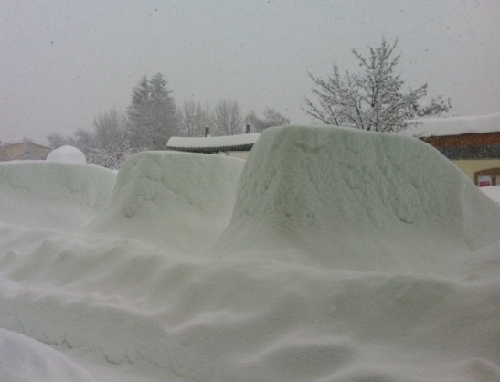
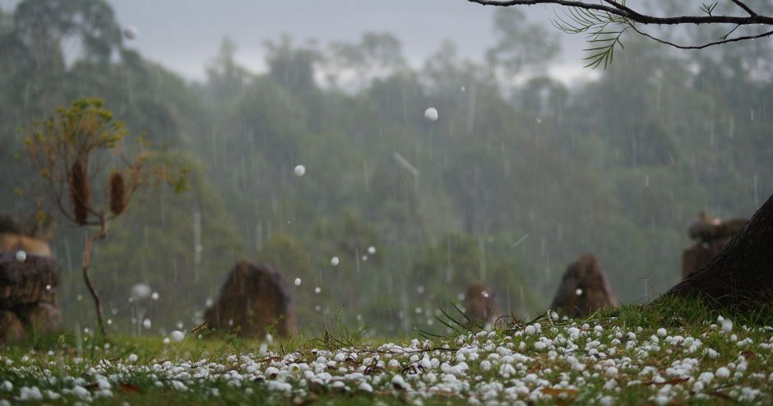
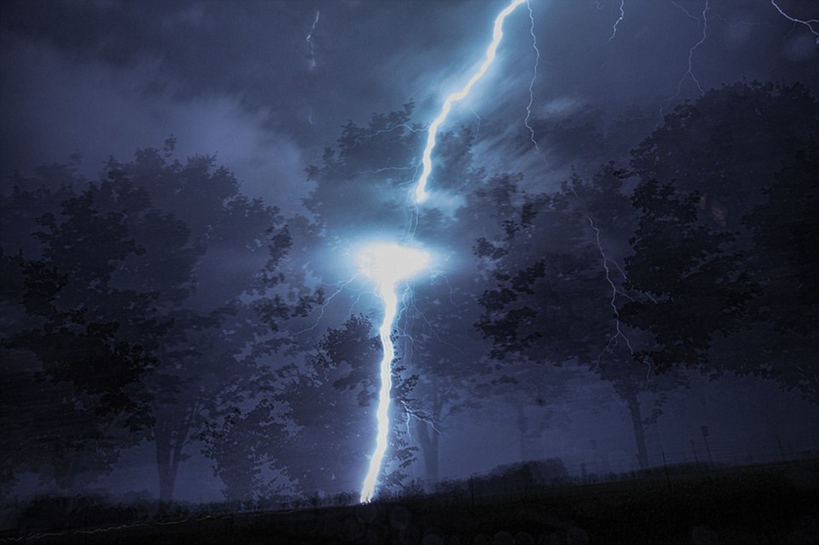
CAUSES OF SUCCESSION
Heavy snowfall
1. Climatic Causes:
Plants cannot adjust with the long range variations in the climate.
The fluctuating climate sometimes leads the vegetation towards total or partial destruction and, as a result, the bare area develops which becomes occupied by such plants as are better adapted for changed climatic conditions.
Drought, heavy snowfall, hails and lightning are some of the important factors for the destruction of vegetation. Sometimes new bare ground is formed by emersion of land from the bodies of water (ponds, rivers etc.).
Hails
Lightning

Slide 30
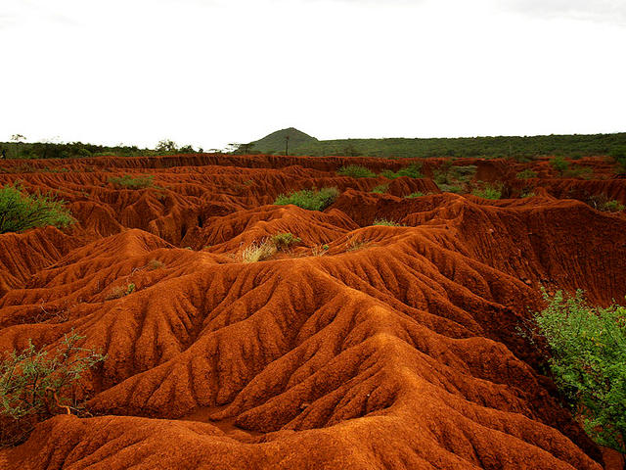
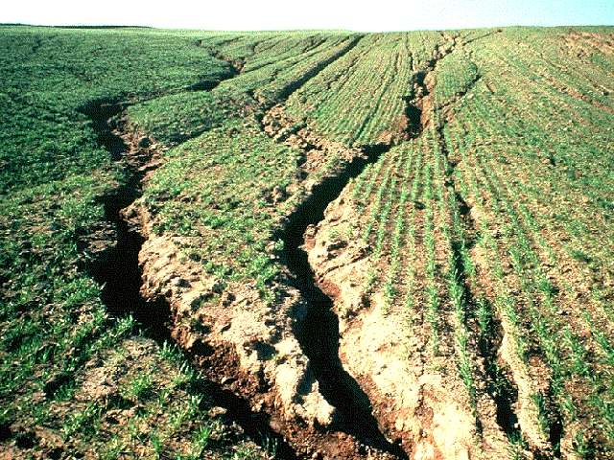
CAUSES OF SUCCESSION
Erosion of the soil
2. Topographic Causes:
These are concerned with the changes in the soil. The following are two important soil factors which bring about changes in the habitat:
(i) Erosion of the soil:
Sometimes surface soil is removed by a number of agents, such as wind, water currents, and rainfall. This process is known as soil erosion. In the process of erosion new and bare area is exposed in which new plant communities begin to appear one after another.

Slide 31
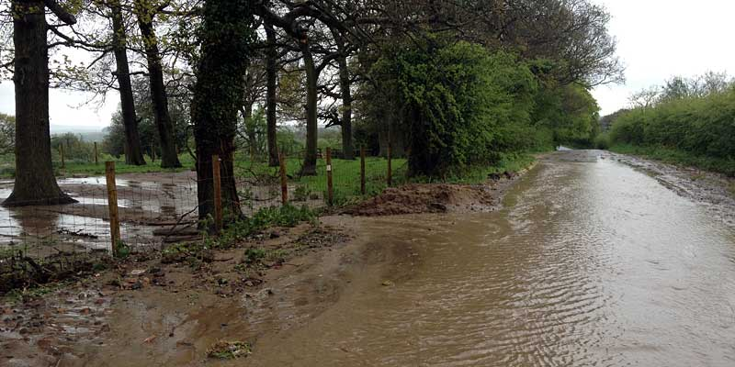
CAUSES OF SUCCESSION
(ii) Soil deposition:
It is one of the important causes that initiates succession. Soil deposition results owing to heavy storms, glaciers, snowfalls and landslides. If the deposition of soil takes place over an area already covered with vegetation, the plants occurring over there may be suppressed and destroyed. Deposition results in a new bare area on which succession of vegetation starts.
Soil deposition

Slide 32
CAUSES OF SUCCESSION
3. Biotic Causes:
Many biological or living agencies also affect the vegetation in many respects.
Grazing, cutting, clearing, cultivation, harvesting, and deforestation, all caused by living agencies, are directly responsible for vegetational change.
The parasitic plants and animals also affect the vegetation and destroy it.

Slide 33
EVENTS IN THE PROCESS OF BIOTIC SUCCESSION
Migration: It is transport of spores, seeds or other structures of propagation to the bare area.
Ecesis: It is successful germination of propagules into the bare area. The germination of seeds and spores produce new seedlings or new plants. As a result, some individuals of species are established in the bare area.
Colonization and Aggregation: In this stage, the plants that had established themselves multiply and form colonies or aggregate into small or large groups.

Slide 34
EVENTS IN THE PROCESS OF BIOTIC SUCCESSION
4. Competition: When number of these individuals increases many fold in a given area, they enter into intraspecific and interspecific struggle. This results in the elimination of unsuitable or weak plants and animals. They start showing various types of interactions.
5. Invasion: New varieties of plants and animals migrate into this area and establish themselves in spaces created due to elimination of weaker plants. This is called invasion.

Slide 35
EVENTS IN THE PROCESS OF BIOTIC SUCCESSION
6. Reaction: New migrants interact with the existing plants. This is called reaction. This leads to a changed environment. The changed environment becomes unsuitable for the existing community. Under environmental pressure, the community also changes or gets replaced by better adjusted species.
7. Stabilization: This is the final stage of biotic succession. The terminal community becomes more or less stabilized in the environment and remains in equilibrium with climatic and other environmental conditions of that area. The stabilized community is called climax community.

