Slide 1
Geriatric Pharmacy Practice
Presentation of

Slide 2
Outline
Geriatric Definition
Elderly Patients Are Different And Special.
Impact Of Physiological Changes On Drugs Therapy.
Preventing Risk And Drug Related Problems In Elderly Patients.
Common Drugs Used By Elderly Patients.
Poly Pharmacy In Elderly Patients.

Slide 3
Geriatrics
Geriatrics, or geriatric medicine, is a specialty that focuses on health care of elderly people[1].
It aims to promote health by preventing and treating diseases and disabilities in older adults[1].
There is no set age at which patients may be under the care of a geriatrician or geriatric physician[1].

Slide 4
Elderly Patients Are Different And Special
In Pakistan, 65 years and over (Age) population is 4.56% (male 4,399,926 /female 5,080,448) as per 2018 census[2].
Unfortunately, pharmacotherapy mishaps occur commonly in the older adult population.
This problem greatly affects the morbidity and mortality of elderly patients and greatly increases healthcare costs.
To improve patient care among elderly adults, healthcare practitioners must consider several issues when developing a pharmacotherapy plan[3].

Slide 5
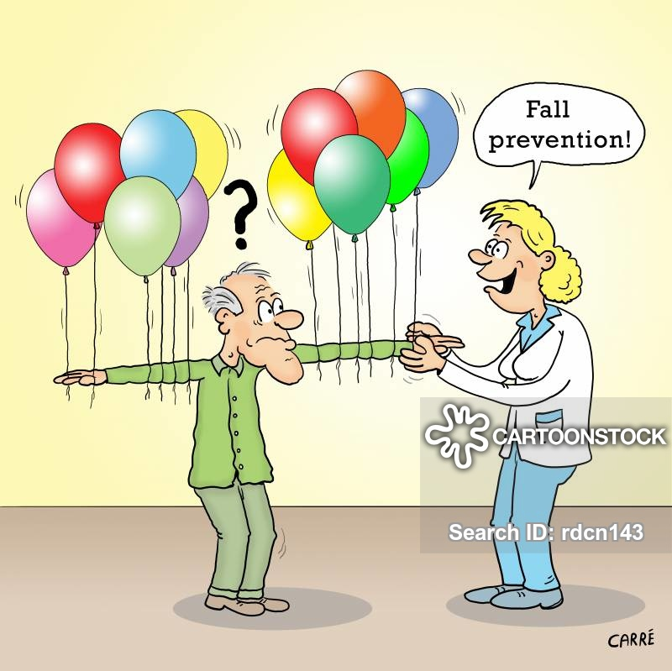

Slide 6
IMPACT OF PHYSIOLOGICAL CHANGES ON DRUGS THERAPY
Ageing results in many physiological changes that could theoretically affect absorption, first-pass metabolism, protein binding, distribution and elimination of drugs[4].
Age-related changes in the gastro-intestinal tract, liver and kidneys are
Reduced gastric acid secretion.
Decreased gastro-intestinal motility.
Reduced total surface area of absorption.
Reduced liver size.
Reduced liver blood flow.
Reduced glomerular filtration.
Reduced renal tubular filtration.

Slide 8
Physiological impact | Examples
Delay in gastric emptying, reduction in gastric acid. | Absorption of drugs such as digoxin may be slower.
Decline in gastro-intestinal motility | Anticholinergic drugs, opiates, tricyclic antidepressants and antihistamines are more likely to cause constipation
Impaired first-pass metabolism | Clomethiazole, labetalol, nifedipine, nitrates, propranolol and verapamil
Increased volume of distribution for fat-soluble compounds | Clomethiazole, diazepam, dimethyl-diazepam and thiopental
Decrease in the distribution volume of water-soluble drugs | Cimetidine, digoxin and ethanol
The glomerular filtration rate declines | Digoxin and aminoglycosides
Structural and neurochemical changes in the central nervous system | Anticholinergics, hypnotics, H2 antagonists and β-blockers cause confusion

Slide 9
Geriatrics Common Clinical Conditions
Sensory Problems: Hearing & Vision
Dementia: Characterized by a gradual deterioration of intellectual capacity.
Parkinsonism: Characterized by resting tremors, muscular rigidity and bradykinesia (slowness of initiating and carrying out voluntary movements).
Stroke: The blood supply to part of your brain is interrupted or reduced, preventing brain tissue from getting oxygen and nutrients.
Osteoporosis: Osteoporosis is a progressive disease characterized by low bone mass and micro-architectural deterioration of bone tissue resulting in increased bone fragility and susceptibility to fracture[5].

Slide 10
Geriatrics Common Clinical Conditions
Arthritis: Arthritis is the swelling and tenderness of one or more of your joints.(Mobility & Dexterity)
Hypertension: Long-term medical condition in which the blood pressure in the arteries is persistently elevated.
Myocardial infarction: When blood flow decreases or stops to a part of the heart, causing damage to the heart muscle.
Urinary incontinence: Due to urethral sphincter incompetence, prostatic hypertrophy, neurological lesions or urinary outflow obstruction.

Slide 11
Geriatrics Common Clinical Conditions
Leg ulcers: Chronic sore that takes more than 2 weeks to heal. They usually develop on the inside of the leg, just above the ankle.
Constipation: Age-related decline in gastro-intestinal motility and treatment with drugs which decrease gastro-intestinal motility predispose the elderly to constipation[6].
Social Issues

Slide 13
Preventing Risk And Drug Related Problems In Elderly Patients.

Slide 14
Preventing Risk And Drug Related Problems In Elderly Patients
Avoid unnecessary drug therapy.
Effect of treatment on quality of life.
Treat the cause rather than the symptom.
Drug history.
Concomitant medical illness.
Choosing the drug of choice.
Elderly Patients Require Relatively Smaller Doses Of All Drugs Compared With Young Adults.
It Is Recognized That The Majority Of Adverse Drug Reactions In The Elderly Are Dose Related And Potentially Preventable[7].

Slide 15
Preventing Risk And Drug Related Problems In Elderly Patients
Dose titration.
Choosing the right dosage form.
Communication, Packaging and labelling.
Good record keeping.
Regular supervision and review of treatment.
Adverse drug reactions (ADRs).
Adherence[4].

Slide 16
Preventing Risk And Drug Related Problems In Elderly Patients
Explanations & Examples
In patients with mild hypertension, non-drug therapies which are of proven efficacy should be considered in the first instance.
Hip replacement is the treatment of choice rather than prescribing NSAIDs with all their attendant adverse effects.
Indigestion may in fact be suffering from angina, and therefore treatment with proton pump inhibitors or antacids is clearly inappropriate.
It is inappropriate to commence diuretic therapy to treat mild hypertension in an elderly male with prostatic hypertrophy.
Elderly patients find it easy to swallow syrups or suspensions or effervescent tablets rather than large tablets or capsules[8].

Slide 17
Preventing Risk And Drug Related Problems In Elderly Patients
Explanations & Examples
Elderly patients with arthritis find it difficult to open child-resistant containers and blister packs.
Medicines should be dispensed in easy-to-open containers that are clearly labelled using large print.
Although it is commonly believed that the elderly are poor compliers with their drug therapy, there is no clear evidence to support this[9].
Herbal and drug adverse interaction are common in elder patients[10].

Slide 18
Common Drugs Used By Elderly Patients

Slide 19
Common OTC Drugs Used By Elderly Patients
Multivitamins & Supplements
Laxatives
Herbal Medicines
Acetaminophen
Aspirin
Antacids
The researchers concluded that older adults might be unaware of the adverse risks associated with concurrent use of pain medicines, alcohol, high blood pressure drugs, and regular caffeine use[13].

Slide 20
Poly Pharmacy In Elderly Patients
Polypharmacy may be deﬁned as the number of medications (e.g., Using a large number of different medications prescribed by different providers), the necessity of the medications that are prescribed, or the complexity of a patient’s problems.
Polypharmacy occurs simply because healthcare providers fail to communicate proper patient recommendations.
If each patient had a primary healthcare advocate who coordinated the patient’s overall care, then the risk of polypharmacy could be reduced.
One simple recommendation is to ask every patient to bring all of his or her current medications to each doctor’s visit so that the physician can thoroughly review the medications being taken[3].

Slide 21
How To Reduce Poly Pharmacy
Use only 1 primary care provider who communicates with specialists.
Use only 1 pharmacy.
Reduce the number of drugs necessary because of adverse effects of another agent (e.g., laxatives for drugs that cause constipation).
Review all medications on each visit to doctor.
Maximize doses when possible instead of adding a new drug[3].

Slide 22
Summary
1. The complex interactions among
Comorbidity,
Polypharmacy,
Changes in pharmacodynamic sensitivity,
And relatively modest pharmacokinetic changes
in the older patients warrant the dosing recommendation to follow the conventional wisdom of “start low and go slow”[11].
2. Effective communication may help appropriate prescribing in the older population[12].
3. The number of elderly patients, especially those aged over 75 years, is steadily increasing, and they are accounting for an ever-increasing proportion of health care expenditure in the West[3].

Slide 23
Summary
4. A UK survey showed that 59% of prescriptions to the elderly had been given for more than 2 years, 32% for more than 5 years and 16% for more than 10 years. Of all prescriptions given to the elderly, 88% were repeat prescriptions; 40% had not been discussed with the doctor for at least 6 months, especially prescriptions for hypnotics and anxiolytics[4].
5. Understanding age-related changes in pharmacodynamic factors, avoiding polypharmacy and regular and critical review of all drug treatment will help in the rationalization of drug prescribing, reduction in drug-related morbidity and also the cost of drug therapy for this important subgroup of patients[4].

Slide 24
References
Devi, D., R. Srivastava, and B.J.A. Dwivedi, A critical review of concept of aging in Ayurveda. 2010. 31(4): p. 516.
Wazir, M.A. and A. Goujon, Assessing the 2017 census of Pakistan using demographic analysis: A sub-national perspective. 2019, Vienna Institute of Demography Working Papers.
Wooten, J.M.J.S.M.J., Pharmacotherapy considerations in elderly adults. 2012. 105(8): p. 437-445.
Walker, R., Clinical pharmacy and therapeutics E-Book. 2011: Elsevier Health Sciences.
Kaufman, S.R.J.M.A.Q., Old age, disease, and the discourse on risk: geriatric assessment in US health care. 1994. 8(4): p. 430-447.
Cigolle, C.T., et al., Geriatric conditions and disability: the Health and Retirement Study. 2007. 147(3): p. 156-164.
Strausbaugh, L.J.J.E.i.d., Emerging health care-associated infections in the geriatric population. 2001. 7(2): p. 268.
Hoenig, H., N. Nusbaum, and K.J.J.o.t.A.G.S. Brummel‐Smith, Geriatric rehabilitation: state of the art. 1997. 45(11): p. 1371-1381.
Singh, M., et al. Comprehensive geriatric assessment in the management of older patients with cardiovascular disease. in Mayo Clinic Proceedings. 2020. Elsevier.
Bush, T.M., et al., Adverse interactions between herbal and dietary substances and prescription medications: a clinical survey. 2007. 13(2): p. 30-35.
Shi, S. and U.J.C.d.m. Klotz, Age-related changes in pharmacokinetics. 2011. 12(7): p. 601-610.
Shargel, L., B. Andrew, and S. Wu-Pong, Applied biopharmaceutics & pharmacokinetics. 1999: Appleton & Lange Stamford.
Amoako, E.P., L. Richardson-Campbell, and L.J.J.o.g.n. Kennedy-Malone, Self-medication with over-the-counter drugs among elderly adults. 2003. 29(8): p. 10-15.

Slide 25
Case Study
An 80-year-old man with a previous history of hypothyroidism presented with a history of abdominal pain and vomiting. He had not moved his bowels for the previous 7 days. Two weeks earlier his general practitioner had prescribed a combination of paracetamol and codeine to control pain in his osteoarthritic.
Is there any discrepancy in the prescribed medication?
Is there any adverse reaction you can point out?
What is the best treatment or intervention you will suggest?

Slide 26
Thank you…
For Your Attention…
All Questions are Welcome!!!

