Slide 1
Dr. Muhammad Ali-ur-Rasheed
Lecturer , Department of Physiotherapy.
Sargodha Medical College.

Slide 2
Examination of Motor Function: Motor Control and Motor Learning

Slide 3
OVERVIEW OF MOTOR FUNCTION
A motor program is defined as “an abstract representation that, when initiated, results in the production of a coordinated movement sequence”.
A motor plan (complex motor program) is an idea or plan for purposeful movement that is made up of several component motor programs.
Motor memory (procedural memory) involves the recall of motor programs or subroutines and includes information on
(1) initial movement conditions;
(2) how the movement felt, looked, and sounded (sensory consequences);
(3) specific movement parameters (knowledge of performance); and
(4) outcome of the movement (knowledge of results).

Slide 4
Motor skills are acquired and modified by actions of the CNS through processes of motor learning.
Motor learning is defined as “a set of internal processes associated with practice or experience leading to relatively permanent changes in the capability for skilled behaviour.
Feedback is response-produced information received during or after the movement and is used to monitor output for corrective actions.
Feedforward, the sending of signals in advance of movement to ready the sensorimotor systems, allows for anticipatory adjustments in postural activity.

Slide 5
COMPONENTS OF THE EXAMINATION
(1) patient history,
(2) a review of relevant systems, and
(3) specific tests and measures that allow formulation of the diagnosis, prognosis, and POC.

Slide 6
FACTORS THAT MAY CONSTRAIN THE MOTOR FUNCTION EXAMINATION
Consciousness and Arousal
Cognition
Orientation
Attention
Memory
Communication
Sensory Integrity and Integration
Musculo-skeletal integrity

Slide 7
ELEMENTS OF THE MOTOR FUNCTION EXAMINATION
TONE
Tone is defined as the resistance of muscle to passive elongation or stretch. It represents a state of slight residual contraction in normally innervated, resting muscle, or steady-state contraction
0 to 4+ scale:
0 No response (flaccidity)
1+ Decreased response (hypotonia)
2+ Normal response
3+ Exaggerated response (mild to moderate hypertonia)
4+ Sustained response (severe hypertonia)

Slide 8
Tone of muscles
Hypertonia ,
Hypotonia ,
Dystonia
Abnormal tone
Hypertonia ,
Spasticity
Clasp knife ,
clonus , Clonus is characterized by cyclical, spasmodic alter ation of muscular contraction and relaxation in response to sustained stretch of a spastic muscle.
babinski ,
reflexes
Rigidity
Lead pipe
Cog wheel

Slide 9
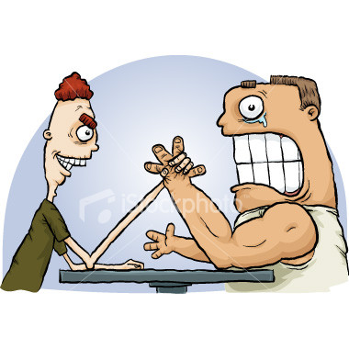
Motor assessment
Bulk of muscles
Tone of muscles
Power of muscles
Reflexes

Slide 10
Inactivation of muscles (Generally discuss the four thing related to muscles:
1. Muscle activation/ appropriate
2. Muscle sustain or persistence
3. Muscle strength
4. Muscle endurance

Slide 11
Bulk of muscles
Wasting of muscles
Hypertrophy
Atrophy
Pseudo hypertrophy
Measuring tape

Slide 12
Flaccidity
Hyper extensibility of joint
Dystonia or Athetoid
Focal or segmental

Slide 13
Examination of tone
Initial observation of posture & palpation
Passive movement
Active movement
Pendulum test
Modified Ashworth scale (0 , 1 , 1+ , 2 , 3 , 4 )

Slide 14
Clinical Scale for Spastic Hypertonic (Modified Ashworth Scale)
0 No increase in tone
1 Slight increase in muscle tone, manifested by a catch and release or minimal resistance at the end of the ROM when the affected part(s) is moved in flexion or extension
1+ Slight increase in muscle tone, manifested by a catch, followed by minimal resistance throughout the remainder (less than half) of the ROM
2 More marked increase in muscle tone through most of the ROM, but affected part(s) easily moved
3 Considerable increase in muscle tone, passive movement difficult
4 Affected part(s) rigid in flexion or extension

Slide 16
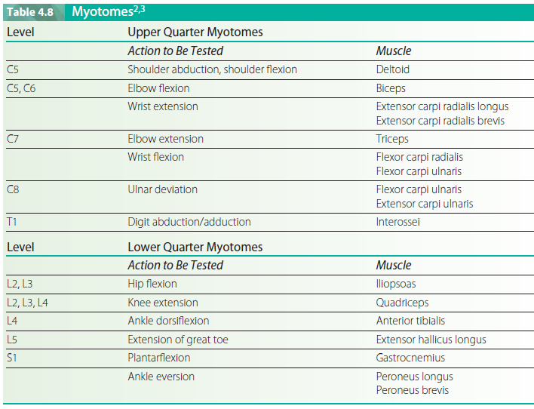

Slide 17
Reflexes (0 , 1+ , 2+ ,3+, 4+)
DTR
Jendrassik maneuver
Superficial reflex
Neonatal reflexes
ATNR
STNR

Slide 18
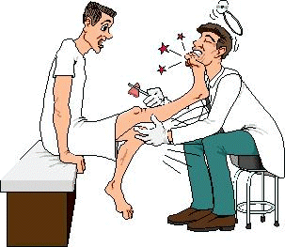
Reflexes
Superficial reflexes
Planter reflex
Abdominal reflex
Deep reflexes
Ankle jerk
Knee jerk
Biceps jerk
Triceps jerk
Brachioradialis jerk
Reinforcement
Upgoing planters
UMNL , hypoglycemia , deep coma ,post epileptic, below age of 1 yr

Slide 21
Difference between UMNL & LMNL
Synergies normal & abnormal
Mass movement
Functional movement
Spastic posture

Slide 25
Proximal muscle weakness
Myopathies
Distal muscle weakness
Neuropathy

Slide 26
How assess upper limb
Bilateral drift
How quickly assess lower limb
Sit to stand
Walk
Walk on toes
Walk on heels
Squat

Slide 27
Motor Apraxia:
Partial or complete inability to execute purposeful movements (even with strength or ability) :
Ideomotor inability to remember a command
Ideational : inability to formulate a plan to accomplish a task (scratch nose, brush teeth, draw a clock, comb hair)

Slide 28
Dressing
Constructional

Slide 29
Assessment of motor Apraxia
Ask the patient to perform combing hair….
Imitate the combing and ask the patient to follow …..Lack of imitation
Give comb to patient and ask for combing……
Both have real object and ask the patient to follow

Slide 30
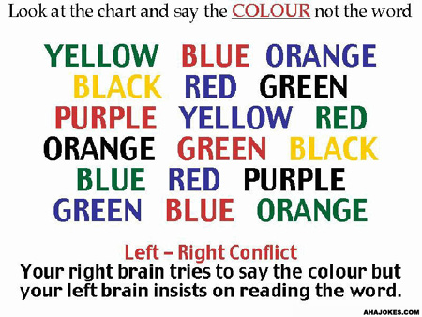

Slide 31
Functional Movements Tested
Level of Independence
6 - independent
5 - requires supervision
4 - requires verbal cueing
3 - requires minimal physical assistance of 1
2 - requires moderate physical assistance of 1
1 - requires physical assistance of 2
0 - unable to perform with maximal assistance

Slide 32
