Slide 1
Difference Between Whole Circle Bearing and Quadrantal Bearing
Lecture # 10

Slide 2
Introduction of WCB Vs. QB
Whole circle bearing(WCB) and Quadrantal bearing(QB) are the two types of bearing which is used in the field of surveying for the purpose of measurement of the bearings.
In this article, we will get to know about the whole circle bearing and Quadrantal bearing and their differences.

Slide 3
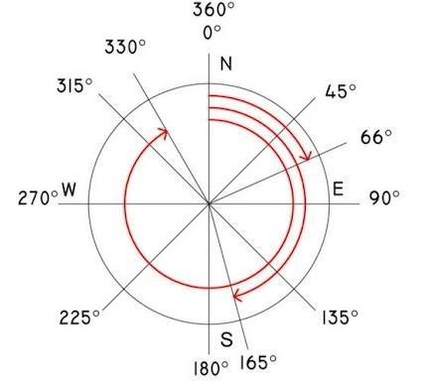
What Is Whole Circle Bearing (WCB)

Slide 4
What Is Whole Circle Bearing (WCB)
The whole circle bearing (WCB) is defined as the bearing of the line at any point which is measured with respect to the Meridian is known as Whole circle bearing.
The Whole Circle bearings values range from 0° to 360°.
The Whole circle bearing is generally used in the Prismatic compass.
The whole circle bearing is used to measure the angle in the clockwise direction from the magnetic North.
The Prismatic compass is graduated by Whole circle bearing.

Slide 5
Example of Whole Circle Bearing (WCB)
If the survey line falls between the first quadrant then the Whole Circle Bearing lies between the 0° to 90°.
If it lies between the second quadrant then the Whole Circle Bearing of that survey line lies between 90° to 180°.
If it lies in the third quadrant then the Whole circle bearing will be between the 180° to 270°.
And in the fourth quadrant, the Whole Circle Bearing values range between 270° to 360°.

Slide 6
Example of Whole Circle Bearing (WCB)
The Whole circle bearing of any line, can exceed up to 90°, it can be reduced to the corresponding angle which is less than 90°, and has the same numerical value to the trigonometrical functions.
This type of angle is also known as a Reduced bearing.
The examples of whole circle bearing are as follows
30°,45°,80°,120°,230°, and 320°, etc

Slide 7
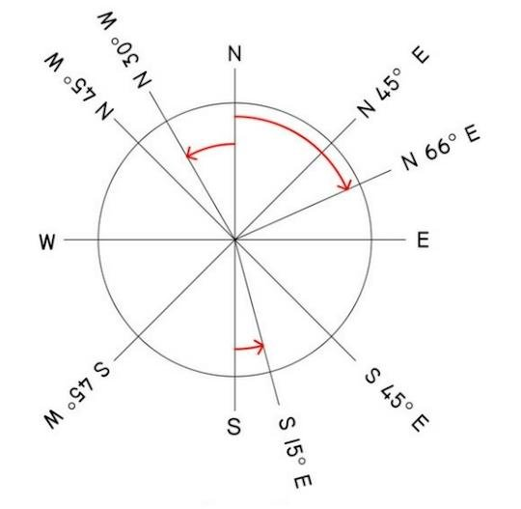
What Is Quadrantal Bearing (QB)

Slide 8
What Is Quadrantal Bearing (QB)
The Quadrantal bearing is also known as Reduced bearing.
Quadrantal bearings are generally measured from the North or South direction towards the East or West direction.
The quadrantal bearing or reduced bearing can be measured either in a clockwise or anticlockwise direction.
The quadrantal bearing varies from 0° to 90°.

Slide 9
What Is Quadrantal Bearing (QB)
In the quadrantal bearing or reduced bearing system, the bearings are taken either from the magnetic North or the magnetic south direction. It will depend on which one is nearer to that line.
In the Quadrantal bearing system, magnetic North and magnetic South lines are considered as a reference line.

Slide 10
Example of Quadrantal Bearing
In the Quadrantal bearing system, you can take both clockwise as well as the anticlockwise angle from the reference line.
It is necessary to state the particular quadrant in which that line lies. The letters N(north), S(south), E(east), and W( west) are used to represent the quadrant.
Reduced bearing is observed by the surveyor’s compass.

Slide 11
Example of Quadrantal Bearing
The quadrants are represented are as follows
1st quadrant = N – E
2nd quadrant = S – E
3rd quadrant = S – W
4th quadrant = N – W
The example of the Quadrantal bearing are as follows
N35°E,S49°E,N65°W,S25°W etc.

Slide 12
Difference Between Whole Circle Bearing and Quadrantal Bearing
Sr. No | Whole Circle Bearing | Quadrantal Bearing
1 | The horizontal angle which is made by the survey line, with the magnetic north in a clockwise direction is known as the Whole circle bearing. | The horizontal angle which is made by a survey line with the magnetic North or South whichever is near the line in the eastward or westward direction is known as Quadrantal wearing or reduced bearing.
2 | In the whole circle bearing, the magnetic North line is considered as the reference line. | In the Quadrantal Bearing, both magnetic North as well as South lines are considered as a reference line.
3 | The value of the whole circle bearing ranges from 0° to 360° | The value of the Quadrantal wearing for reduced bearing ranges from 0° to 90°

Slide 13
Difference Between Whole Circle Bearing and Quadrantal Bearing
Sr. No | Whole Circle Bearing | Quadrantal Bearing
4 | In the whole circle bearing only clockwise angle is taken from the reference survey line | In the Quadrantal bearing both clockwise, as well as the anticlockwise angle from the reference line, is taken
5 | The example of a whole circle bearing are 30°,45°,80°,120°,230°, and 320°, etc | Example of Quadrantal bearing or reduced bearing are N35°E, S49°E, N65°W, S25°W, etc.

Slide 14
Formula to convert WCB to RB
When WCB lies between 0° and 90°: RB = WCB
When WCB lies between 90° and 180 degrees: RB = 180 - WCB
When WCB lies between 180° and 270 degrees: RB = WCB - 180
When WCB lies between 270° and 360 degrees: RB = 360 - WCB
In the above formula, based on the quadrants use NE, SE, SW and NW accordingly.
Example if WCB is 240 degrees, it lies in the third quadrant. Use SW.
RB = WCB - 180° = 240° - 180° = 60°
RB = S60W

Slide 15
Examples on WCB to RB
Convert WCB = 35° to RB
It is in the First quadrant (NE)
Angle = 35°
RB = N35°E
Convert WCB = 130° to RB
It is in the Second quadrant (SE)
Angle = 180 - 130° = 50°
RB = S50°E

Slide 16
Examples on WCB to RB
Convert WCB = 240° to RB
It is in the Third quadrant (SW)
Angle = 240° - 180° = 60°
RB = S60°W
Convert WCB = 290° to RB
It is in the Fourth quadrant (NW)
Angle = 35°
RB = N70°W

Slide 17
Formula to convert RB to WCB
A formula for converting the reduced bearing (RB) to a Whole Circle Bearing (WCB). 1st quadrant = same 2nd quadrant = 180 - RB 3rd quadrant = 180 + RB 4th quadrant = 360 - RB

Slide 18
Examples on RB to WCB
Convert the following reduced bearings into whole circle bearings:
(i) N 65° E
(ii) S 43° 15′ E
(iii) S 52° 30′ W
(iv) N 32° 42′ W

Slide 19
Examples on RB to WCB
Solution: Assume 'θ' be whole circle bearing.
(i) Since it is in NE quadrant,
θ = α = 65° Ans.
(ii) Since it is in south east quadrant
θ = 180° - 43° 15′ = 136° 45′ Ans.
(iii) Since it is in SW quadrant
θ = 180° + 52° 30′ = 232° 30′ Ans.
(iv) Since it is in NW quadrant,
θ = 360° - 32° 42′ = 327° 18′ Ans.

Slide 20
Assignment Problems
Convert WCB = 45° to RB
Convert WCB = 150° to RB
Convert WCB = 230° to RB
Convert WCB = 320° to RB
Convert to RB = N 55° E
Convert to RB = S 40° 25′ E
Convert to RB = S 62° 20′ W
Convert to RB = N 42° 35′ W

Slide 21
Thanks

