Slide 1
ART OF INTERVIEW

Slide 2
Taking interview is an art and not everybody can take interviews

Slide 3
First Step:
Before Starting the Interview
Prepare for the interview: Take some time to go through the profile of the candidate.
Try to understand his role and also prepare a list of questions that you like to ask.
* Schedule your time. Don’t give same time to more than one person. Start the interview on time. If you think that you will not be able to start the interview on specified time then inform the candidate. Even if you have informed the candidate about the expected delay apologize before you start the interview.

Slide 4
2. Environment for the Interview
* Don’t take interview at a place, which is either too noisy or too congested.
* If possible, put a tag “Do not disturb “outside your cabin or room.
* Ensure that the lights are proper and the person sitting there is comfortable.
* Record the proceedings of the interview, write it down.
3. Begin the Interview The candidate might thin Who are you to take my interview?
Introduce yourself. Your Name Your Designation Your Total Experience A brief about your role in the organization Since how long you have been associated with your present organization.

Slide 6
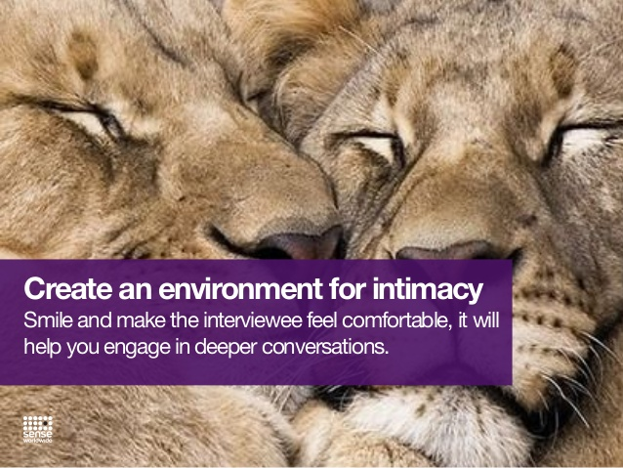

Slide 7
Concentrate on following things : Now, smartly put the ball in his court by asking him to give a brief about his family, followed by his education.
1) His role
2) His span of control
3) Organizational Hierarchy
4) Major achievements in that particular job/ role.
5) Major Challenges that he has faced in his present job; in his career; in his life
6) Why he want to change his job and why he has changed his jobs in past? Appreciate him, when he discusses about his achievements. Make him comfortable and provoke him to speak as much as he can. Ask him about his strengths and his personal achievements. Don’t forget to ask him about his goals, aspirations…where he sees himself in next 5-6 years. What is his purpose in life? What are his dreams?

Slide 8
CLOSING THE INTERVIEW
Closing the interview
* Tell the candidate that it was a pleasure to talk to him and you are through with the interview, however, if he have any question; if he want ask or know anything. He can do that.
* Tell him that someone from your team will get in touch with him for future course of action.

