Slide 1
Week 12-13

Slide 2
Lecture Contents
Background
Demand Paging
Copy-on-Write
Page Replacement
Allocation of Frames
Thrashing
Allocating Kernel Memory

Slide 3
Lecture Objectives
Define virtual memory and describe its benefits.
Illustrate how pages are loaded into memory using demand paging.
Apply the FIFO, optimal, and LRU page-replacement algorithms.
Describe the working set of a process, and explain how it is related to program locality.

Slide 4
Why Virtual memory
Virtual memory – separation of user logical memory from physical memory
Only part of the program needs to be in memory for execution
Logical address space can be much larger than physical address space
Allows address spaces to be shared by several processes
Allows for more efficient process creation
More programs running concurrently
Less I/O needed to load or swap processes

Slide 5
Virtual memory (Cont.)
Virtual address space – logical view of how process is stored in memory
Virual memory can be implemented via:
Demand paging
Demand segmentation

Slide 6
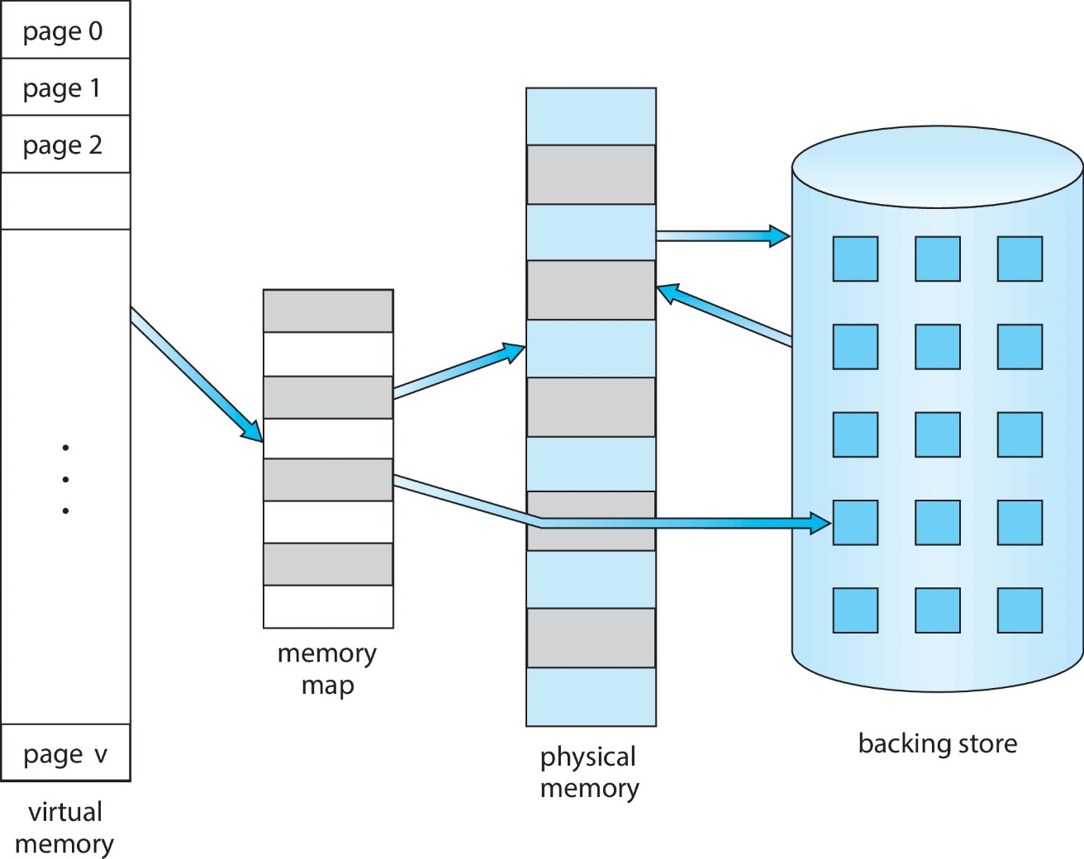
Virtual Memory That is Larger Than Physical Memory

Slide 7
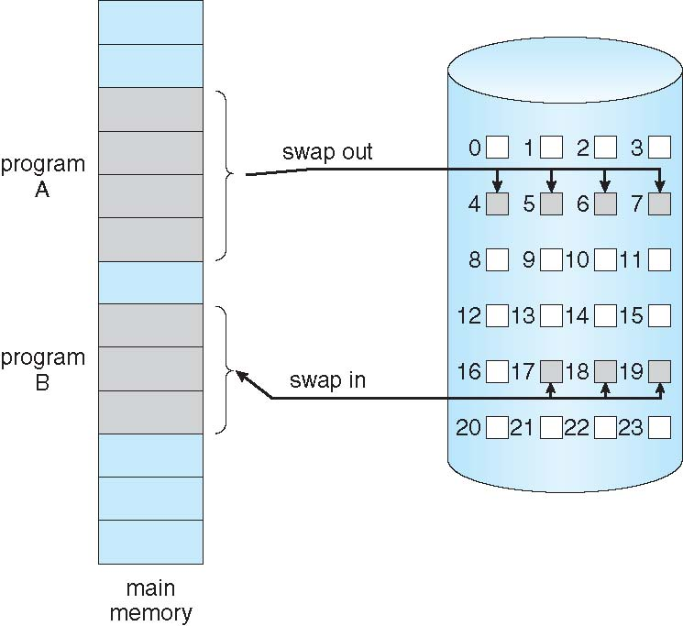
Demand Paging
Could bring entire process into memory at load time
Or bring a page into memory only when it is needed
Less I/O needed, no unnecessary I/O
Less memory needed
Faster response
More users
Similar to paging system with swapping (diagram on right)

Slide 8
Basic Concepts
With swapping, pager guesses which pages will be used before swapping out again
Instead, pager brings in only those pages into memory
How to determine that set of pages?
Need new MMU functionality to implement demand paging
If pages needed are already memory resident
No difference from non demand-paging

Slide 9
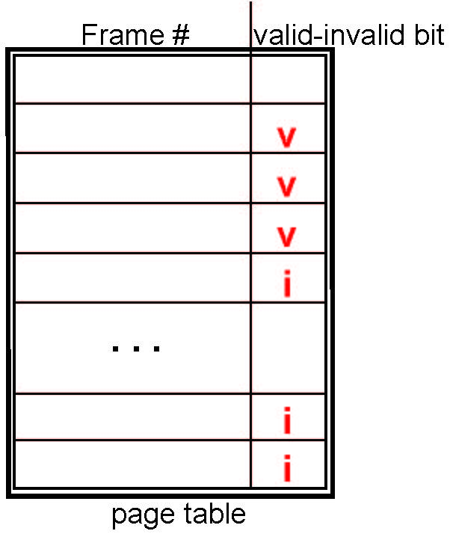
Valid-Invalid Bit
With each page table entry a valid–invalid bit is associated (v ⇒ in-memory – memory resident, i ⇒ not-in-memory)
Initially valid–invalid bit is set to i on all entries
Example of a page table snapshot:
During MMU address translation, if valid–invalid bit in page table entry is i ⇒ page fault

Slide 10
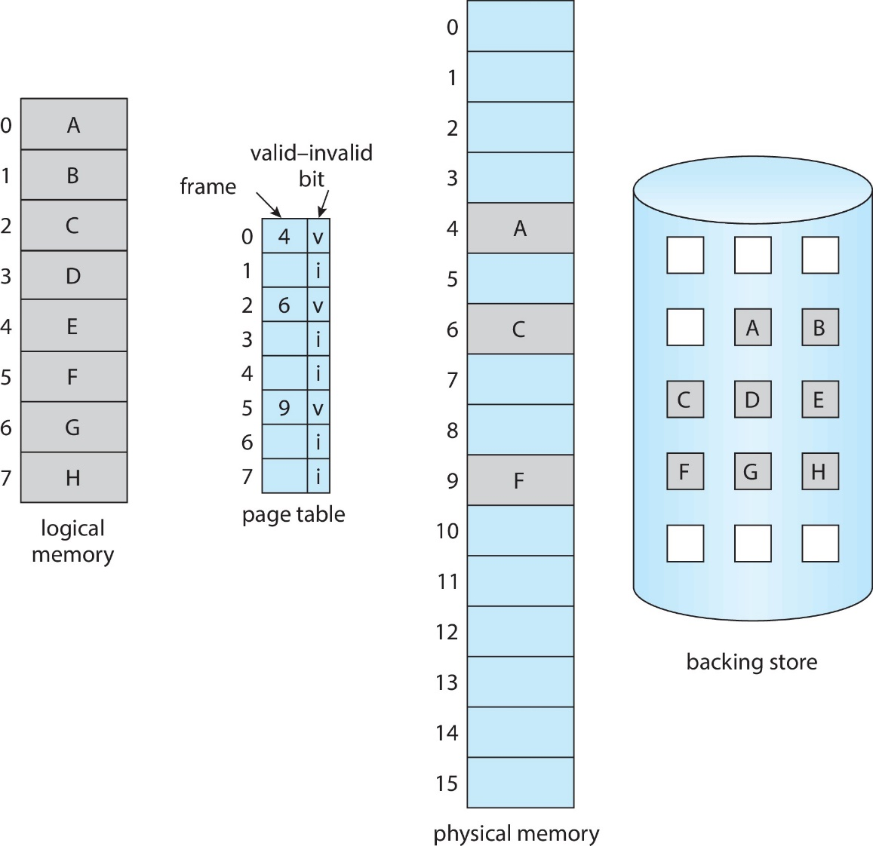
Page Table When Some Pages Are Not in Main Memory

Slide 11
Page Replacement
Prevent over-allocation of memory by modifying page-fault service routine to include page replacement
Use modify (dirty) bit to reduce overhead of page transfers – only modified pages are written to disk
Page replacement completes separation between logical memory and physical memory – large virtual memory can be provided on a smaller physical memory

Slide 12
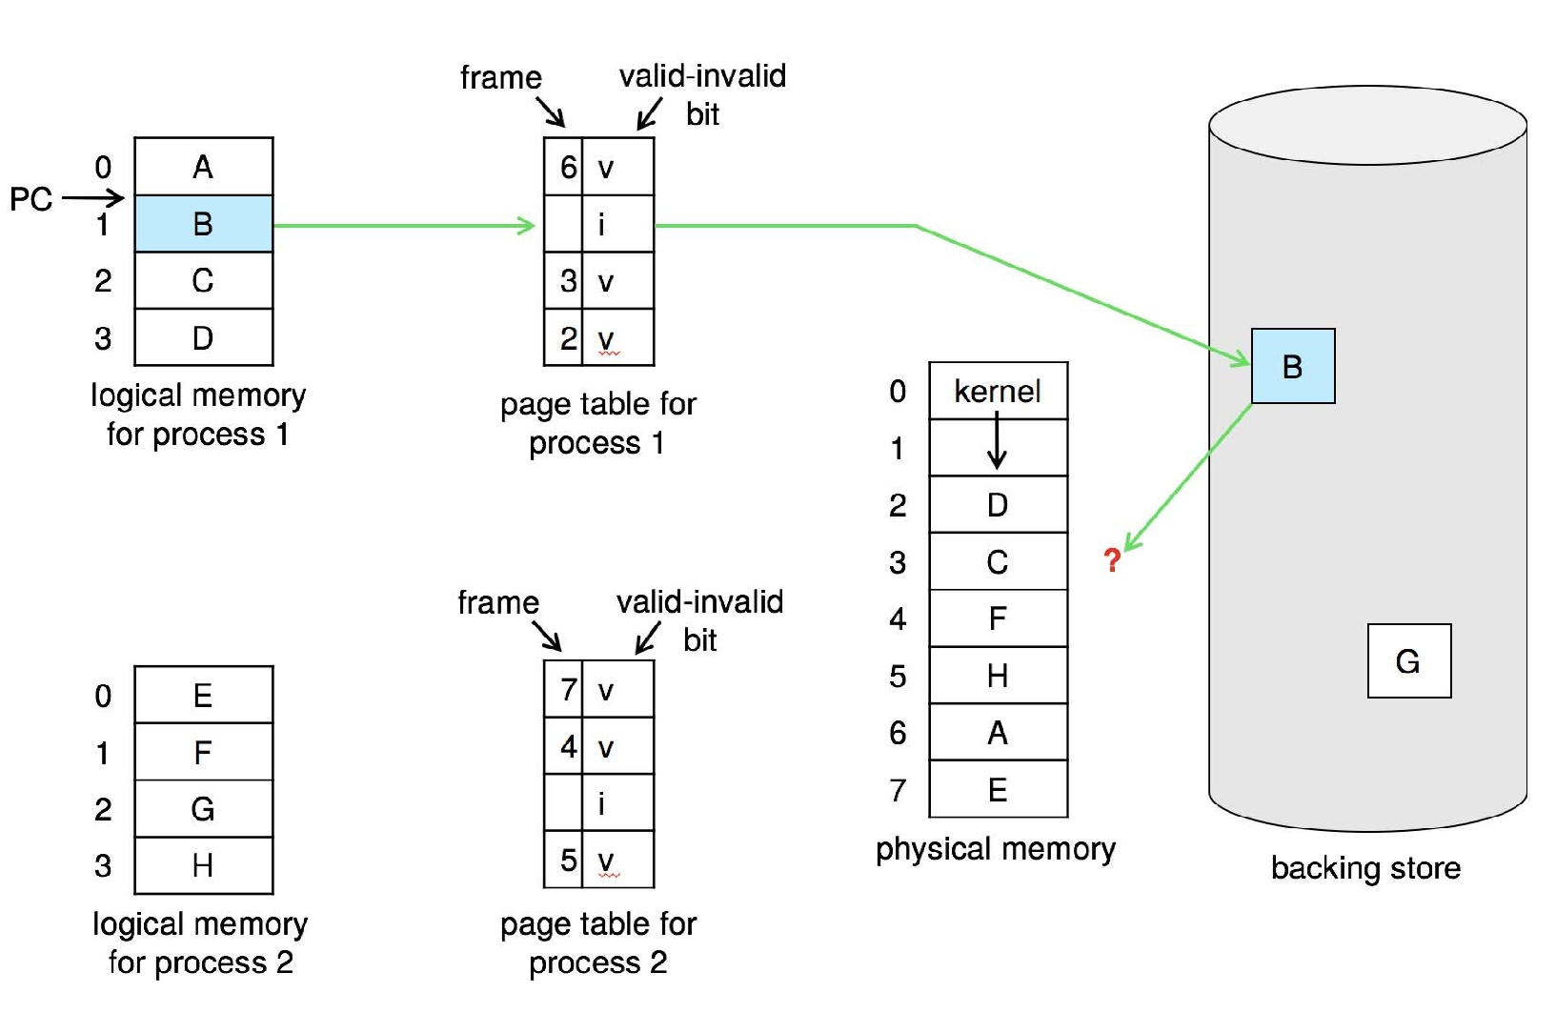
Need For Page Replacement

Slide 13
Page and Frame Replacement Algorithms
Frame-allocation algorithm determines
How many frames to give each process
Which frames to replace
Page-replacement algorithm
Want lowest page-fault rate on both first access and re-access
Evaluate algorithm by running it on a particular string of memory references (reference string) and computing the number of page faults on that string
String is just page numbers, not full addresses
Repeated access to the same page does not cause a page fault
Results depend on number of frames available
In all our examples, the reference string of referenced page numbers is
7,0,1,2,0,3,0,4,2,3,0,3,0,3,2,1,2,0,1,7,0,1

Slide 14
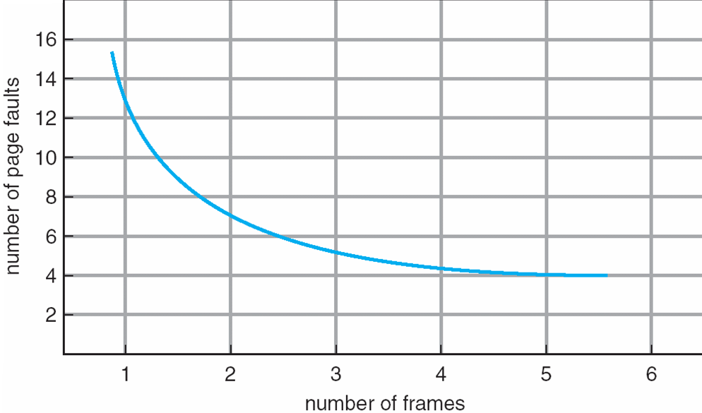
Graph of Page Faults Versus the Number of Frames

Slide 15
Page and Frame Replacement Algorithms
FIFO
Optimal
LRU
Using Stack
Using Counters
Second Chance Algorithm
Counting Algorithms
LFU
MFU

Slide 16
Global vs. Local Allocation
Global replacement – process selects a replacement frame from the set of all frames; one process can take a frame from another
But then process execution time can vary greatly
But greater throughput so more common
Local replacement – each process selects from only its own set of allocated frames
More consistent per-process performance
But possibly underutilized memory

Slide 17
Thrashing
If a process does not have “enough” pages, the page-fault rate is very high
Page fault to get page
Replace existing frame
But quickly need replaced frame back
This leads to:
Low CPU utilization
Operating system thinking that it needs to increase the degree of multiprogramming
Another process added to the system

Slide 18
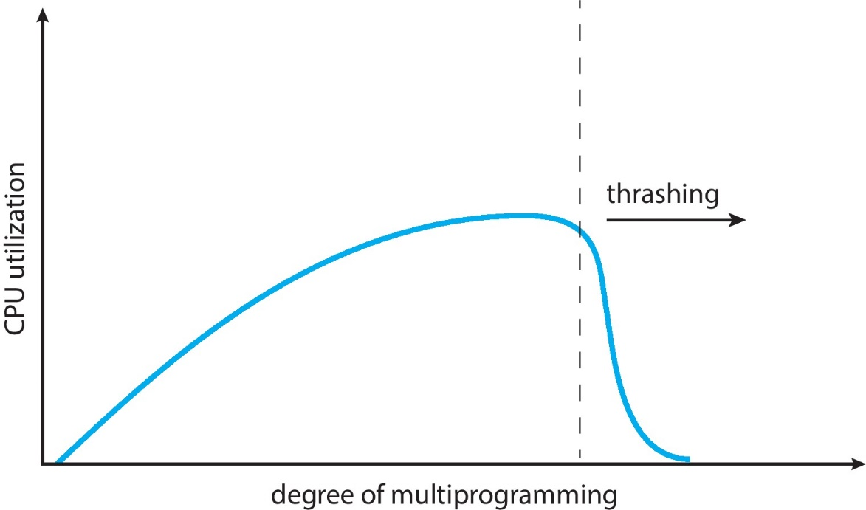
Thrashing (Cont.)
Thrashing. A process is busy swapping pages in and out

Slide 19
Lecture Material
Slides of chapter 9 can be found from the given link
https://codex.cs.yale.edu/avi/os-book/OS10/slide-dir/index.html

