Slide 1
Post harvest Packaging and Transportation
Prof. Dr. Sarfraz Hussain
FST 508

Slide 2
Packaging
Packaging is the science, art and technology of enclosing or protecting product for distribution, storage, sale and use.
It also act as containment for easy handling
Large-sized containers are used for transport and wholesale
small-sized packages for retail trade.

Slide 3
Role of Packaging
Packaging plays a very important role in protecting fresh produce
• It provides protection from dirt & dust
• It reduces microbial contamination from the surrounding environment and from consumer contact
• It helps to maintain the freshness of produce
• It extends the postharvest shelf life
• It increases the sale of fresh produce.
The development of packaging which is suited to the handling of fresh produce necessitates an understanding of the physiological characteristics of the produce.

Slide 4
Purpose of Cushioning
A cushioning material must provide effective energy absorption
Prevent the critical stress/strain level in the produce tissue that initiates bruising
Packaging material choice is based on the
stacking height
duration of storage
pretreatments
cooling
cost

Slide 5
Continued . . .
Immobilization and proper cushioning of the produce help in reducing damage due to cuts, punctures, bruises, abrasion, impact, and friction.
This can be done by various types of trays, or by certain volume-fill techniques, such as padding or cushioning. The material used for padding should have the following
Properties:
(i) ability to absorb the impact energy without damaging the produce

Slide 6
Continued. . .
(ii) should not impart a high rebound energy to the produce,
(iii) durability by internal structure fatigue and surface wear (needs lower thickness),
(iv) cushion cleanup, sanitation, and compatibility with water, fungicides, waxes, and cleaning solutions must be excellent, and
(v) the cushion physical properties (thickness and stiffness).
The materials that can be used are PVC, polyethylene, neoprene, polyurethane, wool carpet, polypropylene, poron, or no bruze.

Slide 7
Packaging material
The commonly used padding materials are leafs, straw, grass, coconut husk, paper, and plastics. Plastic films, mesh, or net and plastic-lined paper may also be used to prepackage fresh produce
Fresh produce is generally packed in
plastic crates,
plastic bags or corrugated paper boxes
Corrugated paper boxes are used for the packaging of fixed counts of uniformly sized produce such as avocadoes, mangoes and oranges

Slide 8
MAP
This type of package is designed to exactly match the handling conditions and respiration rates of specifically packaged produce, by manipulating O₂ and CO₂ levels in the packages
In some instances, MAP films are impregnated with minerals, in order to absorb and remove ethylene produced in the storage environment around the bagged produce.
Impregnated MAP films are particularly suitable for transporting bulk fresh fruit and vegetables to distant markets or between farmers

Slide 9
Con . . .
Advantages of MAP
Extends shelf life
Prevents dehydration
Retains green color and prevents yellowing
Preserves fresh taste and aroma
Delays ripening
Prevents fungal and bacterial growth
Increases the sale of fresh produce

Slide 10
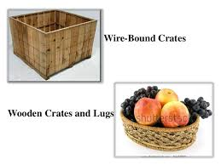
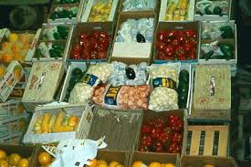
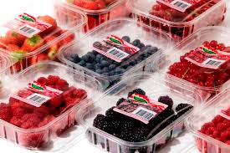
Packing materials

Slide 11
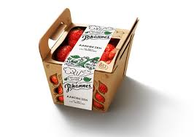
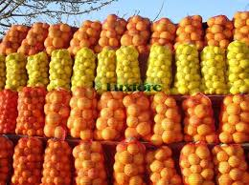
Packing material

Slide 12
Properties Considerations for packaging
Prevention: where it is needed
Minimization: of mass and volume
Reuse: encourage reuse of packages
Recyclable: reprocess it into new methods
Dispoal: use disposable, ecofriendly packages
Low price :
Availability: at low price

Slide 13
Transportation
Fresh produce is primarily transported by road, from farmer to consumer.
A marketing concern is that fresh produce should be of the highest quality and should be kept in the best condition during transportation.
Minimizing losses during transportation, necessitates that special attention be given to vehicles, equipment, infrastructure and handling.
Fresh produce is transported using both Refrigerated and Non-refrigerated vehicles.

Slide 14
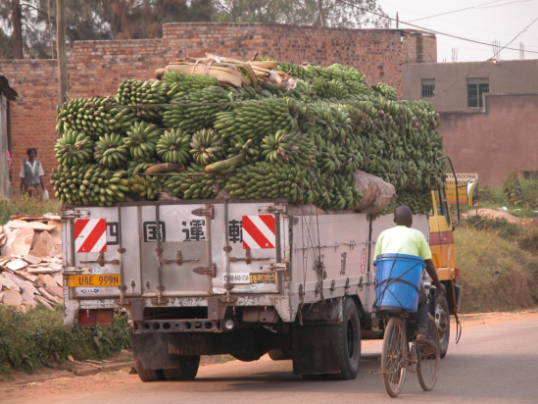
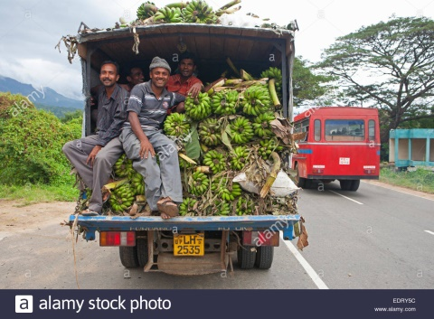
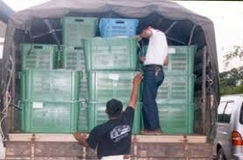
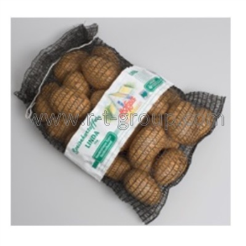
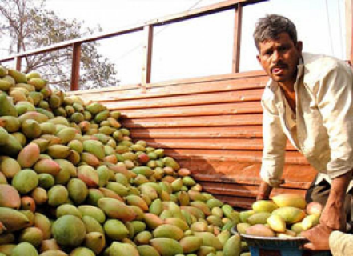
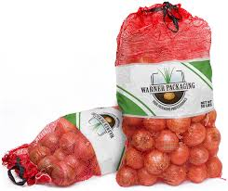
Transportation

Slide 15
Continued . . .
Non-refrigerated vehicles are generally open-sided trucks, with wire mesh frames.
They are inexpensive
convenient and easy
Truck can be used for the delivery of fresh produce, other goods and passengers when required
Layers of produce are not, however, separated in order prevent heat generation.

Slide 16
Continued . . .
Non-refrigerated vehicles are used for transporting produce over distances of up to 850 km
On arrival the produce must be unloaded or sold as quickly as possible to overcome overheating.
Fresh produce must not be watered prior loading, as this will lead to decay, rotting and extensive losses

Slide 17
Losses due to non refrigeration
Major causes of losses during the non refrigerated transportation of fresh produce are
• Improper handling during loading and unloading
• Over loading without separation of produce which leads to overheating and mechanical injury to produce at the bottom of the stack
• Rough roads
• Lack of ventilation of the produce
Often the produce is stacked too high
Refrigerated Vehicles Fresh fruits and vegetables are increasingly demanded in international markets

Slide 18
Refrigerated Transportation
Refrigeration during transportation is convenient and the most effective means of reducing losses.
Proper insulation and ventilation of trucks help in minimizing loss of quality in the absence of truck without refrigeration. Following measures have been suggested to minimize heat accumulation during transportation of fruits and vegetables:
(1) avoiding closed vehicles without refrigeration except for local deliveries,

Slide 19
Continued . . .
(2) fitting open-sided or half-boarded trucks with roofing and siding to protect produce from
direct sun and wind exposures,
(3) fitting a second white-painted roof 8–10 cm above the main roof to act as a radiation shield,
(4) provision for air intake in conjunction with louvers in unrefrigerated vehicles used in long-distance transport to ensure positive airflow through the load, and
(5) equipping transport vehicles such as trucks, railcars, and sea containers with refrigeration for long journeys.

Slide 20
It is a considerable challenge to the postharvest handling of fresh produce
Koldkraft and Izhar fosters are serving in Pakistan for cold storage vehicles
Use of properly designed containers for transporting maintain the produce’s freshness, succulence, and quality
significantly reduce mechanical damage during handling, transport, and storage

Slide 21
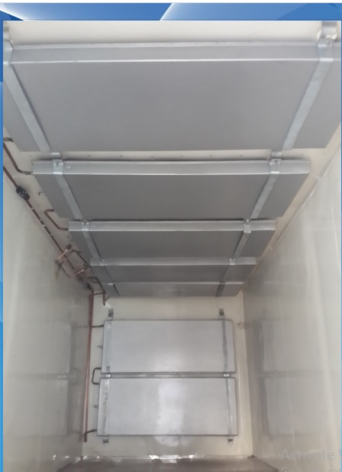

Slide 22
These systems have resulted in extending shelf life, retaining fresh produce quality and reducing losses.
The problem of moisture condensation within the MAP bags still arises.
New packaging innovations designed to control this,
condensation control packaging (CCP)
Compact controlled atmosphere packaging (CCAP)

Slide 23
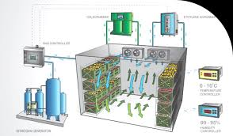
Condensation control packaging

