Slide 2
drug dependence By Dr.NAVEED AHMAD LECTURERE department of forensic medicine & toxicology sargodha medical college

Slide 3
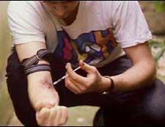

Slide 4
Hypnotics/sedatives
These are drugs, which produce sleep and calmative effects on CNS e.g. barbiturates, benzodiazepines.
Narcotics
These are drugs that relief pain and produce sleep, e.g. opium, morphine, pethedine.

Slide 5
Stimulants
Drugs, which produce wakefulness, exhilaration, alertness etc by acting on the CNS e.g. cocaine and amphetamines.
Psychotropic Drugs
These are drugs that alter mental functions by their action and include stimulants, depressants, narcotics and hallucinogens.

Slide 6
Drug may be given therapeutically/drug abuse
(e.g. morphine for pain)
Pain relief
Euphoria
Desire to take repeatedly for euphoric effects
Psychological dependence
Regular use and dose increasing
Craving for drug
withdrawal syndrome (if deprived of drug)
Drug addiction

Slide 7
Important terms commonly used in the description of drug dependence
Tolerance
Development of body or tissue resistance to the effects of a drug so that larger doses are required to produce the original effect.

Slide 8
Psychological dependence
This means that the mind needs the drug. There is craving for the repeated or compulsive use of a drug to satisfy emotional or absences of discomfort are evolved but not physical pain.

Slide 9
Physical dependence
This means that the body needs the drug to feel normal and function properly.
Tendency to continue and to increase the dose for this purpose.
The presence of withdrawal symptoms (especially physical pain).

Slide 10
Drug abuse
Improper use of a therapeutic or nontherapeutic drug, which may or may not be harmful, even in absence of addiction, constitutes drug abuse.

Slide 11
Drug habituation
It is defined as a condition, which results from the continued use of a drug which does not cause much harm to individual or society.
Habituation is characterized by
Desire (but not craving) to take the drug when convenient.
Harmful effects if present, to individual only.
Psychological (but not physical dependence).
The common drug used is caffeine (coffee).

Slide 12
Drug addiction
Drug addiction is defined as a state of periodic or chronic intoxication, harmful to the individual and to the society.
It is characterized by:
Craving (to obtain and take the drug on any cost).
A tendency to increase the drug dose.
A psychological and physical dependence.
Withdrawal symptoms.

Slide 13
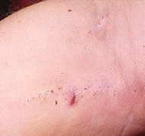
Injection Marks

Slide 14
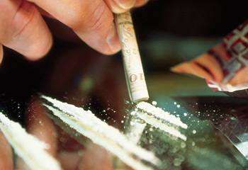

Slide 15
Cocaine Insufflations

Slide 16
Cocaine Smoking

Slide 17
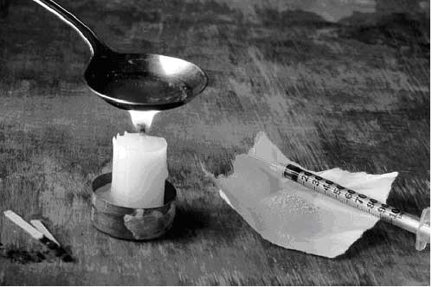
Preparation for Injection

Slide 18
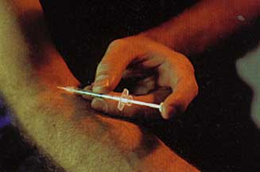
Cocaine Injection

Slide 19
Differentiating characteristics of drug addiction and drug habituation
Sr.No | Characteristics | Drug Addiction | Drug Habituation
1. | Compulsion | Present | Only desire, no compulsion
2. | Dose | Tendency to increase | Not so
3. | Dependence | Both psychological and physical | Only mild psychological
4. | Withdrawal symptoms | Characteristic | None/mild
5. | Harm | To both victim and society | If any, only to victim

Slide 20
Drug dependence
WHO has coined the term drug dependence to replace the term “Drug addiction & Drug habituation”
It is defined as, “ a state, psychological or physical, in which a person has the compulsion to take a drug on continuous or periodic basis, either to experience its pleasurable effects or to avoid the discomfort of its absence.”

Slide 21
Substances of Drug Dependence and Drug Abuse are
Alcohol
Barbiturates
Opium and its derivatives
Cocaine
Cannabis indica (Bhang).
Benzodiazepines.
Caffeine/Nicotine etc.

Slide 22
Thank You

