Slide 1
Post Harvest of Okra
Prof. Dr. Sarfraz Hussain
FST 508

Slide 2
Botanical classification
Kingdom: Plantae
Division: Mangoliophyta
Class: Magnoliopsida
Order: Malvales
Family: Malvaceae
Genus: Abelmoschus
Species: A. esculantus
Botanical Name: Hibiscus esculentus

Slide 3
OKRA
Okra is a flowering plant of Mallow family
Its origin is tropical Asia and Africa
The main region of cultivation and diversity of okra is India, Srilanka, Pakistan, Nepal, Bangladesh
It is bright green when fully matured.
Season Year-round

Slide 4
Quality Characteristics and Criteria
High quality pods are 5 to 15 cm (2 to 6 in) long, flexible, bright-green, and turgid.
Seeds should not be protruding through the epidermis
ridges should be free of blackening and bruising

Slide 5
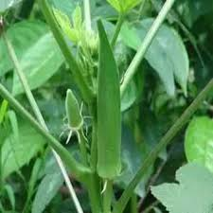
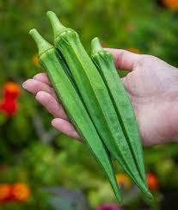
Horticultural Maturity Indices
Okra pods are harvested when immature and high in mucilage but before becoming highly fibrous— generally within 2 to 6 weeks after flowering

Slide 6
Grading & Packaging
Okra is graded by size; absence of defects, decay, insects, dirt, shape, tenderness.
Fancy pods are 11 cm (4.25 in). Fresh okra is most commonly presented in 0.45- kg (l-lb) clamshell boxes or as bulk weight or volume-filled 11.4-kg (25-lb) bins.

Slide 7
Precooling Conditions
Okra should be marketed within 36 h of harvest and shipped under refrigeration.
Storage in unventilated containers without refrigeration can cause degradation of color.
Some growers use hydro cooling or forced-air cooling.

Slide 8
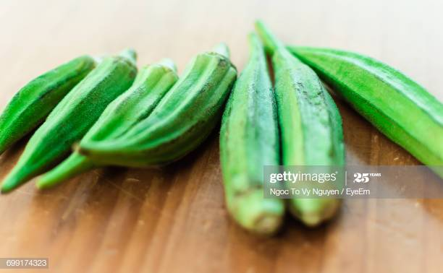
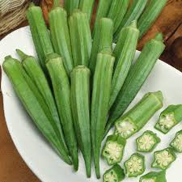
Optimum Storage Conditions
Okra pods lose weight readily and are chilling sensitive. Pods can be stored for 7 to 14 days at 7 to 10 °C (45 to 50 °F) with >90% RH.

Slide 9
Controlled Atmosphere (CA) Considerations
There is a slight benefit from storage at 7 to 12 °C (45 to 54 °F) in 4 to 10% CO₂
Other combinations have also shown some benefit, including 5 to 10% CO₂ at 5 to 8 °C
3 to 5% O₂ and 0% CO₂ the levels of CO₂ >20% can cause off flavors.

Slide 10
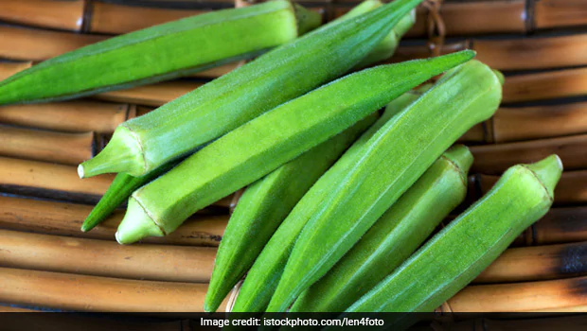
Retail Outlet Display
Conditions include that Okra should be kept dry, refrigerated, and humidified

Slide 11
Chilling Sensitivity
Okra pods are highly sensitive to chilling, especially very young (more mucilaginous) pods. As little as 2 days at 2 °C (36 °F) can cause chilling injury. Chilling injury shows up within 24 h at 20 °C (68 °F) after pods have been held 7 days at 2 or 5 °C (36 to 68 °F). Symptoms include presence of water-soaked areas, exuding lesions, and appearance of mold or mildew, especially if held at 5 °C (41 °F)
Green pods turn a brown-olive-green, yellow varieties turn brown, and burgundy varieties become a dull brown-red.

Slide 12
Ethylene Production and Sensitivity
Okra produce small amounts of ethylene during storage: 0.5 µL kg-1 h-1
Okra pods exposed to >1 µL L-1 ethylene for 3 or more days show yellowing

Slide 13
Physiological Disorders
Pods are susceptible to chilling injury, yellowing, shrivel from weight loss, and warty pods (nitrogen deficiency).
Postharvest Pathology
Cladosporium, gray mold (Botrytis cinerea), mildew, yeasts, Rhizopus stolonifer, Rhizoctonia solani, and Psuedomonas pv syringae can all be problematic in okra

Slide 14
Special Considerations
The ridges on okra pods damage easily
Avoid storing okra with melons, onions, and potatoes, since pods will trap their odors and develop off flavors.
The immature green fruit pods of okra are popular as a vegetable, while in West Africa, the leaves are also consumed as a vegetable and the stem is used for making paper.

Slide 15
Benefits of Okra
okra pods are loaded with significant amounts of protein, fiber, calcium, iron and zinc
prevents liver diseases
boosts immunity
improves eyesight
helps controlling hunger
it is loaded with soluble fibers

Slide 16
Continued. . .
Helps to lose weight
Keeps Asthma symptoms in check
Okra seeds can delay fatigue
They contain antioxidant polyphenols and flavonoids that promote glycogen storage in liver. Glycogen is a body fuel and more of it means you will take longer to get fatigue

Slide 17
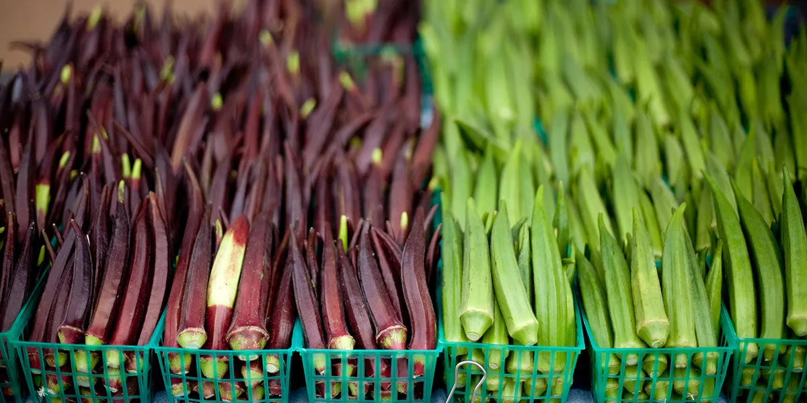
Market Requirements :
All Markets: Require small, fresh green okra with tips which snap readily.

Slide 18
References
Baxter, L., and L. Waters Jr. 1986. Controlled atmosphere effects on physical changes and ethylene evolution in harvested okra.
HortScience 25:92-95 Duzyaman, E. 1997. Okra: botany and horticulture. Hort. Rev. 29:41-72. Lamont, W. 1999. Okra—a versatile vegetable crop. HortTechnology 9:179-184. Perkins-Veazie, P.M., and J.K. Collins. 1992.
Cultivar, packaging, and storage temperature differences in postharvest shelf life of okra. HortTechnology 2:350-352. Ramaswamy, H.S., and S. Rangana. 1982. Maturity parameters for okra (Hibiscus esculentus (L) Moench var Posa Cawani). Can. Inst. Food Sci. Technol. J. 15(2):140-143. Saltveit, M.E. 1997.
A summary of CA and MA requirements and recommendations for harvested vegetables. In M.E. Saltveit, ed., Proceedings of the 7th International Controlled Atmosphere Research Conference, vol. 4, pp. 98–117.
University of California Postharvest Horticulture Series no. 18, University of California, Davis, CA. Scholz, E.W., H.B. Johnson, and W.R. Buford. 1963. Heat evolution rates of some Texas-grown fruits and vegetables. J. Rio Grande Valley Hort. Soc. 17:170-175. Snowdon, A.L. 1992.
Color Atlas of Postharvest Diseases and Disorders of Fruits and Vegetables, vol. 2, Vegetables, pp. 94-95. CRC Press, Boca Raton, FL.

