Slide 1
Software Design
Lecture : 20

Slide 2
Relationships between Classes
Association –Discussed
Aggregation Discussed.
Composition – Discussed.
Generalization– Discussed in previous lecture, solution to be discussed Today
Reflexive Association

Slide 3
Sample Class Diagram

Slide 4
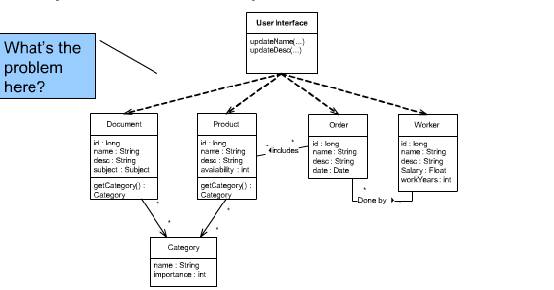

Slide 5
Improvement in the class Diagram

Slide 6
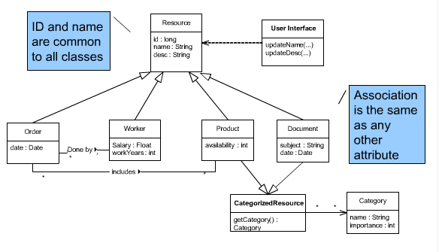

Slide 7
Reflexive Association Relationships
Objects within the same class have a relationship with each other.
A class is having association with itself – Recursive Relationship
Course
0..*
is pre-requisite for
0..*
has pre-requisite of

Slide 8
Reflexive Associative Relationship
It shows a relationship between super / sub class.
Super Class and Sub classes are related by drawing Arrow from sub towards super class.

Slide 9
A Directory may contain subdirectories

Slide 10
Abstract Class
An Operation or Class is abstract if it has no implementation
Abstract Class cannot have any direct instances.
It can only exist in the context of inheritance hierarichy
Abstract classes are represented by writing class name in Italics as shown in next slide.

Slide 12
Problem Statement
In an inventory management system of a video shop there are items of multiple types i-e saleable and rentable which are available for the customer; games, VCR, concession items, videos . Inventory is related to salelrentalineitem and purchaseOrderLineitems. There can be two types of transactions mainly for sale and rentalitems. Both type of transactions are performed by members of the shop. Transactions are managed by employees, employees belong to a particular store location. To fill the inventory supplier supplies the items against purchase order issued by the shop.

Slide 13
Video Store – UML Class Diagram
1
1
Inventory
SaleItem
RentalItem
Video
Game
ConcessionItem
VCR
Transaction
0..*
Employee
0..*
StoreLocation
1
1
SaleTransaction
RentalTransaction
Suplier
1
0..*
0..*
1
1
0..1
1
0..*
Member
PurchaseOrder
1..*
1..*
1
SaleRentalLineItem
1..*
0..*
0..*
PurchaseOrderLineItem

Slide 14
Wrap-up Discussion on Class Diagram

Slide 16
Task To Do:
Task : Write Scenario which generate diagram given in next slide

Slide 17
Class Diagram Given

