Slide 1
Technical Writing and Presentation Skills

Slide 2
Course Description
The main objective of the course is to equip you with skills that will enable you to communicate clearly and concisely in diverse business situations.
You will learn the importance of planning and organizing effective written messages. The course will emphasize on determining objectives and on developing a logical argument before presenting the message in an appropriate format.

Slide 3
Technical Writing and Presentation Skills
The course is divided into two sections:
1. Written communication
2. Oral communication or Presentation Skills

Slide 4
1.Written communication
Written communication will cover planning, structure, and stylistic issues.
Specifically, you will learn to write memos and letters; proposals; short and long reports; and procedure and policy documents.
Moreover, you will learn to simplify complex information through editing and revising, enhancing your ability to create powerful documents to sell your ideas.

Slide 5
2. Oral communication
The oral communication section will cover planning and execution of effective presentations; group behavior ; and planning and conducting effective meetings.

Slide 6
Writing will be critical to your success.
As a college graduate you will need to spend an average of 20 percent of your time at work writing. That comes out to one out of every five-day work week.
Besides enabling to do your job, Writing can bring you many personal benefits as well
Recognition in the form of praise
Raises
Promotions
In many organizations the communication with the upper management is not feasible.

Slide 7
Writing will be critical to your success.
In such a company, your memos, reports, and other writing may be the only evidence
they have of your good work as either a specialist or a communicator.
Writing is an important responsibility of mangers who have to communicate a wide variety of messages to those above and below him.
Consequently employers look for writings when considering people for advancement.

Slide 8
Writing will be critical to your success.
In a study 94 percent of the graduates from seven departments that send students to technical writing classes reported that the ability to "write well" is of "some" importance to them.
Furthermore 58 percent said that it is of great or critical importance to them.

Slide 9
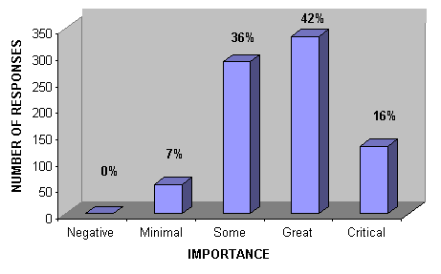
Writing will be critical to your success.

Slide 10
Writing will be critical to your success.
In addition to bringing you recognition, writing well at work can bring you personal satisfaction.
It will enable you to make an important impact.
To succeed in any endeavors during your professional career, you will need to influence peoples opinions, actions and decisions mostly through writing.

Slide 11
writing
Writing at work differs from writing at school
To write successfully at work you will need to develop new writing skills and even new ways of thinking about writing.
That’s because on-the-job writing differs in some very fundamental ways from writing done at school.

Slide 12
writing
Purpose
As a student you communicate for educational purposes for example writing term papers or taking a written exam etc.
In contrast as an employee you will communicate for instrumental purposes.
Most of your communications will be designed to help your employer achieve practical business objectives.

Slide 13
School vs work Writing
Example
At school, where your aim is to show how much you know, one of your major writing strategies is to write as much as you can about your subject.
At work, your communications should only include the information your readers need.
Extra information would only clog your readers’ path to what they need, resulting in
decreased efficiency
increased frustration

Slide 14
School vs work Writing
Audience
At school your interaction is only one person, the instructor.
In contrast at work, you will often create communications that will address a wide variety of people with different backgrounds.
The audience might include who are differ in
familiarity with your subject
the use they will make of your information
the kinds of professional and personal concerns they will bring to your presentation.

Slide 15
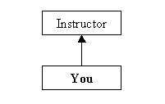
School vs work Writing

Slide 16
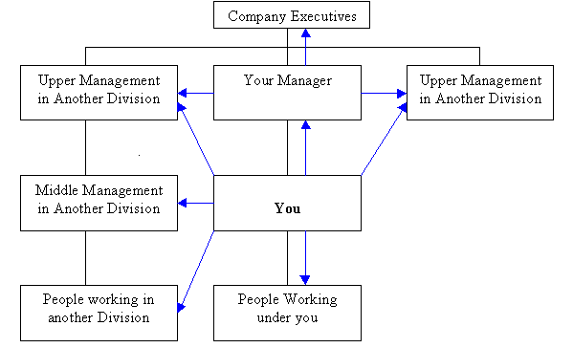
School vs work Writing

Slide 17
Example
Consider the report in which Naila will present her recommendations for improving the hospital kitchen.
Her recommendations might be read by her supervisor Mr. Nadeem, who will want to know what measures he will have to take in order to follow her recommendations.
The vice president of finance, Mr. Altaf, will want to verify the cost estimates that Nalia includes.
The director of purchasing, Mr. Chauhan, will need to know about the new equipment he will need to order.
The head of personnel, Miss Sara, will want to learn whether she needs to write any new job descriptions.
And lastly the kitchen staff to assure them that their new work assignment will treat them fairly.

Slide 18
Types of Communications
People at work write different communications than the communications written at schools.
Instead of term papers and exams, they write such things as
memos
business letters
instructions
project proposals
progress reports.

Slide 19
Types of Communications
Each on-the-job communication has its own conventions.
To write successfully at work, you will need to learn how to construct these kinds of communications.

Slide 20
Ownership
Ownership of a writer’s work is very important.
While at school your communication only belongs to you, at work however, your communication will belong only partly to you.
They will belong to your employer.
What you write at work represents not only you but also your department or your employer.

Slide 21
Example
If you write a letter or report to a customer, the customer views it as an official communication from your employer.
If you write a proposal, your employer will get the contact - or lose it.

Slide 22
Two other situations fairly common at work
Employees often work on committees that write reports, proposals, and other documents collaboratively. The final version cannot be accredited to only one individual.
People often write communications that are sent under someone else’s name. It is common for departmental reports to be signed by Head of Department, even though are written by staff members.
To succeed on the job, you will need to learn to write under the circumstances in which
your employer claims ownership of your communications.

Slide 23
It is absolutely essential to think constantly about your readers.
Think about what they want from you - and why?
Think about the ways you want to affect them.
Think about the ways they will react to what you have to say.
Think about them as if they were right there in front of you while you talked together.

Slide 24
As you write in a professional environment you need to remember three things.
Readers create meaning
Readers responses are sharpened by situation
Readers react on a Moment-by-Moment basis.

Slide 25
Readers create Meaning
Instead of receiving the message, people interact with the message to create meaning.
While reading we build larger structures of knowledge from small fragments of sentences. These structures are not the words we have just read but our own creation.

Slide 26
Readers’ responses are shaped by the situation
Responses to a communication are shaped by a total situation surrounding the message such as
factors as their purpose of reading
the readers’ perceptions of the writer’s aims
their personal interest and stake in the subject discussed
past relations with the writer

Slide 27
Readers react on a moment-to-moment basis
On job people react to each part of the memo, report or other business communication as soon as they come to it

