Slide 2
Image-based Clothes Animation for Virtual Fitting
Zhenglong Zhou, Bo Shu, Shaojie Zhuo, Xiaoming Deng, Ping Tan, Stephen Lin*
National University of Singapore,
Microsoft Research Asia*

Slide 3
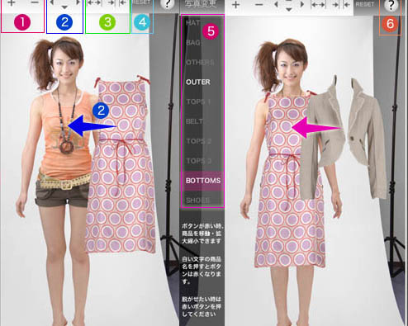
Virtual Clothes Fitting
Awesaba (Aveilan)

Slide 4
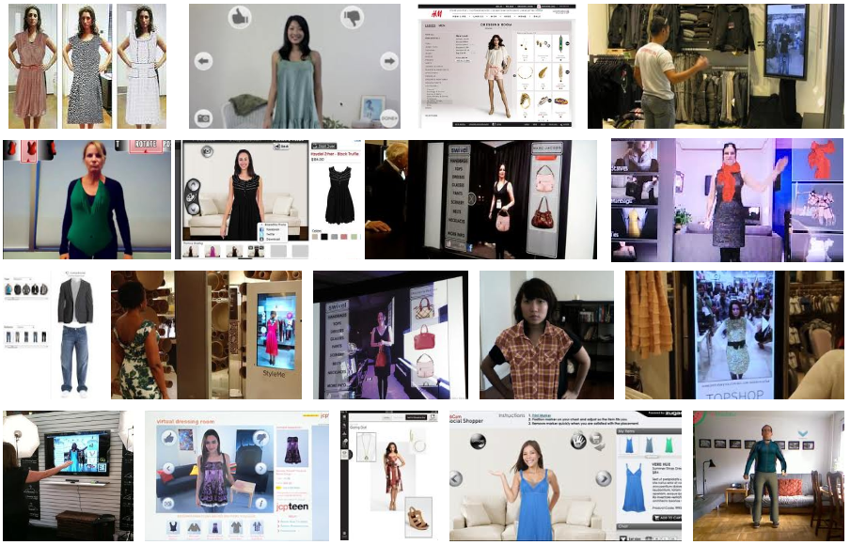
Lots of Systems in the Market

Slide 5
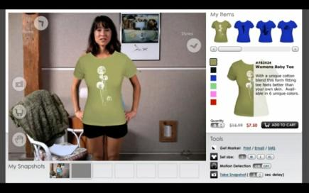
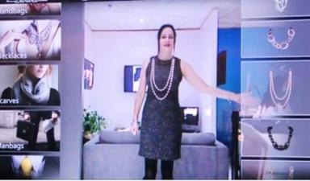
2D Systems
Overlay a still image on the user’s figure
Limitation:
No clothes animation
Virtual dressing room (Zugara )
Swivel (Face cake)

Slide 6
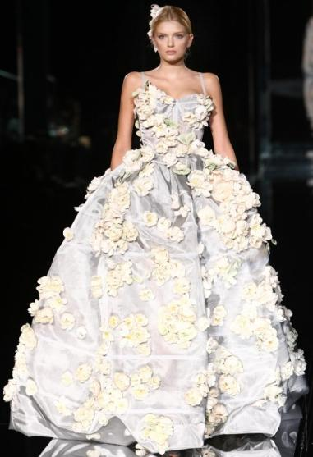
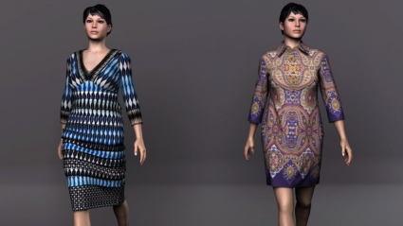
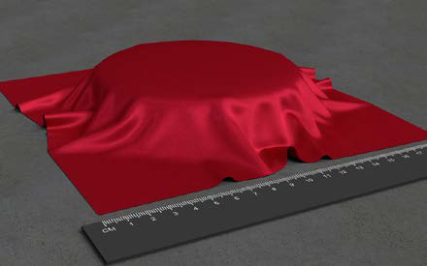
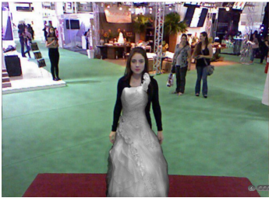
3D Systems
Render and animate 3D garment models according to the user’s motion
Limitations:
3D modeling is difficult
Real-time animation is difficult
Realistic rendering is difficult
styku
Shuang et al. 2011
Fitnect

Slide 7
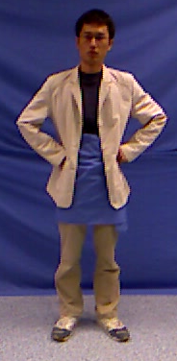
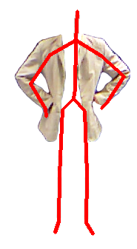
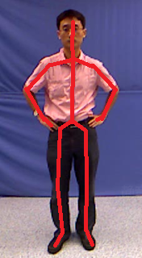
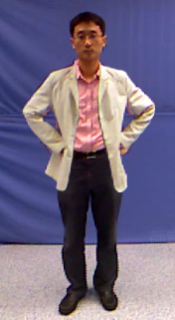
Our Data-driven Method
Data preparation
Garment transfer
Model data
Database
Input
Output

Slide 8
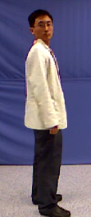
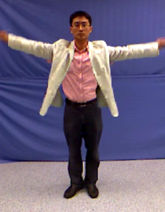
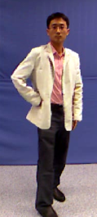
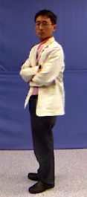
Advantages of Our System
No 3D modeling & rendering
No 3D cloth animation
“Image-based virtual fitting” in real-time

Slide 9
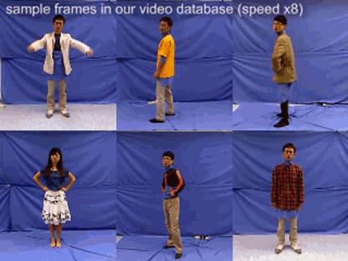
Data Preparation
Record approximately 5000 video frames
A blue background to facilitate segmentation in Adobe Affter Effects
Store segmented images and corresponding skeletal poses.

Slide 10
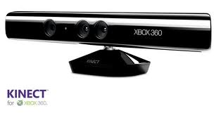
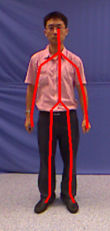
Garment Transfer
Pose estimation
from Microsoft Kinect
Pose descriptor
Garment database query
Input key: User’s pose vector
Return value: Segmented garment image of similar pose
Concatenation of joint positions

Slide 11
Motion Smoothness Optimization
Input
Nearest Neighbor
Input video
#12
#52
#55
#71
Discontinuous animation

Slide 12
Motion Smoothness Optimization
Buffered frames
#12
#10
#11
#13
Multiple
Nearest Neighbors
Smooth Motion

Slide 13
Motion Smoothness Optimization
Displaying
Buffered frames
Temporal motion smoothness
Pose similarity
Shortest path
Source
Target

Slide 14
Motion Smoothness Optimization
Displaying
Buffered frames
Target

Slide 15
Motion Smoothness Optimization
Displaying
New frame
Buffered frames
Buffered frames
Source
Target

Slide 16
Motion Smoothness Optimization
Displaying
New frame
Buffered frames
Source
Target

Slide 17
Motion Smoothness Optimization
Displaying
New frame
Buffered frames
Source
Target

Slide 18
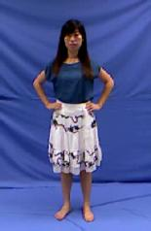
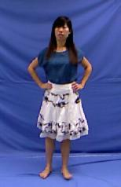
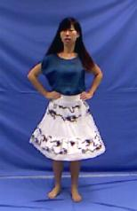
Motion-aware Frame Query
Clothes deformation depends on motion
Measure motion by concatenating neigboring pose vectors
Give higher weight to the central frames
Replace the pose similarity in optimization by motion similarity

Slide 19
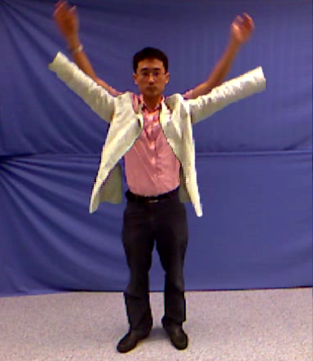
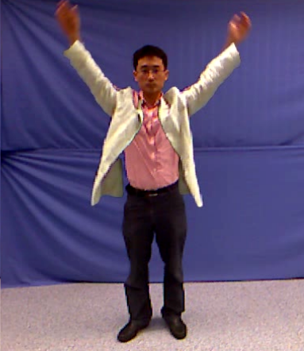
Image Warping
Exact match often cannot be found
Skeleton based warping
Apply moving least square warping [Schaefer et al. 2006]
Use the skeleton joints as control points.

Slide 20
Frame Interpolation and Alignment
Our optimization chooses locally consistent sequences
Discontinuity exists at the connection of different sequences
#11
#12
#13
#14
#55
#56
#57
#58
Apply optical flow based linear interpolation to transit

Slide 21
Results
Please refer to the video demo on the project website.

Slide 22
Conclusion
We propose an image-based technique for clothes animation
It provides a practical solution for virtual clothes fitting

Slide 23
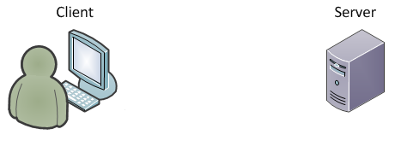
Future work
Body shape estimation.
Online system.
Send pose vector
Receive garment image
Simple image rendering.
Pose vector
Garment image

Slide 24
Thank you!

