Slide 1
multimodality
Presenter: Atiqa Riaz

Slide 2
Outline
Mode(include all personal, interpersonal etc kress view all), sign, social semiotics
Unimodaity
Limitations of unimodality
Multileracy
Multimodality (design elements, meaning making, diff modes and their function)
imp terms that are related to it (motivated sign, affordance…)
Diversity of learners
Role of digital technology
Who is a multimodal learner
Vark model of learning
Benefits
Limitations
Conclusion

Slide 3
Mode
Kress advocates a dynamic view: “socially, what counts as mode is a matter for a community and its social-representational needs. What a community decides to regard and use as mode is mode. ... Formally, what counts as mode is a matter of what a social-semiotic theory of mode requires a mode to be and to do” (p. 87, emphasis, here and in other quotations, in original).
Multimodality as a field of research conceives of representation and communication as relying on a multiplicity of modes, all of which have been socially developed as resources to make meaning. Modes such as gesture, sound, image, colour, or layout, for example, are conceived as sets of organized resources that societies have developed – each to a greater or lesser level of articulation in different social groups – to make meaning and to express and shape values, ideologies, and power relations. When in combination with speech and/or writing, they are not a mere accompaniment of, or support to verbal language, as labels such as para-/extra-linguistic or non-verbal might suggest; rather, each concur with a specific functional load to the meaning made by the overall text – and as such they deserve attention.
mode as socially-shaped, the motivated sign, the meaning potential of semiotic resources, and genre as the entexting of social relations.

Slide 4
Mode
Kress (2009) defines mode as “a socially shaped and culturally given resource for making meaning” and problematises this notion from the perspective of qualifying criteria as well as features and descriptive planes which help differentiate between individual modes. He says that resources have to fulfil three criteria in order to be recognised as modes. They need to be able to represent 1) states, actions, or events (ideational function); 2) social relations of participants in a given communicative act (interpersonal function); and 3) both of the above need to be represented as coherent (both internally and within their environments) texts (textual function). According to Bateman (2011), on the other hand, the minimal requirement for a semiotic resource to be recognised as mode is that a particular material substrate is sufficiently controllable as to be used purposefully in the meaning-making process.
a mode is what a community takes to be a mode, based on its representational needs and practices (Kress 2009, pp. 58-59), and a resource can only be recognised as a mode for a particular group of users if it is used by this group regularly, consistently, and with shared assumptions about its meaning potential

Slide 5
Mode
Modes are channels of information, or anything that communicates meaning in some way, including:
Pictures
Illustrations
Audio
Speech
Writing and print
Music
Movement
Gestures
Facial expressions
Colors
And much more!
Modes are experienced in different ways by each of the senses — usually visual, auditory or tactile. They often interact with each other, creating a dynamic learning experience. For instance, an educational video might include speech, images, music and text — all of which can enhance a student’s learning experience.
Various modes of communication. Image source: Region 10 ESCTeachers should combine two or more multimodal learning modes to provide a well-rounded educational experience. Since school environments have diverse student populations with a wide variety of learning styles, a multimodal approach helps each student achieve academic success in their own way.
To properly implement multimodal learning, you first need to understand learning styles.

Slide 6
Sign
Kress pays much attention to the pragmatics of communication: a sign-maker issues a “prompt” (e.g., a gaze, a gesture, a spoken sentence, a touch) to an addressee or audience; the latter will then start interpreting the sign and respond to the prompt in accordance with their own interest (p. 35). This approach is commensurate with the Relevance Theory model (Sperber and Wilson 1995, Wilson and Sperber 2004, Forceville 1996: chapter 5, 2005, 2009), but this latter model has been developed with more precision and detail, and thus is a better candidate for Kress’ desideratum of a single theory “able to deal with all instances of communication” (p. 36).

Slide 7
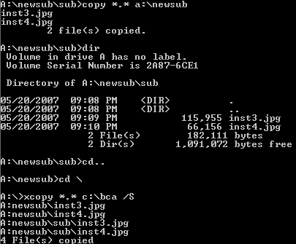
Unimodality
The system based on single channel of input.
Restricted to use only one mode as tool of communication
This made interpretation difficult, time consuming, boring
Example: text based user interface.

Slide 8
»
Unimodality
Multimodality

Slide 9
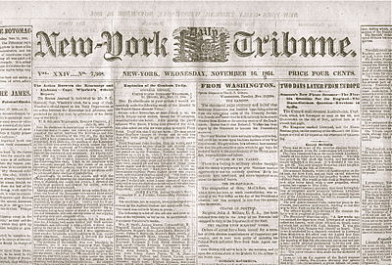
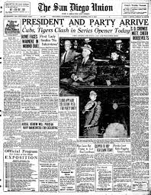
»
Unimodality
Multimodality
The newspaper of 19th century
The newspaper of 20th century

Slide 10
Multiliteracy
Multiliteracies is a term coined in the mid-1990s by the New London Group and is an approach to literacy theory and pedagogy.
This approach highlights two key aspects of literacy: linguistic diversity, and multimodal forms of linguistic expression and representation.
The term was coined in response to two significant changes in globalized environments: the proliferation of diverse modes of communication through new communications technologies such as the internet, multimedia, and digital media, and the existence of growing linguistic and cultural diversity due to increased transnational migration. Because the way people communicate is changing due to new technologies, and shifts in the usage of the English language within different cultures, a new "literacy" must also be used and developed.
The second way to incorporate the term multiliteracies is the way technology and multimedia is changing how we communicate. These days, text and speech are not the only and main ways to communicate. The definition of media is being extended to include text combined with sounds, and images which are being incorporated into movies, billboards, almost any site on the internet, and television. All these ways of communication require the ability to understand a multimedia world.
The formulation of “A Pedagogy of Multiliteracies” by the New London Group expanded the focus of literacy from reading and writing to an understanding of multiple discourses and forms of representation in public and professional domains.
Notes:
Simply promoting multimodality. This is used as a pedagody theory, where we use the multimodalities to communicate better.

Slide 11
Multimodality
Multimodality is a concept introduced and developed in the last two decades to account for the different resources used in communication to express meaning. The term is used both to describe a phenomenon of human communication and to identify a diversified and growing field of research.
As a phenomenon of communication, multimodality defines the combination of different semiotic resources, or modes, in texts and communicative events, such as still and moving image, speech, writing, layout, gesture, and/or proxemics.
Within the field of “multimodal studies” (O’Halloran and Smith 2011), the phenomenon of multimodality is approached through different theoretical perspectives (Jewitt 2009a; O’Halloran 2011), all hinging on four key assumptions (Jewitt 2014a), namely that (a) all communication is multimodal; (b) analyses focused solely or primarily on language cannot adequately account for meaning; (c) each mode has specific affordances arising from its materiality and from its social histories which shape its resources to fulfill given communicative needs; and (d) modes concur together, each with a specialized role, to meaning-making; hence relations among modes are key to understand every instance of communication.
Multimodality as a field of research conceives of representation and communication as relying on a multiplicity of modes, all of which have been socially developed as resources to make meaning

Slide 12
Multimodality
All communication is, and has always been, multimodal (Kress and van Leeuwen 1996). Be it either face-to-face or distance, synchronous or asynchronous, every instance of communication relies on more than one mode to make meaning.
Multimodal studies are based on three main assumptions: Firstly, it is assumed that communication always involves the use of multiple modes (speech, writing, gestures, images, and others), and their intermodal relationships contribute to meaning-making. Secondly, meaning is constructed through selection and configuration of different modes in interactions. Finally, resources used by interactants are socially shaped over time to create a shared cultural sense of the way in which they can convey meaning. Multimodal expression, thus, is highly context-dependent, with multimodal meanings constructed within specific social and cultural contexts, based on the communicative needs of different communities or cultures. As a result, multimodal research can benefit immensely from the insights of intercultural communication studies. At the same time, when researching intercultural communication, multimodal approaches bring to light aspects of great significance to communicating interculturally. It is, indeed, not only verbal or textual expression that conveys meaning in particular cultures, but a whole array of other culturally contextualised semiotic means.

Slide 13
Multimodality
Social semiotics:
Following the Hallidayan thought, Kress and van Leeuwen (1906, 2001), Jewitt (2006), and Machin (2007) have developed the multimodal social semiotic view of communication. One central concept in this multimodal approach is semiotic resources. According to van Leeuwen (2005) semiotic resources are:
the actions, materials and artifacts we use for communicative purposes, whether produced physiologically – for example, with our vocal apparatus, the muscles we use to make facial expressions and gestures – or technologically – for example, with pen and ink, or computer hardware and software – together with the ways in which these resources can be organized. (p. 285)

Slide 14
Multimodality
Social semiotics refers to all diff ways we communicate through within the social context.
According to Kress:
“social semiotics refers to the ways in which different aspects of society combine to create meaning”
These semiotic resourses for making meaning in specific social contexts include langauge, music, images, gestures and so on.
For example: teacher delivering a lecture
Social semiotics’ approach to modes is socially specific. What constitutes a mode depends on the social group who uses it and the range of meanings that the group can express through its resources. For wine tasters, wine is a fully articulated mode, with colour, aroma and taste as its modal resources, which can express all three meta-functions; they can represent something about the world (the type of soil where the vine was grown, the level of maturation of the grapes, or any defects in the wine making process, such as oxidation, for example); they can tell something about the participants (wine preferences in aroma and flavours are associated to identity features, e.g., adjectives such as “feminine” or “masculine”, “gentle” or “harsh”, in the vocabulary of wine tasting); they can construct cohesion and vary information structure in their combined use (if aroma is long but taste is short, wine is considered unbalanced, the same if aroma is fruity while taste is markedly mineral, for example).

Slide 15
Multimodality
Specific modes, what are their material affordances?
Kress rightly emphasizes that each mode can do some things well (what Gibson 1979 calls its “affordances”) and others less so, or not at all – its “constraints” (p. 185).
The visual mode can excellently present concrete details, for instance, but is bad at rendering abstract concepts – unless by means of strongly coded symbols. Usually, two or more modes join forces in “modal ensembles” (p. 28) to communicate information. Modes are bound to the specific medium via which they are made accessible.

Slide 16
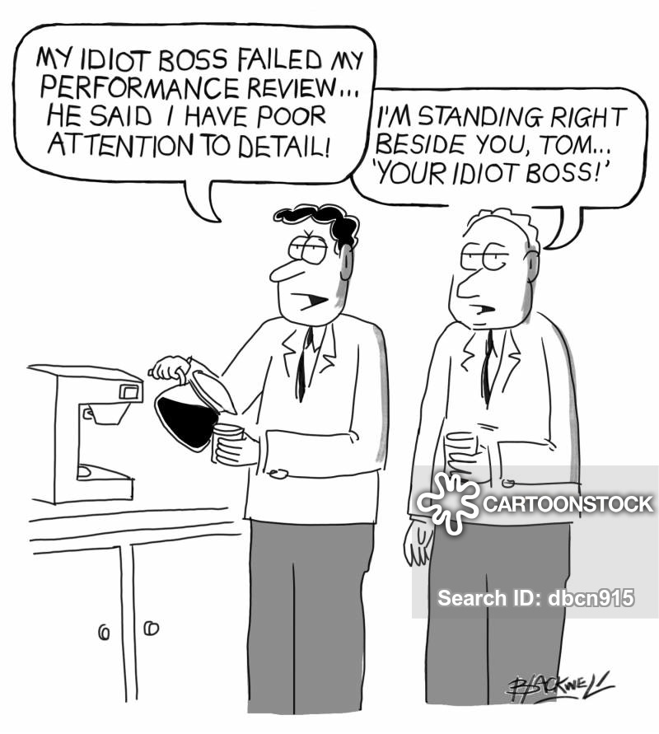
Multimodality
Affordance:

Slide 17
Multimodality
Text:
Tom: my idiot boss failed my performance review, he said I have poor attention to detail
Boss: I’m standing right beside you tom, “YOUR IDIOIT BOSS”.

Slide 18
Multimodality
Motivated sign:
Kress’ motivated sign stresses the motivation that can be traced in the relation between a sign-maker’s selection of a given form and its expression of a given meaning.
In the Saussurean structuralist tradition (rather or more than in Saussure’s original elaboration), the positing of an arbitrary relation between signifier and signified has meant a focus on language as a system (langue) and its driving forces, thus disregarding how individuals and social groups shape signs (through individual acts of parole) – and hence which systems of values and power drive their choices in doing it. In contrast, in tracing the motivation between signifier and signified, multimodal analysts can achieve insights into the sign-maker’s social, cultural and material context at the time of producing the sign. The motivated association existing between a form and a meaning in a sign is crucial to interpretation, and provides empirical grounds to multimodal analysis

Slide 19
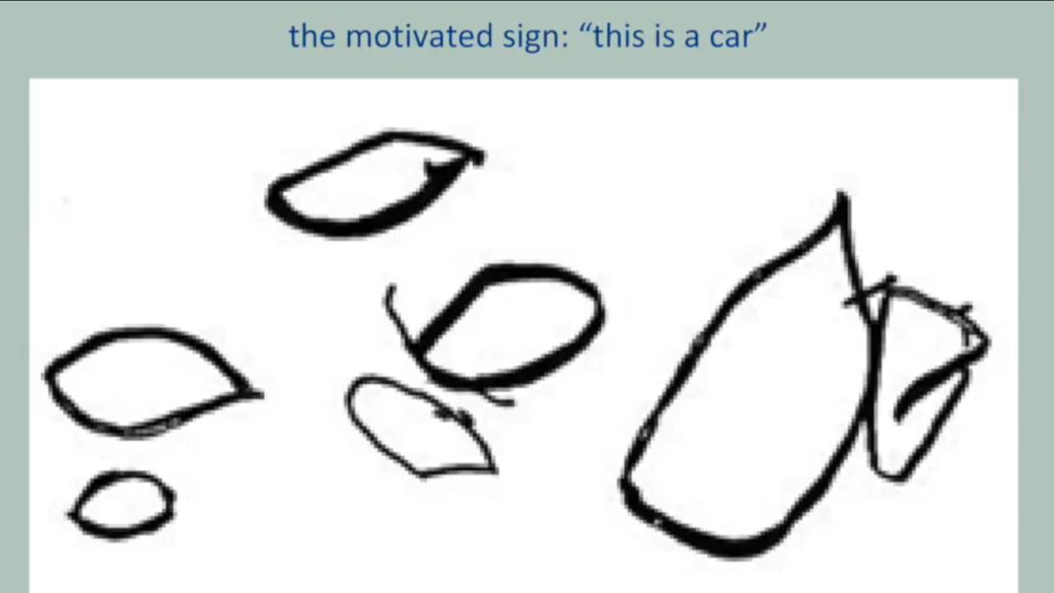
Multimodality
Example:
Notes:
Similarly example of love apple

Slide 20
Multimodality
Example:

Slide 21
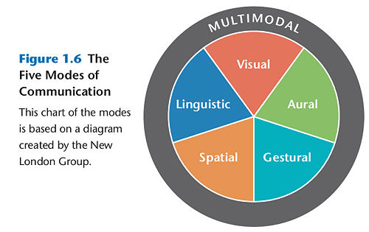
Multimodality
The grouping of certain semiotic resources is called of communication or modes of meaning. The New London Group describes modes of communication as resources that permit the design of meanings. They propose the following modes: inguistic, audio, spatial, gestural, and visual mode. Another concept in multimodality is intersemiotic relationships. It refers to how meaning is distributed across modes to the general meaning of a text.

Slide 22
Multimodality
Notes:
This also tells how diff modes communicate diff information.

Slide 23
Multimodality
Cohesion and coherence:
How different modes work together to produce coherence and make a complete “text”.

Slide 24
Diversity of learners
“one size does not fit all”
Education is not about limiting and controlling students.
Notes:
Text, videos, diagrams, tables

Slide 25
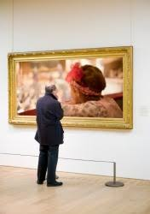
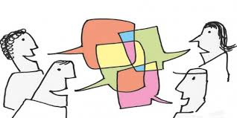
Diversity of learners

Slide 26
Digital technology:
In recent years, the social impact of digital technologies for text production, among other factors, has made more visible the fact that texts are multimodal and hence that language alone cannot suffice to explain meaning made through them. Digital technologies have reduced costs for the production of printed images and the use of colour. Their (market-led) widespread use has made available to an unprecedented number of sign-makers forms of text production that afford modes other than speech and writing. Online environments have provided sign-makers with platforms and easy-to-use interfaces for publishing their multimodal texts and distributing them to diversified audiences, thus making the phenomenon of multimodality visible to an unprecedented extent.

Slide 27
Digital technology:
The digital texts we daily engage with make meaning through the combined use of colour, writing, sound, images, and layout, at least. It is not only the case of texts that we encounter on the web, but also of “texts” that we interact with daily, to fulfill ordinary tasks in our offline environments, such as the interfaces displayed on the screens of ATM machines or those for purchasing a train ticket, for instance. This holds also for the texts that we produce; everyday communication in digital environments faces sign-makers with a wide range of modal options. The multimodal character of digital texts is also redefining the use of the resources of language (van Leeuwen 2008); writing is also increasingly developing resources for meaning-making, like those of font (van Leeuwen 2005b; van Leeuwen 2006), which are generally disregarded in linguistic studies. While speech is changing its functional load in the online homologue of face-to-face interaction, i.e., video-chats (for the phenomenon of “mode-switching” in video-chats, Sindoni 2013), the mode of image is being used for new interactive functions, as in Facebook comments, for example. Such a changed semiotic landscape contributes in essential ways to the visibility of multimodality as a phenomenon of contemporary communication, and to its usefulness as a notion that can account for contemporary meaning-making. Digital technologies provide analysts with multimodal means of recording, coding and transcribing data, such as videos and video annotation systems. When analysing a video-recorded rather than a tape-recorded face-to-face interaction, the multimodal character of the communicative event becomes more immediately manifest and what could be regarded as “context” or “contextual information” in earlier tape-recordings (something that the researcher could neither see nor handle from tape-recorded data) is now visible as meanings expressed by participants through gestures, movement, and face expressions, or through 3D objects.

Slide 28
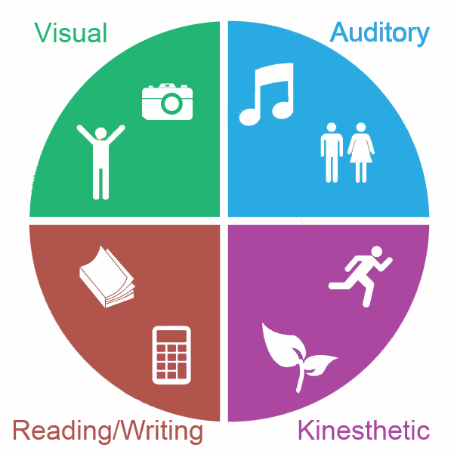
Who is a multimodal learner?
There different models to explain learning styles. One of the most popular is the VARK model, created by New Zealand teacher, Neil Fleming.
The multimodal learning style
Some people strongly prefer one of the four learning types. But many others have a shared preference among two or more types, making them multimodal learners.
Multimodal learners have a near-equal preference for different learning modes and can receive input from any of these modes. Some multimodal learners, however, are different and require multiple inputs to learn.
A multimodal learning style works most effectively with many communication inputs, or modes. A multimodal learner will thrive in a comprehensive learning environment that uses visual, auditory and kinesthetic inputs — both verbal and non-verbal — including videos, images, actions, real-life examples and hands-on activities.

Slide 29
Why is multimodal learning important?
Multimodality supports a universal design for learning by communicating concepts in the most effective ways and making sure everyone gets exactly what they need. For instance, having:
Both text and audio supports reading and hearing
Images and animation can help focus attention
Examples can aid understanding
Multimodal learning can also benefit children and improve abilities. Research from Cisco found students who were given a combination of text and visuals learned better than those who only received text inputs. Compared to the more rigid unimodal learning you might picture when you think of traditional classroom settings, multimodal learning is more effective at teaching.

Slide 30
Why is multimodal learning important?

Slide 31
Importance of multimodal analysis
Multimodal analysis can be applied to print materials (e.g., press advertisements, comic books, children’s books or text books, face-to-face interactions, or film/video. Each of these types of data requires a different method of collection, handling, and analysis, and an altered ethical approach.
Multimodal communication is central to human interactions and multimodal analysis enables a more systematic insight into how multiple modes are employed in multimodal ensembles to convey complex meanings. It is also in modes other than speech and writing that social and cultural meanings are often conveyed.
Video data provides a wealth of details for analysis in a durable and sharable form and provides scope for micro-analysis of fine-grained details.

Slide 32
Limitations:
Firstly, there is the question of how many modes to include in analysis and how much attention to pay to a single mode.
There is a danger of devoting too much attention to individual modes, which may result in too much importance being given to only one of the ways in which people make meaning.
Multimodal analysis and transcription require a lot of processing time. Time consuming and labour-intensive, the process forces a researcher to be selective in how much and what part of collected data to transcribe, which means that any further analysis is influenced by the researcher’s initial selection.

Slide 33
Conclusion:
Meanings expressed in different modes are characteristic of communities and cultures that produce them and it is within these social and cultural contexts that multimodal meanings can be analysed. Communities shape the way in which modes are commonly understood and what tools are considered to be modes.
Appropriate selection of multimodal data, data collection process and analysis provides ample opportunity for scholars working in the field

Slide 34
Done!

