Slide 1
Department of B .S Education 3^{rd semester} Course Name: Education psychology Assignment: Planning for effective teaching & Teaching large and small groups Effectively Submitted to:Mam Hina Zahra Submitted by: Ahmar Ali &M.saqib &Syed Gazafar abbas University of sarghodha sub campus bhakkar

Slide 2
* Effecting Teaching
Because of the complexity of teaching and individual variation among students effective teaching is not “ one size fits all.” Teachers must master a variety of perspectives and strategies and be flexible in their application. Successes requires the following key ingredients:(1) professional knowledge and skills, and (2) commitment, motivation, and caring.

Slide 3
*Professional knowledge and skill
Effective teacher have good command of their subject matter and a solid core of teaching skills. The know how to use instructional strategies supported by methods of goal setting, instructional planning, and classroom management. In addition, they understand how to motivate students and how to communicate and work effectively with those of varying skill levels and culturally diverse backgrounds. Effective teachers also employ appropriate levels of technology in the classroom.

Slide 4
* Thinking skill
Effective teachers model and communicate good thinking skills, especially critical thinking, which involves thinking reflectively and productively and evaluating the evidence. Getting students to think critically is not easy; many students develop a habit of passively learning material and rotely memorizing concepts rather then thinking deeply and reflectively. Thinking critically also means being open-minded and curious on the one hand, yet being careful to avoid key mistakes in interpretation on the other.

Slide 5
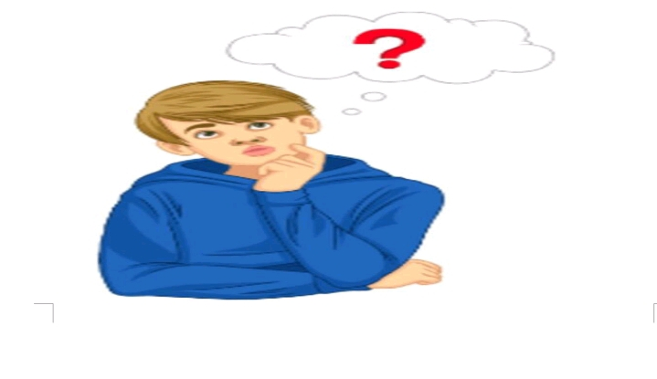
Throughout this book we will encourage you to think critically about topics and issues. At the end of each main section in a chapter, you will be asked” reflect” questions related to the topic about which you have read. In chapter 9 you will read more extensively about critical thinking and other higher-level cognitive processes such as reasoning, decision making, and creative thinking, and you will learn how to encourage critical thinking in your students by building it into yours lesson.

Slide 6
* Classroom Management skill
An important aspect of being an effective teacher is keeping he class as a whole working together and oriented toward classroom tasks. Effective teachers establish and maintain an environment in which learning can occur. To create this optimal learning environment, teachers need a repertoire of strategies for establishing rules and procedures, organizing groups, monitoring and pacing classroom activities, and handling misbehavior.

Slide 7
Motivational Skills Effective teachers have good strategies for helping students become self-motivated and take responsibility for their learning. Educational psychologists increasingly stress that this is best accomplished by providing real-world learning opportunities of optimal difficulty and novelty for each student. Students are motivated when they can make choices in line with their personal interests. Effective teachers give them the opportunity to think creatively and deeply about projects.
*Motivational skill
Effective teachers have good strategies for helping students become self-motivated and take responsibility for their learning. Educational psychologists increasingly stress that this is best accomplished by providing real-world learning opportunities of optimal difficulty and novelty for each student. Students are motivated when they can make choices in line with their personal interests. Effective teachers give them the opportunity to think creatively and deeply about projects.

Slide 8
In addition to guiding students to become self-motivated learners, teachers need to establish high expectations for student’s achievement. Too often children are rewarded for inferior or mediocre performance with the result that they do not reach their full potential. When high expectations are created, however, a key aspect of education is to provide children___especially low-achieving children__ with effective instruction and support to meet these expectations.

Slide 9
*Communication skill
Also indispensable to teaching are skills in speaking, listening, overcoming barriers to verbal communication, tuning in to student’s nonverbal communication, and constructively resolving conflicts. Communication skills are critical not only in teaching but also in interacting with parents. Effective teachers use good communication skills when they talk “with” rather than “ to” students, parents, administrators, and other; keep criticism at a minimum; and have an assertive rather than aggressive, manipulative, or passive communication skills as well. Student communication skills are especially important because they have been rated as the skills most sought after by today’s employers.

Slide 10
*Technology skill
Technology itself does not necessarily improve students’ ability to learn, but it can support learning. Conditions that support the effective use of technology in education include vision and support from educational leaders; teachers skilled in using technology for learning; and an emphasis on the child as an active, construction learner. There is a profound gap between the technology knowledge and skills most students learn in school and those they need in the twenty_ first_ century workplace. Students will benefit from teachers who increase their technology knowledge and skills, and integrate computers appropriately into classroom learning. This integrated should match up with student’s learning needs including the need to prepare for tomorrow’s jobs, many of which will require technology expertise and computer-based skills.
Technology skills Technology itself does not necessarily improve students’ ability to learn, but it can support learning. Conditions that support the effective use of technology in education include vision and support from educational leaders; teachers skilled in using technology for learning; and an emphasis on the child as an active, construction learner. There is a profound gap between the technology knowledge and skills most students learn in school and those they need in the twenty_ first_ century workplace. Students will benefit from teachers who increase their technology knowledge and skills, and integrate computers appropriately into classroom learning. This integrated should match up with student’s learning needs including the need to prepare for tomorrow’s jobs, many of which will require technology expertise and computer-based skills.

Slide 11
2: Teaching small and large groups effectively
Small group
Define
Small group teaching is not defined by numbers. We define it as any teaching situation in which dialogue and collaboration within the group are integrated to learning. The teacher is still key to this learning. But now their role is to facilitator rather than to direct, to coordinate as much as to communicate, to inspire rather than inform.

Slide 12
*A Manifesto for small group teaching
* Flexibility
Small group teaching opens up education spaces that are processed, dynamic, and responsive. The skill of the teacher is to use these spaces creatively, developing an awareness f the students and responding to the group’s learning as it develop.Teaching small groups underscores the literative and dynamic nature of all good teaching and learning, and the value of being open to.

Slide 13
* Reflexivity
We want our teachers to be many things. Authentic, human, honest, inspiring. We can never live up to such lofty expectation. But we can developed our own teaching personal, and bring a self-critical modesty to everything we do

Slide 14
* Engagement
Small group teaching cultivates creativity, passion and enthusiasm. It should hopefully expose students to current debates and offer them an opportunity to develop their own academic identity. At best it transcend the teacher-learner hierarchy, and becomes a process of learning together.

Slide 15
*How to Encourage student participation
Use questions more effectively
Be aware of learning styles of students
Try some ideas for active learning in small group
Use task group (e.g. discuss a video)
Use open question
Use peer education groups
Use role play and simulation

Slide 16
*Your student should know about small group teaching
Preparation matters
The rules of engagement
The importance of listening
Asking the right questions
Learning is a social process
Writing and thinking go hand in hand
Taking feedback seriously
Giving feedback responsibly

Slide 17
*Words of wisdom about small group teaching
Be kind
Be prepared Be enthusiastic
Be open
Be honest
Be inclusive
Be reflective

Slide 18
* Large group
Define
The large group, lecture format is often synonymous with what most people think of university studies. Faced with a room of more than one hundred students, promoting active learning in the large lecture theatres is a challenge most academic are likely to face. It is no surprise that this poses particular concern with research showing that student attention span can decline after 10 to 15 minutes.

Slide 19
* Introduction to large group teaching
Motivational context
Learner activity
Interaction with others
A well structured knowledge base

Slide 20
Structuring the lecture of large group
The learner should have
Beginning: tell them what you are going to tell them (introduction)
Middle: tell them it (body)
Endings: remind them what you have told them

Slide 21
*Communication issues in the lecture
Try to keep eye contact with as many of the group as possible.
Make strategies use of silences.
Vary your tone of voice
Consider going up and down the aisles.
Make sure you are heard
Mannerisms, heard you voice
Use of humour – if you are comfortable with this.

Slide 22
* Idea for active learning in large groups
With a large group setting, active learning can be encouraged in:Individual or pairs of students in a large Lecture Groups of students in a large Group

Slide 23
* Individual or pairs of a student in large group
Silent reflection
Write down answer to a question
Swap answer with person beside
Take a short test
Write down a question
Solve a problem
Read some notes
In pairs, discuss an issue
Write a plan what you need to do
Summaries the main points

Slide 24
* Conclusion
The assessment of student achievement, or understanding what students know and can do, is fundamental to effective teaching and to students’ learning. Unless teachers know students well and are knowledge about their achievements, they cannot be confident that they are meeting the learning needs of their students. Large group teaching and learning is essentially a one way process, while small group teaching is more focused, interactive, and leads to the development of concepts/principles

