Slide 1
Soil Formation
Pedogenesis

Slide 2
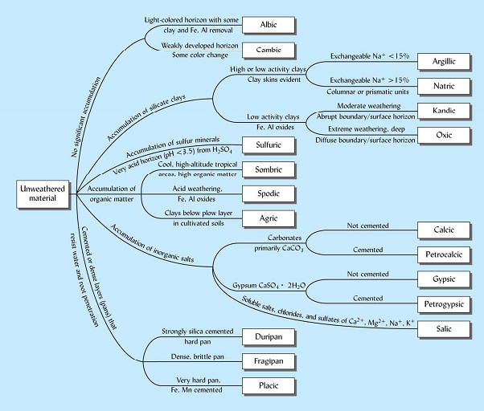

Slide 3
The pedogenic processes
Term | Brief definition
Eluviation | Movement of material out of a portion of a soil profile as in an albic horizon.
Illuviation | Movement of material into a portion of soil profile as in an argillic or spodic horizon.
Leaching (depletion) | General term for washing out or eluviating soluble materials from the solum.
Enrichment | General term for addition of materials to a soil body.
Erosion, surficial | Removal of material from the surface layer of a soil.
Cumulization | Aeolian & hydrologic addition of mineral particles to the surface of a soil solum.

Slide 4
Term | Brief definition
Decalcification | Reactions that remove calcium carbonate from one or more soil horizons.
Calcification | Processes including accumulation of calcium carbonate in C_{Ca} & possibly other horizon of a soil.
Salinization | The accumulation of soluble salts such as sulfates & chlorides of Ca, Mg, Na & K in salty (salic) horizons.
Desalinization | The removal of soluble salts from salic soil horizons.
Alkalization (Salonization) | The accumulation of Na ions on the exchange sites in a soil.
Dealkalization (Solodization) | The leaching of the Na ions & salts from nitric horizons.

Slide 5
Term | Brief definition
Lessivage | The washing in suspension of fine clay & lesser amounts of coarse clay & fine silt down cracks & other void in a soil body.
Pedoturbation | Biological & physical (freeze-thaw & wet-dry cycles) churning & cycling of soil materials, thereby homogenizing the solum in varying degrees.
podzolization | The chemical migration of aluminum & iron & organic matter, resulting in the concentration of silica (ie. silication) in the layer eluviated.
laterization (desilication, feralization, ferritization, allitization). | The chemical migration of silica out of the soil solum & thus the concentration of sesqsuioxides in the solum (goethite, gibbsite, etc.), with or without formation of ironstone (laterite, hardened plinthite) & concretions.

Slide 6
Term | Brief definition
decomposition | The breakdown of mineral & organic materials.
synthesis | The formation of new particles of mineral & organic species.
melanization | The darkening of light colored mineral, initially unconsolidated materials by admixture of organic matter (as in a dark Al or mollic or umbric horizon).
leucinization | The paling of soil horizons by disappearance of dark organic materials either through transformation to light colored ones or through removal from the horizons.

Slide 7
Forms and agents of Pedoturbation
Form of pedoturbation | Soil-mixing agents
Aeroturbation | Gas, air, wind
Anthroturbation | Humans
Aquaturbation | Water (rain splash, eluviation/illuviation processes)
Argilliturbation | Shrinking and swelling of clays
Cryoturbation | Freeze-thaw activity, ice crystals
Crystalturbation | Crystals, such as ice and various salts

Slide 8
Form of pedoturbation | Soil-mixing agents
Faunalturbation (Bioturbation) | Animals, including insects
Floralturbation (Bioturbation) | Plants
Graviturbation | Mass movements, such as creep
Impactturbation | Extraterrestrial impacts such as comets and meteorites, and human-generated impacts, that is, artillery shells and bombs
Seismiturbation | Earthquakes

Slide 9
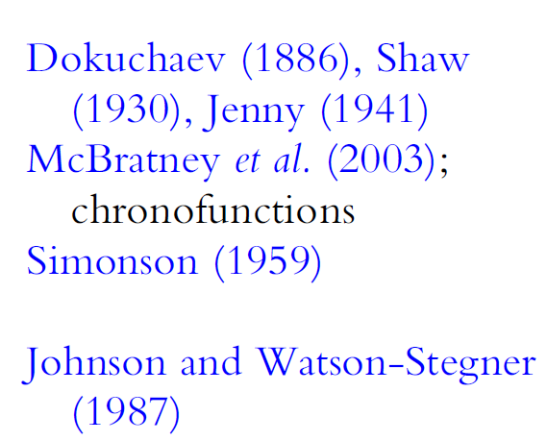
Summary of models of soil formation

Slide 10
Soil formation
Soils are formed from rock, loose unconsolidated materials (may be transported), or organic residues.
Two processes of soil formation:
Weathering
Horizon development.

Slide 11
Soil formation
Weathering of soil minerals:
Physical and chemical breakdown of rock unable to support plant life to smaller size material able to support plants.
During chemical weathering, primary minerals are dissolved and form secondary minerals.

Slide 12
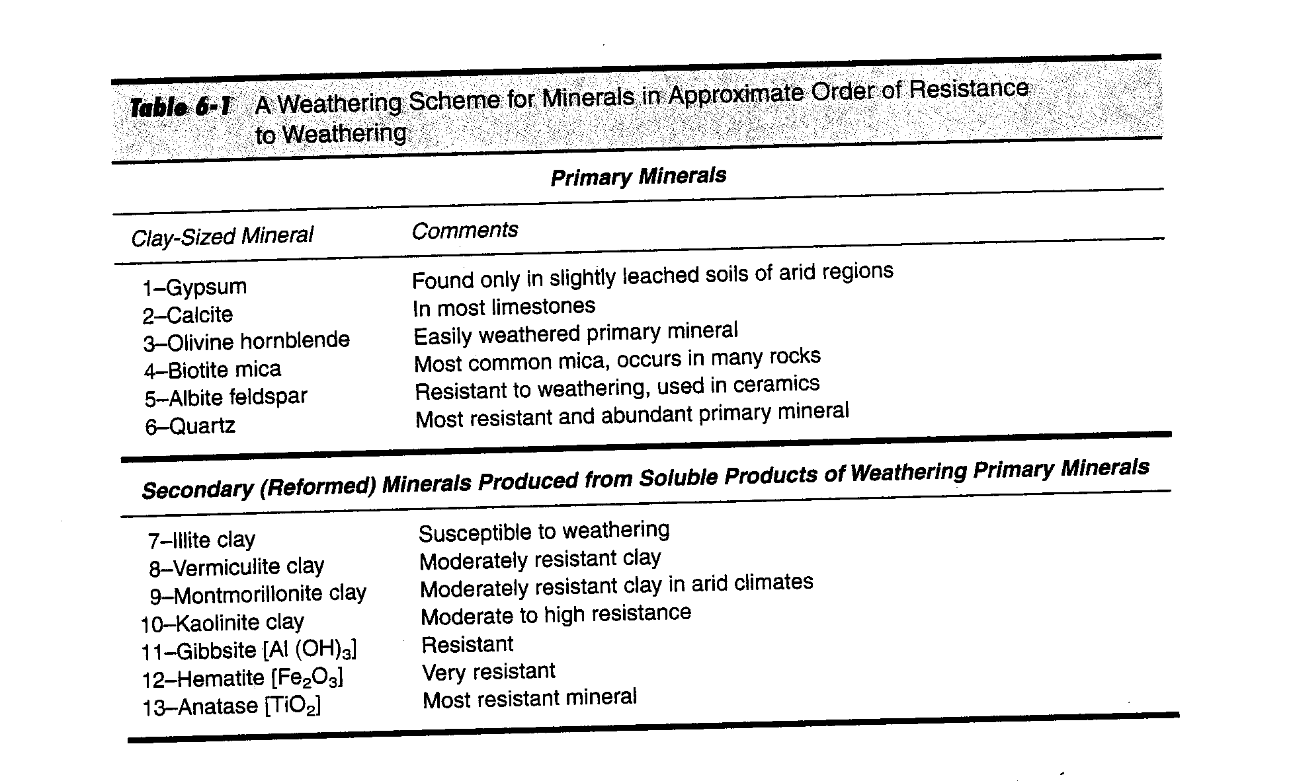

Slide 13
Soil formation
Chemical weathering of soil minerals:
This is accomplished by:
Hydrolysis (H+ and OH- from water)
Hydration (taking on water)
Carbonation (carbonic acid)
Organic acids (which are very important and effective because they chelate)
Oxidation and reduction (losing or gaining of electrons).

Slide 14
Soil formation
Weathering of soil minerals:
Soluble products of weathering (such as Na,
Si, Ca, K HCO₃⁻) leach away, less soluble products (like Fe₂O₃) stay behind.

Slide 15
Soil formation
Soil formation is defined as the physical and chemical changes in this weathered material.
These include:
Additions of organic matter
Losses of materials due to leaching
Translocation of clays and dissolved materials from one horizon to another
Transformations within horizons. (Wait to list these below)
These are collectively called Soil Formation. Horizons (layers) result from soil formation.

Slide 16
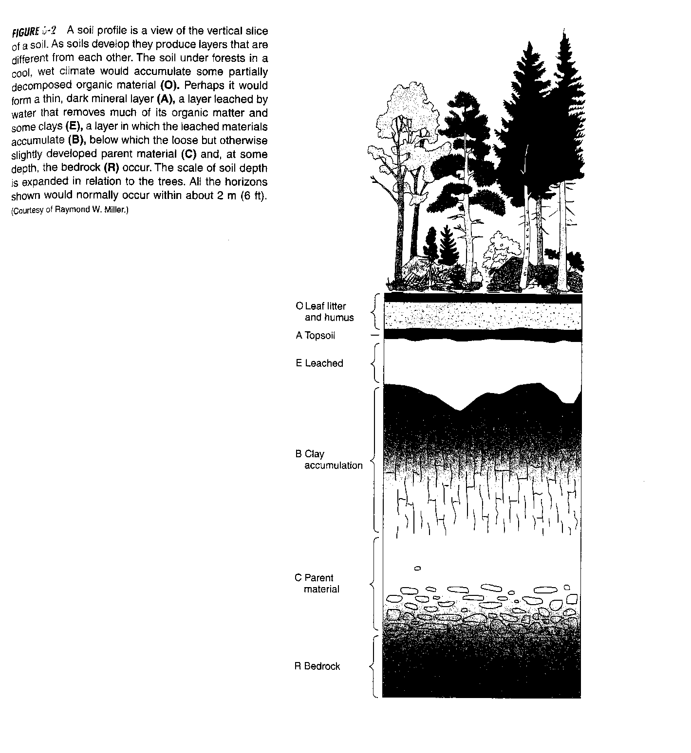

Slide 17
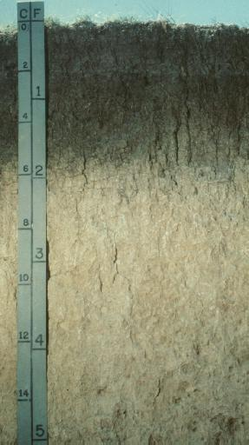
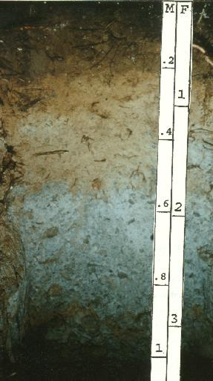
Photo of soil profile
Inceptisol Mollisol

Slide 18
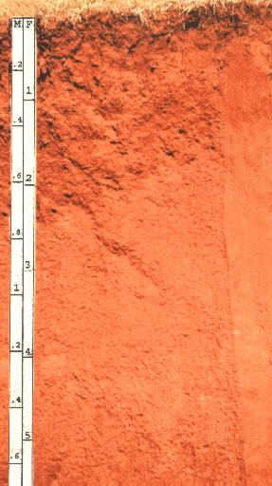
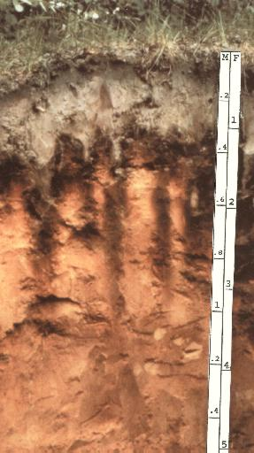
Photo of soil profile
Oxisol Spodosol

Slide 19
Pedogenic (soil forming) processes:
Think of what would happen if you took a sand, silt, and clay parent material fresh from a borrow pit and put it out and left it for 10,000 years in:
1) boreal forest,
2) temperate forest,
3) grassland,
4) desert,
5) tropical forest.
What kinds of processes would affect the development of these materials into soils?

Slide 20
Pedogenic (soil forming) processes:
1) Additions (organic matter, particles, dust, chemicals) from:
Water (rain and irrigation)
Sediment from wind (aeolian deposition resulting in loess deposits) and water (alluvium)
Organic matter (most important addition)

Slide 21
Pedogenic (soil forming) processes:
2) Losses
Leaching of chemicals organic matter, and ions
Erosion
Gaseous (organic matter, N, S; especially during fire and in in flooded soils for N and S)

Slide 22
Pedogenic (soil forming) processes:
3) Tranformations (within horizons):
Dissolution and precipitation
Organic matter decay and stabilization

Slide 23
Pedogenic (soil forming) processes:
4. Translocation
Movement of clays, organic matter, dissolved ions (Fe, Al) from one horizon to another

Slide 24
Factors of soil formation

Slide 25
Factors of soil formation
1) Parent material:
Especially important in early soil development, less so in older soils.
Influences nutrients (other than N) by both total content and rate of weathering
Influences initial texture (particle size dist).

Slide 26
Factors of soil formation
1) Parent material:
Examples: granitic rock, glacial till, lacustrine clay, mixed colluvium, limestone.
Landforms: characteristic mineral or organic masses (e.g., mesa, butte, plateau, plain, terraces, etc).
More on landforms later

Slide 27
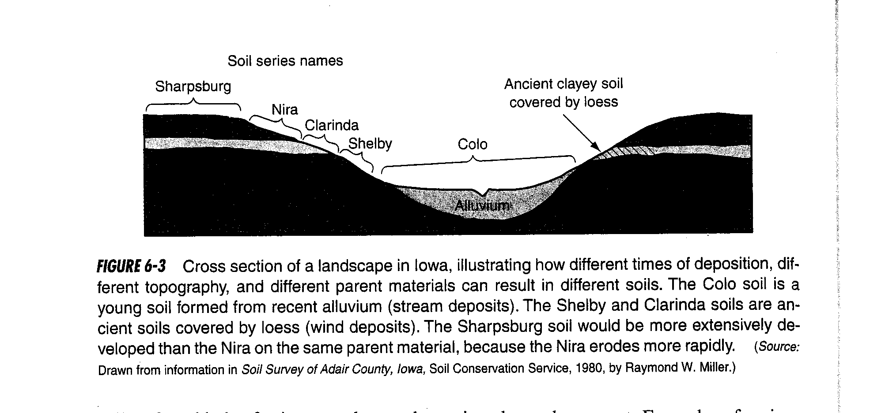

Slide 28
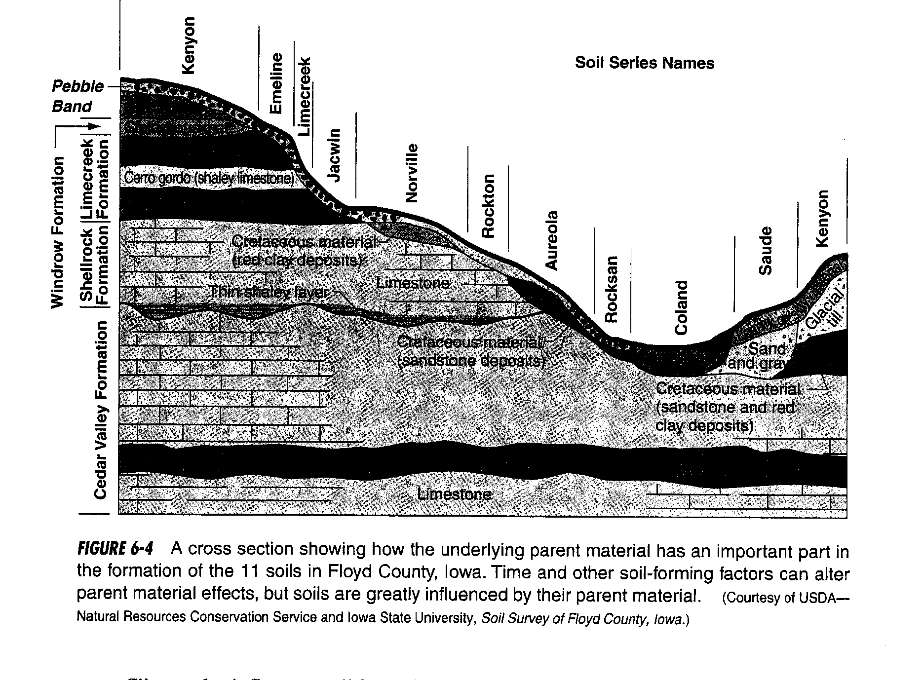

Slide 29
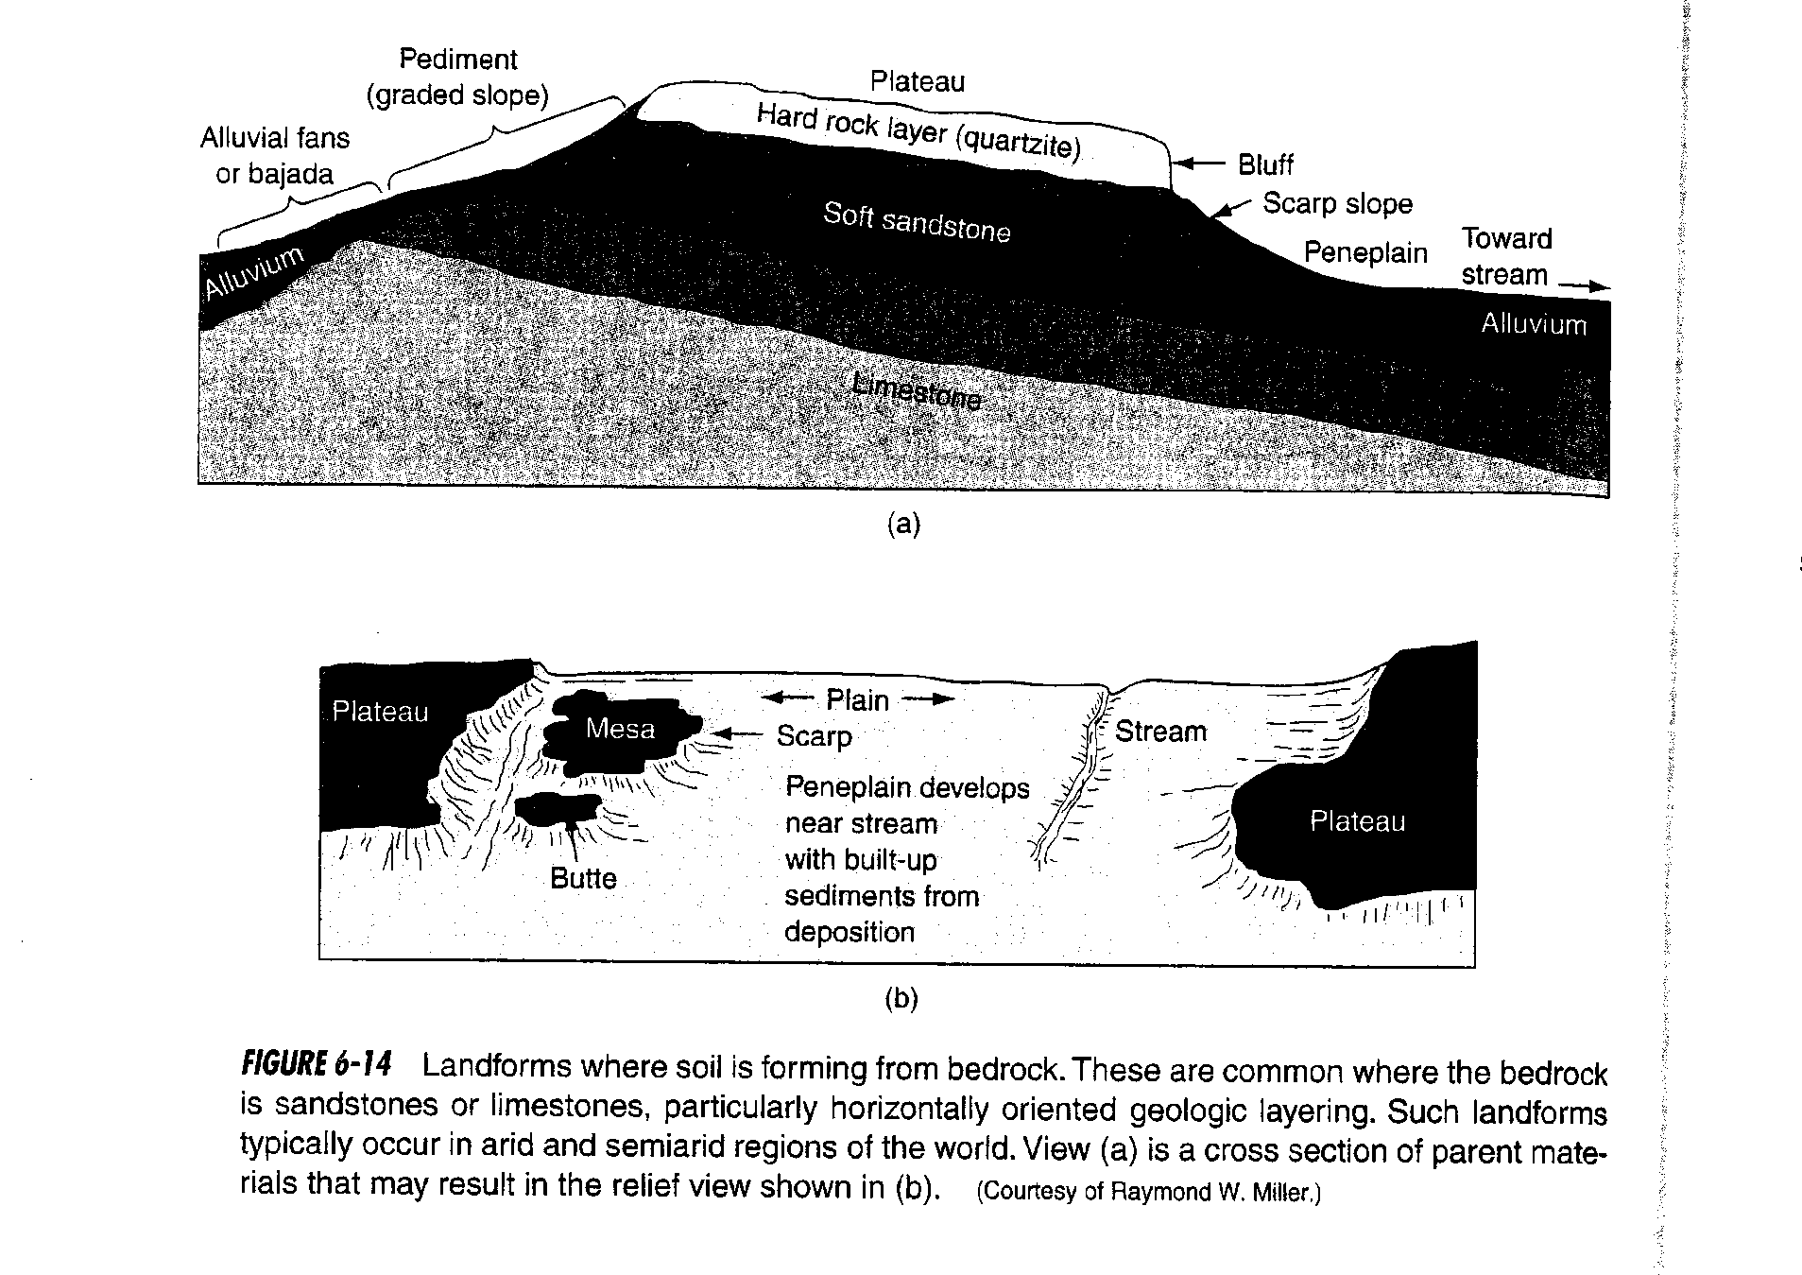

Slide 30
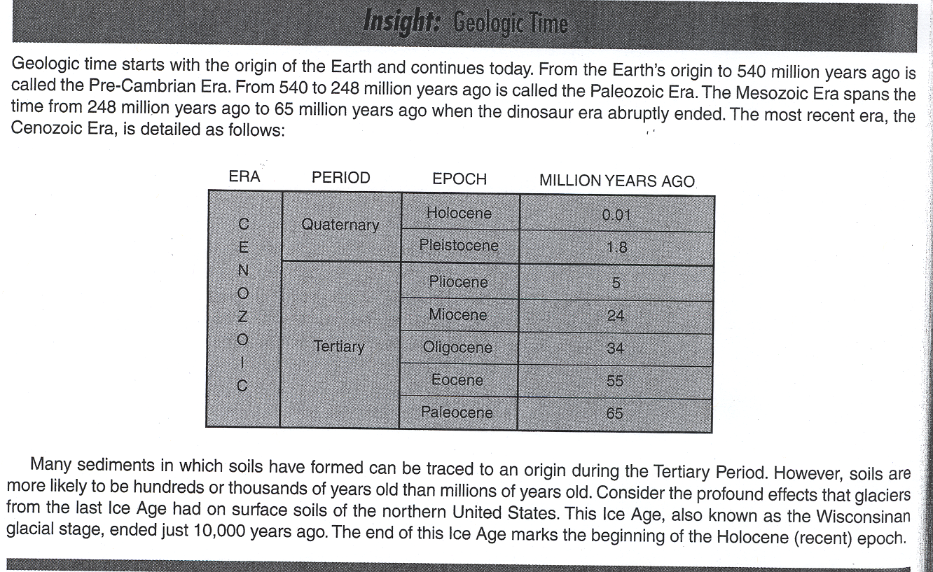

Slide 31
Factors of soil formation
2) Climate
A. Influences chemical weathering: rainfall rate affects dissolution and leaching
Accumulation of carbonates and salts in arid soils (calcareous or alkaline soils).
A result of low water availability
For example: dissolved calcium and sulfate precipitate to form calcium sulfate (gypsum):
Ca²⁺ + SO₄²⁻ → CaSO₄

Slide 32
Factors of soil formation
2) Climate
A. Influences chemical weathering: rainfall rate affects dissolution and leaching
2. Acidic soils from high leaching rates.
-Dissolution (carbonates, easily weatherable minerals)
-Carbonic acid production (acidifying):
Carbon dioxide + water forms carbonic acid:
CO₂ + H₂O ----> H₂ CO₃
Carbonic acid dissociates to hydrogen and bicarbonate:
H₂ CO₃ → H⁺ + HCO₃⁻

Slide 33
Factors of soil formation
2) Climate
B. Influences physical weathering
Erosion
Colluviation (downslope movement)
Stronger in warm regions than in cold regions.
Important after fire – Gondola example

Slide 34
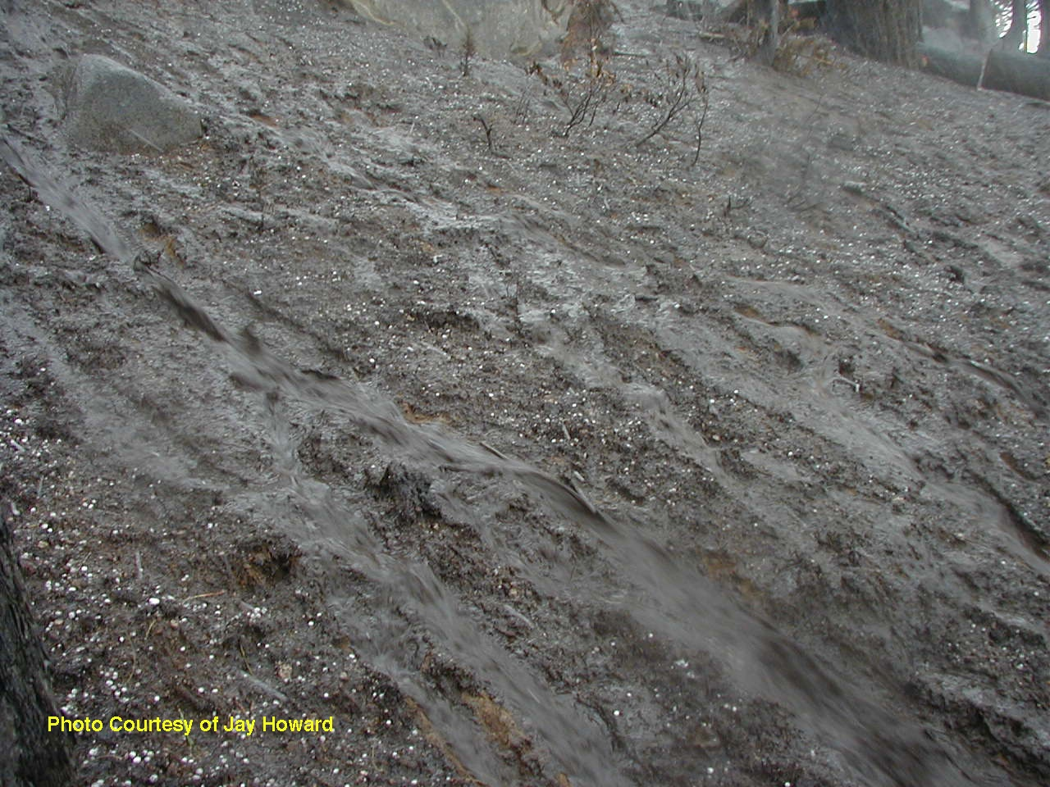
Erosion on the burned areas of the Gondola fire during a thunderstorm 3 weeks later. (Note the hail on the ground)
Note the tan streaks in rills – after the storm, this soil layer was dry enough to throw dust!

Slide 35
Factors of soil formation
2) Climate
B. Influences physical weathering
Not in book:
-temperature fluctuations
-frost cracking

Slide 36
Factors of soil formation
2) Climate
C. Influences organic matter indirectly via plant productivity and decomposition

Slide 37
Factors of soil formation
3) Biota
Influences the rate and nature of organic inputs:
High inputs in tropical forests
Low in deserts.
Organic matter accumulation rates vary with climate

Slide 38
Factors of soil formation
3) Biota
Islands of fertility in deserts caused by far-separated plants (photo)
Tree roots breaking rocks
Burrowing animals (esp. earthworms)
Micro-organisms (extremely important)
Lichens: symbiotic relationship between algae and fungi, first to colonize rocks

Slide 39
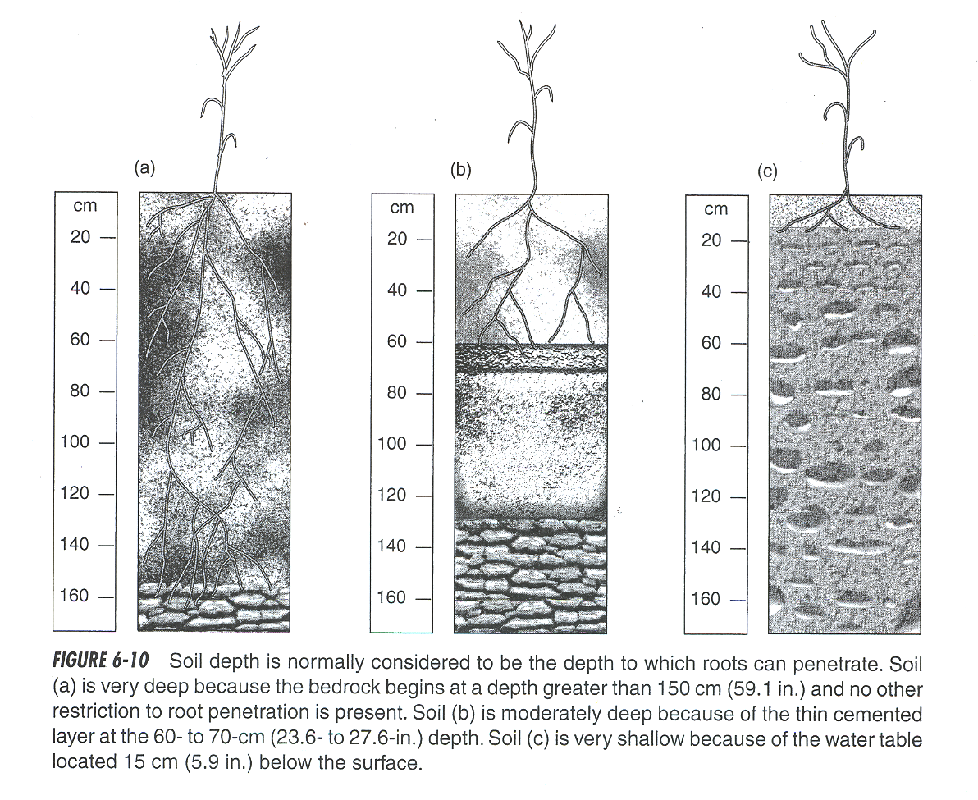

Slide 40
Factors of soil formation
4) Topography:
Aspect and temperature
Drainage, precipitation, redox potential.
Erosion, alluvial, colluvial activity (Figures 6-20, 6-21)
Slide Mountain example

Slide 41
Factors of soil formation
5) Time
Soil development may occur in less than 200 years in humid climates, but can continue for thousands.
Rate of development depends upon intensity of climate and biota factors and weatherability of parent materials.

Slide 42
Factors of soil formation
Interactions of soil forming factors
Low rainfall: low leaching --> calcareous, salt buildup, high pH; low production --> low SOM
High rainfall: high leaching --> loss of CaCO3, base cations, acidification more horizon buidups; high production ---> higher SOM, less patchy.

Slide 43
Factors of soil formation
Factors that may retard soil development:
1. Low rainfall
2. Low RH
3. High CaCO3 content (soil materials less mobile)
4. Sandy parent material (often ends up as Entisol)
5. High clay (poor aeration, slow water movement).
6. Resistant parent material (quartzite)
7. Steep slopes - lots of erosional renewel

Slide 44
Factors of soil formation
Factors that may retard soil development:
8. High water tables (slow leaching, decomp).
9. Cold temps (low biota, slow chemical reactions)
10. Constant deposition (like steep slopes, alluvial, aeolian deposits)
11. Severe wind or water erosion (similar to 10)
12. Mixing by animals (but can also create mollisols)
13. Toxics - serpentine, etc.

Slide 45
Paleosols (Ancient soils):
Soils formed under previous climate, vegetation. Mostly during the Quarternary (since beginning of last ice age)
Relict soils: exposed paleosols, quite different from those currently exitsing. Example: near Ultisols in the middle of aridisols near Pyramid lake
Fossil soils: Relict soils that are buried and preserved.

Slide 46
Paleosols (Ancient soils):
¹⁴C dating: ¹⁴C/¹²C ratio in atmosphere is constant until bomb testing in the 60’s.
¹⁴C decays to 1⁴N, emitting beta.
1/2 life of ¹⁴C is 5568 yr

Slide 47
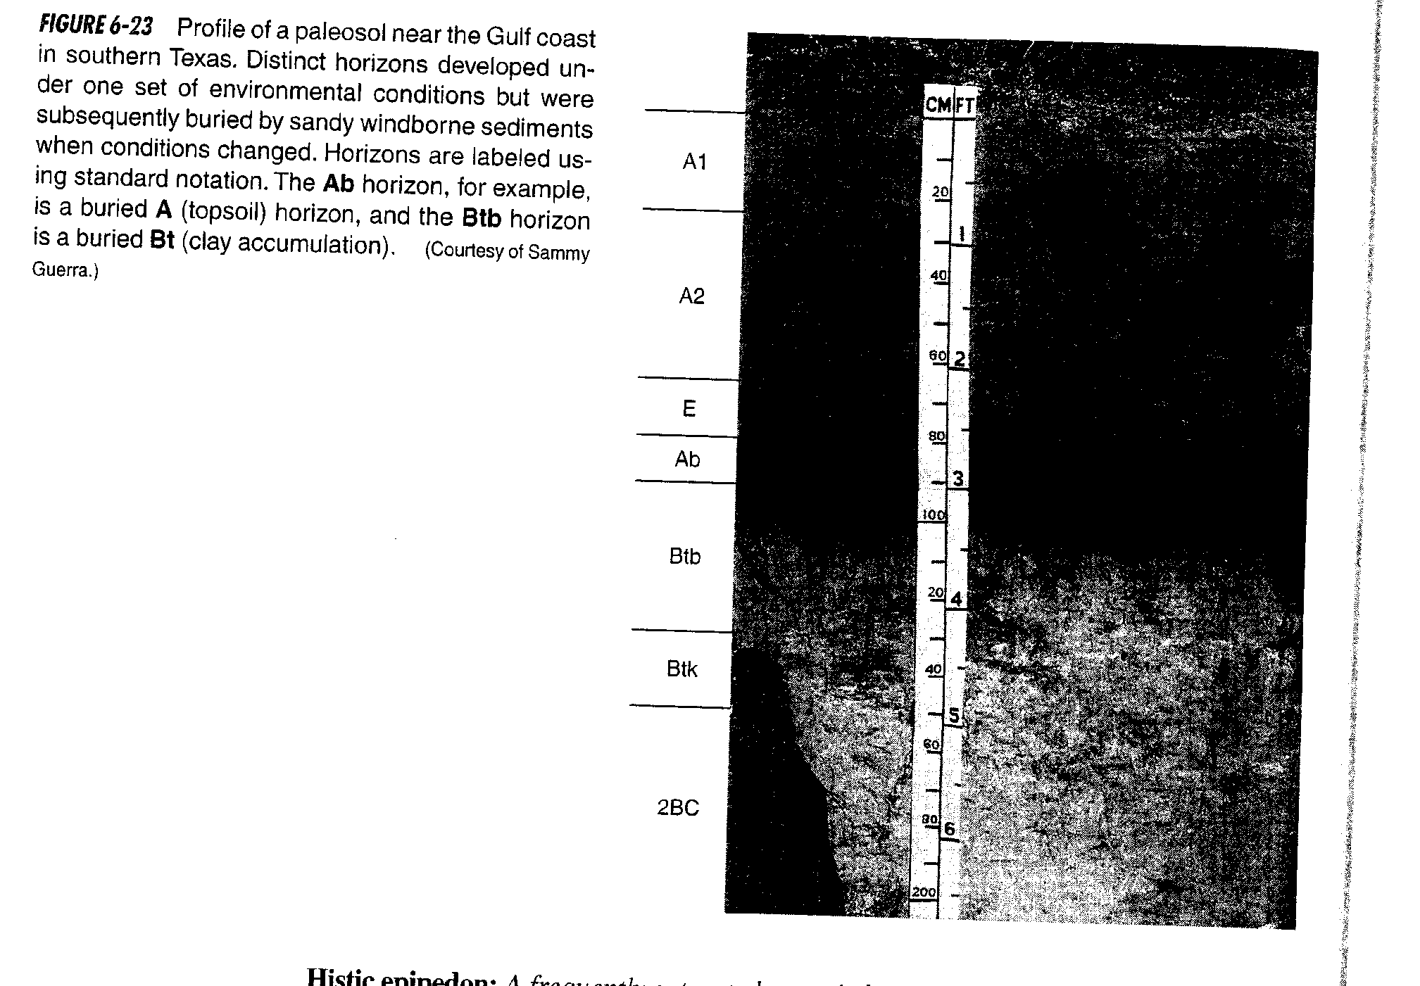

Slide 48
Landforms and soil development
Different parent materials often have a distinctive landform.
“Most soils form on rocks in place (residual soils).”

Slide 49
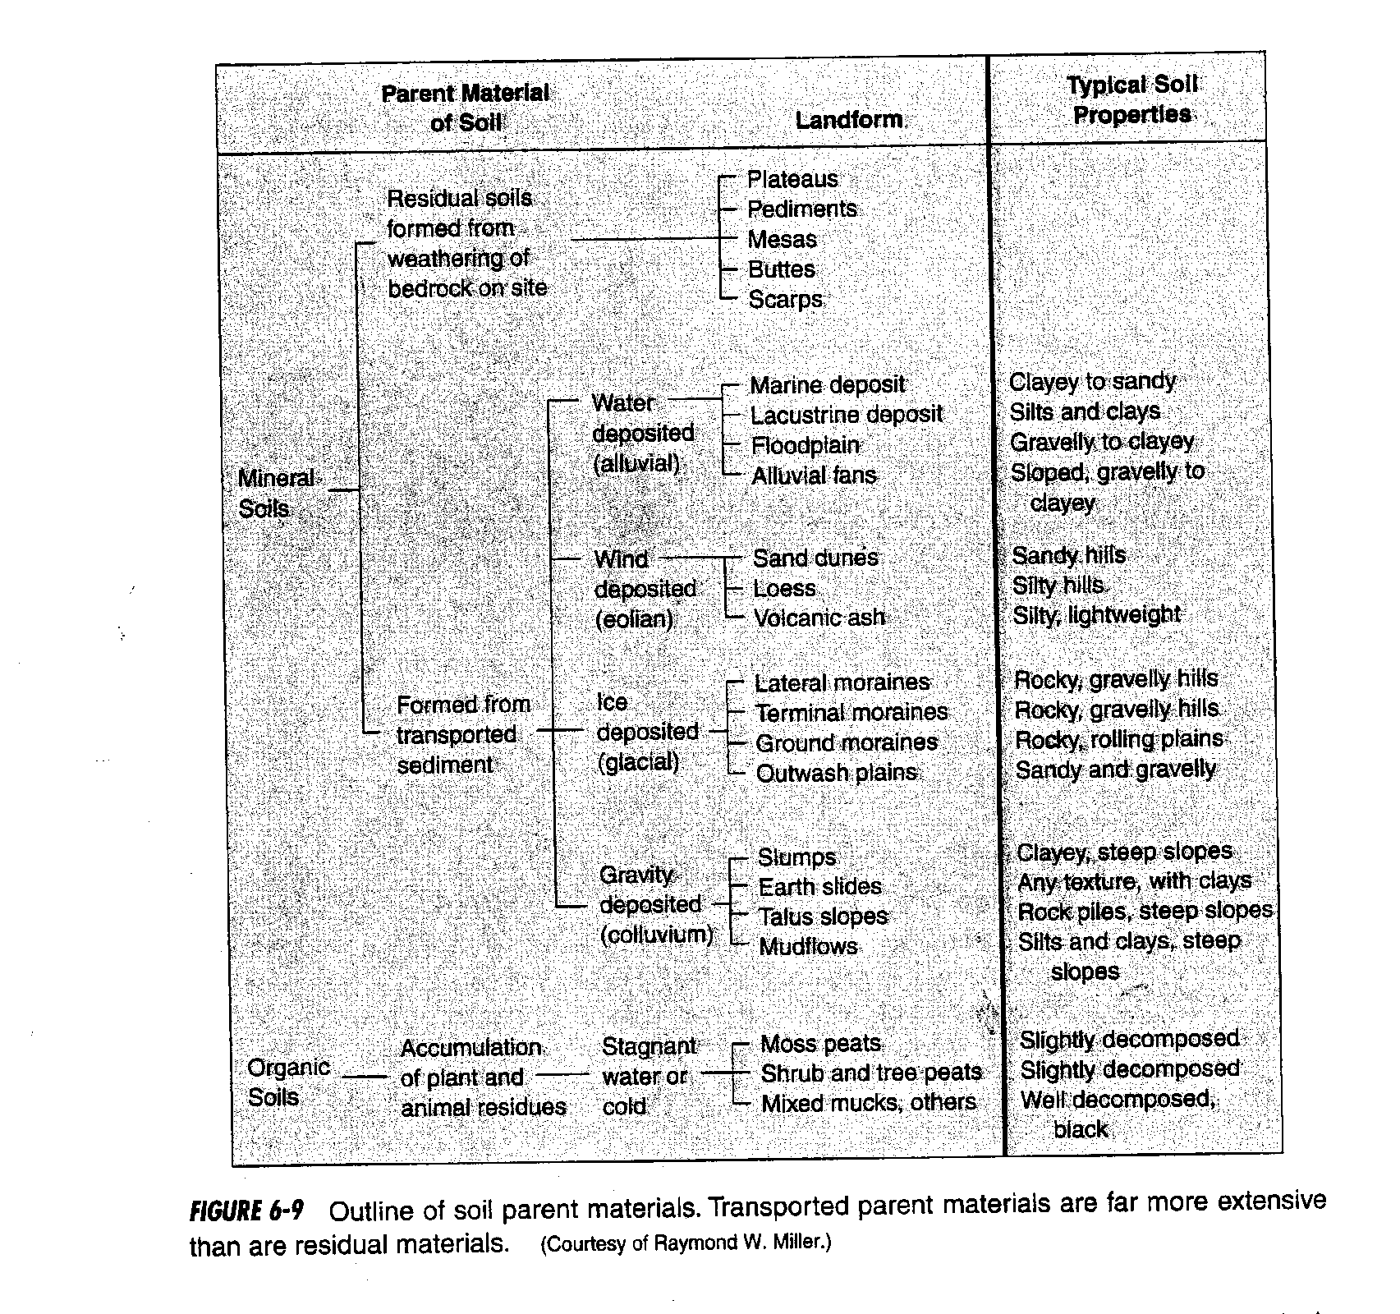

Slide 50
Landforms and soil development
Erosion tends to level off parent rock and leave a layer of soil behind.
This landform is called a pediment.
Water then can cut these up, leaving behind plateaus (large flat areas) or mesas (smaller flat areas) or buttes (even smaller areas).
These are cut up with bluffs and scarps on the sides.

Slide 51
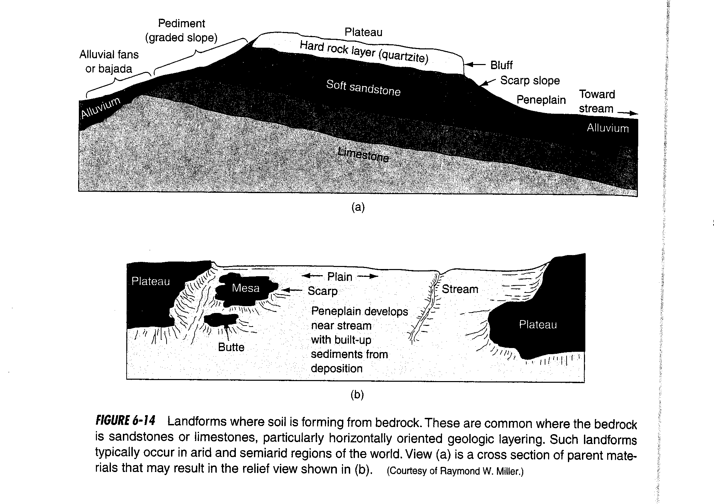

Slide 52
Materials deposited by water are called alluvium.
Floodplains: low flat deposits (floods)
River Terraces: Somewhat less flat areas deposited by rivers at flood stage or in previous channels.
Alluvial Fans: Not flat; material carried down mountain canyons land left during flood events.
Bajadas: Coalesced alluvial fans at base of mountains

Slide 53
Materials deposited by water are called alluvium.
Peneplains: Nearly level areas near streams from low flooding.
Playa: Dried up lake bed (lacustrine deposit)
Marine Sediments: make up limestone and dolomite deposits, beaches, deltas

Slide 54
Materials deposited by winds are Aeolian deposits:
Fine silts, sands, clays.
A lot of this during the last glacial period forming loess soils.
Loess soils in the midwest are some of the best for farming because of optimal particle size (silt)
Also much aeolian activity in desert systems today.
You have seen this in Nevada; good examples near Honey Lake and Washoe Lake, for example.

Slide 55
Materials deposited by ice:
Ice sheet during Pleistocene.
Glacial till: general name for glacial deposits.
Terminal moraine: ice melted as fast as it formed, leaving a sort of dike
Lateral moraine: On the sides of glacier, melting and deposition
Ground moraine: ice melted faster than it formed, leaving a flatter deposit from material within the ice.

Slide 56
Materials deposited by ice:
Outwash plains: near edges of glaciers, water borne.
Eskers: tunnels beneath the ice, filled up with sand and other deposits.
Kettle: block of ice left, sediment washed around it, then ice melted leaving a hole.
Erratics: large boulders left behind.
Basal till: book failes to mention this. It is what was under the ice and very compacted (cement-like). Holds water.

Slide 57
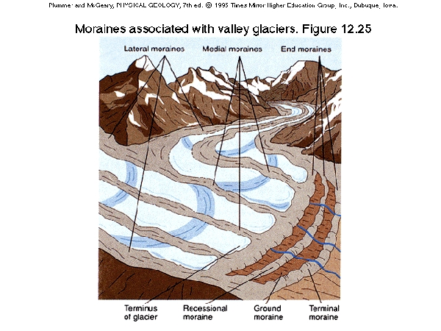

Slide 58
Sediments moved by gravity are called colluvium
Talus: rocky material
Soil creep: slow movement
Solifluction: slow movement (few cm per day)
Debris flow, mudflow, earthflow: self-explanatory.
Avalanche: rapid flow

Slide 59
Development of soil horizons
Think again of what would happen to our parent materials laid out in different climates.
Materials move downward, forming
Soil layers that are often approximately parallel with the soil’s surface.
Boundaries can be abrupt (distinct) or indistinct
Boundaries can also be smooth (even thickness) or tonguing
Horizons form by physical and chemical movement, sometimes also by animals (Mollisols).

Slide 60
Oxisol Spodosol
Photos courtesy of USDA NRCS, National Survey Center
http://www.statlab.iastate.edu/soils/photogal/orders/soiord.htm

Slide 61
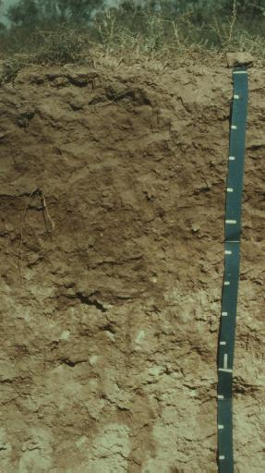
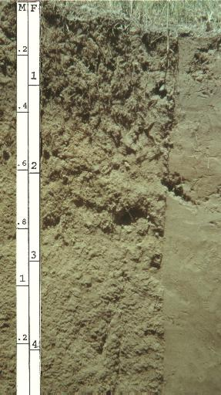
Aridisol Entisol
Photos courtesy of USDA NRCS, National Survey Center
http://www.statlab.iastate.edu/soils/photogal/orders/soiord.htm

Slide 62
Inceptisol Mollisol
Photos courtesy of USDA NRCS, National Survey Center
http://www.statlab.iastate.edu/soils/photogal/orders/soiord.htm

Slide 63
Soil Horizons:
Letters are used to designate horizons: A,B,C,R.
Capitals are master horizons
Small letters are suffixes for characteristics of master horizons (e.g., Bt)
Arabic numerials after master indicate vertical subdivisions
Arabic numerals before master indicate discontinuities (i.e., buried horizons)

Slide 64
Horizons (layers) result from soil formation.
Basic soil profile
Horizon Characteristics
O Organic (litter)
A Mineral soil high in organic matter
and/or
E Eluviated (leached, loss of clay)
B Accumulation (Fe, Al oxides, clay)
C Fractured parent material

Slide 65
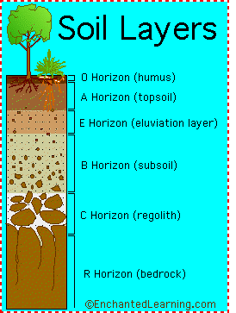
Photo of soil profile

Slide 66
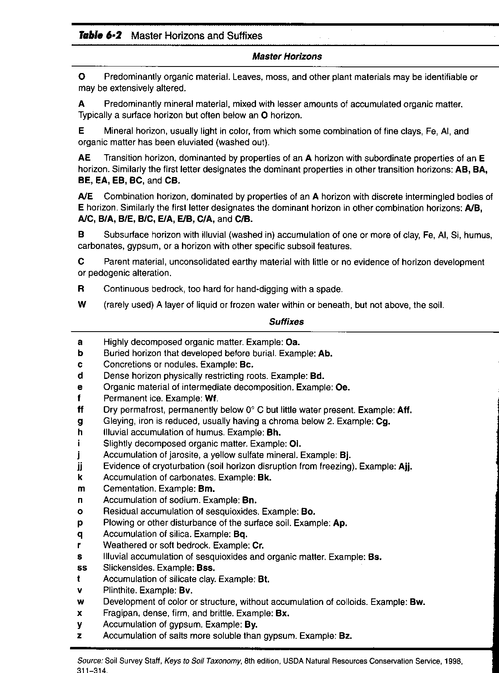
Photo of soil profile

Slide 67
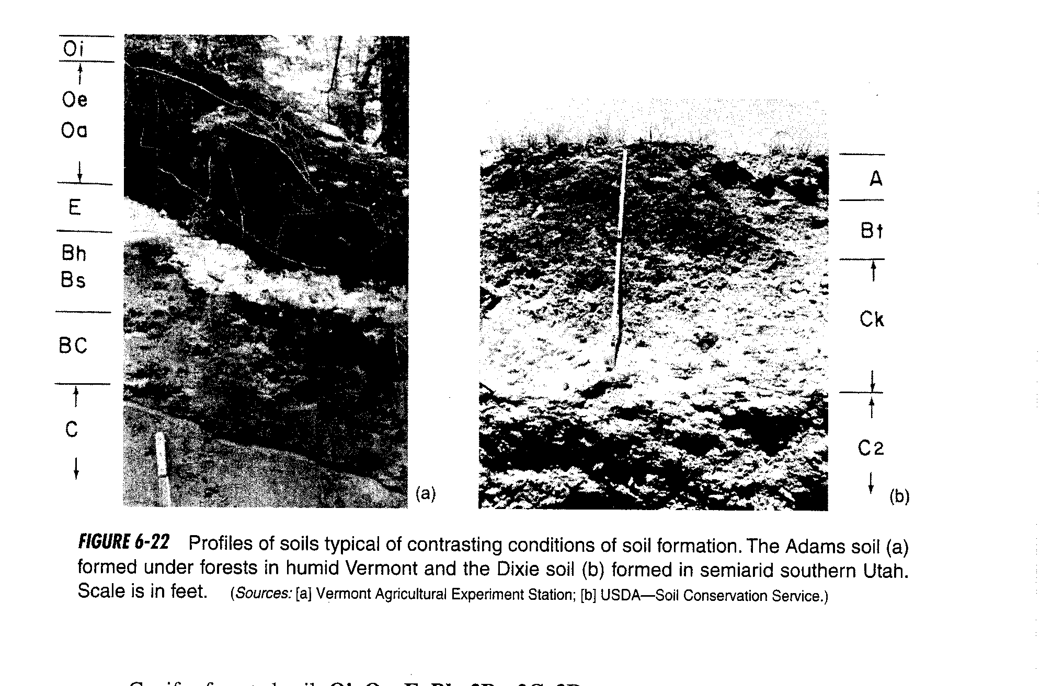
Photo of soil profile

Slide 68
Diagnostic horizons: used to differentiate and classify.
Epipedon: upper profile
Endopedon: lower profile

Slide 69
Epipedon: Surface Horizon
Anthropic: Affected by People (e.g., plough layer)
Folistic: Infrequently saturated organic horizon.
Histic: Frequently saturated organic horizon.
Melanic: Thick, humus rich (black).
Mollic: Rich in organic matter, dark brown-black, not very acidic
Ochric: Light-colored; Low in organic matter
Plaggen: People-caused high humus. (Manuring)
Umbric: Dark, but more acidic than Mollic
Relationships among horizons (VG Fig 2-21)

Slide 70
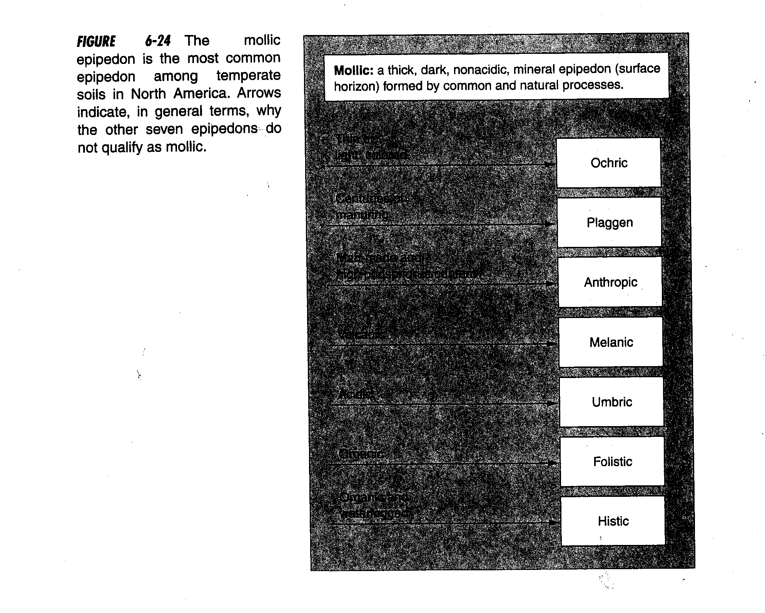

Slide 71
Endopedon: Subsurface horizon
Agric: Clay and humus rich due to ploughing
Albic: Strongly leached, whitish colored
Argillic:Clay-rich due to migration
Calcic: Calcium carbonate
Cambic:Altered horizon but not one of the above. Occupies B horizon position
Duripan: Cemented pan by caused by silica
Fragipan:Physically hard compacted pan; Not chemically cemented

Slide 72
Endopedon: Subsurface horizon
Glossic: Degraded clay accumulation (used to be argillic, kandic, or natric)
Gypsic:Calcium sulfate
Kandic: Argillic horizon of kaolinite clays (lower CEC than Argillic)
Natric:Argillic horizon with high sodium or other base
Orstein: Thick, cemented illuvial horizon
Oxic: Highly-weathered, rich in Fe and Al oxides. Often reddish

Slide 73
Endopedon: Subsurface horizon
Petrocalcic: Carbonate-cemented
Petrogypsic: Gypsum cemented
Placic: Reddish, thin cemented pan of Fe, Mg and organic matter complexes
Salic:Salty
Sombric: Acidic, humus accumulation, tropical B horizon
Spodic: High in organic matter, iron, and aluminum oxides due to podzolization

Slide 74
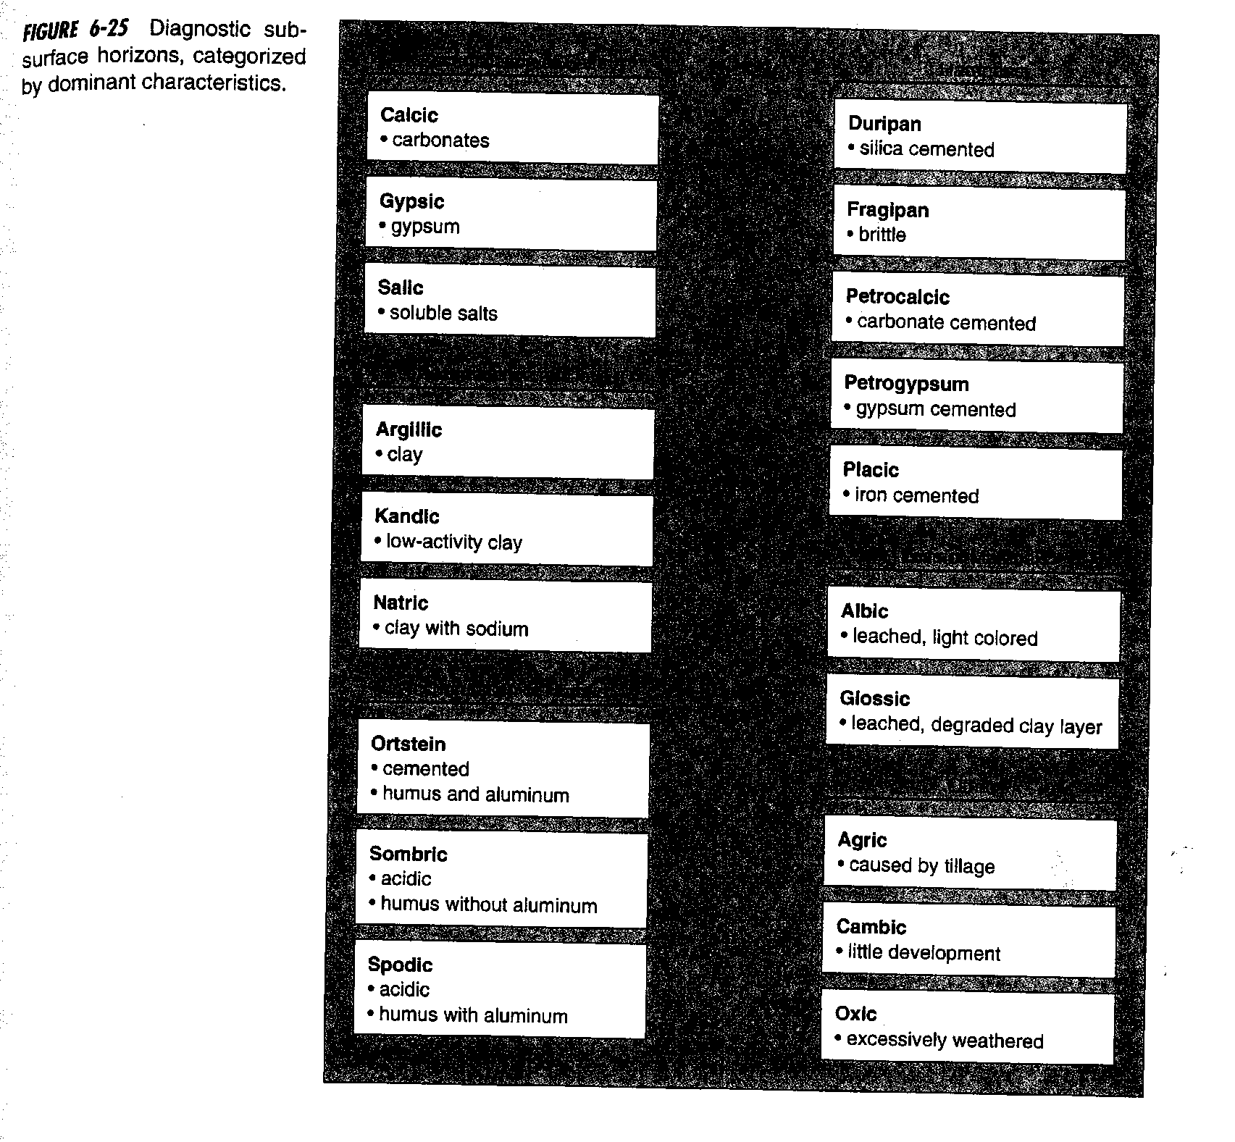

Slide 75
Soils as Mapping units
Pedons: smallest unit of soil that can be called an individual.
Polypedons: contiguous soils having the same thickness, humus, pH. Adjacent pedons which are similar, relate to series.
GIS is critical to mapping these days. Read this section.

