Slide 1
ENTO-306
Agricultural pests and their management
Identification of important agricultural pests
Their mode of damages
Control measures
By: Dr. Muhammad Zeeshan Majeed

Slide 2
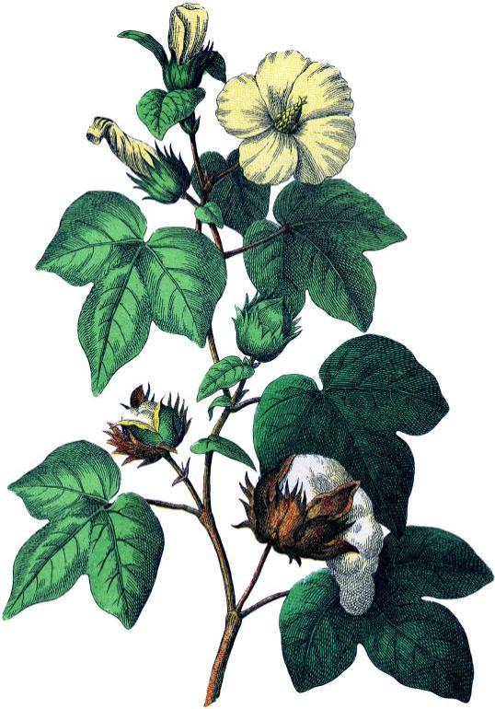
Major Insect Pests of Cotton (Gossypium hirsutum)
Crop in Pakistan
Sucking pest complex
Bollworms complex
Notes:
Single crop country facing threat again by 3 million shortfall (30% less than targeted) of cotton lint (phutti) mainly due to cotton mealy bug and CLCV (12 March 2015).
Target 2018-19= target sowing Punjab 2.31 (overall 2.95) M hec, sown = 2.29 (2.68) M hec. (in 2015 was 3.23 M hec)
Estimated proudction = 8.8 M bales
In major cotton areas, Vehari, Multan, DG Khan, RY Khan, Rajanpur, cotton crop fails due to cotton mealybug.
Cotton growers from Mailsi, Sahiweal, Pakpattan, and Gojra complained bearing Rs 1500 additional expenses on each acre on purchasing pesticides on double rates due to severe Mealy Bug attack.
1300 insect species on globe / 93 species attack in Pakistan.

Slide 3
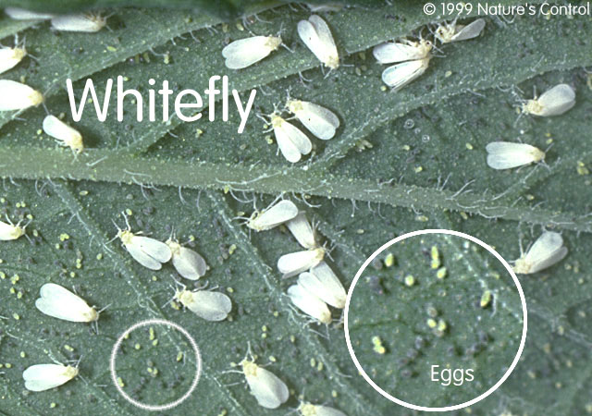
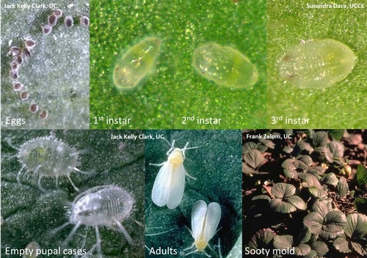
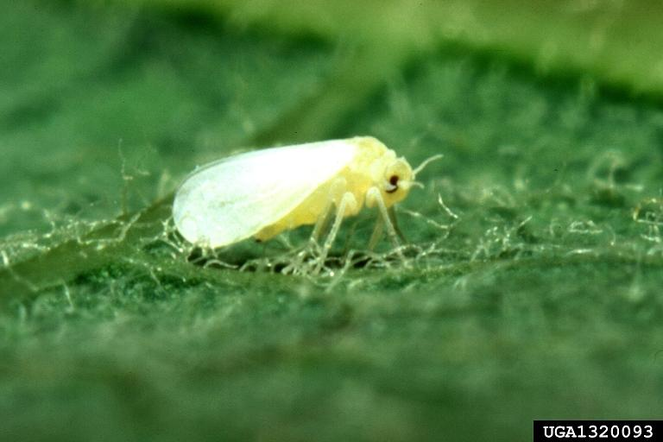
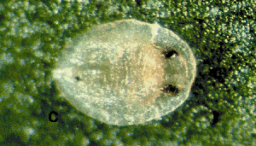
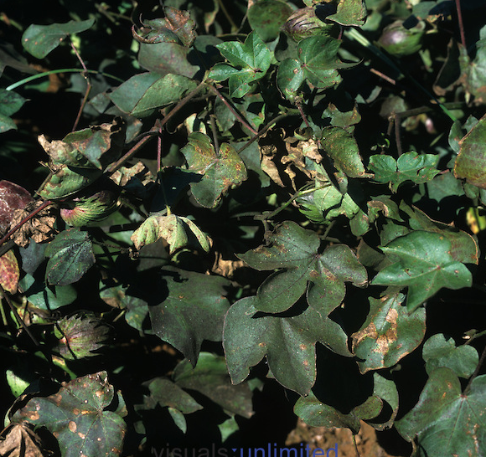
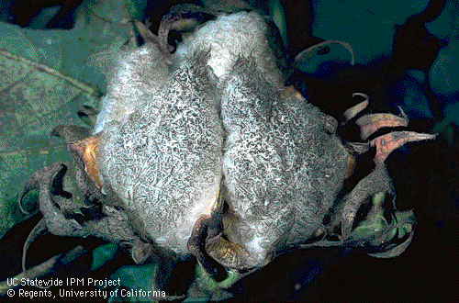
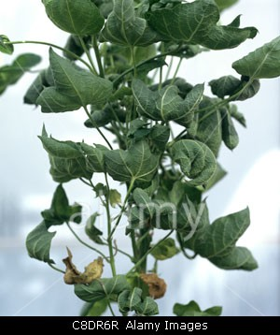
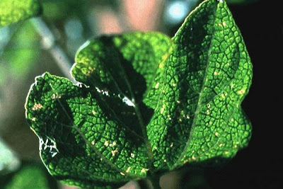
ENTO-306 Agricultural pests and their management 4(3-1)
Insect pests of cotton Whitefly (Bemisia tabaci ; Aleyrodidae, Homoptera)
Sooty mold on lint
CLCV symptoms
Notes:
Bemisia tabaci
Remains active throughout year
No hibernation
Desaping_yellowing and then falling of leaves
Toxic saliva_abnormaling plant physiological processes_disorders.
Blackish and sickly appearance due to sooty mould growth on honeydew_photosynthesis interruption
B. tabaci_transmits 38 viral diseases in more than 70 different plant species (Polyphagous)
Bemisia argentifoli_more fecundiy (about 120 eggs per female on cotton; 70-100 for B. tabaci) and honeydew production than B. tabaci.

Slide 4
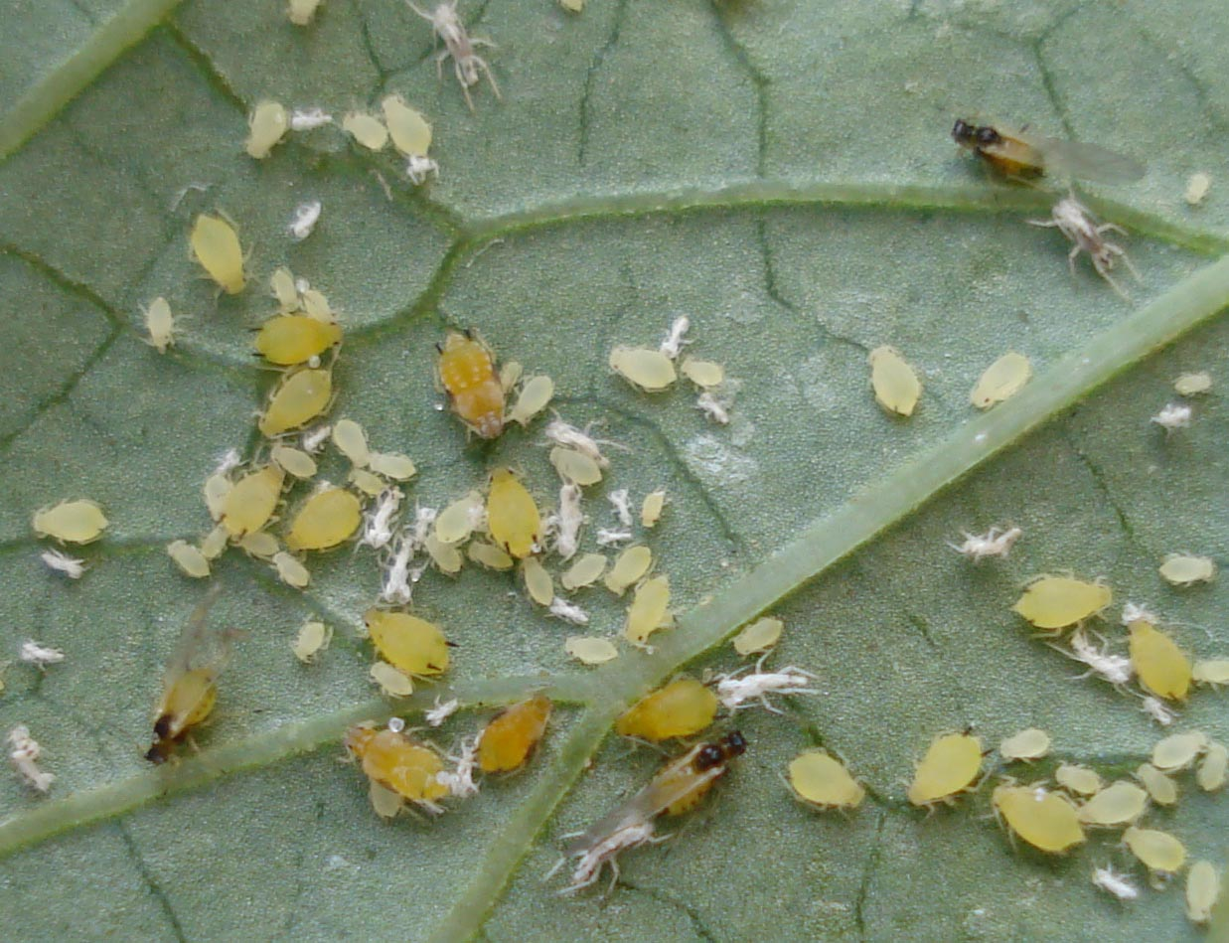
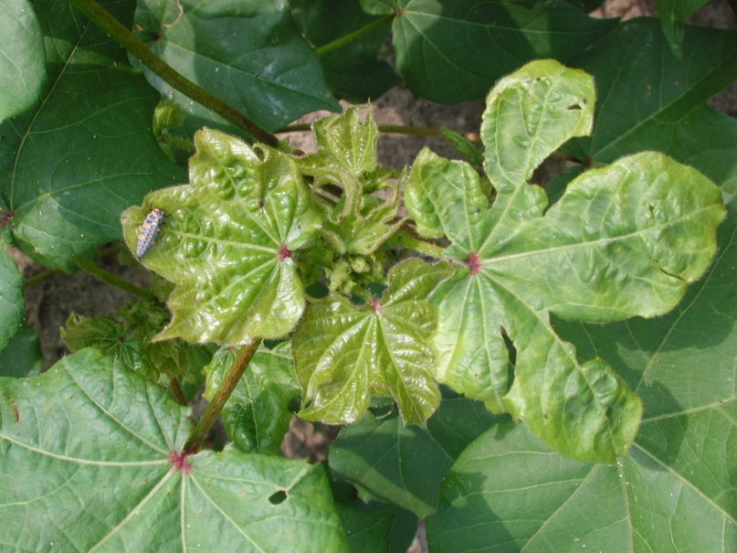
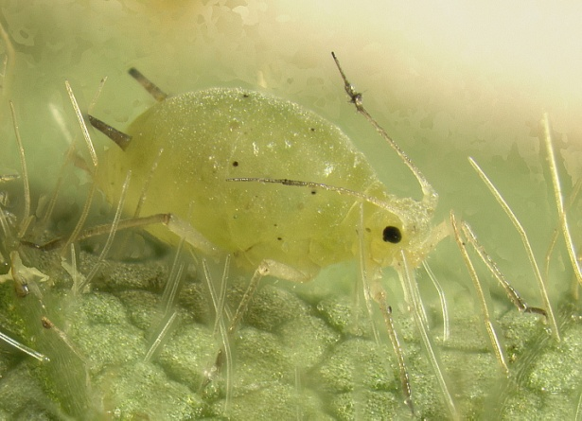
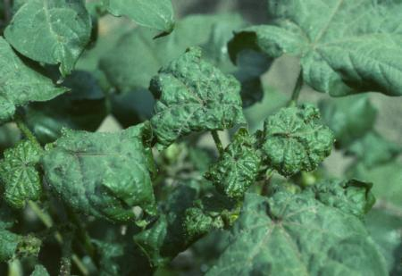
ENTO-306 Agricultural pests and their management 4(3-1)
Insect pests of cotton Aphid (Aphis gossypii ; Aphidae, Homoptera)
Stunted growth with shriveling/withering
Notes:
Aphis gossypii
Desaping_decline in plant vitality and fruiting capacity
Alate/apteraeus, polymorphism (season, growth, host-changing, overcrowding),

Slide 5
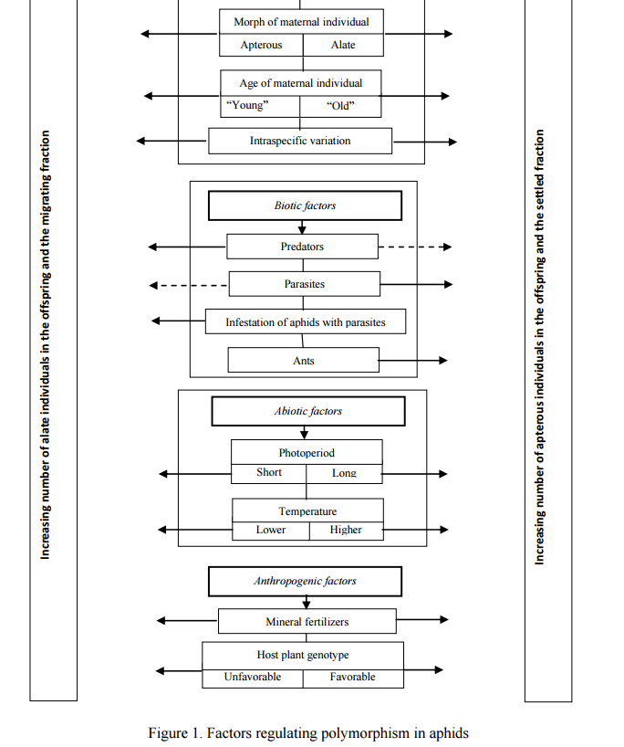
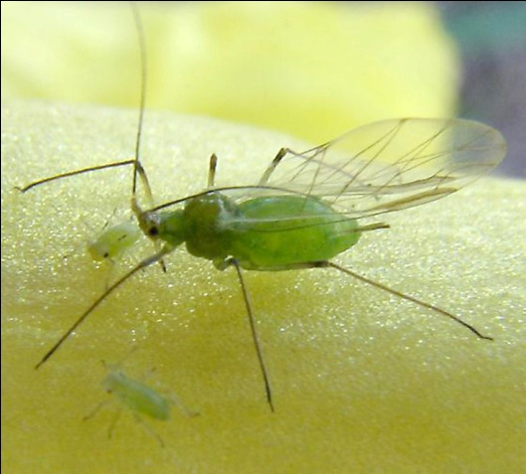
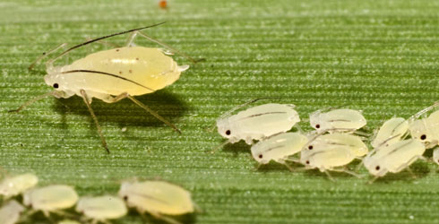
Vereschagina and Gandrabur 2014

Slide 6
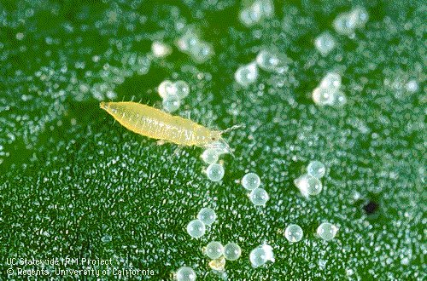
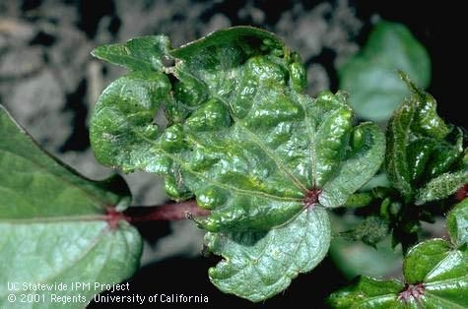
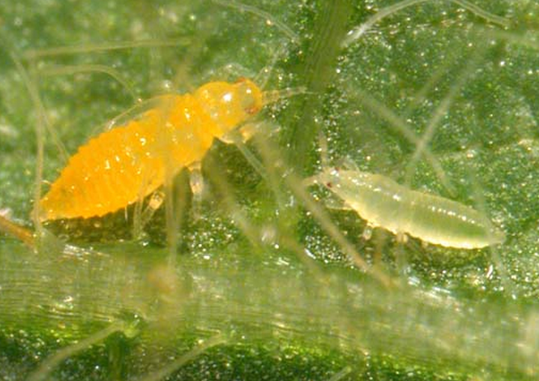
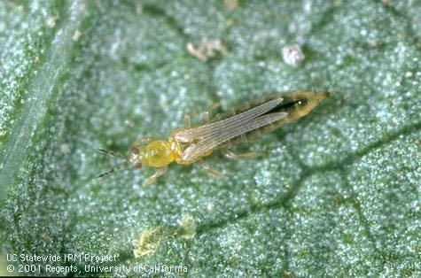
ENTO-306 Agricultural pests and their management 4(3-1)
Insect pests of cotton Thrips (Thrips tabaci ; Thripidae, Thysanoptera)
Rasping/withering
Silvery white crumple shaped leaves
Premature boll opening
Notes:
Thrips tabaci (Severe pest in hot and dry conditions) 4 nymphal instars
1 mm long yellowish brown nymphs. Males are wingless and females have long stripy strap-like wings with long hairs at hind margins.
Breeds on onion, garlic etc. during winter (Nov. to may) than comes to cotton, okra, tomato, cucumber, tobacco, cabbage, cauliflower etc.
50-60 kidney shaped eggs laid singly by females in slits made by females on leave tissues.
Early seedlings (and usually lower leaves) are more attacked by thrips.
Vector of streak-viral disease of peas.
Rasping_feeding on exuded secretions.
Infested leaves silvery white, then dirty white and then become crumpled (wrinkled) shaped and gradually dry up. And curves up-ward.

Slide 7
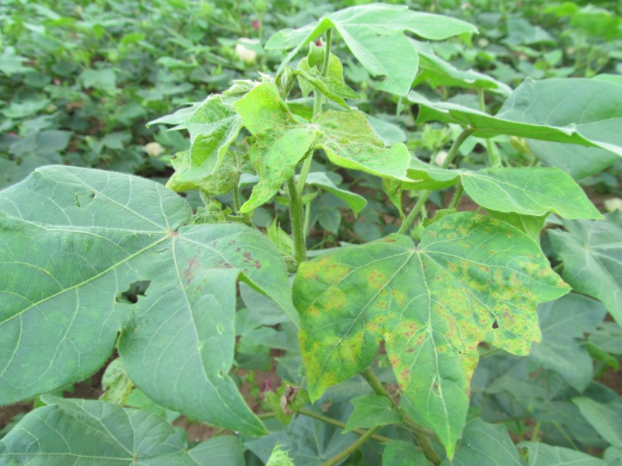
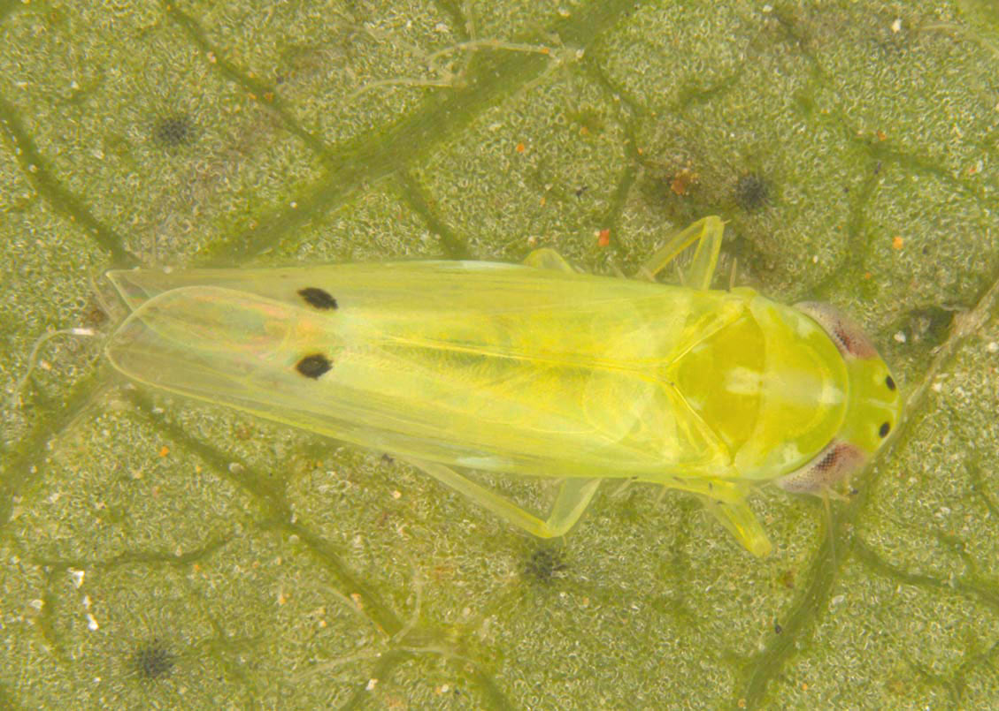
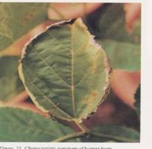
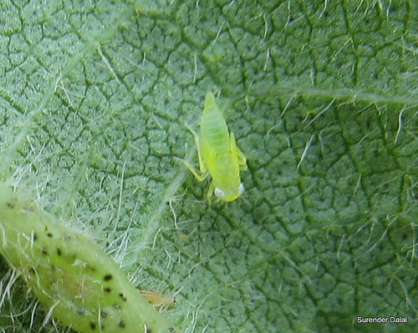
ENTO-306 Agricultural pests and their management 4(3-1)
Insect pests of cotton Jassid (Amrasca bigutella ; Cicadellidae, Homoptera)
Question: Why Okra leaf curls
Upward and cotton leaf
downwards by jassid attack?
Inverted cup-shaped leaves of brick red color (Hopper-burn)
Notes:
Amrasca bigutella bigutella (in hot and humid conditions)
Yellowing (pale color) , then cup-shaping, then brick red marginal color or rust-red (hopper burn appearance) and dry up and falls. Up to 30% loss to cotton production could be due to jassid if not controlled.
Cotton leaves turn downwards (inverted cup shape) by jassid desaping (attack).
Attack is more conspicuous on middle aged leaves than older or new ones.
Adults about 3mm long greenish yellow
Adults and nymphs agile and move briskly forwardly or sideways. 6 nymphal instars
Both damage by desaping plant.
Attracted towards light source at night.
Attack on cotton, potato, tomato, okra, brinjal and several wild plants. Only adults are found on potato and tomato during winter. 7 – 8 generations per annum
About 15 eggs per female embedded into leaf veins on lower side of leaves.

Slide 8
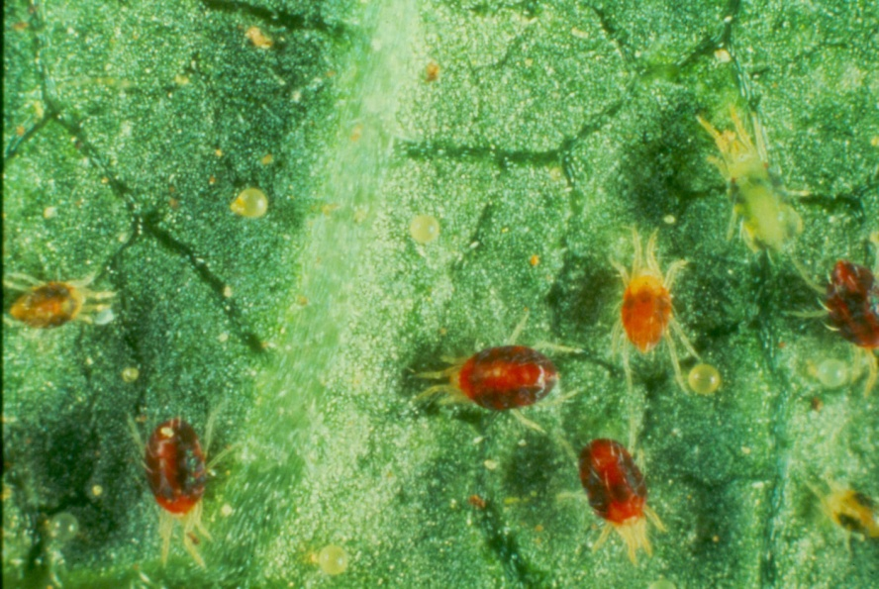
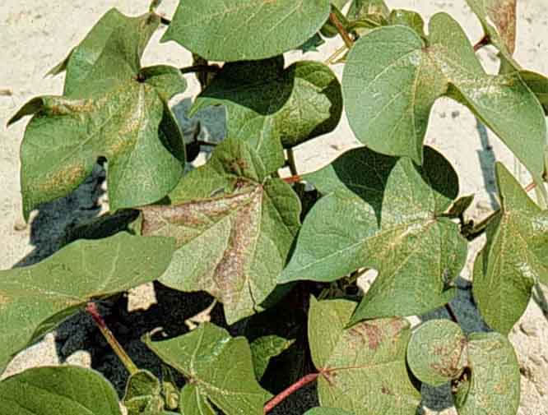
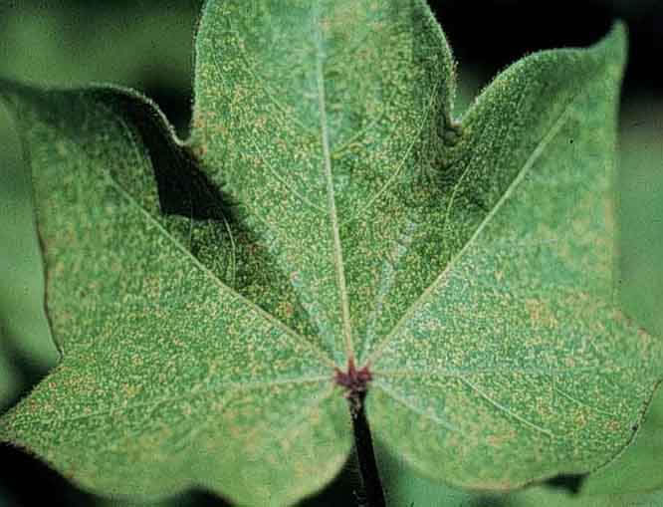
ENTO-306 Agricultural pests and their management 4(3-1)
Insect pests of cotton Red spider mites
Yellowish leaf speckling
Leaf bronzing or purplish color
Notes:
Tetranychus urticae (Acari: Tetranychidae)

Slide 9
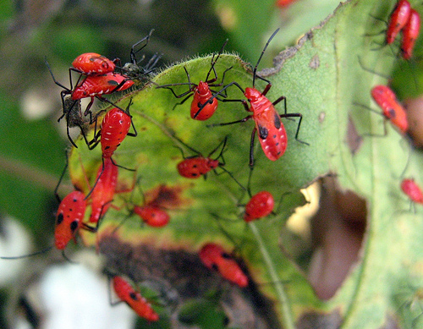
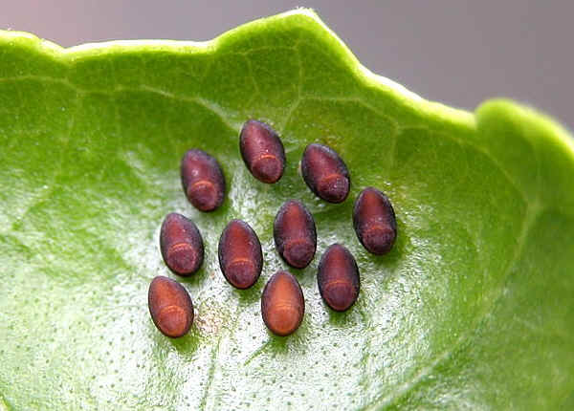
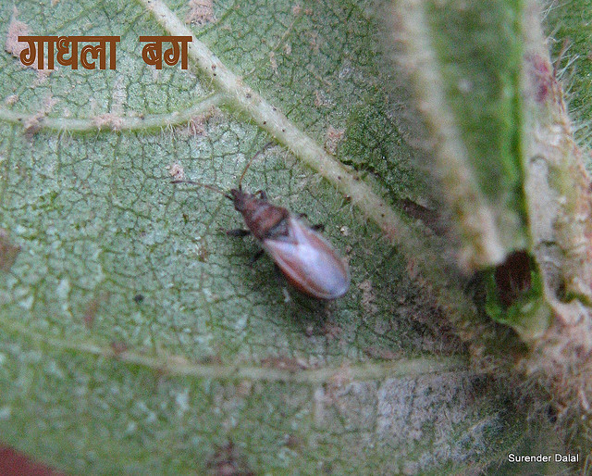
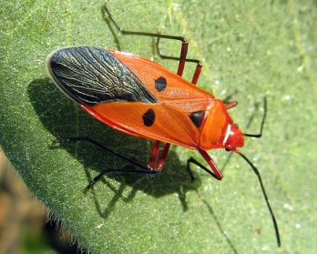
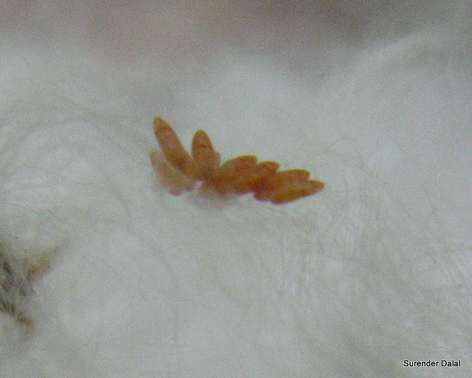
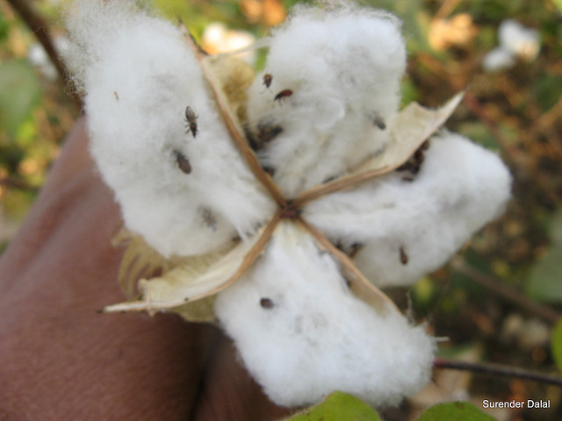
ENTO-306 Agricultural pests and their management 4(3-1)
Insect pests of cotton Red cotton bug
Dusky cotton bug
Notes:
Oxycarenus laetus (DCB) Lygaeidae 4-5mm, dark brown, white transparent wings, cigar shaped eggs are laid in the lint of cotton crop. Suck sap from immature cotton seeds inside bolls,
Dysdercus koenigii (RCB) cotton stainer Pyrrhocoridae crimson red colored with white bands across the abdomen.
All sucking insects jassid, DCB and RCB pass winter as adults. Female lays about 100 spherical eggs in moist soil in form of patches. 5 nymphal stages, bolls fail to open or open immaturely. Seeds produced from such crops have low germination and less oil contents. Their excreta and body juices stain cotton lint during ginning process and hence Lowering market price of lint.
Devitalizing plant
Future threat to Cotton in Pakistan: Red Cotton Bug and Dusky ... the body secrets colored liquid resulting in lint staining with yellow or red spots

