Slide 1
Language Comprehension and Reading Skills
Dr. Azhar Pervaiz

Slide 2
Reading Comprehension
Active reading is nothing more than mindset.
It all depends on the attitude you have
Before you start reading, try keeping a dictionary, note paper, pen/pencils and highlighter in hand
Read with a positive approach and a open mind
“Reading Comprehension means understanding an idea of a text in its wholeness”
“Reading is a complex communicative process in which a reader receives inputs through the physical process of reading, followed by decoding and understanding the text, analysis and finally a proper response”

Slide 3
Decoding : Ability to recognise words accurately and
their meaning and pronunciation. Read letters and focuses to
change the coded message into information
Comprehending : Identification of the central theme,
main ideas, supporting details and writing patterns. The Reader
interprets the message and understands its literal meaning
Text Analysis :Process of identifying relationships
among different units within the text in order to distinguish
between relevant and irrelevant information and draw
inferences and conclusions.
Response : Our response to a text depends on correct
understanding and evaluation of the text.

Slide 4
Reading Comprehension
Input Decoding Analysis Response
For Effective Reading
Basic familiarity with language being used
Know the visual shapes of words, sound and pronunciation of each word and its meaning
Have knowledge of grammar of that language
Develop the ability to read at different speeds, skip and skim when required

Slide 5
Reading Comprehension
Dont’s in reading
moving your head, instead of eyes from side to side
Indicate words on a page with finger or something like pen or pencil
Notice one word at a time while reading

Slide 6
Types / Techniques of Reading Skills
Scanning : Reading something rapidly for a specific information. Concentrate on the key word and need not recall the exact content of the page.
Skimming : Reading a text quickly to gain a general impression of whether the text is of any use . The purpose is to get an overview of the text to check its relevance.
Word for Word : When some textual material is not readily understood and it requires a slow, careful and analytical reading.

Slide 7
Types / Techniques of Reading Skills
Extensive Reading : Broaden the general understanding of a subject. Read for pleasure with emphasis on understanding the overall meaning.
Intensive Reading : An in-depth knowledge and understanding of the finer details of the subject .
Speed Reading (Fixation) : In order to increase our speed we must take in more words with each fixation, rather than make our eyes move faster. Reading everything in detail but develop speed through practice.

Slide 8
 | READING SPEED
100 wpm | Low level of reading experience coupled with low comprehension and understanding. | Maximum levels of regression, sub-vocalization and mind drift.
100 – 200 wpm | Individual displaying a life-long avoidance of reading. | Characterized by high levels of regression, sub-vocalization and concentration problems.
200 – 250 wpm | Vast majority of the world’s readers are positioned | Regression of about 10% of all words read with full sub-vocalization, Occasional concentration

Slide 9
 | READING SPEED
250 – 350 wpm | Enthusiastic readers with a fair reading experience. | Occasional regressions with slightly reduced sub-vocalization.
350 – 500 wpm | Enjoyment of reading as a pleasurable activity. | Occasional regressions to compensate for mind drift and better recognition of words without full sub-vocalization.
500 – 800 wpm | Reading is pleasurable | Good control over daily reading commitments

Slide 10
 | READING SPEED
800 – 1000 wpm | Word recognition and Comprehension is maximum. | Extremely Efficient reading speed with low sub-vocalization and no regressions.
1000wpm + | A speed reader who maintains skills by regular practicing and drilling. | Optimum Comprehension and complete control over all reading requirements.

Slide 11
Reading Different Kinds of Text
Reading Entertaining Messages / Text : Not to receive serious information but to be entertained.
2) Reading General Messages / Texts : To broaden our outlook and widen our intellectual understanding and appreciation of things.
3) Reading Reference Materials : To obtain specific information that might be used in various academic and professional activities.

Slide 12
Reading Different Kinds of Text
4) Reading Business Documents : Requires attention to all parts of the document. It demands concentration, involvement and responsibility.
5) Reading Scientific and Technical Texts : We should understand not only linguistic and semantic patterns, but also discipline – specific information.
Linguistic and Semantic Patterns : Visual Skills, Perceptual Skills, Vocabulary Skills, Skimming Skills, Critical Reading Skills
Discipline – Specific information : basic understanding of the subject and familiarity

Slide 13
Reading Between Lines
Understanding the hidden meaning or intention behind explicitly stated words is known as reading between the lines.
Many writers do not directly state what they mean but present ideas in a more indirect, round about way. ( What do you infer from these lines ? What does the author imply in lines…..? )

Slide 14
Reasons for Poor Comprehension
Inability to understand a word / sentence
Inability to understand how sentences relate to one another
Lack of interest or concentration
Inability to understand how the information fits together in a meaningful way

Slide 15
Ways to improve your Reading Comprehension
Skim the passage for overall understanding and to grasp the main idea.
Use intensive reading techniques to get the contextual meaning
Use the ‘Study Reading Speed’ of about 200 – 300 WPM.
Read a variety of materials. Don't limit yourself to books.

Slide 16
Ways to improve your Reading Comprehension
Circle unknown or unfamiliar words as you read.
After reading, recall , jot down and check for accuracy and completeness.
Answer the questions about the material after reading it.
Answer to the point even if the answer is in few words or just one word.

Slide 17
MODULE II
Concept of communication: The speaker/writer and the listener/reader, medium of communication, barriers to communication, accuracy, brevity, clarity and appropriateness
Reading comprehension: Reading at various speeds, different kinds of text for different purposes, reading between lines.
Listening comprehension: Comprehending material delivered at fast speed and spoken material, intelligent listening in interviews.
Speaking: Achieving desired clarity and fluency, manipulating paralinguistic features of speaking, task oriented, interpersonal, informal and semi formal speaking, making a short classroom presentation
Group discussion: Use of persuasive strategies, being polite and firm, handling questions and taking in criticisms on self, turn-taking strategies and effective intervention, use of body language

Slide 18
Listening comprehension
Listening is an active process of receiving, interpreting and reacting to the spoken word.
Listening means trying to see the problem the way the speaker sees it--which means not sympathy, which is feeling for him, but empathy, which is experiencing with him.
Listening requires entering actively and imaginatively into the other fellow's situation and trying to understand a frame of reference different from your own.
This is not always an easy task.
"The reason why we have two ears and only one mouth is that we may listen the more and talk the less."

Slide 19
Listening comprehension
Hearing is not Listening
Listening Actively- Conscious effort to focus on the sound and determine what it is.
Listener has to hear, analyze, judge and conclude.
A person who listens well and engineers appropriate body language is a good conversionalist though he/she may speak little.
This is active listening.
It leads to learning

Slide 20
Listening comprehension
Listening Is With The Mind
Hearing With The Senses
Listening Is Conscious.
An Active Process Of Eliciting Information
Ideas, Attitudes And Emotions
Interpersonal, Oral Exchange

Slide 21
Purpose of Listening
To get an overall idea of some message
To understand the main points of a lecture
To go through the whole material or learn it whole heartedly
To give suggestions to someone.
In seeking advice to solve problem
To get entertainment
To understand speaker’s point of view to specific information

Slide 22
Listening Process
Sensing : Listening sounds and concentrate on them in order to receive the message.
Decoding : Process of changing the coded message into information. It also involves the recognition of false starts, pauses, stress etc.
Evaluation : In order to evaluate a verbal message correctly, facts have to be separated from opinions, relevant from irrelevant information etc.
Response : If the message has been analyzed, interpreted and evaluated correctly, the response will be appropriate.

Slide 23
Barriers to good Listening
Listening partially or selectively or ignore the messages.
Reasons
Physical
Distractions from other sounds or distance
Example: Talking in a moving train, crowded street
Prejudging
You automatically shut out information
Prejudge- you disagree or don’t care
May not like the person
Differences in culture, social status, age, attitude or environment

Slide 24
Barriers to good Listening
Tips to avoid prejudging
Listen to information that is useful even if it isn’t pleasant to hear
Listen to message, not messenger
Try to remove cultural, racial, gender, social and environmental barriers
Careless Listening
Listening is partial
Inattentive listening
Talking

Slide 25
Barriers to good Listening
Psychological Barriers : Emotional Disturbance, Anxiety
Linguistic Barriers : Improper Message Decoding, Ambiguous Language, Unclear Phrases
Cultural Barriers : Cultural Differences, values, Social Norms

Slide 26
LISTENING TO WORDS SPOKEN AT DIFFERENT SPEEDS
We can speak around 120 to 150 wpm
Brain is capable of processing 500 to 750 wpm
Hence we waste this time on side excursions
Thus we miss connection and thus takes to time to get in track
Three techniques to keep your concentration
Summarize what the speaker has said. Take notes.
Try to guess where the speaker is going next
Question the truth, validity of speaker’s words

Slide 27
LISTENING INTELLIGENTLY AT INTERVIEW
Interviews require you to listen as much as you speak
Try to understand interviewers perspective.
Listen with the whole body. Example: Body language of listener, posture, facial expression
Let the interviewer finish starting her/his questions
Paraphrase and query to fine-tune the question and answer

Slide 28
SKILLS AND TIPS FOR TELEPHONIC INTERVIEWS
Plan ahead
Be punctual
Concentrate on your voice modulation
Speak clearly and slowly
Avoid long pauses or frequent halting
Use simple, direct and enthusiastic responses
Always keep a glass of water handy
Maintain the highest level of concentration
Sit at a quiet place without background noises and other disruptions, and be relaxed
Smile through the phone, it really makes a difference
Keep the conversation interesting and easy to follow

Slide 29
SKILLS AND TIPS FOR TELEPHONIC INTERVIEWS
Know when to talk and when to stop talking
Always keep a paper and pen within reach
Role-play practice may help in the telephonic interview
Always end on a positive note

Slide 30
PRESENTATION SKILLS
Concept of communication: The speaker/writer and the listener/reader, medium of communication, barriers to communication, accuracy, brevity, clarity and appropriateness
Reading comprehension: Reading at various speeds, different kinds of text for different purposes, reading between lines.
Listening comprehension: Comprehending material delivered at fast speed and spoken material, intelligent listening in interviews.
Speaking: Achieving desired clarity and fluency, manipulating paralinguistic features of speaking, task oriented, interpersonal, informal and semi formal speaking, making a short classroom presentation
Group discussion: Use of persuasive strategies, being polite and firm, handling questions and taking in criticisms on self, turn-taking strategies and effective intervention, use of body language

Slide 31
PRESENTATION Skills
The purposeful process by which people, using audible and visible symbols, communicate meaning in the minds of their listeners. It is flexible, changing, as well as complex and varied.
Is an interactive communication process that involves speaker and listener.

Slide 32
Achieving desired Clarity and Fluency
Flow of words without pauses and repetition
Range of vocabulary appropriately used
Appropriate use of grammar
Confident of the content
Clarity
The average number of words can be spoken per minute is about 120-140.
Correct Pronunciation
The volume should be adjusted keeping in mind the number of audience, the size of the room etc.

Slide 33
Achieving desired Clarity and Fluency
Proper Stress and Intonation
Think and organize the contents of the message properly
Simple and unambiguous words and expressions should be used in a speech
Recording one’s presentations may help to know

Slide 34
Achieving desired Clarity and Fluency
Fluency
Aim for clear oral communication devoid of speech errors
Practice correct pronunciation, accent, and tone to make the speech impressive.
Learn from your mistakes and make sincere efforts to correct them
Concentrate in your ideas rather than your appearance
Listen to good speakers and read material written in good English.

Slide 35
Achieving desired Clarity and Fluency
Read aloud the passages from books or magazines that you enjoy reading
Practice your speaking skills in small talks – on hobbies, current affairs, games etc with your friends or family members.
Believe in what you’re speaking
Spare at least one hour everyday for developing your English fluency
Write personal diary in English

Slide 36
Betty Botter bought some butter but, said she, the butter’s bitter. If I put it in my batter, it will make my batter bitter. But a bit of better butter will make my bitter batter better. So she bought some better butter, better than the bitter butter, Put it in her bitter batter, made her bitter batter better. So ‘twas better Betty Botter bought some better butter.

Slide 37
Paralinguistic Features of Speaking
Paralinguistic communication refers to the study of human voice and how words are spoken.
Paralinguistic signals and cues refer to every element and nuance of your speech.
Paralinguistic communication can be more
subtle than other forms of non-verbal communication.

Slide 38
Paralinguistic Features of Speaking
Rate: How many words per minute? Some persons speak slowly and some speak very fast. It is best to vary your speaking pace. Use pauses to create emphasis. A well-paced , varied message suggests enthusiasm, self-assurance and awareness of audience.
Volume: How loud or soft is the voice? Vary your volume to make your voice audible and clear. Confidence, Assertiveness, and Boldness are reflected in louder speech.

Slide 39
Paralinguistic Features of Speaking
Pitch: Pitch refers to the number of vibrations per second of your voice. The rise ( anger, excited ) or fall (sadness, shock) of the voice conveys various emotions. A well balanced pitch results in a clear and effective tone. It helps us avoid being monotonous.
Inflection: Refers to the rising and falling pitch of the voice when somebody says a word or syllable.
Intonation : Intonation refers to variations in pitch.

Slide 40
Paralinguistic Features of Speaking
Articulation : Speakers should be careful not to slop, slur, chop, truncate, or omit sounds between words or sentences. If all the sounds are not uttered properly, the flow of understanding gets interrupted and deters the listener from grasping the meaning of the message.
Good Pronunciation: Pronunciation is the manner of uttering or speaking (words and sounds), and ‘ Good’ Pronunciation is the way of speaking that ordinary people find easy to understand. One should be careful enough to pronounce individual sounds along with word stress according to the set norms.

Slide 41
Paralinguistic Features of Speaking
Quality: Quality generally refers to those vocal characteristics that allow you to differentiate one voice from another. It may be rich and resonant, soft and alluring, hoarse and husky or harsh and irritating. All of these represent different combinations of rate, pitch, and volume.
Intensity or Voice Modulation: Modulation pertains to the way we regulate,vary or adjust the tone, pitch and volume of sound.
Flexibilty and vitality to your voice

Slide 42
Paralinguistic Features of Speaking
Word Stress and Sentence Stress
Pauses or Silence: A pause in speaking lets the listener reflect on the message understand it accordingly.
Advantages :
Glide from one thought to another
Disadvantages :
Hinder the flow of speech

Slide 43
Types of Speaking
Inter-personal : When you come face to face with someone and communicate with that person it is called interpersonal speaking. However, there are occasions when it is Semi-formal and Informal.
Semi-Formal : Exchange of information in a classroom, Bank counter
Informal : Exchange of personal Information with Friends and relatives

Slide 44
Semi-Formal
Informal
Semi – Formal Content
Mostly factual
Semi-formal words and expressions
Accepted rules and
custom
Fixed norms of behavior
Always formal in style
Objective approach
Logically organised and structured
Personal and Emotional content
May be emotional or factual
Colloquial words and expressions
No accepted rules
No fixed norms
Both formal and informal style
Both objective and subjective
Not always structured

Slide 45
Guidelines for effective speeches and presentations
Break the material into main parts .Do not have more than 5-6 main ideas as it is difficult to remember more at a stretch
Prepare notes or outlines
Arrange them in a logical, coherent manner
Make your information or facts effective. You may include statistics, illustrations and graphs if required.
Draw conclusions based on your main points
Use appropriate visual aids
Be prepared with answers to possible questions from the audience

Slide 46
Making speeches and presentations
Right style
Using the correct language
Signposting
Content of presentation

Slide 47
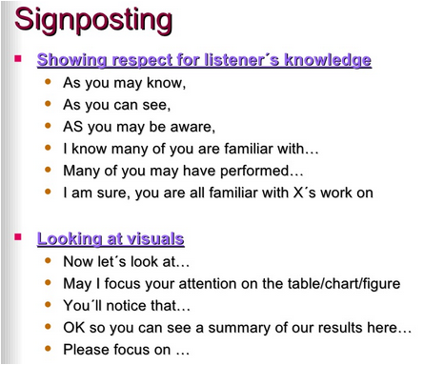

Slide 49
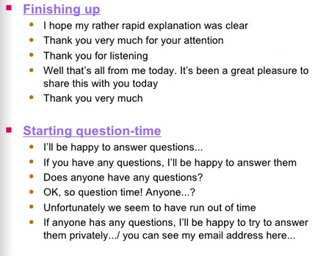

Slide 50
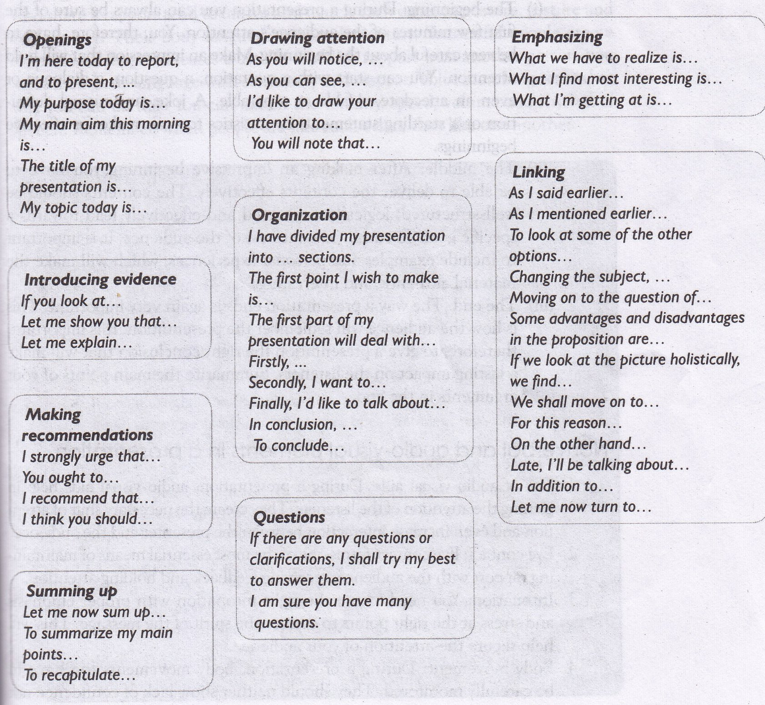

Slide 51
Content of presentation
Why are you making the presentation and who will be listening to the presentation
Selecting the content
Planning for the talk
i)The beginning
ii)The middle
iii)The end

Slide 53
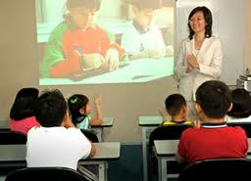
Non verbal and audio visual elements
1.Use of audio-visual aids
2.Eye contact
3.Intonation
4. Body movement
5. Word /phrasing-
The way something
is expressed in
words : order of
words to express
something

Slide 54
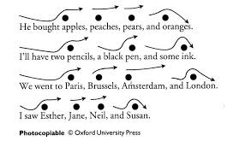
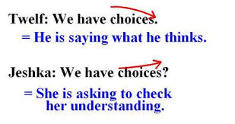
INTONATION

Slide 55
MODULE II
Concept of communication: The speaker/writer and the listener/reader, medium of communication, barriers to communication, accuracy, brevity, clarity and appropriateness
Reading comprehension: Reading at various speeds, different kinds of text for different purposes, reading between lines.
Listening comprehension: Comprehending material delivered at fast speed and spoken material, intelligent listening in interviews.
Speaking: Achieving desired clarity and fluency, manipulating paralinguistic features of speaking, task oriented, interpersonal, informal and semi formal speaking, making a short classroom presentation
Group discussion: Use of persuasive strategies, being polite and firm, handling questions and taking in criticisms on self, turn-taking strategies and effective intervention, use of body language

Slide 56
What Is GD?
Group Discussion is a Systematic and Purposeful Interactive Oral Process.
Group Discussion is a systematic oral exchange of information, views and opinions about a topic , issue, problem or situation among members of a group who share certain common objectives for decision making or problem solving.

Slide 58
Use of Persuasive strategies
Use of following tips may be helpful
Do your homework and be acknowledgeable about the topic of the discussion.
Show maturity before reacting to others.
Listen carefully and then react.
Always use evidence to justify your views.
Establish mutual respect.
Win confidence of others.
Be considerate.
Always be friendly and respectful during GDs

Slide 59
Strategies for Improving GD Skills
(I) Content
Initiative Leader
Remind Goal, Procedure
Contribute Systematically - Good General Knowledge & Awareness of the Current Affairs
Keep the discussion alive and lively
If the topic is unfamiliar, wait till someone come up with important information
Create Conducive Atmosphere – tending to promote or assist
Promote Optimal Participation
Moving the Discussion Along
Handle Conflict
Effecting Closure

Slide 60
(II) Communication
Use simple and appropriate words with right pronunciation
Use grammatically correct sentences, concise and unambiguous expression
Use simple language without exaggeration
Speak fluently but with a moderate speed, pauses and volume
Use tone variation and do not let your speech become monotonous

Slide 61
Do not interact just in monosyllables
Do not use non-word fillers too often- uh, um, er ,ah
Filler sounds must be checked
Do not use slang
Use linking phrases to link arguments
Make use of polite expressions to disagree or to interrupt others
Avoid using technical terms

Slide 62
III) Critical Thinking : A good discussion always involves a lot of networking. Networking involves active thinking, building on one another’s points, negotiating , persuading and collating views.
To improve Critical Thinking :
Restraining your emotions
Looking at things differently
Analysing information
Asking Questions
Solving Problems

Slide 63
IV) Knowledge of Group Dynamics
To manage a group well :
Generate agreement on a common viewpoint
Be adaptable
Show positive attitude
Do not Distract others
Accept Criticism sportingly

Slide 64
Motivate other participants
Deal with hostile members and conflicts tactfully
Join the Discussion
Never enter the discussion with a disagreement
Do not make a personal remarks
Have a shared leadership

Slide 65
Process of a Group Discussion
Topic is declared beforehand or can choose from the given ones
Anyone can initiate discussion or a particular candidate
One person may conclude or a particular member
Group can decide the procedure or follow as per the instructions
Discussion may take place on a topic to find common solution
GDs can be conducted through teleconferencing also
GDs may be conducted in the form of case study

Slide 66
Topics for Group Discussion :
Abstract - Perceptive and creative thinking more than facts. Example: Black is beautiful
Concrete – Need factual content in combination with the right perspective. Example: Deforestation is harmful
Range of Topics :
Current, Social, Political, Economic Management,
Case Studies, Abstract / Creative

Slide 67
Leadership Skills
(I) Being Polite but Firm :
Do not apologize when you disagree with someone
Do not make sentences sound like questions
Avoid using tag questions
Do not say anything unless you’ve completed your thoughts
Use the ‘I’ language
Do not allow yourself to be interrupted
To make a statement powerful, try and drop the tone of your voice at the end of the sentence.
Be assertive and not aggressive.
If we feel suggested ideas by other member may not go well with the organization, we need to express our view firmly but politely

Slide 68
II) Handling Difficult Questions and Criticism
Questions
Before you answer a question, always think it over
Avoid prolonged discussions, responses and arguments with one person
Avoid providing detailed responses to questions that will take the focus away
Pre-empt a Difficult question
After you’ve responded to a person, ask them if you’ve answered to their satisfaction

Slide 69
Criticisms
Not to become nervous and defensive the moment someone disagrees ( approach / flaw)
Keep an open mind and try to judge your own statements objectively
Do not hold grudges against people

Slide 70
III) Turn –Taking and Effective Intervention Strategies
Taking turn
Being ready to speak when one finishes is taking one’s turn.
Holding the turn
There may be members in a group who do not wish to give turns to others to speak.
These type of members in fact lose by coming across as bad listeners.
Yielding the turn
When we give a hint that we are concluding our remarks and others can take up the discussion further, we are yielding the turn.

Slide 71
III) Turn –Taking and Effective Intervention Strategies
Interferences are necessary in GDs as for correcting error, controlling unruly behaviour, adding some detail, or asking a question for clarification.
Interrupt somebody when only when there is a valid reason and also using appropriate phrases while doing so.

Slide 72
III) Turn –Taking and Effective Intervention Strategies
Do not go on speaking yourself. Keep your arguments short and precise.
Do not speak just to interrupt someone.
If you need to make a point , you can say
Always intervene to help someone to say
Do not allow Group Discussion to become unfocused
If too many people are speaking at the same time, you can intervene

Slide 73
MODULE II
Concept of communication: The speaker/writer and the listener/reader, medium of communication, barriers to communication, accuracy, brevity, clarity and appropriateness
Reading comprehension: Reading at various speeds, different kinds of text for different purposes, reading between lines.
Listening comprehension: Comprehending material delivered at fast speed and spoken material, intelligent listening in interviews.
Speaking: Achieving desired clarity and fluency, manipulating paralinguistic features of speaking, task oriented, interpersonal, informal and semi formal speaking, making a short classroom presentation
Group discussion: Use of persuasive strategies, being polite and firm, handling questions and taking in criticisms on self, turn-taking strategies and effective intervention, use of body language

