Slide 1
Jojoba( Simmondsia chinensis Link Schnider )

Slide 2
Origin and distribution:
Jojoba Simmondsia chinensis plants originated in the Sonoran desert of Northern Mexico and the United States (South West Arizona and Baja California) .
Now, due to its high economic value, it is cultivated as a commercial plant in different parts of the world like Argentina, Australia, India, Egypt, Israel, Mexico, Peru, Kenya, Brazil, South Africa, Costa Rica, Haiti, Paraguay, Chile and Iran, jojoba has extraordinary characteristics as a desert shrub ,it is a characteristic plant of marginal and dry lands .

Slide 3
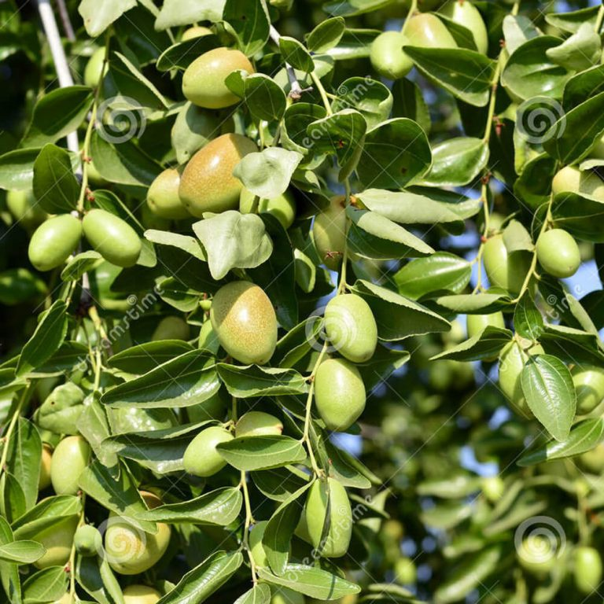
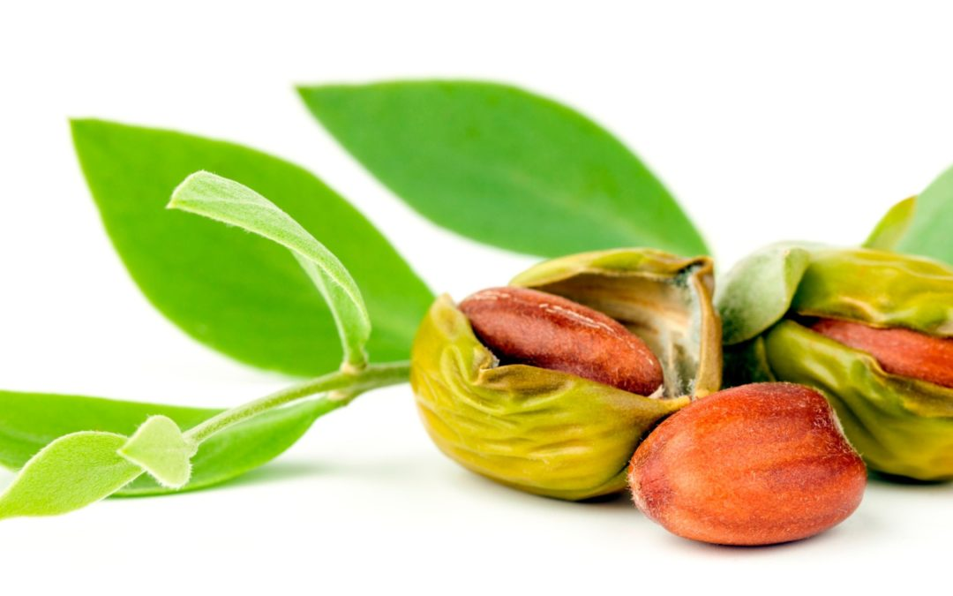
Jojoba common names
The name Jojoba was derived from the Indian name jojowi and the plant has many more names like buck nut, coffee nut, goat nut, wild hazel, pig nut.

Slide 4
Botanical description
Jojoba is a perennial evergreen dioecious plant, woody, wind-pollinated, shrub or small multi-stemmed tree and has condensed crown.
Leaves opposite, oval, 2-3 cm long and 1.0 -1.5 cm broad, leathery, oblong, grey green or bluish-green.
jojoba has a deep rooting habit, the roots can penetrate to a depth of 15-25 m, and this extensive root structure enables the plant to survive in the arid conditions.
In its natural habitat Simmondsia. chinensis tolerates high temperatures and drought and may be classified as a true xerophyte .

Slide 5
Flowering:
Jojoba is dioecious with male and female plants, flower bud formation is mainly associated with new vegetative growth , occurring during the warm season in late summer or early fall after the harvesting previous crop.
Generally male seedlings flower earlier than female seedlings, with male flowering beginning to occur during the second year of growth .
The flowers are small, greenish-yellow, with 5-6 sepals and no petals, the female ones are usually borne singly at alternate nodes, also, light green with long pedicles and there are no female petals or scent to attract insects.
Meanwhile, the male flowers are borne in clustered at the nodes .

Slide 6
Fruiting
The fruits are corn-shaped ovoid, three-angled capsule 1-2 cm long, partly enclosed at the base by the sepals, which turn gradually from green to brown color on maturation.
Seeds are different in shape, size, color and weight, according to management, are elongated, slightly spherical and pointed .
The mature seed is a hard oval, dark brown in color and contains oil (liquid wax) content of 40 - 50% approximately.
Under commercial planting conditions, jojoba seedlings usually begin producing seeds the second or third year after planting,while jojoba seeds ripen during the summer.

Slide 7
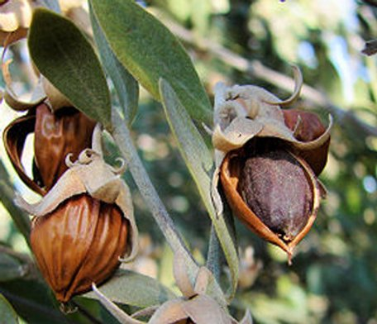
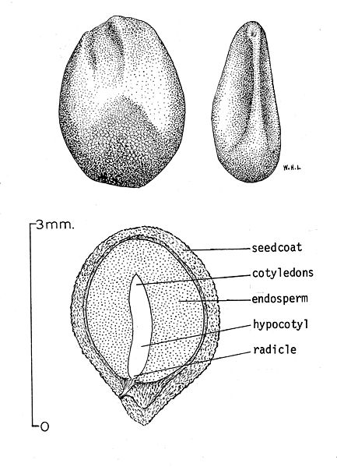
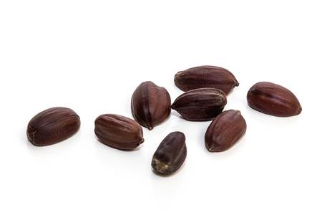

Slide 8
The most significant yield components in jojoba
Large seed.
High oil content.
Flowers at every node, more than one seed per node in clusters.
Early flowering to escape frost damage precocious seed production starting before the fifth year.
Consistent high production from year to year.
And upright growth habit.

Slide 9
Economic Status And Utilization
The economic value of the plant is in the seed that ripens during the summer and is harvested in the autumn.
The seed has a high “oil” content which constitutes about 50% of the dry weight of seeds. This “oil” consists of lipids that contain straight chain liquid wax esters of uniform length (Dunstone, 1980).
It has properties similar to those of sperm whale oil, which it has replaced in lubricants, pharmaceuticals and cosmetics but jojoba also has potential for a wide range of applications including extenders for plastics, printer ink, surfactants and leather lubricants (Yermanos and Duncan 1976; National Research Council, 1985).

Slide 10
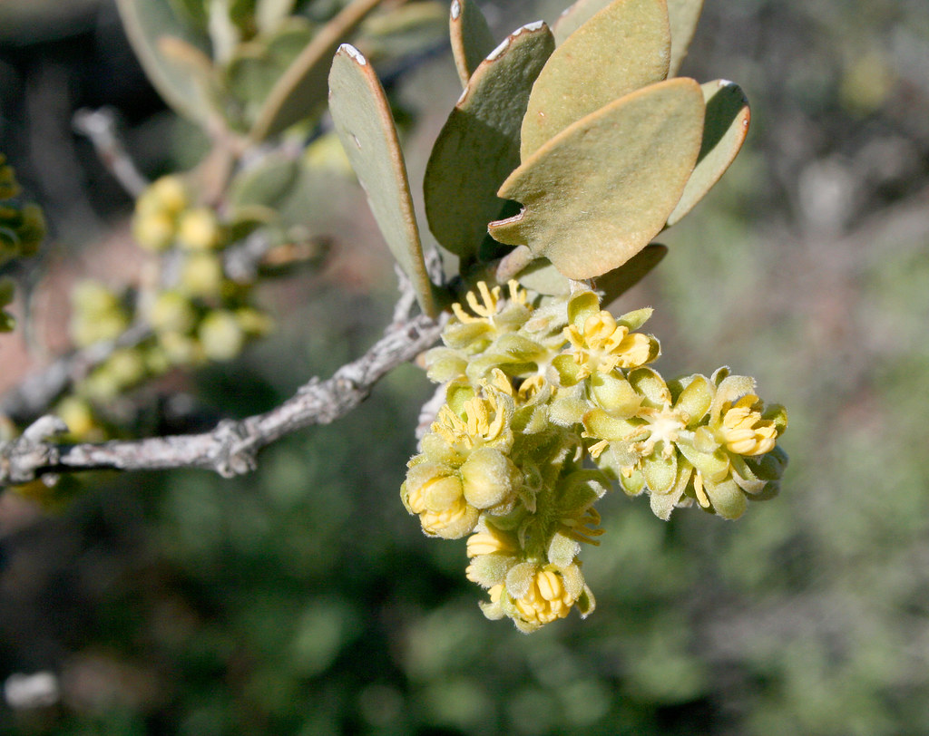
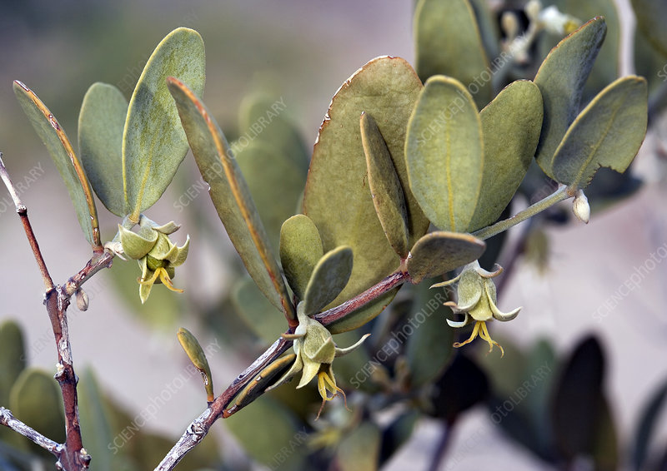
Male flower Female flower

Slide 11
Conti…
The wax esters in jojoba have a high tolerance to heat and oxidizing conditions and as such can substitute for synthetic oils used for high temperature and high pressure industrial lubrication.
The viscosity index of jojoba oil is much higher than that of petroleum oil and the utility of the jojoba product can be increased by such standard chemical modifications as hydrogenation, sulphurisation, and polymerisation (Frankel, 1976).
Jojoba oil contains no cholesterol or triglycerides and is not broken down by normal metabolic pathways. The oil can also be used as an anti-foam agent in antibiotic production and as a treatment for skin disorders (Benzioni and Forti 1989).

Slide 12
Conti..
Jojoba is used as a bio diesel fuel as well as biodegradable lubricants. It is a new solution of fuel in coming days.
The seed meal (plant material after extracting the oil) is rich in protein 29–30%, in addition to simmondsin which toxic for livestock , these toxicants could be broken and the meal could be used as livestock feed ingredient .from other side Simmondsin have insecticidal, antifeedant and antifungal activities .

Slide 13
Jojoba Producing countries
Successful jojoba cultivating countries include Israel, Mexico, Argentina, Peru Paraguay and other Latin American countries.
Each country produce 200- 800 tons of jojoba oil.
Australia has also started planting jojoba plantation late in its arid areas under irrigation condition in 2002 and got production of 9-12 tons in 2003.

Slide 14
Jojoba Agronomy And Management
Climate:
Jojoba naturally grows in marginal areas with rainfall ranging between 220-400 mm yr-1.
Jojoba is planted when soil temperatures are 20°C, Jojoba tolerates high temperatures ranging, with an optimum between 27-33°C.
Frosts below (-3°C) especially during flowering can damage the plant, in this regard, frost damage in the early flowering stages may not be as harsh as at later stages; given enough time, a new crop of flowers will replace the damaged one.
Although, excessive cold during early seedling development may kill whole plantations, however, mature bushes are able to withstand cold better than the seedlings and frost may not endanger their survival to the same degree but it may reduce yields.

Slide 15
Soil type
Jojoba grows on rough, light and medium textured well drained sandy or gravelly soils, with a pH of 5-8.5 , jojoba prefers very sandy soils with low organic matter, and it tolerates saline environments.
Drainage is critical factor; hence, water-logged clay sites should be avoided since jojoba will die if flooded for a short period.

Slide 16
Propagation
Jojoba may be propagated through seed, stem cuttings, grafting and tissue culture.
Seed propagation method:
It is an easier and cheapest method but produce male and female plants, with a slight tendency to produce more male plants, (normally 1:1 or even up to 5:1 male to female) in seeded fields. This may create a problem in field regarding position and regularity of male and female plants, at least 50% of the plants are nonproducing males, and many of the females are low-yielding or are undesirable, which leads to low productivity in seeded plantation.
Also, seed plantation of jojoba has genetic heterogeneity, which considered as negative points of seed propagation.

Slide 17
Vegetative Propagation methods
Vegetative propagation solve the problem of high male to female ratio in the field since fewer male are required compared to females, and use only desirable plants, also, these methods allow growers to plant according to planting plans.
There are different asexual methods used for jojoba propagation, like stem cuttings, air-layering , grafting and tissue culture.

Slide 18
Stem cuttings
The use of stem cuttings becoming the favorite method for propagating jojoba, for this reason, commercially stem cuttings use to produce female seedlings to improve the ratio of female to male plants, also, reducing the expense of removing male plants in seeded fields, the use of cuttings also improved the growth rate of the female plants, which no longer needed to compete with faster growing male plants for nutrients and water.
Rooting of stem cuttings, is the most commonly used as vegetative propagation method, and become the most commonly adopted methods.
For better rooting of cuttings, preferable taken during the dormant stage, when they have high carbohydrate to nitrogen (C/N) ratio, also, the use of rooting hormones on jojoba cuttings promotes quickly root formation,
The advantages of using vegetative propagation methods in commercial jojoba plantations are that they afford uniform and expected plant growth and yield and can be sexed earlier before flowering.

Slide 19
Rooted cuttings
This method has not been used commercially because of lack of mother plants as sources of cuttings; in addition, production of cuttings proceeds slowly and requires considerable controlled greenhouse facilities.

Slide 20
Vernalization
Flower induction in jojoba request 15 days to 1 month at 15-20°C to as chilling requirement for induction and break flower dormancy .

Slide 21
Time of Planting And Planting Depth
For quicker emergence, plantings should be during the warm months of the year, when soil temperatures of 21o C (70 o F) or higher.
Depth of planting should not more than 2 to 3 cm (1 1/2 inches)
However, low soil temperature may delay emergence from 20 days up to 3 months approximately.
The recommended ratio is 1:10 (male to female) in order to obtain highest yields ha-1

Slide 22
Water Requirement
Natural jojoba populations grow in areas receiving 3 to 18 inches (76 to 450 mm) of precipitation annually.
Irrigation should be applied as needed during the first 8 to 12 weeks to preserve enough moisture near to the surface of the raised bed to insure good germination and root establishment.
Later, irrigations may be applied at monthly intervals between September and January to supply the field with minimum water requirement, overwatering jojoba raised beds or may be disastrous to seedling emergence and survival

Slide 23
Plant Population
Per acre number of plants required: 750 plants.
Per acre ratio requirement of male & female plants 650 female + 100 male plants. Plant to plant distance 4-5 ft.
Row to row distance 12-13 ft.

Slide 24
Oil Content
Jojoba oil is a fixed oil of seeds, which contain about 40-50% of the light yellow, odorless oil referred as jojoba oil and consists of a long series of esters instead of a mixture of triglycerides, which gives jojoba oil unique characteristics.
Jojoba oil mainly composed of straight chain monoesters in the range of C40–C44.
Most of the wax content is esters of high molecular weight monounsaturated fatty acids and alcohol in addition to many sterols and vitamins.

Slide 25
Physio-chemical properties of Jojoba oil
Jojoba oil contains no cholesterol or triglycerides and is not broken down by normal metabolic pathways, this oil can be used as an anti-foam agent in antibiotic production and as a cure for skin disorders, also, this oil has brilliant qualities for many industrial and medicinal uses.
The oil has a peculiar molecular structure in comparison with the rest of conventional plant oils, chemically it is a liquid wax and by hydrogenation is easily transformed to a hard white wax.
Jojoba oil considered a mixture of monounsaturated C20 and C22 alcohols and acids where the double bond is placed at each side of the ester bond; this composition is unique among the rest of the vegetable oils because of the almost complete absence of glycerine .
In addition, Jojoba oil is a unique source of straight monounsaturated alcohols such as 11-eicosenol, 13-docosenol and 15-tetracosenol, which they are classified as high-added value products.

Slide 26
Genetics of Wax Production
A number of key genes encoding the enzymes involved in wax synthesis have been isolated from
jojoba (Lassner et al. 1999).
The aim is to introduce these genes into varieties of rapeseed (Brassica rapa) via transgenic Arabidopsis thaliana. B. rapa is a member of the mustard (Brassicaceae) family, which includes cultivated species such as cabbage and radish.
The production of liquid waxes in an oilseed crop more suited to large scale agriculture could allow
the production of wax esters at a price more acceptable to industrial users.
At present levels of jojoba wax achieved in transgenic B. rapa are quite high with up to 50 % of the seed oil present as “wax” in the transgenic pCGN8559 plant with the best phenotype.
The development of transgenic rapeseed varieties could provide a new source of wax esters with a lower price than the liquid wax produced in jojoba (Lassner et al. 1996; Lassner et al. 1999).

Slide 27
Expected yield:
Jojoba generally does not produce an economically viable yield until at least the fourth year after planting.
The seed production per tree around 2-3 kg per year which means to 3 metric tons per hectare.
The seed yield can reach 4-5 kg per bush with improved selection and management, from other side, there have been considerable yield differences between clonal varieties developed world wide, also, the total yield may be fluctuated depending on local conditions and management.

Slide 28
CONCLUDING REMARKS
Jojoba is an emerging crop that is well suited to production in arid regions including California, India, Israel and Australia. It requires careful management of fertilizer, soil pH and irrigation to obtain maximum yields. However, the main limitation to the widespread adoption of the crop and the development of sustainable markets for jojoba oil is a yield that is stable and predictable. This can best be achieved through vegetative propagation of adapted clonal lines produced for each region/country. Alternatively, the production of jojoba-type waxes from transgenic canola may provide a means of large scale production and the establishment of new markets. As with all new crops, the number and importance of pests of the crop is not well documented, but the crop does appear to have relatively few pests that threaten its production in any country.

