Slide 5
The special characteristic of most corrosion processes is that the oxidation and reduction steps occur at separate locations on the metal. This is possible because metals are conductive, so the electrons can flow through the metal from the anodic to the cathodic regions. The presence of water is necessary in order to transport ions to and from the metal, but a thin film of adsorbed moisture can be sufficient.

Slide 6
A corrosion system can be regarded as a short-circuited electrochemical cell in which the anodic process is something like
Fe(s) → Fe²⁺(aq) + 2 e–
and the cathodic steps can be any of
O₂ + 2 H₂O + 4e– → 4 OH–
H⁺ + e– → ½ H₂(g)
M²⁺ + 2 e– → M(s)

Slide 8
Corrosion often begins at a location (1) where the metal is under stress (at a bend or weld) or is isolated from the air (where two pieces of metal are joined or under a loosely-adhering paint film.) The metal ions dissolve in the moisture film and the electrons migrate to another location (2) where they are taken up by a depolarizer. Oxygen is the most common depolarizer; the resulting hydroxide ions react with the Fe²⁺ to form the mixture of hydrous iron oxides known as rust

Slide 9
Which parts of the metal serve as anodes and cathodes can depend on many factors, as can be seen from the irregular corrosion patterns that are commonly observed. Atoms in regions that have undergone stress, as might be produced by forming or machining, often tend to have higher free energies, and thus tend to become anodic.

Slide 10
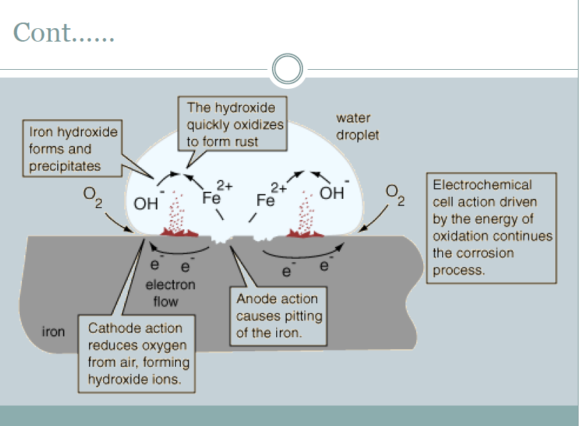

Slide 12
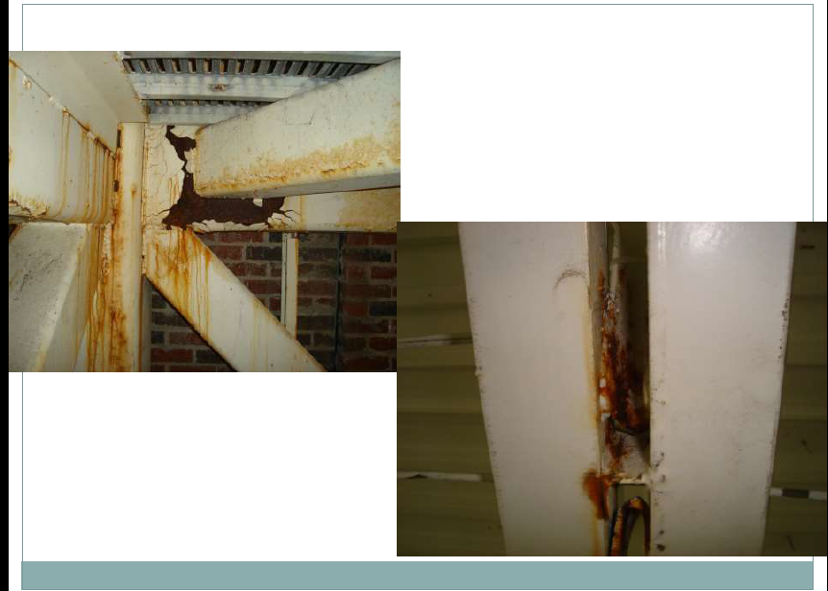

Slide 17
Sacrificial protection
Sacrificial protection is the protection of iron or steel against corrosion by using a more reactive metal. Pieces of zinc or magnesium alloy are attached to pump bodies and pipes. The protected metal becomes the cathode and does not corrode. The anode corrodes, thereby providing the desired sacrificial protection.

Slide 18
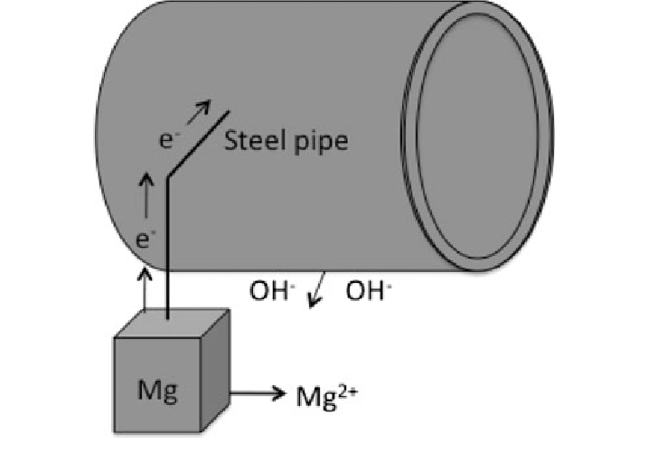

Slide 20
Impressed current cathodic protection (ICCP)
Impressed current cathodic protection (ICCP) is a type of system usually applied where there are elevated current requirements for protection against corrosion. This is used in cases where the driving voltage is higher than the galvanic system or if there is a need for increased system control.
Cathodic protection is used to prevent corrosion in a wide range of applications where the structure being protected is surrounded by an environment that allows current flow. Unfortunately, atmospherically exposed metal cannot be cathodically protected because air is not a conductor of electrical current, but most submerged and buried applications are suitable for cathodic protection including pipelines, ships, docks, jetties, storage tanks, and a range of other structures.
Impressed current anode systems are different than galvanic (sacrificial) systems because they utilize an external DC power supply to create the electrical current flow. The use of an external power supply enables an impressed current system to generate significantly higher current output with fewer, longer lasting anodes than any sacrificial anode system.

