Slide 1
Preparation of fortified Multigrain Roti
Functional food and nutraceuticals

Slide 2
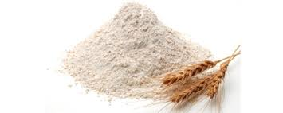

Slide 3
Whole grains Roti/Bread
Bread has always been a dietary staple in households.
It’s a good source of carbohydrate and low in fat
whole grain varieties are a good source of protein, fiber, vitamins, and minerals, as well as healthy fats.
due to the grains being ground down during processing, white and whole wheat breads have a higher glycemic index (GI) than whole grain bread, which results in glucose being released into the bloodstream more quickly.
Regular consumption of lower GI foods helps to regulate blood glucose levels, keeping us fuller for longer and helping us eat fewer calories to keep our weight in check.

Slide 4
Health benefits
Whole grains are high in dietary fiber, which helps keep us feeling full.
Diets high in whole grains are used to reduced risk of health conditions such as
Excess weight
Obesity,
Heart disease
Type 2 diabetes
Some cancers
Dietary fiber is also beneficial for bowel health by preventing constipation and feeding the gut bacteria, which is likely to result in a number of health benefits.

Slide 5
Ingredients
Mix all the flour together and store in an airtight container and use as required
Multigrain Atta
Whole Wheat Flour – 2 kg
Barley Flour– 200 g
Millet Flour – 200 g
Besan – 200 g
Oats Flour – 200 g
2 cups Multigrain Atta
Water to knead the dough

Slide 6
Method
Take Multigrain atta in a bowl. Add water and knead to make a soft dough.
Knead the dough for 2-3 minutes until it is smooth. Cover the dough and keep it aside to rest for 10 minutes.
Make small lemon sized from the dough.
Heat a griddle. Dust and roll the dough balls with very gentle hand to make a 5-6 inch circle.
The roti should be thinner from the sides than the center.
Transfer the roti on the hot griddle. Once brown spots appear on the lower surface, flip the roti.
Cook until brown spots appear on the other sides as well.
Hold the roti with a tong and fluff it over the direct flame.

Slide 7
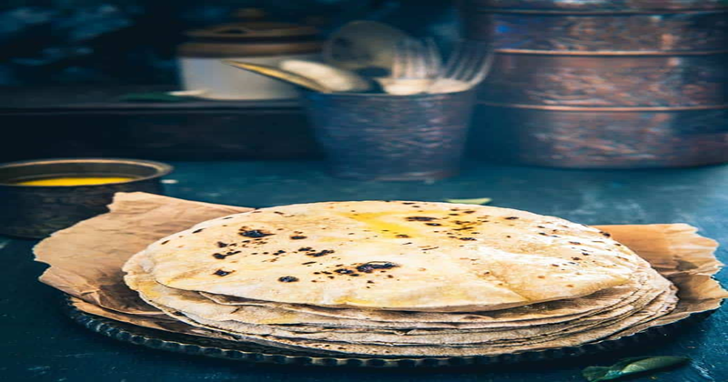
Nutrition Facts for Multigrain Roti
Amount Per Serving
Calories 151 kcal
NUTRITIENTS AMOUNT % Daily Value*
Potassium 44mg 1%
Carbohydrates 31g 10%
Fibre 1g 4%
Protein 4g 8%
Calcium 6mg 1%
Iron 1.9mg

