Slide 1
Plant cell organelles

Slide 2
PLASTIDS

Slide 3
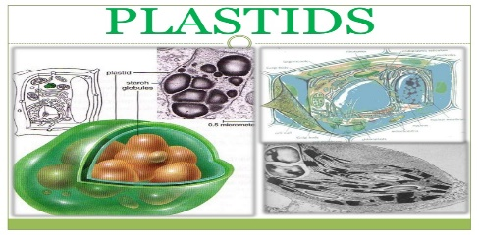
DEFINITION:
Plastid are semiautonomous double membrane-bounded organelle having DNA,RNA and ribosomes, involved in the synthesis and storage of food, commonly found within the cells of photosynthetic plants and also in bacteria.

Slide 4
HISTORY
Haeckel in 1865 discovered plastids, but the term first used by Schimper in 1883.
A well organizes system of grana and stroma in plastids of normal barley plant was reported by de Von Wettstein.
Park and Biggins in 1964 gave the concept of quantosomes.
The term chlorophyll was given by Pelietier and Caventou, and structural detail was given by Willstatter and Stall.
The term thylakoid was given by Menke in 1962.
Fine structure was given by Mayer.
Ris and Plaut in 1962 reported DNA in chloroplasts and was called plastidome.

Slide 5
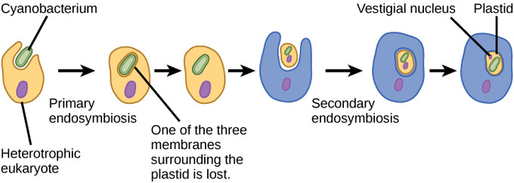
ORIGIN OF PLASTIDS
Takes place through two processes
Primary endosymbiosis
Secandary endosymbiosis

Slide 6
Primary endosymbiosis.
A heterotrophic eukaryote eats a Gram-negative cyanobacterium (A, which is retained rather than being digested).
The cyanobacterial genes are transferred to the nuclear genome of the host.
The protein products of these genes are targeted to the plastid by way of a transit peptide.
The primary plastid is bounded by two membranes derived from the inner and outer membranes of the cyanobacterium.
The presumed phagosomal membrane is lost, as is the peptidoglycan wall (except in glaucophyte algae).

Slide 7
Secondary endosymbiosis.
A primary alga (either a red or green alga) is eaten but not digested by a second eukaryote.
This eukaryotic endosymbiont degenerates and genes encoding plastid-targeted proteins are moved from its nucleus to the secondary host nuclear genome.
Some genes may also move from the plastid genome to the secondary host nucleus.
These plastids would originally be bounded by four membranes derived as indicated.
In euglenoids and dinoflagellates, the plastid is bounded by three membranes, and the primary algal cytoplasmic membrane (second from outside) is presumed to have been lost.

Slide 8
STRUCTURE OF PLASTIDS
SHAPE AND SIZE
Chloroplasts may be spherical, ovoid or discoid in higher plants and stellate, cup-shaped or spiral as in some algae.
They are usu­ally 4-6 µm in diameter and 20 to 40 in number in each cell of higher plants, evenly distributed throughout the cytoplasm.

Slide 9
Stroma
The inner membrane encloses a matrix, the stroma which contains small cylindri­cal structures called grana. Most chloroplasts con­tain 10-100 grana.
Electron dense bodies, osmophilic granules along with ribosomes, circular DNA, RNA and soluble enzymes are also present in the matrix of the stroma.

Slide 10
The Grana and Thylakoids
Each granum has a number of disc-shaped membranous sacs called grana lamellae or thylakoids (80-120Å across) piled one over the other.
The grana are interconnected by a network of anastomosing tubules called inter-grana or stroma lamellae.
Single thylakoids, called stroma thylakoids, are also found in chloroplasts.

Slide 11
Membranes of chloroplasts
Chloroplasts thus have three different membranes, the outer, the inner and the thylakoid membrane.
The thylakoid membrane consists of lipoprotein with a greater amount of lipids which are galactolipids, sulpholipids, phospholipids.

Slide 12
Plastoglobuli
Plastoglobuli (PGs) are plastid lipoprotein particles surrounded by a membrane lipid monolayer.
PGs contain small specialized proteomes and metabolomes.
They are present in different plastid types (e.g., chloroplasts, chromoplasts, and elaioplasts) and are dynamic in size and shape in response to abiotic stress or developmental transitions.

Slide 13
Quantosomes
Quantosomes were first identified by Roderic B. Park in 1962.
They are composed of lipids and proteins that include various photosynthetic pigments and redox carriers.
For this reason they are considered to be photosynthetic units.
They occur in 2 sizes:
The smaller quantosome is thought to represent the site of photosystem I.
The larger to represent the site of photosystem II.

Slide 14
INHERITANCE OF PLASTIDS IN PLANTS
All plastids are derived from proplastids, which are present in the meristematic regions of the plant.
Proplastids and young chloroplasts commonly divide, but more mature chloroplasts also have this capacity.
Most plants inherit the plastids from only one parent.
Angiosperms generally inherit plastids from the maternal source.
Many gymnosperms inherit plastids from the paternal source.
Algae also inherit plastids from only one parent.

Slide 15
CONT…
Intraspecific crossings
In normal intraspecific crossings (resulting in normal hybrids of one species), the inheritance of plastid DNA appears to be quite strictly 100 percent uniparental.
Interspecific hybridizations
In interspecific hybridizations, however, the inheritance of plastids appears to be more erratic.
Although plastids inherit mainly maternally in interspecific hybridizations, there are many reports of hybrids of flowering plants that contain plastids of the father.

Slide 16
TYPES OF PLASTIDS

Slide 17
Proplastids
A proplastid is an organelle found in the meristematic regions of the plant.
It is colorless and small. It is from where plastids are derived.
It is still undeveloped and may divide to produce more proplastids.
As the cell containing proplastids mature, the proplastids transform and develop into plastids with specialized functions.

Slide 18
Chloroplasts:
Chloroplasts are plastids that are located in the mesophyll cells on plant leaves.
Here, chloroplasts form a monolayer as they are pressed against the cell wall by the vacuole.
Some chloroplasts can also be found in the epidermal cells of the plant, but are less developed compared to those found in mesophyll cells.
The thylakoid membrane houses protein complexes that contain chlorophyll molecules that are directly involved in photosynthesis (capturing light and energy pathways).

Slide 19
Pigments in chloroplasts
Chlorophyll a C₅₅H₇₂O₅N₄Mg
Chlorophyll b C₅₅H₇₀O₆N₄Mg
Chlorophyll c C₃₅H₃₀O₅N₄Mg
Chlorophyll d C₅₄H₇₀O₆N₄Mg

Slide 20
CHROMOPLASTS:
"Chromo" comes from Greek word meaning color.
Chromoplasts are brightly colored plastids that act as the site of pigment accumulation.

Slide 21
CONT…
They are typically found in the fleshy fruits, flowers as well as various other pigmented parts of the plant such as leaves.
FUNCTIONS
Plastids play an important role in pollination given that they act as visual attractors for animals involved in pollination.

Slide 22
There are two types of chromoplasts which include:
Phaeoplast
Brownish and naturally found in brown algae
Rhodoplast
Plastids found in red algae.

Slide 23
Based on their structures, chromoplasts are categorized as follows:
Globular chromoplasts
Crystalline chromoplasts
Fibrillar chromoplasts
Tubular chromoplasts
Membranous chromoplasts.

Slide 24
Leucoplasts :
Generally, leucoplasts are colorless plastids that are commonly found in colorless leaves and rapidly growing tissues (tubers, stems, roots etc).
Here, leucoplasts serve as the site of
Starch formation
Storage
Compared to plastids like chloroplast and chromoplasts, leucoplasts lack such pigments as chlorophyll.

Slide 25
Location in plants and function
Moreover, they are located in deep tissue such as plant seeds and are therefore not directly exposed to light.
While the main function is storage, some of the leucoplasts are also involved in the synthesis of fats and lipids.

Slide 26
Leucoplasts are classified into three groups:
Amyloplasts
Elaiplasts or oleoplasts
Proteinoplasts

Slide 27
Amyloplast
Amyloplasts are responsible for storing starch, which is a nutritive polysaccharide found in plant cells, protists and some bacteria.
It is usually in the form of visible granules under a microscope.
Plastids are the only way by which plants synthesize starch and it is also the only place where it is contained.

Slide 28
Function of Amyloplasts
It is in all plant cells and its main function is to carry out amylolysis and phosphorolysis (starch catabolism pathways).
Amyloplasts have considerable amounts of starch. Because their grains are dense, they interact with the cytoskeleton causing the meristematic cells to fracture perpendicularly.
Amyloplasts are the most important of all leucoplasts and differentiate from each other by their size.

Slide 29
Oleoplastos
Oleoplastos or elaiplastos, are responsible for the storage of oils and lipids.
Its size is small and has many small drops of fat inside.
They are also known as lipoplasts
Location in plants
They are present in epidermal cells of some cryptogams and in some monocotyledons and dicotyledons that lack the accumulation of starch in the seed.

Slide 30
Proteinoplast
These types of plastids store proteins that accumulate as crystalline or amorphous inclusions within the organelle and are usually bounded by membranes.
They may be present in different cell types and also vary the type of protein it contains depending on the tissue.

Slide 31
CONT…
Studies have found the presence of enzymes such as peroxidases, polyphenol oxidases, as well as some lipoproteins, as the major constituents of the proteinoplasts.
These proteins can function as a reserve material in the formation of new membranes during the development of the plastid.

Slide 32
Gerontoplasts
The term gerontoplast was first introduced in 1977 to define the unique features of the plastid formed during leaf senescence.
These are basically chloroplasts that go with the aging process.
Geronoplasts refers to the chloroplasts of the leaves that helps the beginning to convert into different other organelles when the leaf is no longer using photosynthesis usually in an autumn month.

Slide 33
CONT…
The process of senescence brings about regulated dismantling of cellular organelles involved in photosynthesis.
The formation of gerontoplasts from chloroplasts during senescence involves extensive structural modifications of the thylakoid membrane with the concomitant formation of a large number of plastoglobuli with lipophilic materials.
The envelope of the plastid, however, remains intact.

Slide 34
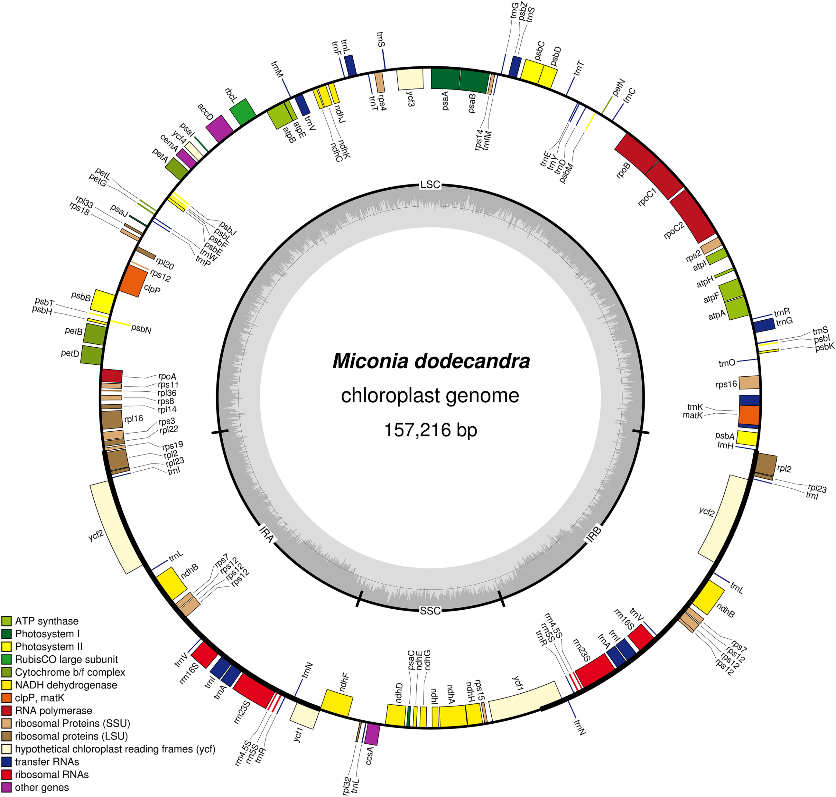
GENOME OF PLASTIDS
Plastids possess their own genome, the plastome, and a specific machinery to decode its genetic information.
The first complete plastid genome sequences were published in 1986.
Since then, more than 30 genomes from embryophytes and eukaryotic algae have been deciphered.

Slide 35
ROLE OF GENES AND PROTIENS N PLASTID GENOME
The plastid genome contains about 100 genes encoding ribosomal and transfer ribonucleic acids (rRNAs and tRNAs) as well as proteins involved in photosynthesis and plastid gene transcription and translation.
Nuclear genes encode the vast majority of plastid proteins, and the expression of plastid genes and nuclear genes is tightly co-regulated to allow proper development of plastids in relation to cell differentiation.
Each plastid has a relatively small genome.

Slide 36
Units of kilobase pairs in plastid genome
Each plastid creates multiple copies of the circular 75-250 kilo bases plastid genome.
Generally, several plastid DNA molecules are organized into nucleoprotein complexes, so-called nucleoids..
The plastid genome of embryophytes typically consists of units of 120 to 160 Kilo base pairs.
In contrast, plastid genome units of algae show large size variations from less than 100 kbp to more than 1.5 Mbp.
Moreover, in some protozoan parasites, relic non-photosynthetic plastid-like organelles of algal origin, contain small 35 kbp genomes.

Slide 37
Stromules
Long, thin protuberances called stromules sometimes form and extend from the main plastid body into the cytosol and interconnect several plastids.
Proteins, and presumably smaller molecules, can move within stromules.
Most cultured cells that are relatively large compared to other plant cells have very long and abundant stromules that extend to the cell periphery.

Slide 38
Plastid nucleoids
Plastid DNA exists as large protein-DNA complexes associated with the inner envelope membrane called "plastid nucleoids."
Each nucleoid particle may contain more than 10 copies of the plastid DNA.
The proplastid contains a single nucleoid located in the center of the plastid.
The developing plastid has many nucleoids, localized at the periphery of the plastid, bound to the inner envelope membrane.
The remodeling of nucleoids is believed to occur by modifications to the composition and abundance of nucleoid proteins.

Slide 39
MECHANISM OF REACTIONS IN PLASTIDS
Photosynthesis
“Basically, photosynthesis is the process through which plants (and other primary producers) are able to convert energy from sunlight to chemical energy that is in turn used to convert water, carbon-dioxide and minerals into organic compounds (glucose).”

Slide 40
Photosystem and reaction center
Each photosystem has antenna chlorophyll complexes and one reaction center in which energy conversion takes place.
In higher plants, the pigments present are chlorophyll-a, chlorophyll-b, carotene, and xanthophyll.
The two photosystems and the components of the electron transport chain are asymmetrically distributed across the thylakoid membrane.
Electron acceptors of both PS I and PS II are on the outer (stroma) surface of the thylakoid membrane.
Electron donors of PS I are on the inner (thylakoid space) surface.

Slide 41
Cont…
Here, the photosynthetic pigments are embedded in the thylakoid membrane.
The process (photosynthesis) involves two major stages including the light phase (light reactions) and the dark phase (dark reactions).

Slide 42
Photsynthesis
Light reactions
Dark reactions

Slide 43
The light reaction involves two important steps which include photolysis and photophosphorylation.
Photolysis
is the process involved in water splitting (releasing oxygen, hydrogen and electrons) in presence of light.
Photophosphorylation
May occur through the process already described above to produce ATP and NADPH through a process known as Non-cyclic photophosphorylation.
However, it can also occur through another process known as cyclic-photophosphorylation (cyclic electron flow) where the end product is only ATP.

Slide 44
Electron Flow
Photosystems I and II (PSII and PSI) are two of the most important transmembrane protein complexes involved in electron transfer in light reactions.

Slide 45
Five Protein Complexes involved in Electron Transfer.
PSII and PSI
Plastoquinone (PQ)
Cytochrome b6f complex
Plastocyanin (PC)

Slide 46
PSII and PSI
These two contain chlorophyll (pigment that absorbs sunlight energy) they release electrons that are then transported through the electron transfer chain.

Slide 47
Plastoquinone (PQ)
When the electrons are released from the photosystems (PSII), they are accepted by plastoquinone (it also accepts hydrogen ions from the stroma).
Electrons from the photosystems are then transported by plastoquinone to the cytochrome b6f complex while the hydrogen ions (protons) are transported to the lumen (thylakoid lumen) which is also important or synthesis and production of ATP.

Slide 48
Cytochrome b6f complex
Electrons carried by plastoquinone are transported to the cytochrome bf complex, which in turn transfers these electrons (as well as protons from stroma) to the plastocyanin.
During photosynthesis, this complex enzyme and contributes in the transfer of electrons to PSI while mediating in the pumping of protons (into thylakoid lumen space) to contribute in the synthesis of ATP.

Slide 49
Plastocyanin (PC)
From the cytochrome bf complex, electrons are transferred to the plastocyanin, which acts as a carrier that in turn transports these electrons to PSI.
As with PSII, photons cause the electrons to become exited and act at higher energy level

Slide 50
PSII
Here, the reaction center belonging to PSI moves these electrons to a small protein known as ferrodoxin located in the thylakoid membrane (stromal side) where NADP reductase (an enzyme) helps synthesize DADPH by moving the electrons in this protein (ferrodoxin ) to NADP ion.
Ferredoxin acts as a carrier that accepts the electrons and consequently reduced to give up the electrons for synthesis of NADPH.
This process (transport process) is also involved in the production of ATP.

Slide 51
ATP SYNTHASE
Here, the protons (Hydrogen ion) transported in the electron transfer chain provides the energy required to produce ATP from the phospholylation of ADP (adenosine di-phosphate).
ATP synthase enzyme uses this energy to catalyze ATP from ADP.

Slide 52
DARK REACTIONS
Unlike light dependent reactions, light-independent reactions take place in the stroma of the chloroplast which is filled with fluids.
As the name suggests, dark reactions do not require light energy and thus take place in the absence of light as such, they are also referred to as light independent reactions.

Slide 53
CALVIN CYCLE
Calvin cycle is named after Calvin Benson, who discovered it and explains the reactions that produce carbohydrate molecules.
The processes that follow are divided into three main phases.
FIXATION
REDUCTION
REGENERATION

Slide 54
Fixation:
RuBP has five atoms of carbon, flanked by two phosphates.
RuBisCO catalyzes a reaction between CO2 and RuBP.
For each CO2 molecule that reacts with one RuBP, two molecules of 3-phosphoglyceric acid (3-PGA) form. 3-PGA has three carbons and one phosphate.
Each turn of the cycle involves only one RuBP and one carbon dioxide and forms two molecules of 3-PGA.
This process is called carbon fixation because CO2 is “fixed” from an inorganic form into organic molecules.

Slide 55
Reduction:
ATP and NADPH are used to convert the six molecules of 3-PGA into six molecules of a chemical called glyceraldehyde 3-phosphate (G3P).
This is a reduction reaction because it involves the gain of electrons by 3-PGA.
For ATP, energy is released with the loss of the terminal phosphate atom, converting it to ADP; for NADPH, both energy and a hydrogen atom are lost, converting it into NADP+.
Both of these molecules return to the nearby light-dependent reactions to be reused and reenergized.

Slide 56
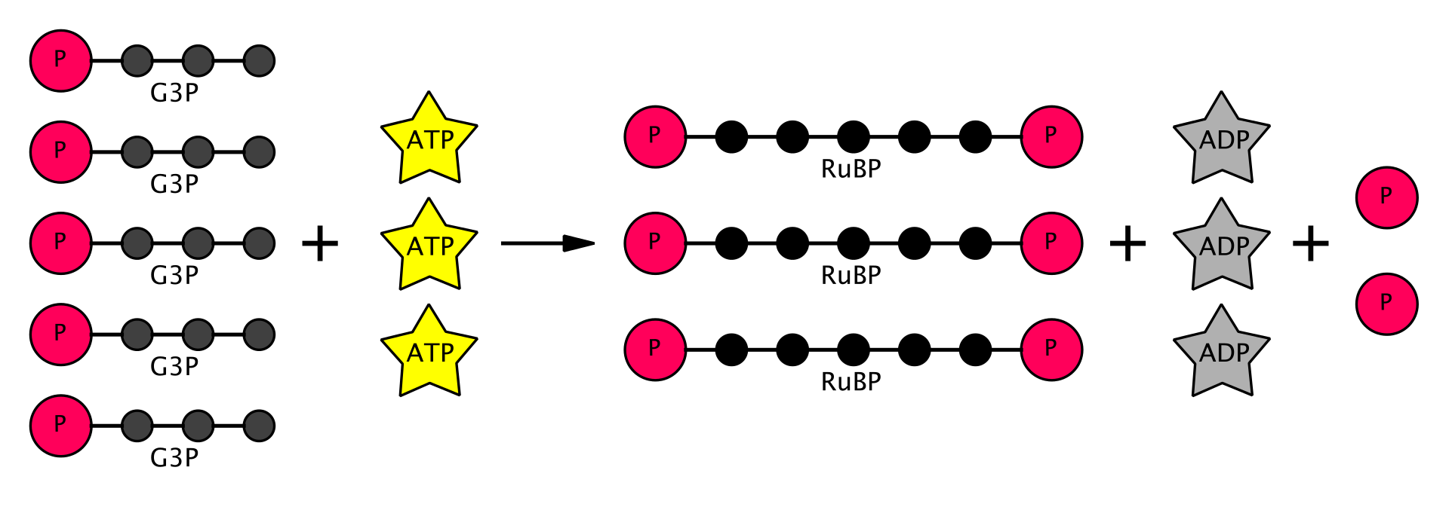
Regeneration:
After formation of six G3Ps. One is exported while the remaining five G3P molecules remain in the cycle and are used to regenerate RuBP, which enables the system to prepare for more CO2 to be fixed.
Three more molecules of ATP are used in these regeneration reactions.

Slide 57
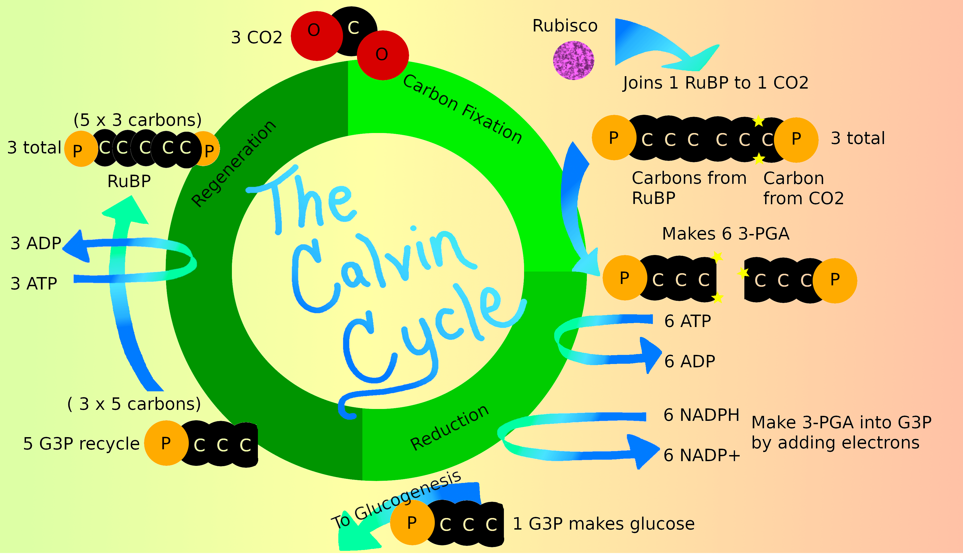

Slide 58
Versatile roles of plastids in plant growth and development
Embryogenesis
Embryogenesis is the very first step of plant development.
Although the early embryo does not contain chloroplasts, it does contain plastids.
According to a recent estimate, > 30 % of genes required for proper embryo formation encode plastid-targeted proteins, highlighting the essential role of plastids in embryogenesis.
Leaf development
Plastid biogenesis, particularly chloroplast biogenesis, affects leaf development as the chloroplast serves as the photosynthetic apparatus in leaf tissues.

Slide 59
CONT…
Gravitropism
The starch-accumulating amyloplast is thought to be involved in gravitropism
Temperature response
Adaptation to external environmental factors, such as temperature, is indispensable for plant survival, and some plastid proteins appear to be involved in the temperature response.
For instance, plastid-localized heat shock proteins are known to affect thermotolerance in Arabidopsis

Slide 60
Function of plastids
Chloroplasts: These plastids are green due to the presence of chlorophyll pigment, and hence are responsible for photosynthesis.
Chromoplasts: These are coloured plastids containing pigments other than chlorophyll, are found in fruits, flowers, roots, and stressed and aging leaves, and are responsible for their distinctive colors.

Slide 61
CONT…
Leucoplasts: These are colorless non-pigmented plastids found in the non-photosynthetic parts of the plant, such as the roots, and may differentiate into more specialized plastids like-
Amyloplasts: used for storage of starch and gravity detection (geotropism).
Elaioplasts: used for fat storage.
Proteinoplasts: used for protein storage and modification.

Slide 62
Plant cell wall

Slide 63
PLANT CELL WALL
INTRODUCTION:
Cell wall was first observed and named simply as wall by ROBERT HOOK in 1665.
Cell wall is the layer that surrounds cell , outside the cell membrane .
It may be rough ,flexible and rigid that provide cell with both structural support and
Protection.

Slide 64
Introduction
On the basis of chemical composition of cell wall ,there are three types of cell wall:
Bacterial cell wall: made up of mucopeptide and muramic acid .
Cell wall of fungi: made up of chitin .
Plant cell wall: made up of cellulose .

Slide 65
PLANT CELL WALL
The plant cell wall is the remarkable structure .
It provides the most signfucant difference between plant cell and other eukaryotic cells .
The cell wall is rigid( up to many micrometers in thickness)and
give plant cell a very well defined shape and structure.
While the other celld have a outer membrane ,none is comparable in strength to the plant cell wall.
The cell wall is the reason for the difference between plant and animal cell functions. Becausr the plants have evolved this rigid structure.
.

Slide 66
COMPOSITION OF CELL WALL
The cell wall is mainly composed of carbohydrate materials .The major components of cell wall are cellulose ,pectins ,hemicellulose ,proteins and phenolics
CELLULOS:
It provides shape and strength to the cell wall. It is polysaachride made up of many sugars .It composes 20-30% of the dry weight of primary wall and accounts 40-90% of he dry weight of secondary wall. Celluose is the most abundunt carbohydrate on the earth as it is present in cll wall f every plant.

Slide 67
PECTINS :
They are group of polysaccharides ,which are rich in galacturonic acid,rhamnose,arabinose and galactose.pectins are present in high concentrations in middle lamella where they presumbly serve the function of cementing adjacent cells together.
HEMICELLULOSES:
These are matrix of polysaccharides built up of a variety of different sugars .they differ in different species and in different cell wall types.It is is present in more amount in primary cell wall and in less amount in secondary cell wall.

Slide 68
Xylan:
It typically makes up roughly 5% of primary cell wall and 20% of secondary cell wall in dicots.It is linked with xylose and arabinose.
PROTEINS :
Different varieties of proteins are present in cell wall, most of which are linked with carbohydrate forming glycoproteins .The wall glycoprotein contains an unusual amino acid hydroxyproline (about 40%) which is generally absent from protoplast.Extensins are present in the primary cell walls of dicots making up one to ten percent of th wall.

Slide 69
COMPONENTS OF CELL WALL:
The plant cell wall is compose of :T
The Middle Lamella
The primary cell wall
The secondary cell wall
The tertiary cell wall

Slide 70
MIDDLE LAMELLA:
It is present between two adjacent cells.
It is situated outside the primary cell wall.
It is made up of calcium and magnesium pectate.
It acts as cement which holds the adjacent cells together.
PRIMARY CELL WALL:
It is formed after the middle lamela.
A thin, flexible and extensible layer.
It is capable of growth and expansion.
The backbone of primary cell wall is formed by the cellulose fibrils.
The matrix is composed of hemicellulose ,pectin compounds, lipids and structural proteins.

Slide 71
Secondary cell wall:
It is inelastic and rigid and thicker.
Inner to primary cell wall.
High amount of cellulose
It contains more cellulose and less hemicellulose
Lignin ,cutin and suberin are also present .
It consist of three layers that only differ in orientation .
Pits are present
Present mostly in woody plants .

Slide 72
TERTIARY CELL WALL;
It is deposited in few cells.
It is considered to be dry residue of protoplast .
Beside cellulose and hemicellulose ,xylan is also present .
PLASMODESMATA:
Plasmodesmata are protoplasmic strands that connect the protoplast of neighbouring cells .
Diameter is 40 to 50 nano meter.
These are small pores ar channels for transportation and communication between adjacent cells .
It acts as bridge between cells.

Slide 73
Difference between primary and secondary cell wall

Slide 74
FUNCTIONS OF CELL WALL:
It determines the morphology,growth and development of plant cells .
It protects the protoplasm from invasion by viral ,bacterial and fungal pathogens .
It is rigid in structure and thus help the plant in withstanding the gravitational forces.
They are involved in the transport of materials and metabolites into and out of cell.
They withstand the turgor pressure which develops within the cell due to high osmotic pressure .

Slide 75
Support:
Cell wall provides the support to the plants
Help the plants to withstand against gravity and harsh environmental factors.
Protection:
Protects from wounds and injuries
Protects from pathogens like bacteria ,viruses and fungi by
blocking their entry into the cell.
It also helps to prevent water loss.

Slide 76
Communication:
Cell wall plays role in communication between two adjacent cells through plasmdesmata.
Plays role in transfering of water and minerals from one cell to other.
Withstand turgor pressure :
Helps to maintain the turgor pressue in the cell.
Turgor pressure is the force exerted against the cell wall as he contents of the cell push the plasma membrane against the cell wall. This pressure helps a plant to remain rigid and erect bu can also cause a cell to rupture .

Slide 77
Regulate diffusion :
The cell wall is porous allowing some substances ,including proteins to pass into the cell while keeping other substances out.
Storage :
The cell wall stores carbohydrates for use in plant growth especially in seeds .

Slide 78
Why do plant have cell wall as well as cell membrane …?
when the solute concentration on one side of the cell membrane is higher than the other,and the solute cannot crosss,the water diffuses across in a process called osmosis .since solute concentration inside the plant cell is higher than the solute concentration in the immediate surroundings, water diffuses into the cells ,and if there was no cell wall,the cells would burst .the cell wall prevents the plant from bursting and helps to give the plant the support which it needs ; the turgor pressure caused by osmosis helps to give plant turgidity and keeps the plant upright .

Slide 79
If the plant begins to dry out ,water diffuses out of the plant cells so that they begin to shrivel up .As turgor pressure is lost ,the plant begins to die.
So, plant cell have additional structure cell wall that performs all those functions that a cell membrane cannot.

Slide 80
Is the cell wall living or dead…?
In each case ,the wall is rigid and essentially inorganic .
It is non-living componet of cell.
Cell wall was considered dead due to the presence of cellulose.
But with increasing pacein cell biology, it is known that cell wall has certain enzymes and proteins called as expansins .
These proteins were found to have an effect in increasing or decreasing size of cell wall.
This change is brought out by external or internal stimulus.

Slide 81
Thus, due to this property i.e ability to sense change in environment and then acting correspondingly is one of the fundamental properties of life .hence, cell wall is considered to be living .

Slide 82
Pits :
Pits are thin portions of the cell wall that adjacent cells can communicate or exchange fluids through.
Pits are characteristics of cell walls with secondary layers .
Each pit has a complementary pit opposite of it in the neighbouring cell.these complementary pits are called pit pairs .pits are composed of three parts :
The pit chamber is the hollow area where the secondary layers of the cell wall are absent .
The pit aperture is the opening at the either end of the chamber .
The pit membrane is the primary cell wall and middle Lamella ,or the membrane between adjacent cell walls , at the middle of pit chamber.

Slide 83
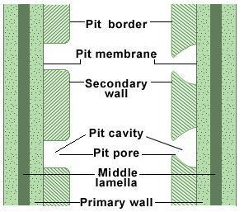

Slide 84
Types of Pits :
Simple Pits :
A pit pair in which thediameter of pit chamber and pit aperture are equal.
Present in angiosperms.
Bordered Pits:
A pit pair in which the pit chamber is over –arched by the cell wall ,creating a large pit chamber and smaller pit aperture .
Half Bordered pits:
A pit pair in which a bordered pit has a complementary simple pit .such a pit pair is called half bordered pit pair .

Slide 85
Blind Pits :
A Pit pair in which a simple pit has no complementary pit .
Compound pits :
A pit pair in which one cell wall has a Larger pit and the adjacent cell wall has numerous small pits .

Slide 86
Pits and plasmodsmata :
Pits and plasmodesmata help plant cell to communicate with each other and transport substances between them .
Pits are thin areas of the cell wall .In contrast ,plasmodemata are the cytoplasmic bridges that transverse in cell wall.
so, this is the key difference between pits and plasmodesmata.
Torus and Margo :
conifer pit membranes have two differentiated areas:
The torus ,the center circle that is very dense and has very small pores ,and the margo which is the external highly porous ring that has very low resistance to sap flow.
Tarus is present in trachides of gymnosprems

Slide 87
Formation of cell wall
After nuclear division,when cytokinesis starts cell waal is formed from the elements of golgi complex and endoplasmic reticulum .the elements of golgi and endoplasmic reticulum are aligned on the equatorial plate.
Middle lamella is formed by the deposition of calcium and magnesium pectates. Primary cell wall secreted by protoplasm which lies inside middle lamella .Secondary wall is secreted by protoplasm which lies inside primary wall.

Slide 88
Steps:
There are following steps in the formation of cell wall.
During telophase stage of mitosis ,phragmoplast widens and becomes barrel shaped .then the cell plate begins to form inside the phragmoplast on the equatorial plane .
During the telophase the phragmosome ,a flattened membranous vesicle containing cell wall components ,forms across the cell within a cytoskeletal array called the phragmoplast.
In the area where the cell plate is formed ,the fibres of phragmoplast becomes indistinct and are restricted to the circumference of the cell plate.

Slide 89
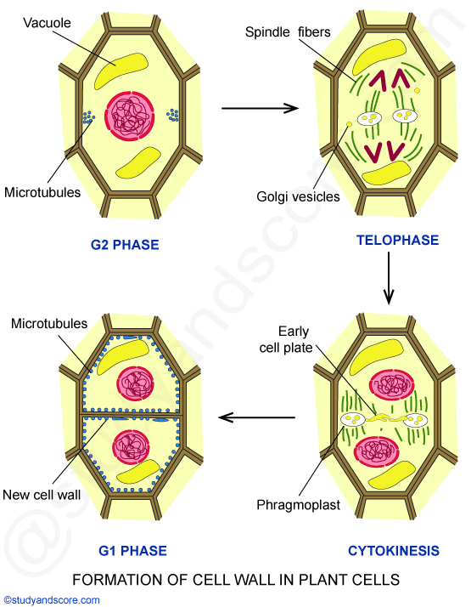

Slide 90
When the cell plate is completely formed phragmoplast
disappears completely .
At this stage ,thin lamellae are laid down by the daughter protoplast on both sides of cell plate .
Then, lamellae ,primary and secondary walls are deposited depending on the age of cell.
Growth of cell wall:
just after the formation ,the cell wall is very thin ad delicate .late it grows by deposition of substances .

Slide 91
The growth of cell wall occurs by two methods:
Intussusception
The growth that occurs by deposition of cell wall material into the spaces within in cell wall is called as intussusception .
As a result the surface area of cell wall increases .
Apposition:
New cell wall materials deposited on the surface of the existing cell wall in the form of thin layers .
It results in the increase in the thickness of the exixting cell wall .
Apposition is also called accretion.

Slide 92
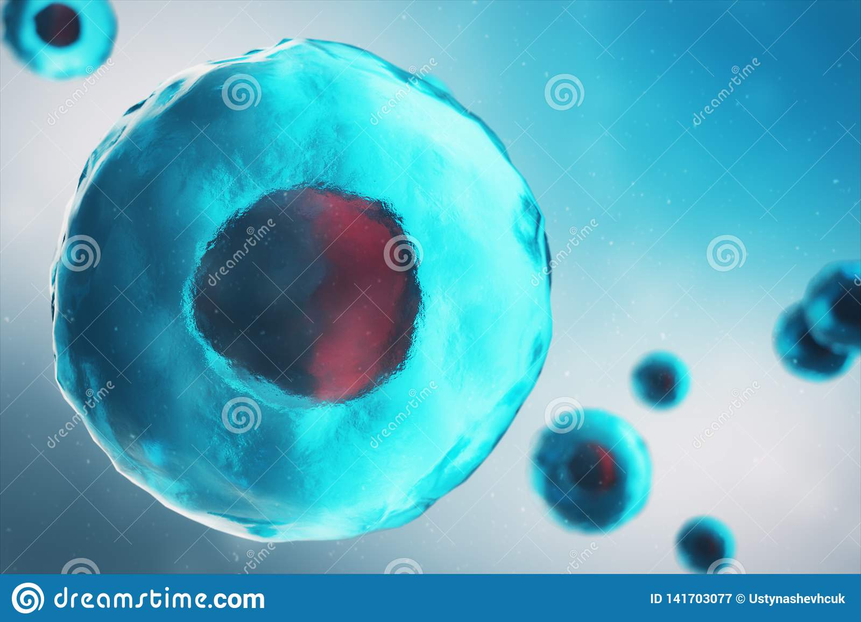
cytoplasm

Slide 93
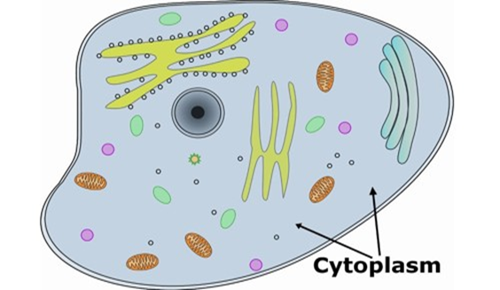
Definition
Cytoplasm, the semifluid substance of a cell that is external to the nuclear membrane and internal to the cellular membrane, sometimes described as the non-nuclear content of protoplasm.
"Cytoplasm" is sometimes used to refer to only the fluid that is not compartmentalized into organelles (membrane-bounded, distinct compartments).

Slide 94
History of Cytoplasm
The term was introduced by Rudolf von Kolliker in 1863, originally as a synonym for protoplasm, but later it has come to mean the cell substance and organelles outside the nucleus.
The cell was discovered by Robert Hooke in 1665 that made studies on strains of cork using a microscope. ... Cytoplasm's discovery was in 1831, by Robert Brown, and in 1874 received the actual name: cytoplasm.

Slide 95
Composition of Cytoplasm
It is composed of:
Water (about 85 %),
Proteins (10 to 15 %)
Lipids (2 to 4 %), nucleic acids, inorganic salts and polysaccharides in smaller amounts. Organelles are also part of the cytoplasm. The cytoplasm makes up nine-tenths of the entire cell.

Slide 96
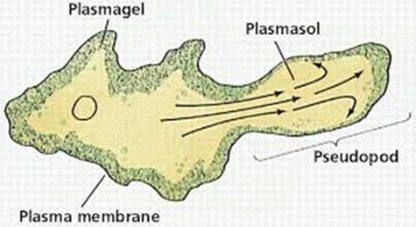
Physical and chemical features of Cytoplasm
Cytoplasm is colloidal
Contains a mixture of insoluble granules and organic substances
The outer layer called the ectoplasm
Near the periphery, is called plasmogel due to its thick and jelly-like nature. The area of the cytoplasm near the nucleus is called the plamosol and is less viscous in nature
20-50% of cytoplasmic proteins like enzymes

Slide 97
Location Of cytoplasm
In eukaryotic cells contain a membrane-bound nucleus. This nuclear envelope separates the nucleus from the other parts of the cell. As a result, the cytoplasm is restricted to the space between the nuclear membrane and the cell membrane.
In prokaryotic cells the cytoplasm occupies the entire cell environment (within the plasma membrane). In this case, all cellular components/organelles, including the genetic material, are suspended in the cytoplasm.

Slide 98
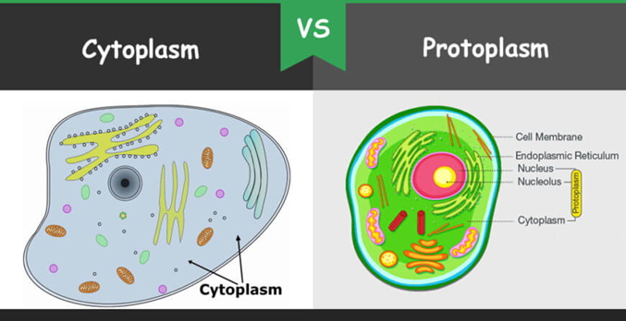
Difference between Cytoplasm and Protoplasm
Protoplasm is considered as the living substance inside the cell. It is a complex, translucent substance which is semi-fluid in consistency and composed mainly of nucleic acids, proteins, lipids, carbohydrates and inorganic salts.
Cytoplasm is a thick solution that fills each cell and is enclosed by the cell membrane. It is mainly composed of water, salts, and proteins.

Slide 99
Protoplasm
Cytoplasm
The protoplasm of a cell consists of nucleus, cell membrane and cytoplasm.
The protoplasm is bound by a plasma membrane or cell membrane on all sides.
Protoplasm has a nucleus.
The protoplasm is a viscous, viscid substance with jelly-like consistency where many biological and chemical cellular processes take place.
The cytoplasm consists of cytosol, organelles and inclusions
cytoplasm is the substance which is present surrounding the nucleus within a cell.
Cytoplasm does not have a nucleus.
Cytoplasm is an organelle of the protoplasm which consists of mainly water and other substances like proteins, food reserves and metabolic wastes.

Slide 100
Functional differences
The organelles present in the cytoplasm are Golgi body, mitochondria, endoplasmic reticulum and ribosomes. These organelles have very specific and different functions. Important functions occurring in the cytoplasm are glycolysis and processes of cell division, cellular respiration and protein synthesis.
Protoplasm is also considered as living part of the cell as all the important processes needed for the living of the cell take place in the protoplasm. Protoplasm is also said to give shape to the organism as it is a translucent, viscid and watery substance. The living protoplasm responds to stimuli and also gets rid of excretory products.

Slide 101
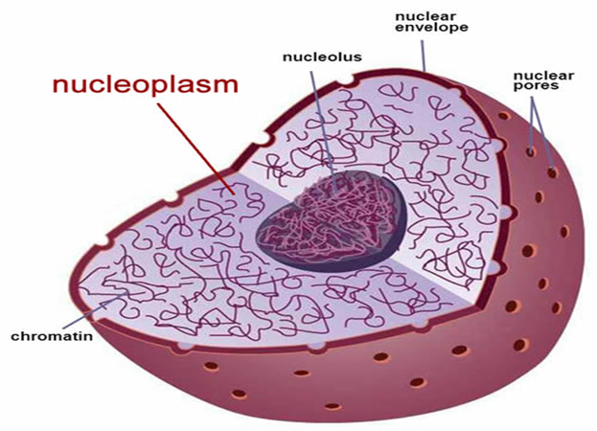
Nucleoplasm
Also known as the karyoplasm and nucleus sap, the nucleoplasm is a type of protoplasm contained within the nuclear membrane.
Like cytosol, nucleoplasm is largely composed of water, various molecules as well as dissolved ions. Apart from maintaining the shape and structure of the nucleus, nucleoplasm is also involved in the transportation of various material required for cell metabolism and other functions.
Compared to cytosol (in the cytoplasm), the nucleoplasm is highly gelatinous.
Prokaryotic cells do not have a nucleoplasm.

Slide 102
Cytoplasm in Eukaryotes
In eukaryotes (i.e., cells having a nucleus), the cytoplasm contains all of the organelles. Among such organelles are the
Mitochondria, which are the sites of energy production through ATP (adenosine triphosphate) synthesis
The endoplasmic reticulum, the site of lipid and protein synthesis
Golgi apparatus, the site where proteins are modified, packaged, and sorted in preparation for transport to their cellular destinations

Slide 103
lysosomes and Peroxisomes, sacs of digestive enzymes that carry out the intracellular digestion of macromolecules such as lipids and proteins
Cytoskeleton, a network of protein fibres that give shape and support to the cell; and cytosol, the fluid mass that surrounds the various organelles.
Although cytoplasm may appear to have no form or structure, it is actually highly organized. A framework of protein scaffolds called the cytoskeleton provides the cytoplasm and the cell with their structure.
The cytoplasm is the site of almost all of the chemical activity occurring in a eukaryotic cell. Indeed, the word cytoplasm means "cell substance".

Slide 104
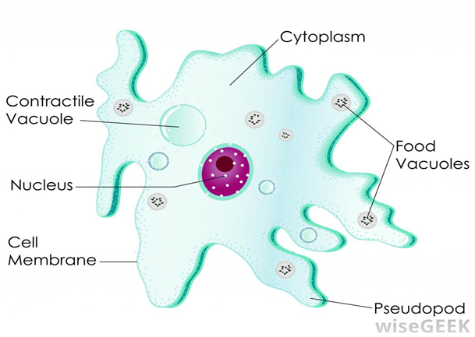
Cytoplasm in Amoeba
Despite being comprised mainly of water (about 65% by volume), the cytoplasm has the consistency of gelatin. Unlike gelatin, however, the cytoplasm will flow. This enables eukaryotes such as the amoeba to adopt different shapes, and makes possible the formation of pseudopods that are used to engulf food particles.

Slide 105
Structure of Cytoplasm
When viewed using the transmission electron microscope, the cytoplasm appears as a three-dimensional lattice-work of strands.
The lattice is made of various cytoplasmic proteins. They are scaffolding structures that assist in the process of cell division and in the shape of the cell.
The shape-determinant is referred to as the cytoskeleton. It is a network of fibers composed of three types of proteins.

Slide 106
1. Microtubules or Spindle apparatus
The microtubules are tubes that are formed by a spiral arrangement of the constituent protein. They function in the movement of the chromosomes to either pole of the cell during the cell division process. The microtubules are also known as the spindle apparatus.

Slide 107
Intermediate filaments
Intermediate filaments are stable, durable. They range in diameter from 8-10 nm (intermediate in size compared with thin filaments and microtubules). They are prominent in cells that withstand mechanical stress and are the most insoluble part of the cell. The intermediate filaments can be dissociated by urea. The intermediate filaments act as more rigid scaffolding to maintain the cell shape.

Slide 108
Microfilaments
Microfilaments, also called actin filaments, are protein filaments in the cytoplasm of eukaryotic cells that form part of the cytoskeleton. They are primarily composed of polymers of actin, but are modified by and interact with numerous other proteins in the cell. Microfilaments are usually about 7 nm in diameter and made up of two strands of actin. Microfilament functions include cytokinesis, amoeboid movement, cell motility & changes in cell shape.

Slide 109
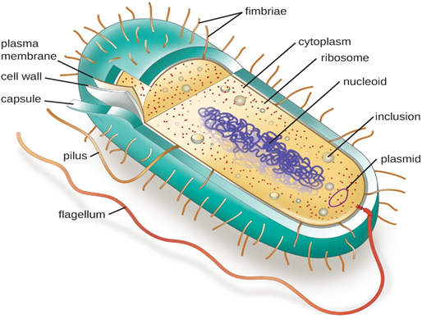
Cytoplasm of Prokaryotic cell
The cytoplasm of prokaryotes is an aqueous gel that contains cytosol, ribosomes, inclusions and the cytoskeleton. Prokaryotes have only one membrane, the plasma membrane, which encloses the cytoplasm and all of its cellular contents.
The cytoplasm is essentially where nearly all the action happens within a prokaryote - metabolic reactions, and the genetic tasks of replication, transcription, and translation.

Slide 110
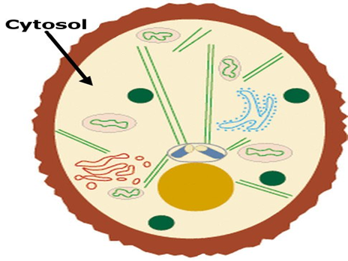
Cytosol of Prokaryotic cells
The cytoplasm is made up of the cytosol and insoluble suspended particles. The cytosol refers to the water and anything that is soluble and dissolved in it such as ions and soluble proteins.
Cytosol is the intracellular fluid, not including the contents within the organelles.
Characteristics of cytosol:
7.0 -7.4 pH range
Viscosity similar to water
Less than 0.0002 mM of calcium ions concentration
High amount of charged macromolecules

Slide 111
Inclusions of Prokaryotic Cells
Inclusions are reserves of nutrients and other chemicals, substances which the cells have an excess of and stores in deposits throughout the cytoplasm. A cell may have inclusions composed of lipids, carbohydrates or compounds containing various elements. Some inclusions even store gasses which function to control buoyancy in aquatic bacteria. Certain types of bacteria form unique inclusions that can be useful in aiding with bacterial identification.

Slide 112
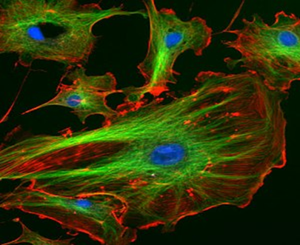
Cytoskeleton of Prokaryotes
The cytoskeleton, a network of protein fibers within the cell, was thought, until recently, to be present only in eukaryotic cells. It is now known that rod shaped bacteria, and bacteria-like prokaryotes called Archaea, also have a cytoskeleton functionally similar to that of eukaryotes. The cytoskeleton plays a role in cell division and maintaining cell shape and structure. Cocci shaped (round) bacteria are not believed to possess a cytoskeleton.

Slide 113
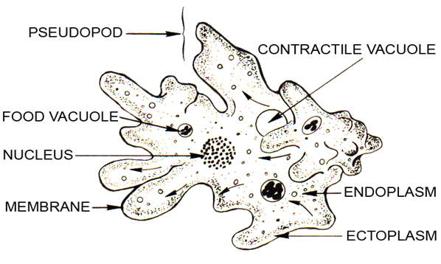
Primary parts of cytoplasm
Ectoplasm
The ectoplasm is the more gel-like peripheral portion of the cytoplasm of a cell
Endoplasm
The endoplasm is the central area of the cytoplasm that contains the organelles

Slide 114
In Amoeba
Endoplasm and ectoplasm are names for the inner and outer portions of an amoeba’s cytoplasm. Ectoplasm is the clear outer cytoplasmic layer of an amoeba. Endoplasm, on the other hand, is the inner granule-rich cytoplasm of the amoeba.
An amoeba is a single cell microorganism made up of a nucleus and cytoplasm. Its ectoplasm is a clear gel, while the endoplasm is more fluid or watery and houses the majority of the cell’s granules and minute structures. The endoplasm makes up the bulk of the cell.

Slide 115
Endoplasm
The endoplasm helps the amoeba with locomotion or movement. Since amoeba move by flowing its cytoplasm over surfaces, flowing the endoplasm in different directions moves the cell along. Some of the other components of the endoplasm include:
Amino acids
Carbohydrates
Lipids
Enzymes
Water
Inorganic Ions
Various molecular compounds

Slide 116
Ectoplasm
The ectoplasm also is responsible for changing the direction of the pseudopodium. When the alkalinity and acidity of the water changes, the location of the pseudopodium changes. Slight changes in the alkalinity or acidity impedes movement or causes the cytoplasm to start flowing. Some of the main characteristics of the ectoplasm include:
Non-granulated
Less dense and thus more clear
Thin and superficial
Contains actin filaments in higher numbers (this provides the cell membrane with elastic support)

Slide 117
Components
Prokaryotic cells, such as bacteria and archaeans, do not have a membrane-bound nucleus. In these cells, the cytoplasm consists of all of the contents of the cell inside the plasma membrane. In eukaryotic cells, such as plant and animal cells, the cytoplasm consists of three main components. They are the cytosol, organelles, and various particles and granules called cytoplasmic inclusions.

Slide 118
Cytoplasmic inclusions
Cytoplasmic inclusions are particles that are temporarily suspended in the cytoplasm. Inclusions consist of macromolecules and granules. Three types of inclusions found in the cytoplasm are secretory inclusions, nutritive inclusions, and pigment granules.
Examples of secretory inclusions are proteins, enzymes, and acids.
Glycogen (glucose storage molecule) and lipids are examples of nutritive inclusions.
Melanin found in skin cells is an example of a pigment granule inclusion.

Slide 119
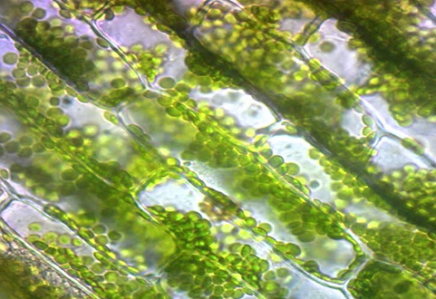
Cytoplasmic Streaming
Cytoplasmic streaming, or cyclosis, is a process by which substances are circulated within a cell. Cytoplasmic streaming occurs in a number of cell types including plant cells, amoeba, protozoa, and fungi. Cytoplasmic movement may be influenced by several factors including the presence of certain chemicals, hormones, or changes in light or temperature.

Slide 120
Impotance of Cytoplasmic streaming
Plants employ cyclosis to shuttle chloroplasts to areas receiving the most available sunlight. Chloroplasts are the plant organelles responsible for photosynthesis and require light for the process. In protists, such as amoebae and slime molds, cytoplasmic streaming is used for locomotion. Temporary extensions of the cytoplasm known as pseudopodia are generated that are valuable for movement and capturing food. Cytoplasmic streaming is also required for cell division as the cytoplasm must be distributed among daughter cells formed in mitosis and meiosis.

Slide 121
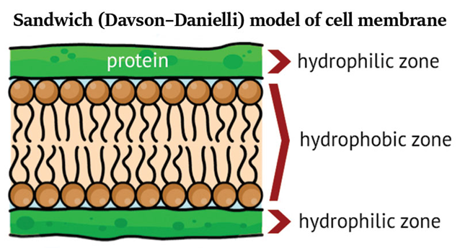
Cell Membrane and Cytoplasm
The cell membrane or plasma membrane is the structure that keeps cytoplasm from spilling out of a cell. This membrane is composed of phospholipids, which form a lipid bilayer that separates the contents of a cell from the extracellular fluid.
Extracellular fluid, proteins, lipids, and other molecules may be added to a cell's cytoplasm by endocytosis.

Slide 122
Functions of Cytoplasm
The site of synthesis:
Biochemical pathways such as glycolysis and the synthesis of fats partly take place in the cytoplasm. Enzymes for these pathways are present in the cytoplasm and in some cases, are transported to the cytoplasm from the organelles.
Transport:
The cytoplasm is involved in several forms of transportation. The endoplasmic reticulum and Golgi apparatus, both components of the endomembrane system, are some of the systems involved in the transportation of material (proteins and lipids respectively) from one point to another in the cell.

Slide 123
cytoplasm is also involved in the transportation and consequent removal of waste products from the cells through structures known as vesicles.
Maintain the shape and structure of a cell:
Cytoplasm is a viscous matrix that is largely composed of water. By exerting an outward pressure (turgor pressure) against the cell membrane, it contributes to the general shape of the cell. Apart from the pressure exerted by the fluid, the cytoplasm also contributes to the shape and structure of the cell through its cytoskeleton

Slide 124
Growth:
The cytoplasm contains proteins and filaments that are essential for growth and expansion of the cell surface. Together with the cell membrane, the cytoplasm helps in cell growth.
Protection:
Consisting of cytosol, a viscous fluid, the cytoplasm protects various components of the cell by acting as a cushion that absorbs some shock that may otherwise damage organelles.

Slide 125
Storage:
Various molecules (lipids, fats, starch, etc.) can be found floating in the cytoplasm. Some of these molecules are used to build different structures of the cells. Before they are used, however, these molecules float in the cytoplasm where they are stored. Adipocytes, for instance, are good examples of cells that store high amounts of lipids in their cytoplasm.
Site of metabolic activities:
Several enzymes can be found in the cytoplasm. The cytoplasm, therefore, is also a site of metabolism for a number of substances. These activities, however, occur at a higher rate in such organelles as the mitochondria. It is worth noting that like the chloroplast and nucleus, the mitochondria is not part of the endomembrane system.

Slide 126
Removal of waste products:
The cytoplasm aids in removal of waste products via small spherical structures called vesicles. Unwanted products in the cytoplasm and the organelles are packaged, stored and transported in vesicles. These vesicles travel towards the cell membrane and release unwanted products out of the cell by fusing with the lipid bilayer.
Movement:
The cytoplasm facilitates the movement of cellular organelles within the cell. Movement of whole cells, as seen in protozoans like an amoeba, is also enhanced by the cytoplasm that produces extrusions from the cell known as pseudopodia. These structures help the amoeba to move and engulf food particles.

Slide 127
Transport of genetic material:
Cytoplasm is a medium for transport of the DNA from the nucleus to other organelles for processing and protein synthesis. Apart from cellular DNA, viral or bacterial DNA is also found suspended in the cytoplasm of infected cells or prokaryotic cells respectively.
Barrier:
Cytoplasm acts as a barrier between organelles and prevent their grouping or collision that would obstruct their regular function.

Slide 128
Cell division:
The elasticity and fluidity of the cytoplasm help in changes to the cell shape during cell division mechanisms such as meiosis and mitosis that ultimately results in the formation of daughter cells. Some of the other functions of the cytoplasm include:
Cell movement
Cell division
Cell growth

