Slide 2
Content
Introduction
Size
Distribution
Flagella
Cell wall
Nutrition
Reserve food
Photosynthetic pigments
Accessory pigments
Spore formation
Heterocyst
Sexual reproduction

Slide 4
Bacteria
Bacteria are unicellular
Microscopic
Prokaryotic organisms
Most of them are devoid of chlorophyll and lead a heterotrophic mode of life.

Slide 5
Cyanobacteria
blue green algae
A group of ancient gram negative photosynthetic prokaryotes.
They are one of the most successful groups of organisms that have survived for about three billion years.
They can also live in extreme habitats like hot springs and under side of icebergs
They differ from other bacteria in that cyanobacteria possess chlorophyll-a While most bacteria don’t contain chlorophyll.

Slide 6
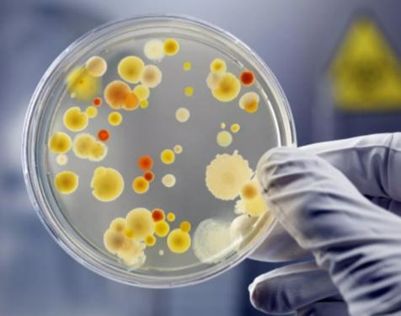
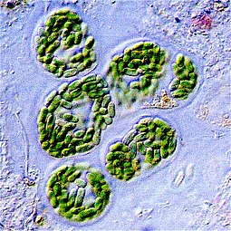
Size
Bacteria
Cyanobacteria
Comparatively larger
It ranges from 0.5 to 60 micrometer.
Comparatively smaller
It ranges from 0.5 to 5 micrometer in length.

Slide 7
Distribution
Bacteria
Cyanobacteria
Found every possible places in earth.
Soil, rock, oceans and even arctic snow.
Some live in or on other organisms including plants and animals including humans.
There are approximately 10 times as many bacterial cells as human cells in the human body.
Only found in presence of sunlight and moisture.
Cyanobacteria are present in a wide range of habitats viz. Marine, freshwater, soil, biological soil crusts, snow, cryoconites, etc.
Further, they are found in symbiotic association with different hosts and also occur in extreme stressed conditions like volcanic ash, salted soils, and anthropogenically disturbed areas.

Slide 8
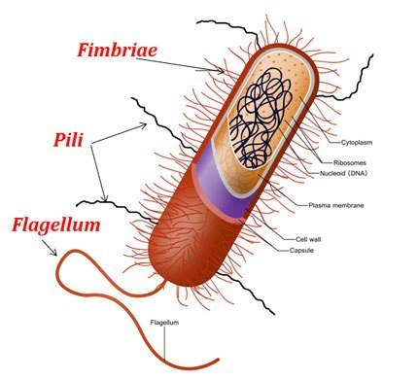
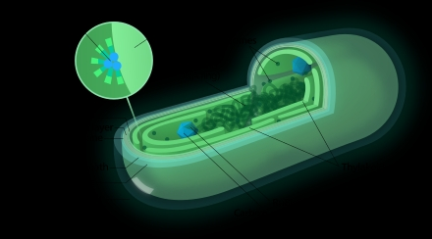
Flagella
Bacteria
Cyanobacteria
May bear flagella.
Flagella always absent.

Slide 9
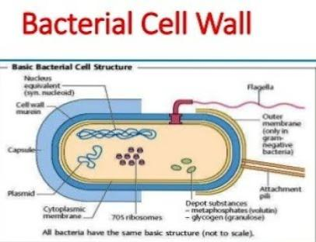
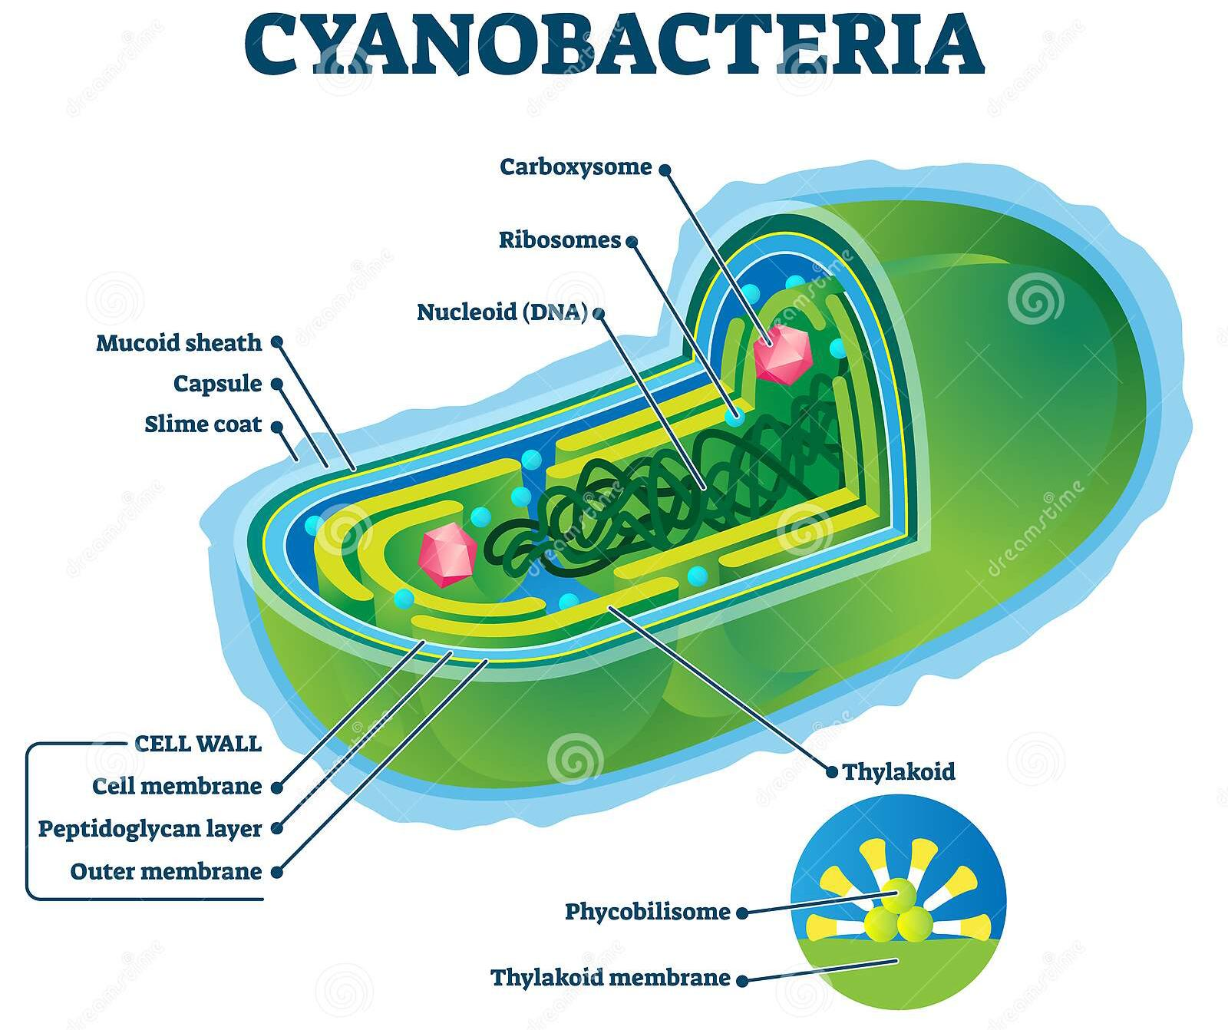
Cell wall
Bacteria
Cyanobacteria
1-2 layered
4-layered

Slide 10
Nutrition and reserve food
Bacteria
Cyanobacteria
May be autotrophic or heterotrophic.
Reserve food material is glycogen
Usually autotrophic.
Reserve food material is cyanophycean starch.

Slide 11
Photosynthetic pigments
Bacteria
Cyanobacteria
Photosynthetic pigments are light-harvesting molecules found in the thylakoid membranes of chloroplasts.
Photosynthetic pigment is bacteriochlorophyll.
Photosynthetic pigment is chlorophyll a.
The photosynthetic pigments of cyanobacteria include chlorophyll a, β-carotene, zeaxanthin, echinenone, myxoxanthophyll, and other xanthophylls in addition to an array of water soluble chromoproteins, organized in the phycobilisomes.

Slide 12
Accessory pigment
Bacteria
Cyanobacteria
Absent
Accessory pigment like phycocyanin and phycoerythrin are present in dominating form.
Cyanobacteria and red algae have phycocyanin and allophycocyanin as accessory pigments to absorbe orange light. They also have a red pigment called phycoerythrin that absorbs green light and extends the range of photosynthesis.

Slide 13
Spore formation and heterocyst
Bacteria
Cyanobacteria
Spore formationn is endogenous.
Heterocyst is absent.
Is not endogenous.
Heterocyst is Present.

Slide 14
Hydrogen donor
Bacteria
Cyanobacteria
During photosynthesis hydrogen donor is not water; as a result oxygen is not evolved. Thus photosynthesis is anoxygenic.
Hydrogen donor is water, oxygen is evolved. Process is oxygenic.

Slide 15
Locomotory organ and sexual reproduction
Bacteria
Cyanobacteria
Flagella act as locomotory organ.
Sexual reproduction takes place by conjugation, transformation and transduction.
Lack flagella and other locomotory organs.
Sexual reproduction is totally absent.

Slide 16
Sexual reproduction in bacteria

Slide 17
References
https://m.youtube.com/watch?v=NYa-NjPOu7offeren...
https://www.pinterest.com/amp/pin/5331840433817...
https://m.youtube.com/watch?v=NYa-NjPOu7o

