Slide 1
Vitamin C

Slide 2
INTRODUCTION
Vitamin C is a nutrient and an antioxidant. Antioxidants are substances that may protect your cells from certain kinds of damage.
Vitamin C is a water-soluble vitamin. It is needed for normal growth and development.
Vitamin C or L-ascorbic acid or simply ascorbate
An essential nutrient for humans and certain other animal species.
Vitamin C is synthesized in almost all species.
Vitamin C is a cofactor in at least eight enzymatic reactions

Slide 3
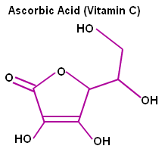
STRUCTURE
Formula: C₆H₈O₆
Molar mass: 176.12 g/mol
Melting point: 190 °C
Boiling point: 553 °C

Slide 4
FUNCTIONS
Vitamin C is needed for the growth and repair of tissues in all parts of your body. It is used to:
Form an important protein used to make skin, tendons, ligaments, and blood vessels
Heal wounds and form scar tissue
Repair and maintain cartilage, bones, and teeth
Aid in the absorption of iron

Slide 5
BIOSYNTHESIS
The vast majority of animals synthesize vitamin C.
The few animals that cannot synthesize
vitamin C in their bodies include
Apes Humans
Guinea pigs, one type of bird
One type of bat and one type of fish.

Slide 6
PROCESS

Slide 7
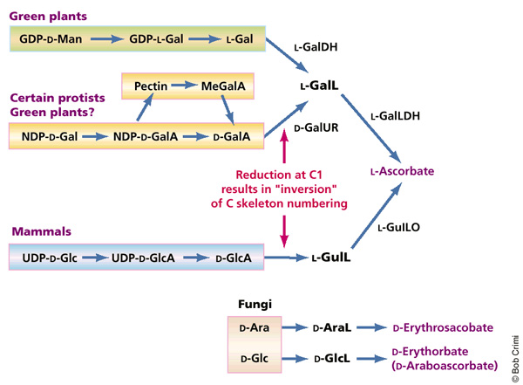

Slide 8
Lack of vitamin C can cause weak and brittle arteries and raise the risk of cardiovascular disease because of lowered collagen

Slide 9
Deficiency of Vitamin C
The newest RDAs for vitamin C are 75 mg for women
90 mg for men, 120 mg
For breastfeeding women
125 mg for male smokers
Five servings of freshfruits and vegetables provide approximately 200 mg of vitamin C.
Optimal amounts for disease prevention of the ascorbated form of vitamin C range from 200 mg to 2 grams daily.

Slide 10
Tiredness and weakness.
Muscle and joint pains.
Easy bruising.
Spots that look like tiny, red-blue bruises on your skin.
Other symptoms can include
Dry skin.
Splitting hair.
Swelling and discoloration of your gums.
Sudden and unexpected bleeding from your gums.
Nosebleeds.
Poor healing of wounds.
Problems fighting infections.
Bleeding into joints, causing severe joint pains.
Changes in your bones.
Tooth loss.
Weight loss.

Slide 11
Recommended daily intake levels for vitamin C
RDAs for Age Males Females
Vitamin C mg/day mg/day
Infants 0–6 months 40 40
Infants 7–12 months 50 50
Children 1–3 years 15 15
Children 4–8 years 25 25
Children 9–13 years 45 45
Adolescents 14–18 years 75 65
Adults 19 years and older 90 75
Adult smokers 19 years and older 125 110
Pregnancy 18 years & younger — 80
Pregnancy 19 years and older — 85
Breastfeeding 18 years & younger — 115
Breastfeeding 19 years and older — 120

Slide 12
DIGESTION
The small intestine is where vitamin absorption happens. Water-soluble vitamins, such as vitamin C, have "active transports" for absorption -- molecules that pick them up in the small intestine, in a section called the jejunum, which is located about midway through. These transports carry the vitamin molecules through the intestine's cell walls and deposit them in the body, where they can enter the bloodstream. Because they dissolve in water, they don't require stomach acids to enable absorption; this also means they leave the body every day in your urine, so you need to consume these vitamins every day in order to maintain a full supply.

Slide 13
Vitamin C works
Two ways to lower cholesterol.
Vitamin C is needed to change cholesterol into bile in the liver.
Vitamin C helps contract the gallbladder to release bile.

Slide 14
Degradation
leached by:
cooking water Reduced by heat
Light light
Oxygen Ffood processing.

Slide 15
Vitamin C May Help with Colds
By reducing damage from phagocyte-released free radicals.
With an antihistamine effect.
By keeping phagocytes and leukocytes“charged” with vitamin C.
By reducing the likelihood of a cold progressingto pneumonia.
More vitamin C is needed during colds.

Slide 16
Vitamin C may lower the risk of:
Coronary heart disease.
Cancer.
High lead levels.

Slide 17
vitamin C is needed in times of stress

Slide 18
Vitamin C as an Antioxidant
Free radicals are unstable and react quickly with other compounds.
Normally, free radicals
attack the nearest stable molecule, “stealing” its electron,
This attack is known as oxidative stress.

Slide 20
Antioxidant Roles of Vitamin C
Protects Protein and DNA.
Regenerates vitamin E and beta-carotene.
Aids absorption of iron.
Inhibits the formation of nitrosamines.

Slide 21
SOURCES
Melons
Tomatoes
Potatoes
Broccoli
Fortified juices
Kiwi
Mangos
Yellow peppers
Citrus fruits
Papaya.
Pineapple.
Strawberries
Raspberries
Cantaloupe.
Watermelon.

Slide 22
REFRANCES
https://www.nlm.nih.gov/medlineplus/ency/article/002404.htm
http://health.howstuffworks.com/wellness/food-nutrition/vitamin-supplements/body-absorb-vitamins.htm
http://www.livestrong.com/article/463013-digestion-of-vitamins-minerals/
https://www.nlm.nih.gov/medlineplus/ency/article/002404.htm

Slide 23
THANKS…!!!

