Slide 1
Electrical Power Transmission
High voltage Dc Transmission (HVDC)
By: Muhammad Imran Hashmi

Slide 2
Hisrory:
The development of direct current (DC) transmission dates back to the 1930’s in Sweden and in Germany, and has been a proven technology since the first major installations in 1954.
Over the last 40+ years, DC projects have shown to offer significant electrical, economic, and environmental advantages when transporting power across long distances.
Early commercial installations included one in the Soviet Union in 1951 between Moscow and Kashira, and a 100 kV, 20 MW system between Gotland and mainland Sweden in 1954.
The longest HVDC link in the world is currently the Xiangjiaba–Shanghai 2,071 km (1,287 mi), ±800 kV, 6400 MW link connecting theXiangjiaba Dam to Shanghai, in the People's Republic of China.
Early in 2013, the longest HVDC link will be the Rio Madeira link in Brazil, which consists of two bipoles of ±600 kV, 3150 MW each, connecting Porto Velho in the state of Rondônia to the São Paulo area, where the length of the DC line is 2,375 km (1,476 mile).

Slide 3
Currently there are more than 20 DC transmission facilities in the United States and more than 35 across the North American grid as indicated in the map below.

Slide 4
Review:
First commercial HVDC transmission, Gotland in Sweden in 1954.
First solid state semiconductor valves in 1970.
First microcomputer based control equipment for HVDC in 1979.
Highest DC transmission voltage (+/- 600 kV) in Itaipú, Brazil, 1984.
First active DC filters for outstanding filtering performance in 1994.
First Capacitor Commutated Converter (CCC) in Argentina-Brazil interconnection, 1998
First Voltage Source Converter for transmission in Gotland, Sweden ,1999

Slide 6
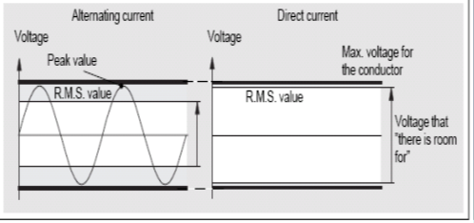
Cont…
HVDC also allows transfer of power between grid systems running at different frequencies, such as 50 Hz and 60 Hz. This improves the stability and economy of each grid, by allowing exchange of power between incompatible networks.
Better voltage utilization rating

Slide 7
Methods and working

Slide 9
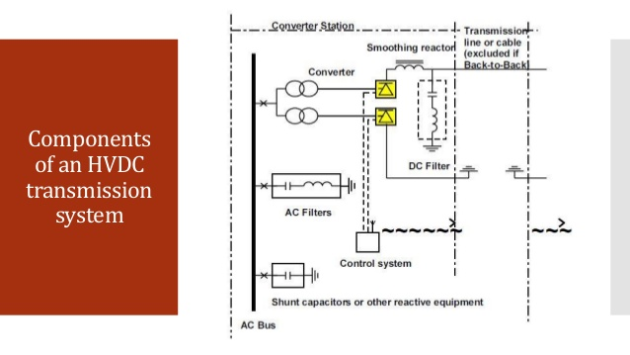

Slide 22
Disadvantages:
(expensive)
Converter stations needed to connect to AC power grids are very expensive.
Converter substations generate current and voltage harmonics, while the conversion process is accompanied by reactive power consumption. As a result, it is necessary to install expensive filter-compensation units and reactive power compensation units.
(complex)
In contrast to AC systems, designing and operating multi-terminal HVDC systems is complex.
(capacities)
The number of substations within a modern multi-terminal HVDC transmission system can be no larger than six to eight, and large differences in their capacities are not allowed.
it is practically impossible to construct an HVDC transmission system with more than five substations.
(difficult grounding)
Grounding HVDC transmission involves a complex and difficult installation, as it is necessary to construct a reliable and permanent contact to the Earth for proper operation and to eliminate the possible creation of a dangerous “step voltage.”
(power faults)
During short-circuits in the AC power systems close to connected HVDC substations, power faults also occur in the HVDC transmission system for the duration of the short-circuit. Inverter substations are most affected.

Slide 23
Future recommendation:
The need for a faster, more efficient and more reliable deployment of offshore HVDC transmission systems for connection of wind farms, oil and gas platforms, multi terminal interconnectors as well as a future HVDC grid

Slide 24
conclusion
Increasing demand of electrical power and need for bulk efficient electrical power transmission system lead to the development of HVDC transmission system. HVDC transmission system today become one of the best alternative for transmitting bulk power over long distance with very less losses.

Slide 25
Thank You !
Feel free to ask your queries 24/7 through whatsapp voice messages.
Stay Home, Stay Safe.

