Slide 1
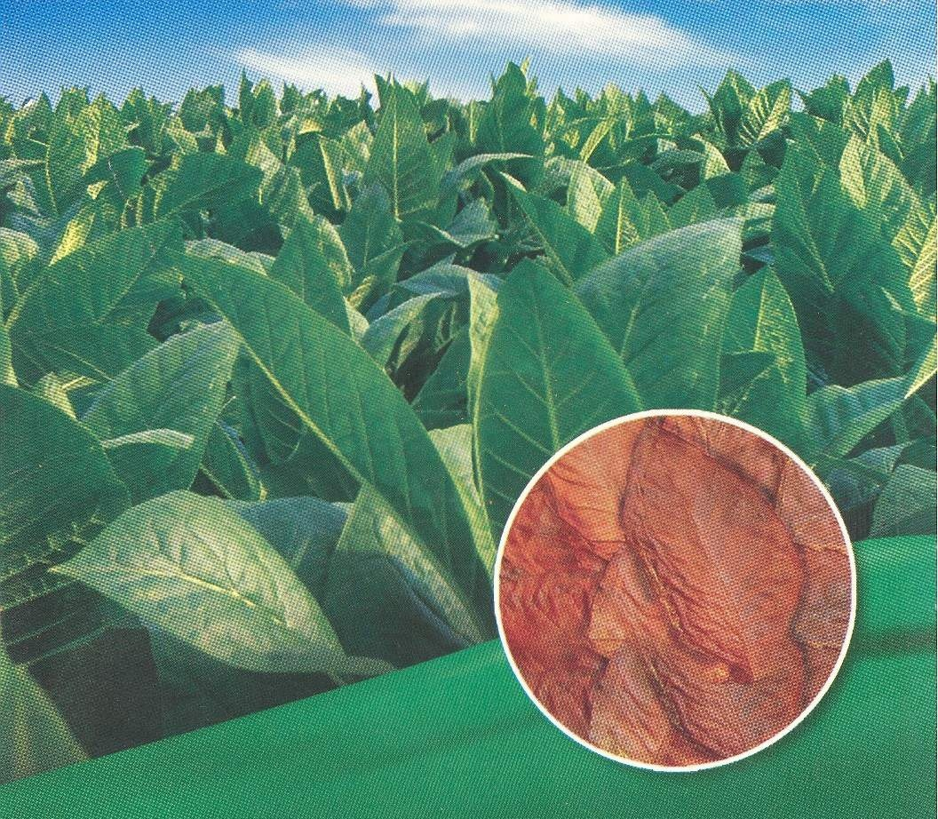
TOBACCO
Production Technology

Slide 2
BOTANICAL NAME:
Cigarette Tobacco Nicotiana tabacum L.
Desi or Hukka Tobacco Nicotiana rustica L.
FAMILY:
Nightshade family “ Solanaceae ”
ENGLISH NAME:
Tobacco
LOCAL NAME:
Tambaku

Slide 3
importance
After sugarcane, Tobacco is the second prominent cash crop in Pakistan.
Most common usage is for smoking in the form of a cigarette or cigar.
Pakistan is 5th largest tobacco producer in the world and 4th highest in yield.

Slide 4
ORIGIN:
Originally grown in South and Central America, but now cultivated throughout the world.
Tobacco grows natively in North and South America. Same family as the potato, pepper and the poisonous nightshade.
Tobacco originated in Western hemisphere, and the types of tobacco presently being cultivated evolved in Mexico and Central America.

Slide 5
BOTANY
Genus name, Nicotiana
About 60 species, most native to tropical America.
Only two species N. rustica and N. tabacum used in commerce.
Adapted to cultivation in subtropical and temperate climates in many parts of the world.
Self pollinated crop and leaves are arranged alternatively.
Annual Plant with tap root system

Slide 6
Continue………,
Leaves large and oval, with rounded or pointed ends.
Leaves and stems are hairy, some of which exude a sticky fluid. Leaves vary in length from 20 to 24 inches (50 to 60 cm) and are about half as wide as they are long. The tube-shaped flowers are greenish-cream to pink or red.
Very small seeds, and one plant usually produces 200,000 or more.

Slide 7
Continue………,
Nicotiana tabacum, also known as Common Tobacco, is a specie of annual dicotyledon.
Genus Nicotiana can be divided in three subgenus:
Subgenus Rustica with yellow flowers : Cultivated in North Africa, Eastern Europe and Asia. Also used for genetic purposes.
Subgenus Petunioides with white, pink, red or violet flowers : this subgenus includes ornamental varieties that can also be of interest for genetics.
Subgenus Tabacum with pink, red or purple flowers.
In this subgenus, the specie Nicotiana tabacum gathers more than 90% of the tobaccos cultivated in the world. Annual herbaceous plant, 50 cm to 150 m high (even 250m for some varieties).

Slide 8
CLIMATE
Long day plant and grown in winter as Zaid Rabi crop
90-110 Days Crop
Although tobacco is a tropical crop, it can be grown in a wide range of environments. Tobacco seeds require about 21⁰C temperature for germination.
Crop grows well within temperature of 13-37⁰C

Slide 9
Soil
Well drained and loamy soil is best for tobacco crop.
Quality of tobacco is greatly influenced by the soil conditions. Tobacco is adopted to moderately acidic soils with a pH ranging from 5.5-6.5
Tobacco will not do well in water logged soils as it is sensitive to water logging.
Salt affected soils are not suitable for tobacco.
Soil analysis should be done

Slide 10
MAJOR CROPPING AREAS OF PAKISTAN
KPK is the focal area in terms of tobacco related activities in Pakistan. It produces around 3/4th of the tobacco leaf grown in the country, and many of the cigarette manufacturing units are also located in this province.
Mardan, Mansehra, Gujrat, Okara and Sahiwal with a zonal office at Lahore and head office in Peshawer

Slide 11
Tobacco cultivars
1. Desi tobacco: (N.rustica)
Sufaid (Rustica Swabi, Rustica Hazro, Rustica-a, Rustica-4,5 and 6 are grown in Swabi, Sindh and Mardan areas).
Kala patta ( Rustica-8, Rustica-9 are grown in Attock district of Punjab.
SL-85
2. Cigarette Tobacco: (N.tabacum)
G-28, G-52, G-58, G-78, G-140

Slide 12
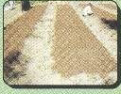
Nursery Sowing
Tobacco seeds are very small and so are not sown directly in the field but are raised in nursery. Red sandy loam soils are preferred for nursery.
Selected site for nursery requires 4-5 ploughings and 1-2 planking and organic manure
Mid October – Mid November is proper time
Seed Rate: 10 – 15 g/acre

Slide 13
lANd Preparation
A clean and well pulverized seed bed of good tilth is needed for transplanting tobacco seedlings.
Land should be well prepared first and by deep ploughing with MB-Plough followed by 4-5 ploughings.
Each ploughing should be followed by planking so that the soil is well pulverized and levelled.

Slide 14
Transplanting
Field for transplanting tobacco seedlings should be well prepared.
Transplantation should be done at proper time for successful crop production. This process should be done in Late January–Early February.
4-5 inches seedlings (5-6 Leaves) are ready for transplanting.

Slide 15
Sowing Method
Flat Sowing
Ridge Sowing
For cigarette tobacco: R x R = 100 cm
P x P = 50 cm
For hukka tobacco: R x R = 75 cm
P x P = 30 cm
3- 4 hoeings

Slide 16
Irrigation
10–12 Irrigations Required at 7-10 days intervals.
After planting, the crop does not require much water for the first 4-6 weeks as it is small.
The crop is usually water stressed during this time to develop a large root system. After this, crop grows rapidly and it is important that water is not lacking.
Irrigation depends on the seasonal conditions and soil type. After topping, harvesting begins and the irrigation requirement of the crop is reduced due to reduced leaf area as leaves are harvested.

Slide 17
Plant Protection measures
Cutworm, budworm and aphids are common insect-pests of tobacco. Any appropriate insecticide can control them i-e Thiodon 35 EC, Larsanban 40 EC, Birllan 10G and Dimecron 100 EC
Diseases such as black shank, root knot nematodes and tobacco mosaic virus may attack crop.
Preventive measures such as crop rotation, sanitation and selection of resistant cultivars.
Chemicals such as Disyston 10 G and Nemacur 10-G can be used.

Slide 18
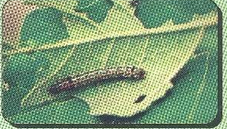
Cutworms
Aphid
Budworm

Slide 19
Topping And Desuckering
Tobacco normally flowers during March and April. To maximize leaf production and encourage leaf ripening, it is necessary to remove the flower. This is known as topping.
Topping increases the size and weight of leaves, increasing the overall yield per hectare.
New shoots rapidly appear after topping. These are known as "suckers". Suckers are controlled by manually breaking them off and through the application of "suckercides". This is known as desuckering.

Slide 20
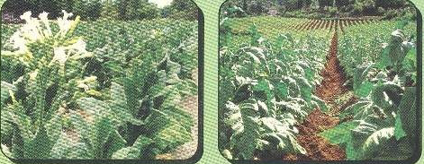
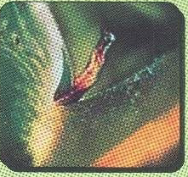
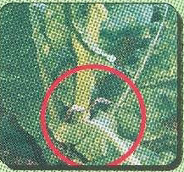
Topping
Desuckering

Slide 21
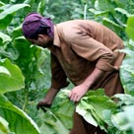
HARVESTING
Harvesting is done in May-June.
The whole plant of desi tobacco is harvested and sun dried for 2-3 days.

Slide 22
Curing
Curing is a carefully controlled process used to achieve the texture, colour and overall quality of a specific tobacco type.
During the process, leaf starch is converted into sugar, the green colour vanishes and the tobacco goes through colour changes from lemon to yellow to orange to brown, like tree leaves in autumn.

Slide 23
METHODS OF CURING
The three curing processes commonly used in Pakistan are:
1) Air-Curing
Air cured tobacco, for example Burley, is hung in unheated, ventilated barns to dry naturally until the leaf reaches a light to medium brown colour. At this point, there are virtually no sugars left in the leaf.

Slide 24
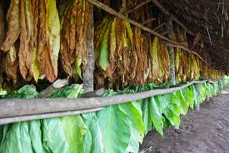
Air-Curing

Slide 25
2) Flue-Curing
Heat is introduced into a barn via pipes from an exterior furnace like radiators connected to a central heating system.
This controlled heat allows the leaves to turn yellow/orange, at which point the process is complete.
These leaves now contain a high amount of sugar. Virginia tobacco is flue-cured.

Slide 26
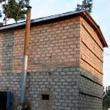
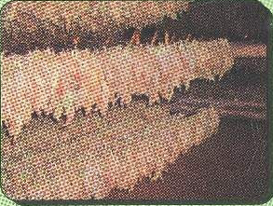
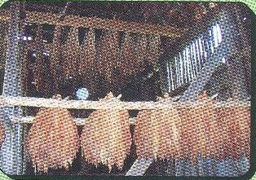
Flue-Curing

Slide 27
Sun-Curing
Leaves are strung out on racks and exposed to the sun. It takes from 12 to 30 days. The sun's direct heat cures the leaves to a yellow to orange colour with high sugar content.
After curing, the farmer grades the leaves into different leaf positions, qualities and colours and packs his grades into bale of 30-50kg. He then brings his bales to our leaf buying depots for sale from where it is sent to our Green Leaf Threshing Plant for further processing.

Slide 28
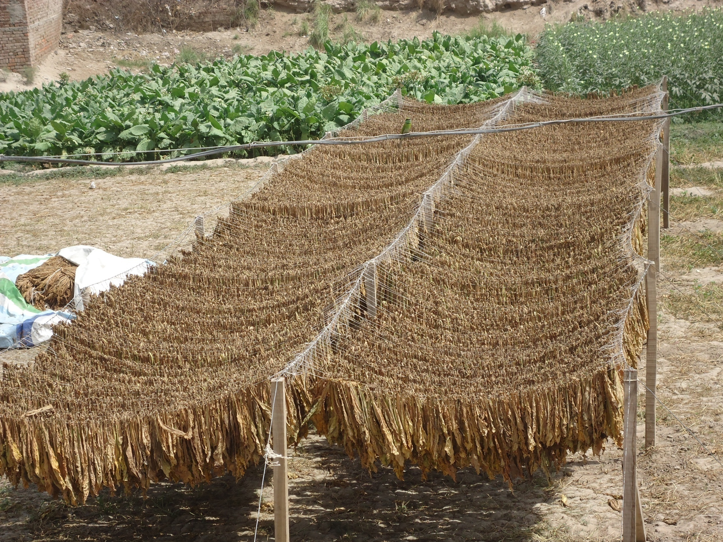

Slide 29
Yield and composition
Yield of Desi tobacco is higher than that of Virginia tobacco.
Desi Tobacco: 1.5-2.5 tons/ha
Desi tobacco contains more alkaloids (particularly nicotine) and more pungent in odor and bitter in taste.
Virginia tobacco contains low nicotine contents and thus having good aroma and taste.

