Slide 1
DNA
DNA • DISCOVERY OF STRUCTURE OF DNA
The structure of DNA double helix and how it was discovered. Chargaff,Watson and Crick, and Wilkins and Franklin worked to solve this question.

Slide 2
Introduction
Today the DNA double helix is most ionoic of all biological molecules.
Untill 1950s the double helix structure of DNA remained a mystry.
In this article we will briefly described the work of all the major scientists
on DNA.

Slide 3
Chargaff rules
CHARGAFF RULES
.ON the key piece of information related to the structure of DNA came from AUASTRIAN biochemist Erwin Chargaff.
He analyzed the DNA of different species determining its composition of A,T,C and G bases

Slide 4
He made several key observations.
1; ,A, T , C and G were not found in equal quantities .
2;The amounts of the bases varied among species but not between individuals of same species.
3;The amount of A always equaled the amount of T , and the amount of C always equaled the amount of G.

Slide 5
WATSON AND CRICK,S model of DNA
WATSON AND CRICK,S model of DNA
The structure of DNA as represented in WATSON and CRICK,S model is
DOUBLE STRANDED
ANTIPARALLEL
RIGHT HANDED HELIX
NITROGENOUS BASES found inside
Form HYDROGEN BOND PAIRS that hold the DNA strands together.

Slide 6
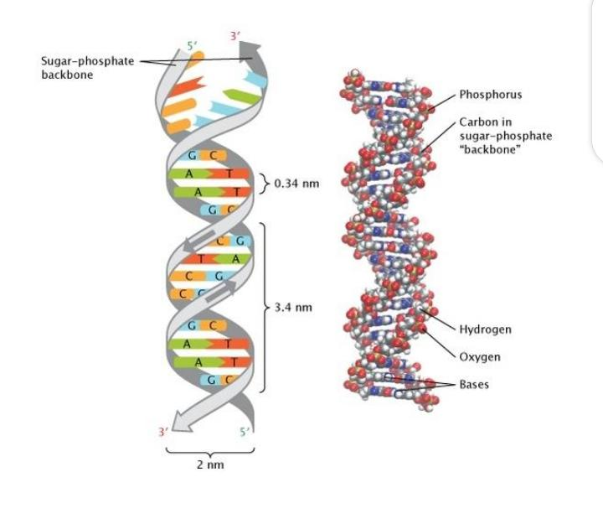

Slide 7
ANTIPARALLEL ORIENTATION
ANTIPARALLEL ORIENTATION
Double stranded DNA is an antparallel molecule that mean it is composed of two strandas that run alongside each other but point in opposite .
In a double stranded DNA molecule the 5 end (PHOSPHATE BEARING) of one strand aligns with the 3 end (HYDROXYL BEARING END) of its partner and vice versa.

Slide 8
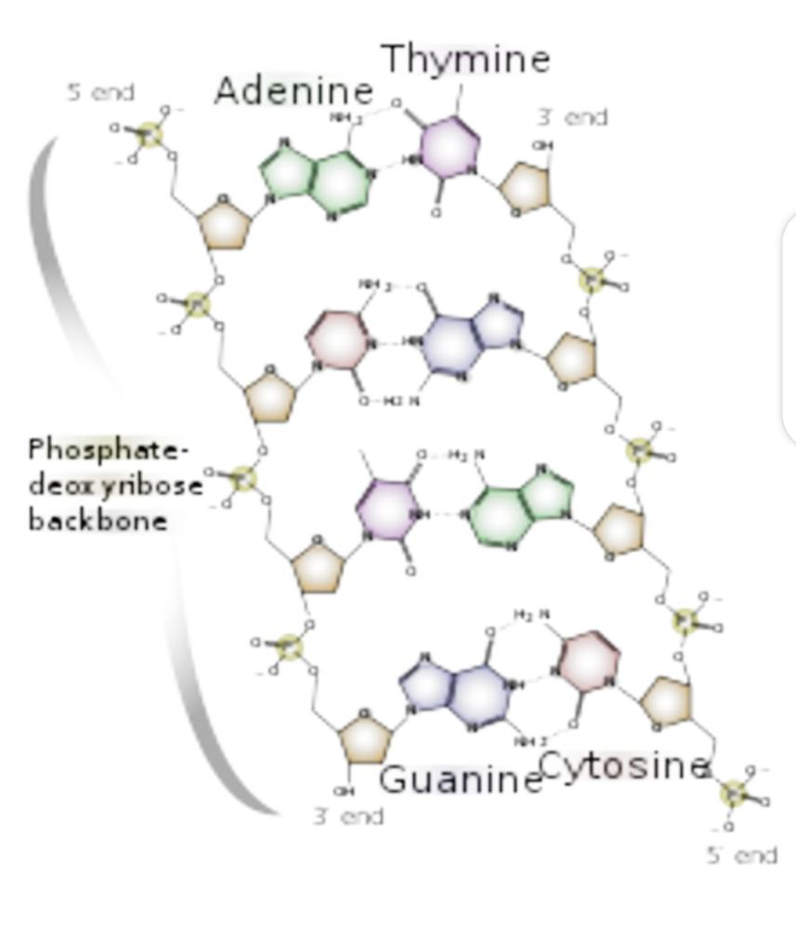

Slide 9
Right hand helix
RIGHT HANDED HELIX
In Watson and Crick,s model the two strands of DNA twist around each other to form a right handed helix . All helics have a handness which is property that describes how there grooves oriented in space.

Slide 10
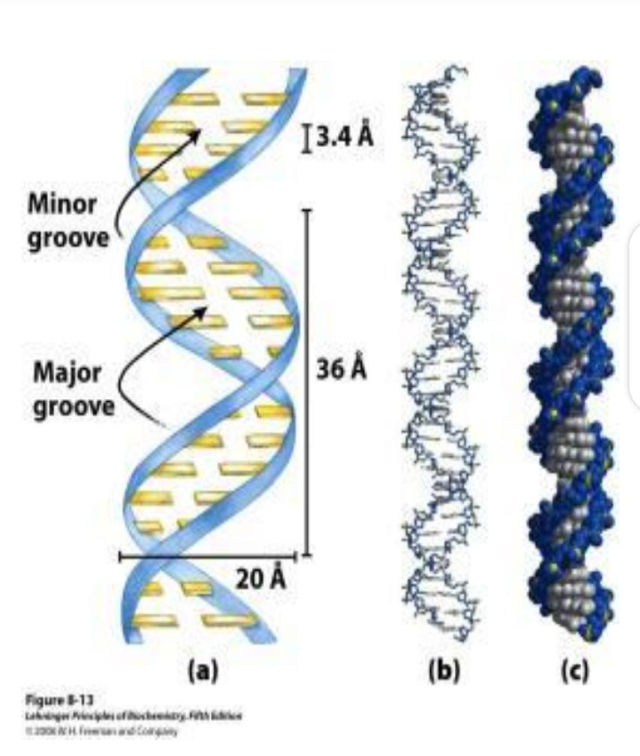

Slide 11
The twisting of the DNA and the geometry of the bases creates a wider gap (called the major groove) and the narrower gap( called the minor groove).
These grooves run along the length of molecule.
These grooves are important building sites for proteins that maintain DNA and regulate gene activity.

Slide 12
Base pairing
BASE PAIRNING
In Watson and Crick,s model the two strandas of double helix are held together by hydrogen bonds between nitrogenous bases on opposite strands .
Each pair of bases lies flat , forming a rung on the ladder of DNA molecule .
Base pairs are not made up of just any combination of bases . Instead if there is an A found on one strand it must pair with T on other strand and vice versa .Similarly G pair with C.
Two hydrogen bonds formed between A And T and threee between G and C .

Slide 13
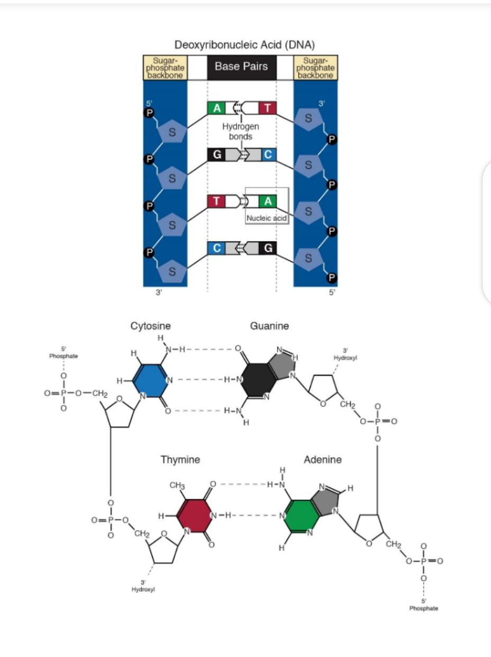

Slide 14
ROSALIND FRANKLIN
ROSALIND FRANKLIN
Franklin discovered the structure of DNA . He obtained excellent X-ray diffraction photographs of DNA .

Slide 15
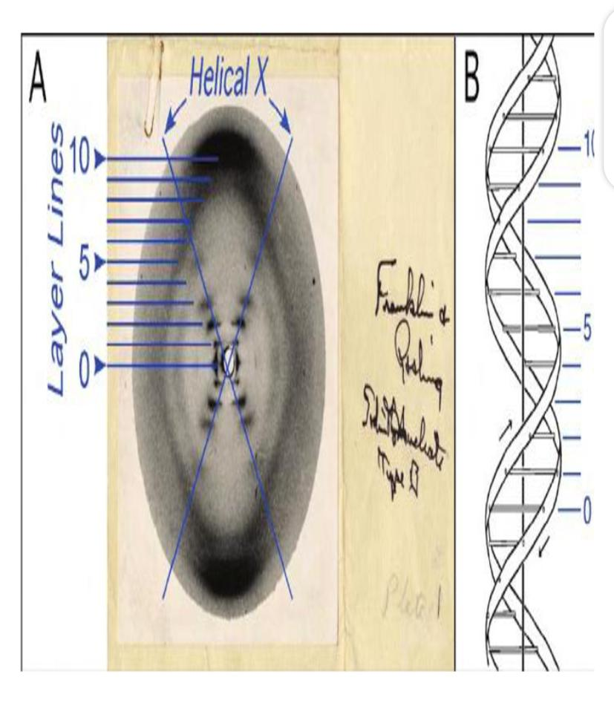

Slide 16
CHEMICAL NATURE OF DNA
CHEMICAL NATURE OF DNA
Hydrolysis of DNA showed that it is composed of:
phosphoric acid , a phosphate group
A 5 Carbon sugar , as deoxyribose sugar
the purine bases , cytosine and thymine
the pyrimide bases cytosine and thymine

Slide 17
DNA is a Polymer
DNA is a Polymer
DNA is a polymer . A polymer is a long chain like molecule , comprising of numerous individual units called monomers linked together in series . The monomer in a DNA is nucleotide.

Slide 18
NUCLEOTIDES
NUCLEOTIDES
Each nucleotide is composed of
A sugar
A nitrogenous base
A phosphate group
The nitrogenous base is linked to sugar .

Slide 19
THE SUGAR COMPONENT OF DNA
THE SUGAR COMPONENT OF DNA
In DNA the sugar component is pentose sugar, deoxyribose. It can exist in chain form or ring form.It contains hydroxyl group attached with carbon atom number two with a hydrogen group

Slide 20
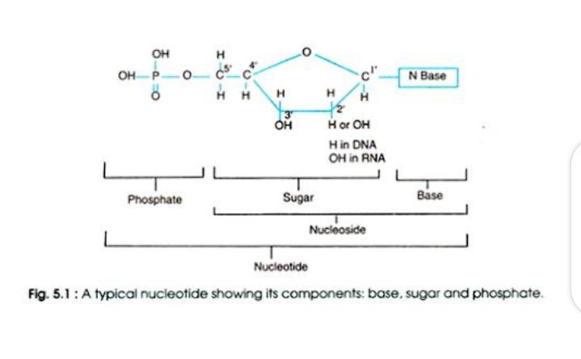

Slide 21
THE NITROGENOUS BASES
These are complex single ring pyrimides and double ring purines

Slide 22
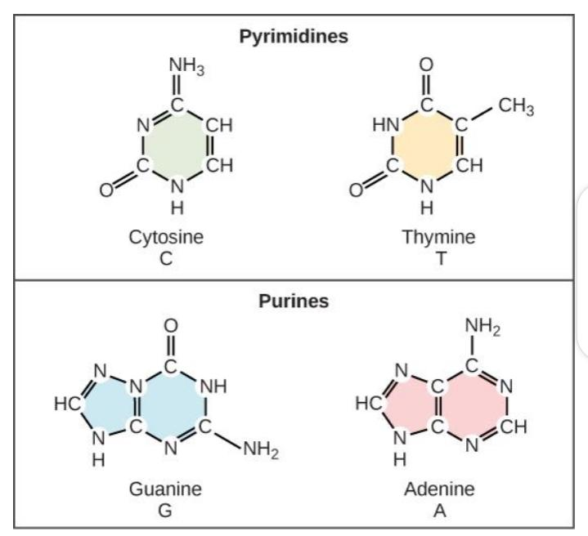

Slide 23
.
THE PHOSPHORIC ACID COMPONENT
A nucleoside is converted into a nucleotide by attachment of phosohoric group to a 5 C of sugar.

Slide 24
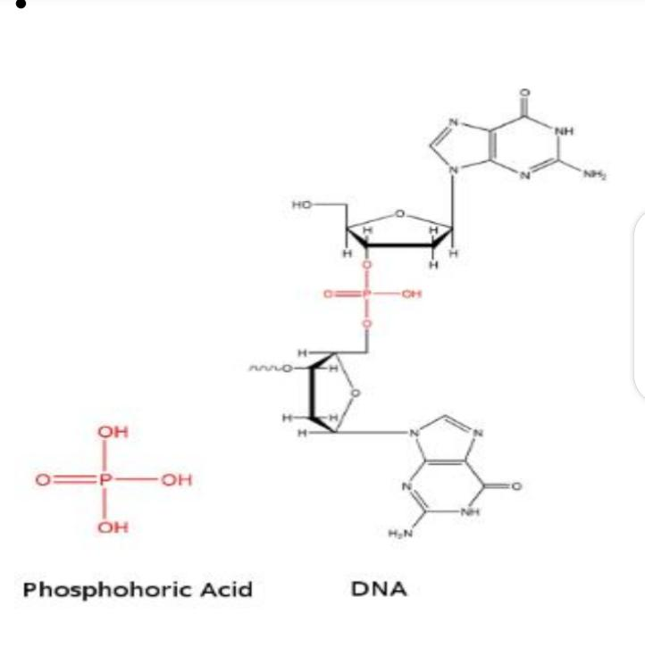

Slide 25
.
ALTERNATIVE FORMS OF DNA
DNA exist in many forms such as:

Slide 26
B DNA
The form OF DNA described above is called B DNA . It is a right-handed helix . It turns in clockwise manner when viewed down its axis. The bases are stacked almost exactly perpendicular to the main axis with about ten base pairs per turn.

Slide 27
A DNA
If the water contents increase to about 75% the A form DNA will occur . In this form the bases are titled with regard to the axis and there are more base pairs per turn as compared to B DNA.

Slide 28
Z DNA
gar –phosphate backbone forms a zigzag structure . The Z DNA looks like B DNA in which each base was rotated 180 degree , resulting in a zigzag left-handed structure. Z DNA is thought to be involved in regulation gene expression in eukaryotes.

Slide 29
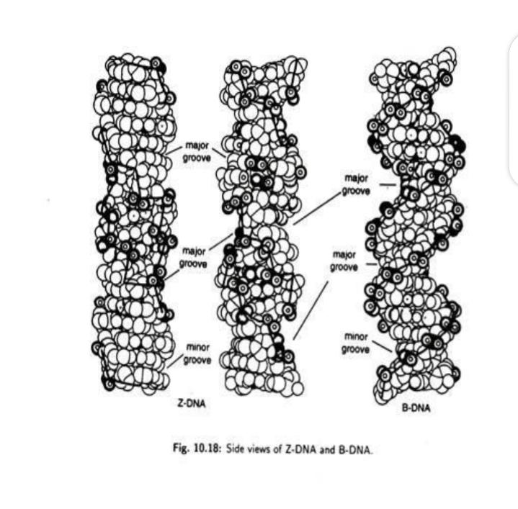

Slide 30
RNA
RNA
It is abbreviation of ribonucleic acid .
It is complexed compound of high molecular weight that functions in cellular protein synthesis and replaces DNA. As a carrier of genetic codes in some viruses.

Slide 31
NITROGENOUS BASES:
The nitrogenous bases in RNA are
ADENINE
GUANINE
CYTOSINE
URACIL

Slide 32
• SUGAR
Ribose sugar present in RNA.
• TYPES OF RNA:e
There are three types of RNA

Slide 33
RIBOSOMAL RNA
RIBOSOMAL RNA
It is largest of RNA molecules and usually constitute about 80% of all RNA in the cells. The molecule is composed of thousands of nucleotides consisting of a single strand with regions in which base pairing result in double helix projecting on either side.
It is produced inside the nucleus . It takes part in formation of messenger RNA and translational RNA

Slide 34
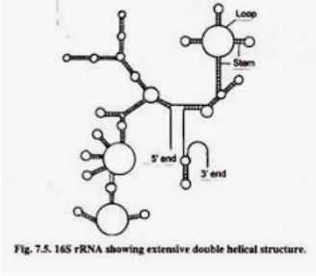

Slide 35
MESSENGER RNA
MESSENGER RNA
It is produced in nucleus from the coded instruction in the DNA and then passes into the cytoplasm where it becomes associated with the ribosomes . It carries chemical information from DNA OF gene to ribosome for protein synthesis .
Molecules of messenger RNA are 75-3000 nucleotides long and are not folded in any special way.

Slide 36
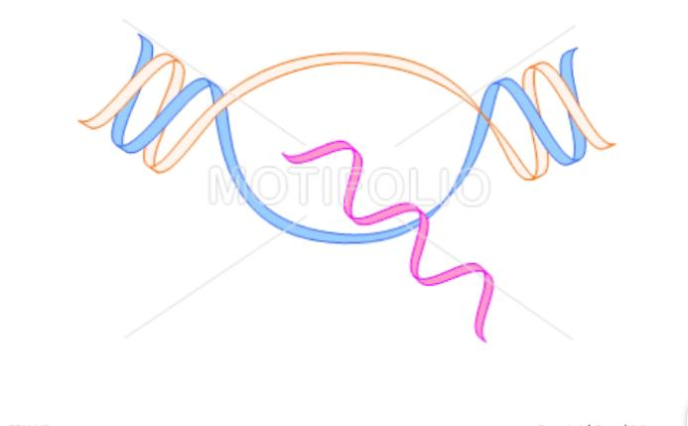

Slide 37
TRANSFER RNA
TRANSFER RNA
It is smallest class of RNA molecules and consisting of 75-90 nucleotides . It carries amino acids to ribosomes during protein synthesis each organism synthesis a number of different tRNAs each in multiple copies. All cells have atleast 20 different kinds of tRNAs molecules .A t RNA molecules is nearly similar in bacteria and eukaryotes.

Slide 38
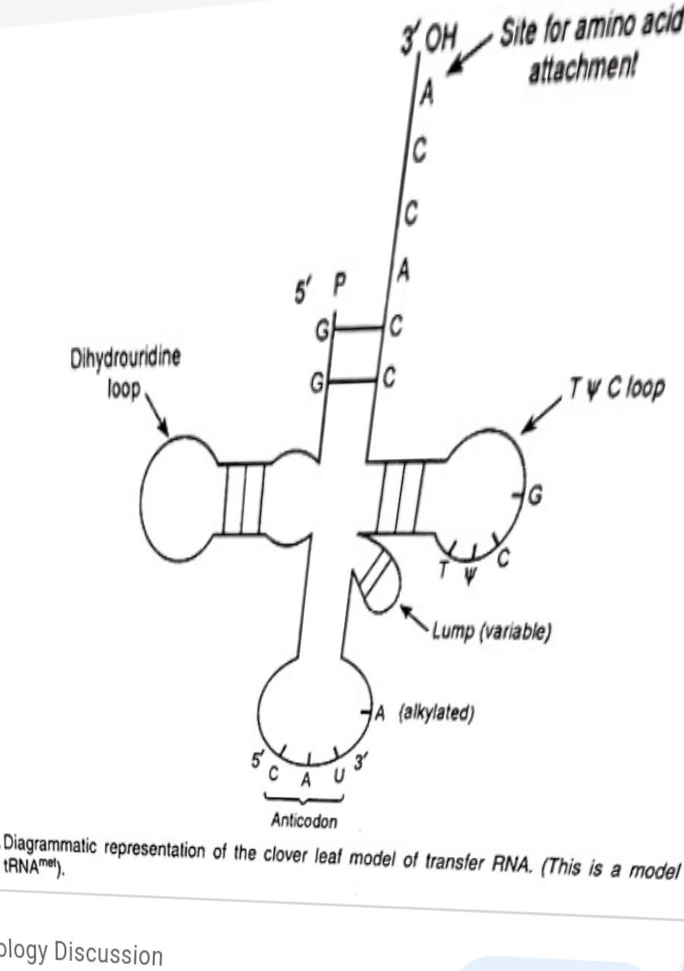

Slide 39
CLOVER LEAF MODEL OF tRNA
CLOVER LEAF MODEL OF tRNA
More is known about the secondary structure of this molecule then any other RNA . All tRNAs have a two –dimensional clover leaf model because it can be folded into a base pair structure like a clover leaf .
Each molecule is held together by a precise base pairing arrangement between different parts of RNA D loop strands each of the base paired region is twisted to form a double helix but when the variable loop molecule is flattened out it has a clover leaf shaped

Slide 40
Thank you

