Slide 1
Creative process in advertising

Slide 2
Creative
Techniques
It is a method by which the copywriter and art director work together to find creative ways to deliver the message that has the greatest appeal to the target audience.
Copywriter: writes ad message
Art director: oversees the overall design of the ad

Slide 3
Brainstorming
Lateral
Thinking
Creative
Techniques
Free
Association
Synectics

Slide 4
Free association
-forming association networks of things
-focuses on key word
-things associated are identified and described

Slide 5
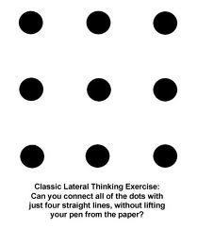
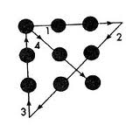
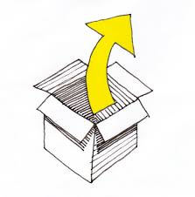
Lateral thinking
Lateral thinking is solving problems through an indirect and creative approach, using reasoning that is not immediately obvious and involving ideas that may not be obtainable by using only traditional step-by-step logic. The term was coined in 1967 by Edward de Bono.
-concerned with creative ad development
-analyzes ad problems in multiple ways

Slide 6
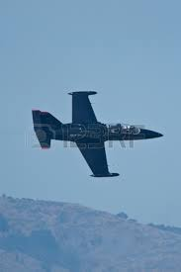
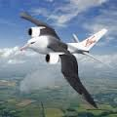
Synectics
-focuses on unrelated topic
-uses techniques of drawing analogy
-based on concept of problems solving

Slide 7
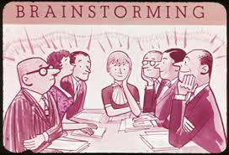
brainstorming
-pooling ideas from a group of experts
-criticism free idea generation
-best idea is selected from various

Slide 8
visualization
The process of conceiving an advertising, giving it shape, and designing the layout of the copy
Visualization is a mental process in which the creative team led by the art director and copywriter determines the arrangements of various ad elements in advertisement
Creative Visualizer: A creative visualizer involves in creating, developing and designing the message of ad copy

Slide 9
Steps of creative process
Immersion
Ideation
Brainfog
Incubation
illuminatioation

Slide 10
Qualities
Visionary
Natural Curiosity
Innovativeness
Patience
Language Competence
Team-Player

Slide 11
Four Characteristics of Creative concept
Focus
Uniqueness
Generativeness
Truth/Honesty

