Slide 1
Acoelomate
An animal that lacks a coelom. Acoelomates, which include flatworms and tapeworms, exhibit bilateral symmetry and have no body cavity between the gut and the epidermis.
Coelomate
animals or Coelomata (also known as eucoelomates – "true coelom") have a body cavity called a coelom with a complete lining called peritoneum derived from mesoderm (one of the three primary tissue layers). ... Most bilateral animals, including all the vertebrates, are coelomates

Slide 2
Pseudocoelomate
Describing any invertebrate animal whose body cavity is a pseudocoel, a cavity between the gut and the outer body wall derived from a persistent blastocoel (see blastula), rather than a true coelom. Pseudocoelomate animals include the Rotifera and Nematoda
Hemocoel
A series of interconnected spaces between tissues and organs through which blood flows freely, unconfined by veins or arteries, occurring in several invertebrate groups, especially mollusks and arthropods

Slide 3
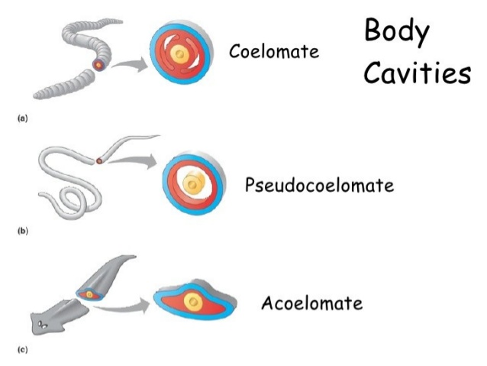

Slide 4
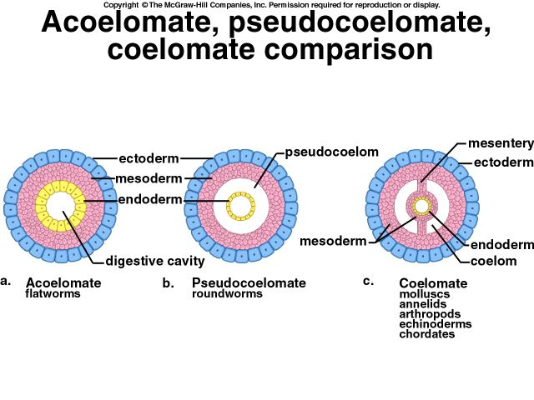

Slide 5
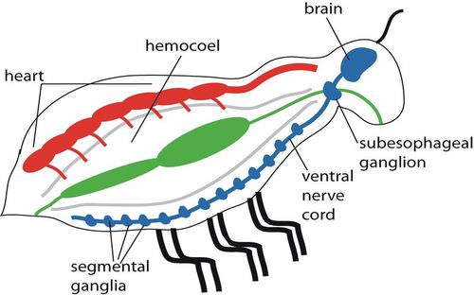

Slide 6
Mineralized tissues and the invertebrates:
Mineralized tissues are biological tissues that incorporate minerals into soft matrices. ... Bone, mollusc shells, deep sea sponge Euplectella species, radiolarians, diatoms, antler bone, tendon, cartilage, tooth enamel and dentin are some examples of mineralized tissues.
Cartilage is a supportive tissues that makeup the major skeleton components of some gastropods, invertebrates , Chordates, jawless fishes, hagfishes , lampreys, sharks and rays.

Slide 7
Cartilage lighter than bone it gives predatory fishes the speed and agility to catch prey . It also provide buoyancy without the need of swim bladder

Slide 8
Skeleton system of vertebrates
The vertebrates endoskeleton is enclosed by other body tissues. This endoskeleton consist of two main types cartilage and bone.
Cartilage
Is a specialized type of connective tissue that provides a site for muscles attachment, aids in movements at joints, provides support , and transmits the force of muscular contraction from one part of the body to another during movement , Like other connective tissues, it consists of cells ( chondrocytes ) fibers, and a cellular matrix.

Slide 9
Bone or osseous Tissues
Bone (osseous) tissue is a specialized connective tissue that provides a point of attachment for muscular contraction from one part of the body to another during movement. In addition , bones of the skeleton support the internal organs of many animals, store reserve calcium and phosphate, and manufacture red blood cells and some white blood cells.
Bone tissues more rigid because its homogeneous , organic ground substances also contain inorganic salt mainly calcium phosphate and calcium carbonate.

Slide 10
When an animal needs the calcium or phosphate stored within bones, metabolic reactions ( under endocrine control) release the required amounts.
Bone Cell
Are in minute chamber called lacunae which are arranged in concentric rings around osteonic canals
These cells communicate with nearby cells by mean cellular processes passing through small channels called canaliculi

Slide 11
Skeleton of Fishes
Both cartilaginous and bony endoskeletons first appeared in the vertebrates. Since water has a buoyancy effect on the fish body .
Mostly terrestrial vertebrates don’t demanded skeleton for support.
Mostly vertebrates have well-defines vertebral column that’s why they are called “Vertebrates”. Not jawless vertebrates for example lampreys and hagfishes
Most jawless fishes have an axial skeleton that include notochord, ribs and cartilaginous or bony vertebrae
Muscles used in locomotion attached to the axial skeleton

Slide 12
Skeleton of Terapods
Terapods must lift themselves to walk on land. The first amphibians needed support to replace the buoyancy of water. For the earliest terrestrial animals support and locomotion were difficult and complicated processes.
Over the period of 200 million years animal adapted this character.
During evolution terapods endoskeleton become modified for support on land .For that reason vertebrates have special structure called intervertebral disk that articulate with adjoining vertebrae.

Slide 13
Intervertebral disks help hold to vertebral column together, and they also absorbs shock and provide joint mobility.
Bone replace cartilage in the ribs, which become more rigid . Various types of connective tissue that connect to the axial skeleton helped keep elevated portion for sagging.
Appendages became elongated for support on a hard surface, and changes in the shoulder enabled the neck to move more freely.
Human Endoskeleton
Having two types
Axial Skeleton
Appendicular Skeleton

