Slide 2
De-Worming of Farm Animals
By
Qasim Mahmood , Arshad Shafi,
Farukh Javid , Hammad Hassan
Submitted to :Dr.Imtiaz Husain
Department of Animal Sciences, University College of Agriculture,
UNIVERSITY OF SARGODHA, PAKISTAN
In partial fulfilment of the requirement for the course of
introduction to Farm Animal Health Bs(Hons) Animal sciences 2016-20

Slide 3
De-Worming of Animals:
According to a careful estimate, 42% animals are affected by different types
of worms. The worms adversely affect efficiency of the animals and cause a
financial loss to their owners. That is why it is important to overcome the
worms to improve production of the animals.
The worms in animals are more in those areas where animals graze more,
than in those areas where animals graze less. There are more worms in those
animals which eat dried feed than in those which eat green fodder. Similarly,
more worms are found in younger animals than in older ones. One important
reason of lesser rate of growth in younger animals in Pakistan is the presence of worms in them.

Slide 4
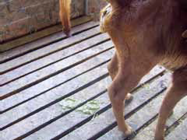
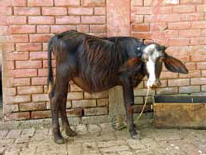
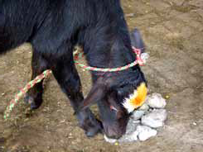
Signs of worm infested Animals:
Diarrhoea
Loss of weight
Soil licking and eating pieces of cloth
Delay in puberty
Weakness and slow growth
Decrease in milk production
Death at an early age
Thin and rough skin

Slide 5
Types of Worms:
Worms are usually of two types:
1. Internal parasites (worms)
2. External parasites

Slide 6
Internal Parasites (Worms):
According to an estimate, the mortality rate among the younger animals of 6 months to one year old due to internal worms is 25-30%. Internal worms include round worms, stomach worms, lung worms, liver flukes and intestinal worms.

Slide 7
Worms of stomach and intestines:
Symptoms:
These worms attack the animals mostly at the end of the summer season and the beginning of the winter season. They stick to the walls of the stomach and intestines and suck the blood of the animal.
Animals become Anemic
The animals take up more feed, yet become weaker
Loss of water in the body, diarrhea and sometimes presence of
blood in excretions
Rough and dry skin

Slide 8
Lung Worms:
These worms grow in the lungs or in the trachea/windpipe. Their presence causes swelling in the trachea/windpipe, and the animal breathes with difficulty.
Symptoms:
Coughing
Phlegm in nostrils
Pneumonia is possible
The animal breathes with open mouth in case of intensity of sickness

Slide 9
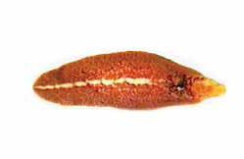
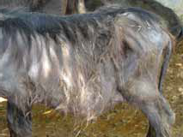
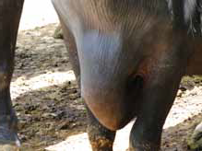
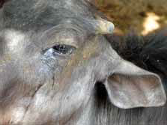
Liver flukes:
These worms are flat like a leaf. They occur mostly in animals residing in areas affected by water-logging and salinity. When animals swim in polluted ponds and drink their water, these worms go into the stomach. Their larvae reach the liver of the animals through blood vessels.
Symptoms:
The animal becomes weaker and thinner and produces less milk
Blurry eyes
Hair fall
Swelling of the body part between the
fore limbs, on the neck and under the jaws

Slide 10
External Parasites:
These parasites are found on external skin. They are mostly blood-sucking parasites and they cause spread of fatal diseases in the animals. They include lice , ticks, flies and mosquitoes, etc.
Ticks:
These parasites not only suck the blood of the animals but also cause the spread of fatal diseases. They are mostly found on the softer parts of the animals’ skin like the udder and between the legs. A very dangerous disease Theleriosis (tick fever) is due to the fever caused by ticks.

Slide 11
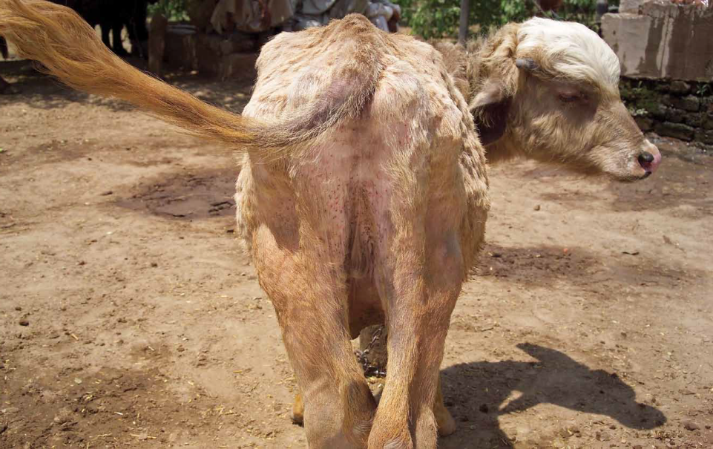
Symptoms:
The animal becomes weak because of loss of blood
Their skin becomes rough and dry.
Milk production decreases.
The animal becomes restless.
The possibility of abortion rises.
Paralysis attack is possible.
Holes appear on the skin and they become like wounds.

Slide 12
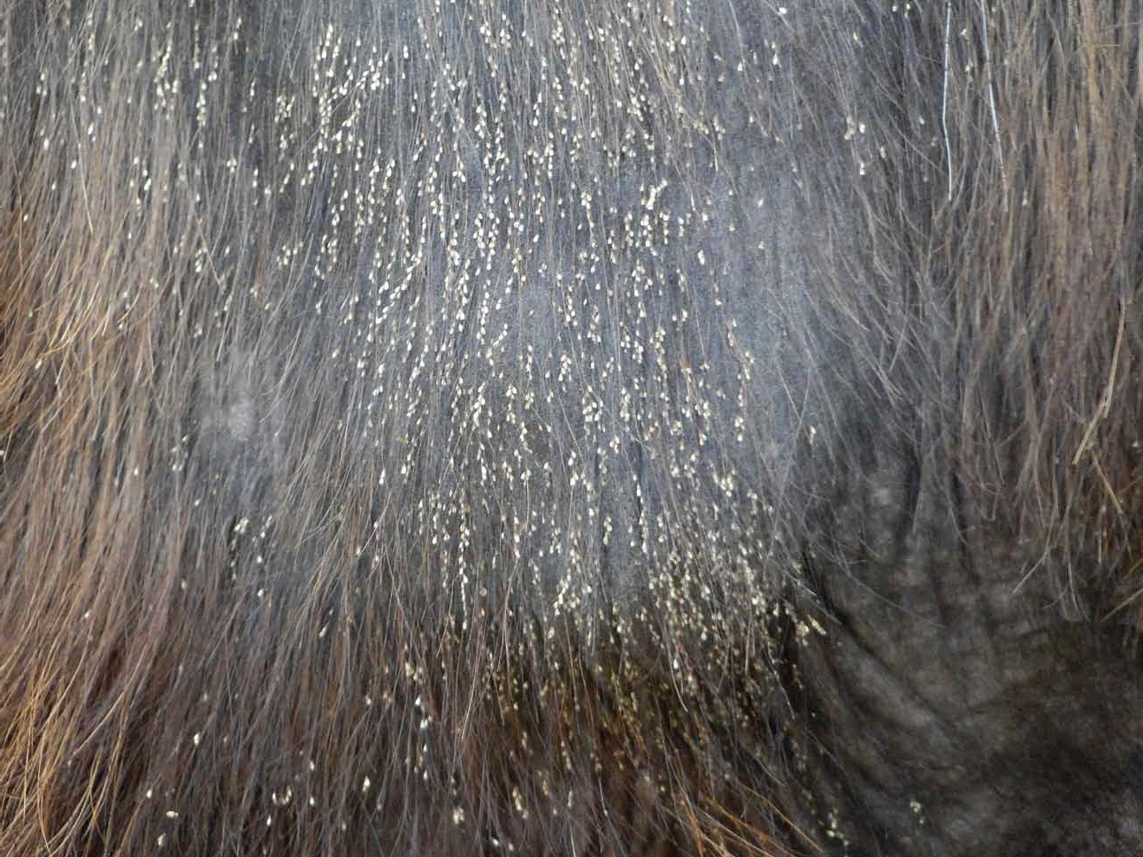
Lice:
Lice are of two kinds:
Biting lice 2. Blood-sucking lice
The lice stick to the skin of the animals and their eggs stick to their hair.
Symptoms:
The animal shows restlessness.
The animal becomes weak.
Continuous scratching or rubbing of the skin with the walls makes the skin
red and these scratches become wounds.

Slide 13
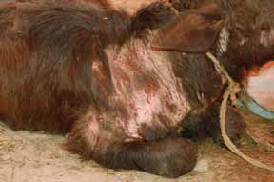
Flies:
The animal fly is a bit bigger than the housefly and its colour is dark orange and brown. It flies fast and creates a sound when it flies. It is usually found in the summer season and it lays its eggs in the skin of the animal.
Symptoms:
Milk production decreases suddenly.
Swellings and scars appear on many parts of the skin.
Sometimes the animal stops cudding and rumination.
The animal urinates again and again and remains restless.

Slide 14
Kinds of adverse effects of Parasitic Infestation:
The adverse effects of infestation can be divided into two types.
1. Hidden 2. Apparent
Hidden diseases include:
Decrease in milk production.
Enlargement of the belly.
Loss of weight.
No pregnancy etc. are the hidden effects of worms.
These adverse effects cause financial losses to the owners of the animals.

Slide 15
Apparent diseases include:
Thinness of skin,
Anaemia,
Scars and swellings on the body,
Cough,
Constipation
Diarrhea etc. which show the apparent adverse effects of the
worms.

Slide 16
Control of Parasites:
Keep animals’ sheds clean.
There should not be any holes/cracks in the walls or roofs of the sheds,
where these external parasites can hide or lay eggs.
Spread limestone powder in sheds from time to time.
Spray sheds with insecticides after removing the animals from their sheds.
In case of ticks, get it treated by a veterinary doctor.
Protect chopped fodder from dust and dirt and give the animals clean feed.
De- worm animals regularly.
Give a variety of de-worming medicines so that the worms cannot
build immunity against any medicine.
Whitewash the water troughs of the animals with limestone powder for
protection against microbes.

Slide 17
Instead of finding treatments for the affected animals, special attention should be paid to the effective prevention of an attack of the disease. Many farmers treat the affected animals only. But if it is found that there are worms in the farm, then all animals must be de-wormed. The farmers bear huge financial losses when de-worming medicines are not used in time and regularly.

Slide 18
Selection of De -Wormer:
These points should be kept in mind when de-worming medicines are being chosen:
Determine the quantity of the medicine according to
the weight of the animal.
Easy to administer
Choosing the most effective medicine
Less expensive
Personal safety
Effectiveness of the medicine / A reliable company
Note: It is safe to drink the milk and/or eat the meat of the animal 3-4 days after de-worming.

Slide 19
De - Wormers
Ivermectin (cattle & Camels 1 ml /Kg body wt. Sheep & Goats
0.5 ml/kg body wt. )
LEVOZAN
OXAREX

