Slide 1
Chapter no 7
Arousal , Anxiety and sporting performance
Anam Yousaf

Slide 2
Arousal , Anxiety and stress
Arousal
A general psychological and physiological activation varying on a continuum from deep sleep to intense excitement. Bored, relax, asleep state of low arousal.
Excited, angry, anxious state of high arousal.
Anxiety (unpleasant sensation, unpleasant state of high arousal)
Anxiety is known as negative emotional state with feelings of nervousness, worry and apprehension associated with activation or arousal of the body .

Slide 3
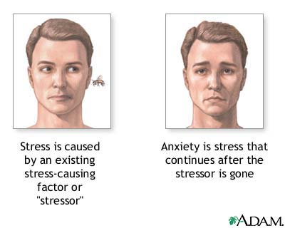
Stress
Stress is a feeling of emotional or physical tension. It can come from any event or thought that makes you feel frustrated, angry, or nervous.
Acute stress,
Chronic stress

Slide 4
distress (negative stress)
Characteristics
Causes anxiety or concern.
Can be short- or long-term.
Is perceived as outside of our coping abilities.
Feels unpleasant.
Decreases performance.
Can lead to mental and physical problems.

Slide 5
Eustress (positive stress)
Chracteristic
Motivates, focuses energy.
Is short-term.
Is perceived as within our coping abilities.
Feels exciting.
Improves performance.

Slide 6
Acute stress
Acute stress is usually brief. It is the most common and frequent presentation. Acute stress is most often caused by reactive thinking. Negative thoughts predominate about situations or events that have recently occurred, or upcoming situations, events, or demands in the near future.

Slide 7
Chronic stress
Chronic stress is the most harmful type of stress. If chronic stress is left untreated over a long period of time, it can significantly and often irreversibly damage your physical health and deteriorate your mental health.
For example, long term poverty, repeated abuse in any form, unemployment, dysfunctional family, poor work environment, substance abuse, or an unhappy marriage can cause significant chronic stress.

Slide 8
Cognitive and somatic anxiety
Cognitive anxiety (mental manifestation of anxity)
Somatic anxiety (physical manifestation of anxiety)
Cognitive symptoms of anxity
include negative thoughts, feelings of apprehension or nervousness , self doubts and images of losing and humiliation. Inability to concentrate, confusion, obsessive thoughts, fear inducing thoughts and ideas
Common symptoms of somatic anxiety include, experiencing butterflies, sweating, heavy breathing or a elevated heart rate. Chest pain, insomnia, headache

Slide 9
Effects of anxiety on sporting performance
When an athlete experiences worry and negative thoughts (cognitive state anxiety) it causes decision making to become poor and concentration levels to drop, increasing the number of errors. This can be monitored by the increase in somatic state anxiety responses, which include an increase in heart rate, sweating and blood pressure. Some of these symptoms of anxiety are beneficial to sporting performance, but if the athlete perceives them as happening because they are unable to meet the demands of the activity they further increase cognitive state anxiety.

Slide 10
State and trait anxiety
State anxiety
Trait anxiety
state anxiety is refers to the emotional state of anxiety ( cognitive and somatic ) typically experienced prior to and during competition.
Trait anxiety is a personality characteristic that remains relatively stable over time, a person high in trait anxiety will be frequently anxious almost irrespective of the situation.

Slide 11
Factors inducing anxiety and stress
How anxious we feel at any time is a product of both individuals and situational factors

Slide 12
Situational factors
Event importance
The more important important a sporting event is , the more stressful we are likely to find it .it is probably true to say for example that most footballers would find themselves more anxious competing in the world cup than in a friendly
Expectations
It seems likely that both high and low expectations can be linked to anxiety . Team can be adversely affected by the pressure of high expectations.

Slide 13
Individual factors
Trait anxiety
Some people are prone to suffer more anxiety than others whatever the situation. Individuals high in trait anxiety are likely to see competition as particularly stressful.
Performance concern
One way in which we vary as athlete is the manner in which we are concerned about our performance and it is a factor of inducing stress or anxiety.
Locus of control
Internal vs external

Slide 14
The relationship between arousal and performance
Drive Theory
Inverted U hypothesis
Catastrophe Theory
Zone of Optimal Functioning (ZOF) Theory

Slide 15
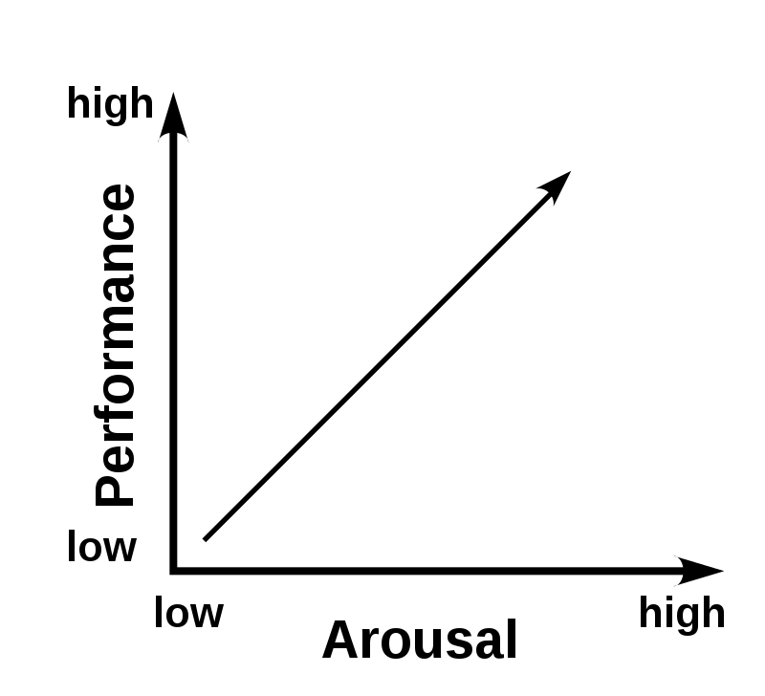
Drive theory
According to drive theory three factors influence performance; complexity of task , arousal and learned habit. the greater the arousal ,the more likely we are adopt the dominant response to a situation that is our habits. the higher the arousal the better will be our performance.

Slide 16
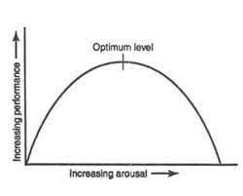
Inverted U hypothesis
This theory states that there is an optimal level of arousal (which will differ from sport to sport and athlete to athlete). Performance levels will be at their highest at the optimal point of arousal. If arousal is too low or too high performance will be lower.

Slide 17
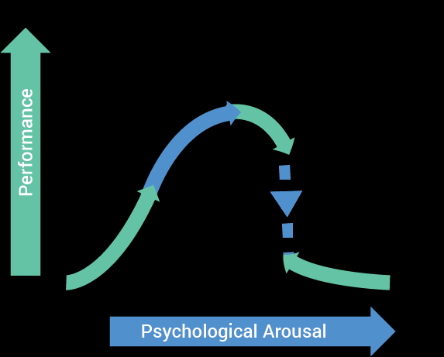
The relationship between anxiety and performance
Catastrophe model
This theory differs from the inverted U hypothesis by linking arousal and anxiety. If the athlete is experiencing high levels of cognitive state anxiety as arousal rises towards the athletes threshold, the athlete experiences a dramatic drop in performance. This theory does also rely on the need for both arousal and cognitive anxiety to achieve optimal performance.

Slide 19
. Zone of Optimal Functioning (ZOF)
The athlete’s preferred anxiety level is called individual zone of optimal functioning .The relationship of stress, anxiety and arousal all impact upon motivation and the improvement of performance up to a point. However optimal performance has many other variables that impact upon arousal and the individual.

Slide 20
Stress management
stress management refers to the environmental, physiological, cognitive, and behavioral techniques employed by an individual to manage the factors and components that underlie the stress process or experience of stress . followings are the techniques which can be used for reducing stress.
Relaxation techniques
Biofeedback
Progressive muscle relaxation(PMR)
Cognitive behavioral techniques

Slide 21
biofeedback
Biofeedback can help control autonomic physiological stress responses, such as increased HR and BP. It also has been used to control anxiety disorders as well as anxiety connected to particular environments or contexts. The premise behind biofeedback is for the athlete to become aware of how stress is manifested physiologically, such as changes in BP, HR, breathing, or muscle tightness, using different modes of objective feedback and monitoring. With this increased awareness, athletes are better equipped to control their actions. With training, athletes become less reliant on the feedback, learning to control their physiological responses on their own.

Slide 22
Progressive muscle relaxation (PMR)
In progressive muscle relaxation, you tense a group of muscles as you breathe in, and you relax them as you breathe out. You work on your muscle groups in a certain order. When your body is physically relaxed, you cannot feel anxious. Practicing progressive muscle relaxation for a few weeks will help you get better at this skill, and in time you will be able to use this method to relieve stress. In the modern version of (PMR) , four sections of the body are relaxed in turn. These are the arm , face , neck, shoulders and upper back, stomach and lower back and the hip and the legs.

Slide 23
Cognitive behavioural technique
Cognitive behavioral therapy (CBT) is based on the connections between your thoughts, emotions, and behaviors, and how they can influence each other. Cognitive Behavioral Training (Gustafsson & Lundqvist, 2016) by which athletes practice to change dysfunctional performance- related behaviors (e.g., avoiding certain anxiety provoking situations) into functional behaviors (e.g., follow the game plan)

Slide 24
Goal setting theory
First, setting goals directs effort and attention toward goal-related activities and away from irrelevant activities. Second, goals can energize an individual within a task, with higher effort expected for more challenging goals than easier goals.
In this coach set long term and short term goal and directed to athlete and this is known as goal setting thoery.

Slide 25
Imagery techniques
Imagery is also called visualization or mental rehearsal.
Imagery means using all of your senses (e.g., see, feel, hear, taste, smell) to rehearse your sport in your mind.
Types of imagery
Internal imagery.in this type of imagery athlete view themselves performing from inside their own body.
External imagery. In this type of imagery athlete picture themselves from outside performing

Slide 26
Mental rehearsal
The ability to picture a performance or aspects of it is a skill that will enhance performance. Mental rehearsal, visualization and imagery are used by athletes to manage and reduce anxiety during a performance.
Mental rehearsal occurs when a performer rehearses in his or her mind the physical skills that the performer wishes to practice. In this process, there is no visible physical movement. The process involves imagining the performance, and rehearsing the activity in the mind, in an attempt to prepare the mind and body for competition (Browne et. Al., 2009).

