Slide 1
Variable
An entity that is capable to vary from individual to individual and object to object.
Variable can also be called as data item.
It is countable and can be measured.

Slide 2
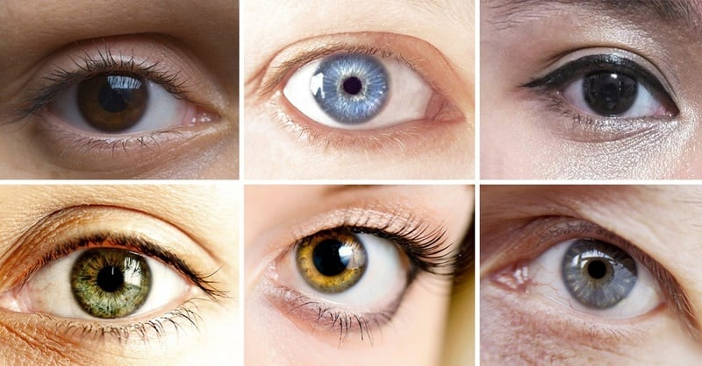
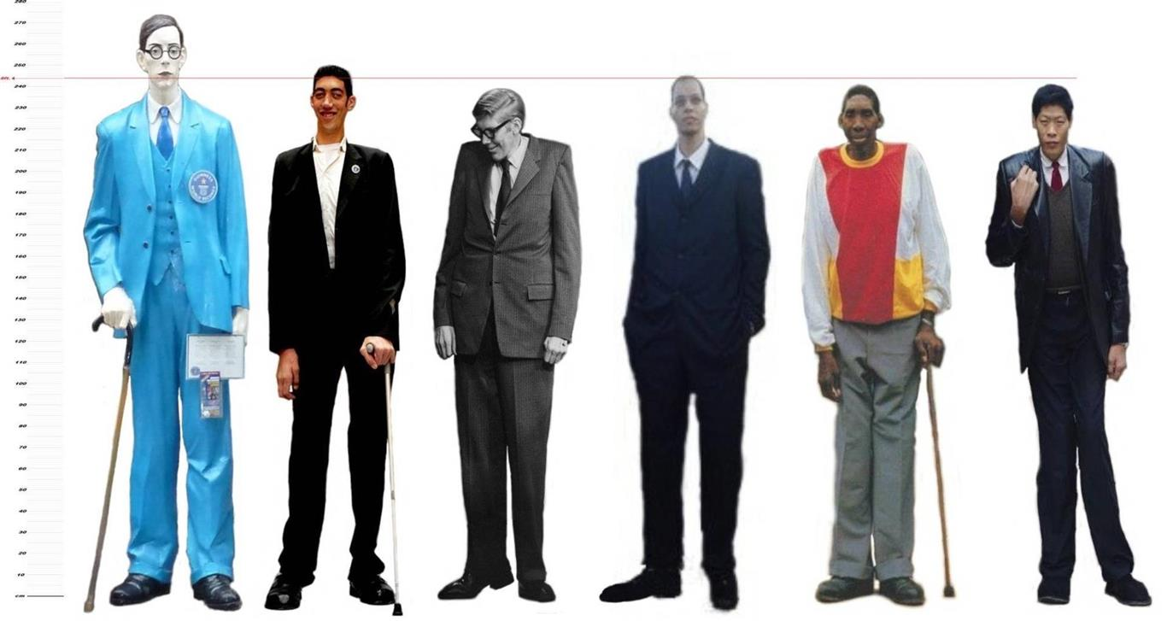
Example
EYE COLOUR
HEIGHT
GENDER

Slide 3
Types of Variable
Qualitative Variable
Deals with description.
Data can be observed.
Can’t be expressed numerically.
Example
Gender
Hair color
Movie Genre

Slide 4
Types of Variable
Quantitative Variable
Deals with numeric values.
Data can be measured.
Example
Income
No. of vegetables
No. of students

Slide 5
Types of Quantitative Variable
DISCRETE VARIABLE
CONTINUOUS VARIABLE

Slide 6
DISCRETE VARIABLE
Variable which may take on only a countable number of distinct values such as 0,1,2,3,4.
Has separated and indivisible categories.
No values can exist between two neighbouring categories.
Example
No. of children in a family.
The Friday night attendance at a cinema.

Slide 7
CONTINUOUS VARIABLE
Which takes an infinite number of values.
Continuous variable are usually measurements.
Have an infinite number of possible values between any two observed values.
Every interval is divisible into an infinite number of equal parts.
Example
Height
Weight
Time required to run a mile

