Slide 1
Deductive Method BS Education-V Teaching Mathematics (EDU-511)
Department of Education University of Sargodha

Slide 2
Deductive method Muhammad Rizwan ul Haq (roll no: Beuf18m002) Teaching of Mathematics (EDU-511) Bs Education (Semester 5) Department of Education University of Sargodha,40100 Sargodha , Pakistan October 2020
SETS Hira Basharat (roll no: Beuf18mo36) Teaching of Mathematics (EDU-511) Bs Education (Semester 5) Department of Education University of Sargodha,40100 Sargodha , Pakistan October 2020

Slide 3
Deductive method
Deductive method is based on deduction. In this approach we proceed from general to particular and from abstract and concrete. At first the rules are given and then students are asked to apply these rules to solve more problems. This approach is mainly used in Algebra, Geometry and Trigonometry because different relations, laws and formulae are used in these sub branches of mathematics. In this approach, help is taken from assumptions, postulates and axioms of mathematics. It is used for teaching mathematics in higher classes.
Deductive approach proceeds form
General rule to specific instances
Unknown to know
Abstract rule to concrete instance
Complex to simple

Slide 4
Steps in deductive approach
Deductive approach of teaching follows the steps given below for effective teaching
ü Clear recognition of the problem
ü Search for a tentative hypothesis
ü Formulating of a tentative hypothesis
ü Verification

Slide 5
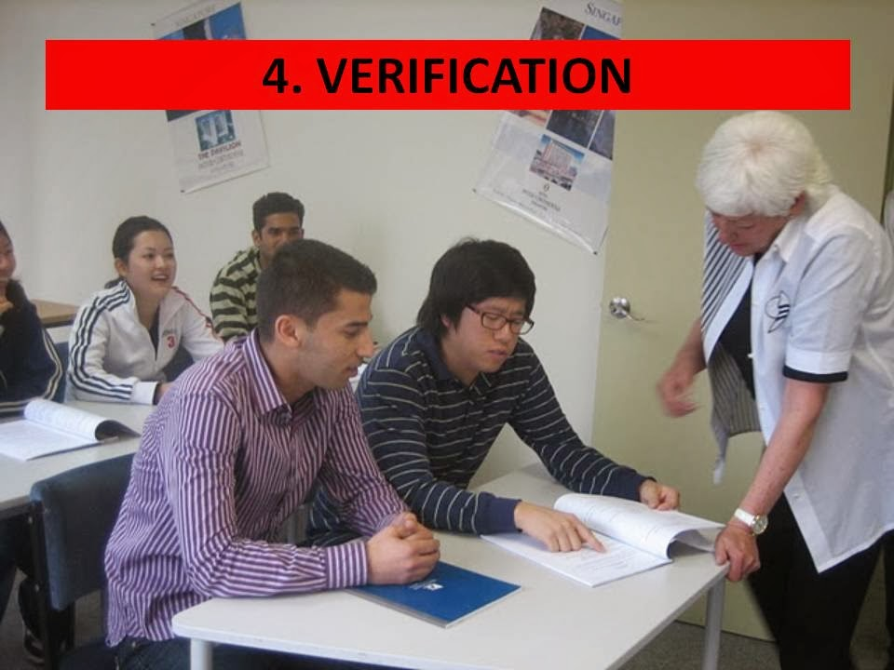

Slide 6
Examples
Example 1:
Find a² X a¹⁰ = ?
Solution:
General : a^{m} X a^{n} = a^{m+n}
Particular: a² X a¹⁰ = a²⁺¹⁰ = a¹²
Example 2:
Find (102)² = ?
Solution:
General: (a+b)² =a²+b²+2ab
Particular: (100+2) ² = 100² + 2² + (2 x 100 x 2)
= 10000+4+400= 10404

Slide 7
MERITS
It is short and time saving method.
It is suitable for all topics.
This method is useful for revision and drill work
There is use of learner’s memory
It is very simple method
It helps all types of learners
It provides sufficient practice in the application of various mathematical formulae and rules.
The speed and efficiency increase by the use of this method.
Probability in induction gets converted into certainty by this method.

Slide 8
DEMERITS
It is not a psychological method.
It is not easy to understand
It taxes the pupil’s mind.
It does not impart any training is scientific method
It is not suitable for beginners.
It encourages cramming.
It puts more emphasis on memory.
Students are only passive listeners.
It is not found quite suitable for the development of thinking, reasoning, and discovery.

Slide 9
Applicability of Deductive Approach
Deductive approach is suitable for giving practice to the student in applying the formula or principles or generalization which has been already arrived at. This method is very useful for fixation and retention of facts and rules as at provides adequate drill and practice.

Slide 10
Reference
posted by thiyagusuriya at 11:09 AM

Slide 11
MCQS
In deductive method we proceed from
a) general to particular
b) particular to general
c) From both
Deductive approach is mainly used in
a)Algebra
b)Geometry and Trigonometry
c)Both a and b

Slide 12
THANKS

