Slide 1
JOB Application and CV
Communication Skills

Slide 2
Job Application
Letter written for searching/seeking a job is called as job application letter.
Job application functions as a personal qualification for the job you are seeking.
An employer makes a decision on whom to call for the interview on the basis of the application letter.
Format/layout must be attractive and impressive.

Slide 3
Types of Job Application
Type 1: All the information regarding qualification, experience & personal details given in the letter.
Type 2: Written in two parts
Short covering letter: giving reference to the advertisement and your most significant qualification for the post.
Curriculum vitae, which gives details about you and your qualification.

Slide 4
Format of Job Application
1st paragraph: Gives what position you are applying for and refer to advt. in newspaper, other media etc.
2nd paragraph: candidate presents himself/herself as the right candidate for the job. Here attention is called to merit by highlighting your special achievement. Also, employer is informed how you could fulfill their demands and contribute to the institute.
3rd paragraph: gives closing statement, assurance how you could fulfill your duties and also some formalities how you could be contacted for interview and also, pay expectations.

Slide 5
Job Application Form Details
Personal Information
Name
Address
City, State, Zip Code
Phone Number
Eligibility to Work in the country
If under age, working paper certificate

Slide 6
.
Education
Schools/Colleges Attended
Degree/Diploma
Graduation Date(s)
Position applied For information
Title of the job you are applying for
Hours/days available to work
When you can start work
Employment information
Names, addresses, phone numbers of previous employers
Supervisor's name
Dates of employment
Salary
Reason for Leaving

Slide 7
References
List of references
Names
Job title or relationship
Addresses
Phone numbers.

Slide 8
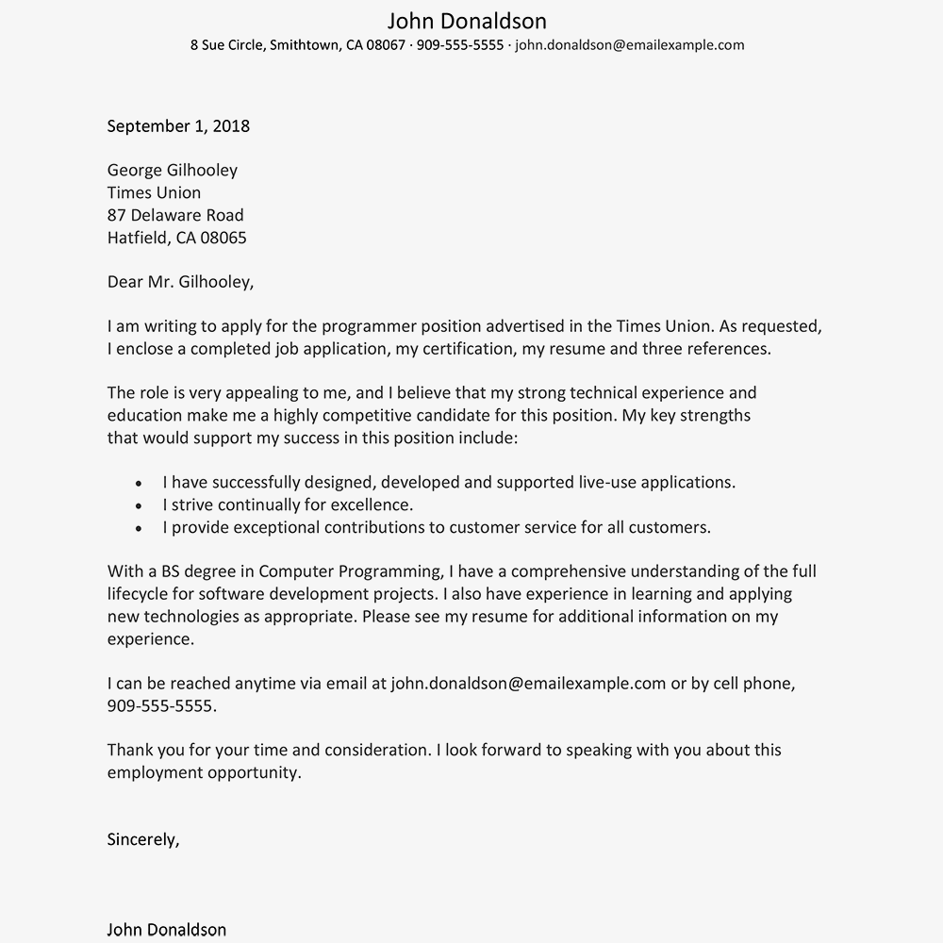
Sample
Job Application Letter

Slide 9
Curriculum vitae
.

Slide 10
What is a CV?
CV: Curriculum (course) Vitae (Life) Origin: Latin
Purpose: to persuade the prospective employer for a personal interview
Serves to provide a summary of your qualifications
Emphasizes your skills and accomplishment
Convince prospective employer that you are well suited to succeed in performing the responsibilities

Slide 11
Difference between CV and Resume
CV is longer (2 or more pages) and more detailed synopsis of your background and skills.
CV includes a summary of your educational and academic backgrounds as well as teaching and research experience, publications, presentations, awards, honors, affiliations and other details

Slide 12
Before You Start…
DO…
DO NOT…
Be brief, clear and concise
Stress your accomplishments and skills, as well as experience
Be neat and organized; direct the reader’s eye with format
Use bold type to emphasize certain elements; use italics sparingly, only to highlight
Be consistent on format and tenses
Concentrate on positives
Use action words to describe your accomplishments
Proofread carefully
Use high quality matching paper
Use the pronoun “I”
Use a font size smaller than 10
Include personal information such as marital status, health, age, place of birth, etc
State salary requirements
Use nicknames
Include a photograph
Include any information that you cannot supply documentation or explain

Slide 13
Parts of CV
(1) Heading
Initial section of your CV details
– Who you are
Do not use nicknames
– How the employer can reach you
Name, address, phone number, email (professional)
Current and Permanent if applicable

Slide 14
(2) Career Objective
Some Do, Some Don’t
Some choose to exclude from cv and state in cover letter
A clear Statement of Your Intentions
– Some employers like to see a clear goal or purpose
– Taylor to the job, examples:
To obtain a position as a management trainee
To secure a full time teaching position at the school/university level.

Slide 15
(3) Education
Content and format
Schools you have attended, including universities, community colleges, technical schools, etc.
Location of school(s)
Date of graduation, actual or anticipated
Degree(s) earned or pursued
Grade Point Average (GPA) / Division
Placement
– Recently graduated students place it after objective
– Graduated a year or more, place after experience

Slide 16
(4) Experience
Experience relevant to your objective
– Full or part-time employment, internships, practicum
– Also be sure to list volunteer work, community committee work. This section includes….
Company or organization and location (city, state)
Position title
Dates of employment or involvement
Descriptions of responsibilities, duties, achievements, etc.
Important to use action words
– Good descriptions are vital to convey your experience
– Keep your tense consistent; present tense if you are currently active in the experience and past tense for all other past experiences
– Use the action word list provided for ideas

Slide 17
(5) Skills
Summary of special skills
– Computer skills, language skills, customer service, leadership
– Be Specific! Example:
Proficient in writing and speaking English Skilled in the use of MS Word, MS Excel, MS Access

Slide 18
(6) Achievements/Activities/ Honors/ Awards
Emphasize significant outside of work
Awards, grants, prizes, and special honors
Memberships in professional clubs and organization
Volunteer activities
Hobbies (optional)

Slide 19
(7) References
Choose two to three people (Past supervisors or employers)
– Name
– Designation
– Contact information
Not usually sent with CV and cover letter unless specified
Can write at end “References Available Upon Request”

Slide 20
Three Types of CV/Resumes
Chronological
Functional
Combination

Slide 21
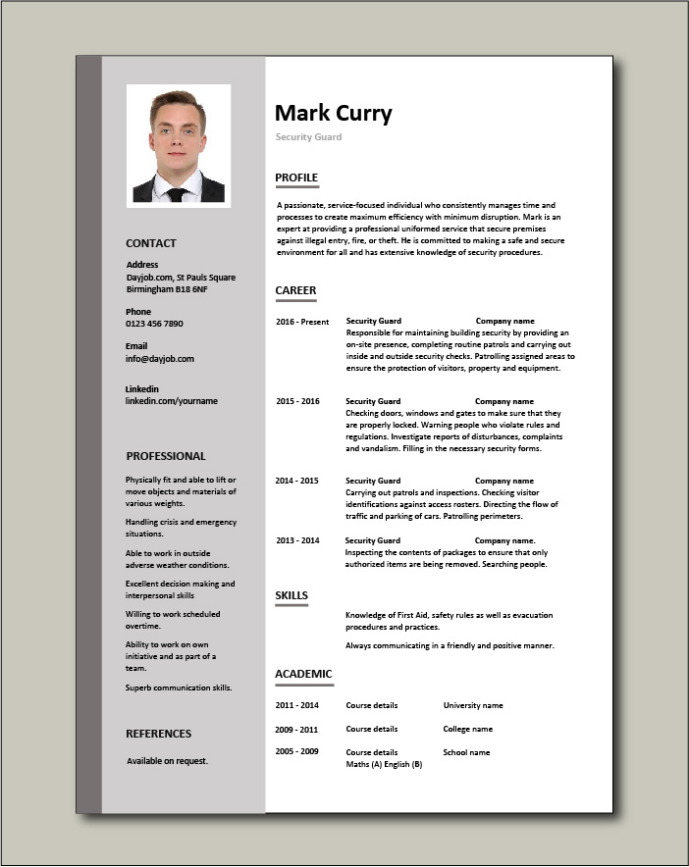
CV Sample

