Slide 2
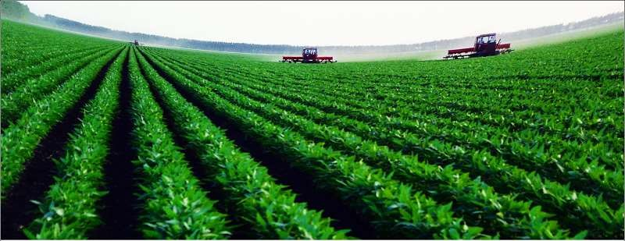
Problems in Agriculture

Slide 3
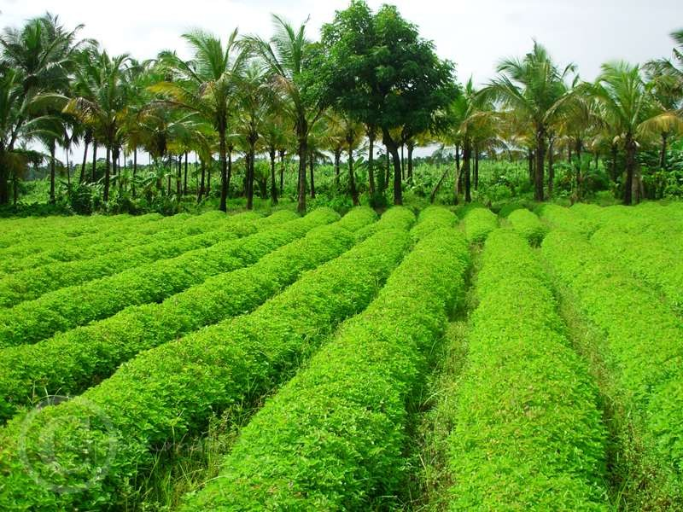
OVERVIEW
 Economy of Pakistan
 GDP 23%
 60% population
 40% employments
 But a lot of problems are there

Slide 4
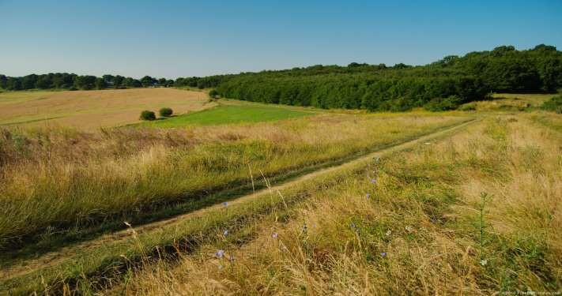
Limited cultivated area
 Total area of Pakistan 79.6 million acre
 23.5% under use
 About 8-9 million area is un cultivated

Slide 5
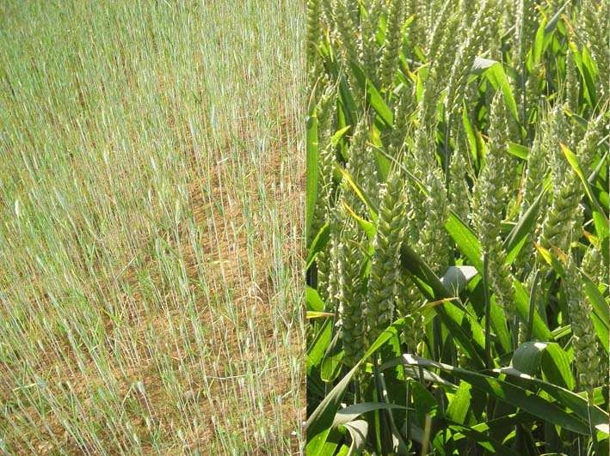
LOW YEILD
 Low per acre yield in major crops
 Like wheat, rice and cotton
 Other countries get more because of skillful labor and use of technology

Slide 6
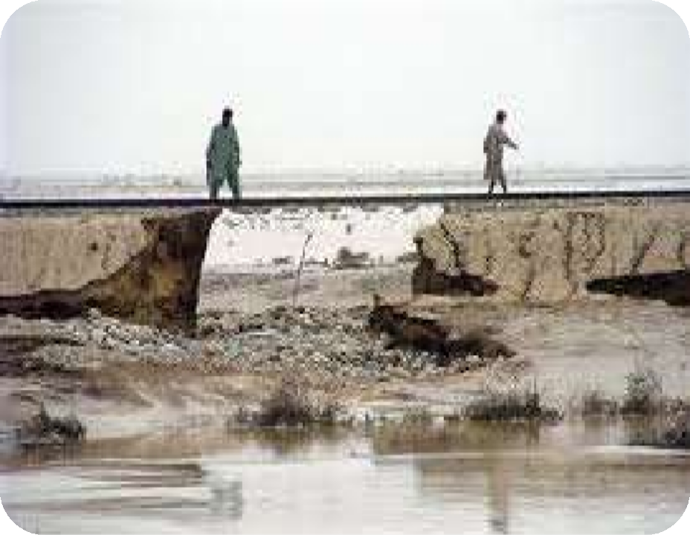
Lack of facilities
 Rural infrastructure is not good
 Lack of education
 Lack of transport
 Improper storage
 Poor road structure
 Far away markets availability

Slide 7
Uneconomic land holding
 Increase in population
 Division of land by law of inheritance
 Further sub-divisions
 Many numbers of farmers have less than 2
hectare land
 Uneconomical - use of machinery

Slide 8
Old methods of farming
 Traditional methods
 Old implements
 Low yield
 But now, modern methods are taking place
 Traditional methods cannot compete with modern one

Slide 9
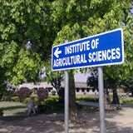
Small numbers of research centers
 In agricultural sector poor research
 Limited research centers
 Unavailability of recourses
 Unavailability of seeds
 No funds for research centers

Slide 10
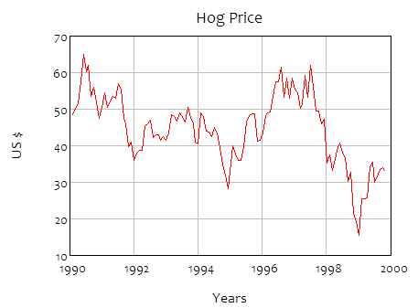
Market prices of Agri. Goods
 Instable prices in our country
 Cobweb theorem:
According to this theorem the price of one commodities is very high in one year and much lower in next year and vice versa.
Farmers get nothing.

Slide 11
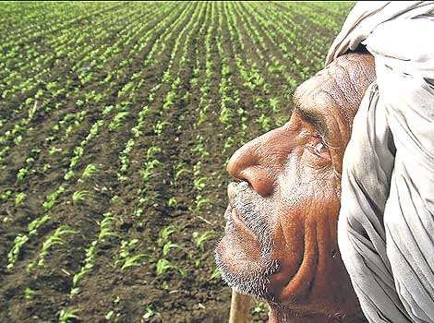
Farmers poor conditions
 Financial crises of farmers
 No money available for investment
 Bank debts
 Do not get much prize from crops
 Far away from markets

Slide 12
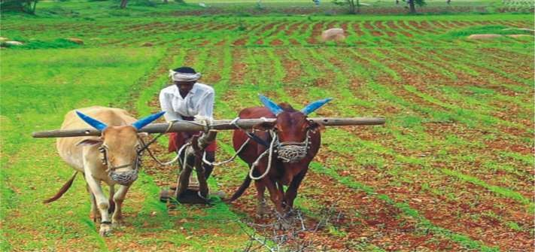
Crop intensity
 Crop intensity is lower
 The number of crops grown on piece of land is known as crop intensity
 Low crop intensity than developed countries

Slide 13
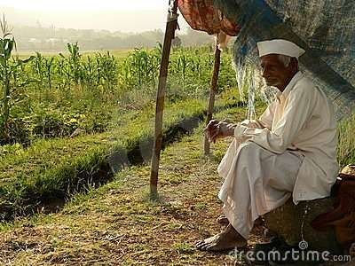
Land tenure system
 land tenure system:
 Common law system in which land is owned by an individual
 Land lords buy fertile piece
of land
 Poor farmers get nothing with hard work
 Low yield on defective land
part

Slide 14
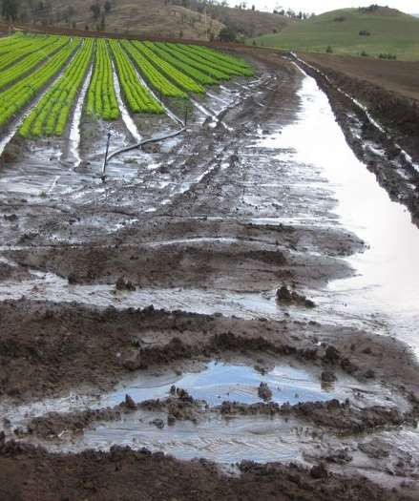
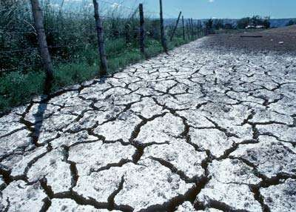
Waterlogging and salinity
 It causes when water-table is above 1.5 meter
 Salts on surface
 Stagnant water
 Low plant growth
 0.1 million acre land is affected

Slide 15
Poor irrigation system
 No proper canals, dams and barrages
 Drought may happen
 Water storage because of more rainfall
 Steeling of water from canals
 No proper division of water

Slide 16
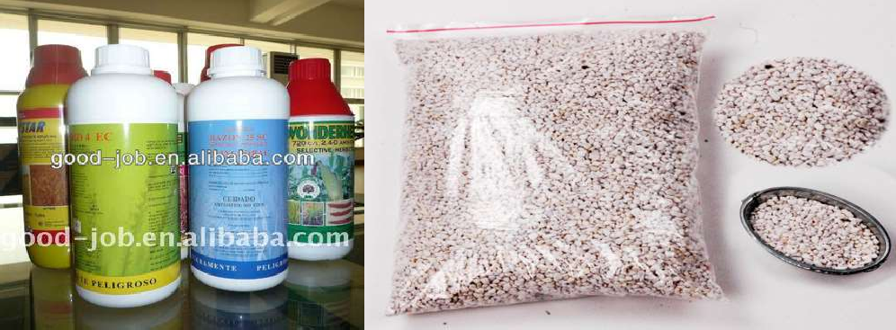
Low quality chemicals
 Low quality fertilizers
 Poor quality pesticides and other chemicals
 Less availability of fertilizers to small farmers

Slide 17
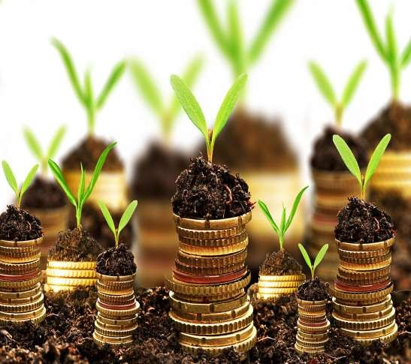
Unavailability of funds
 Government is very poor
 Have not money to spend on agriculture
 Farmers are not financially strong
 IMPROPER LOAN SYATEM

Slide 18
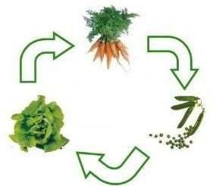
Improper crop rotation
 No crop rotation is done
 No fertility is maintained
 No nutrients enrich soil is maintained
 Continuous cultivation damage the soil

Slide 19
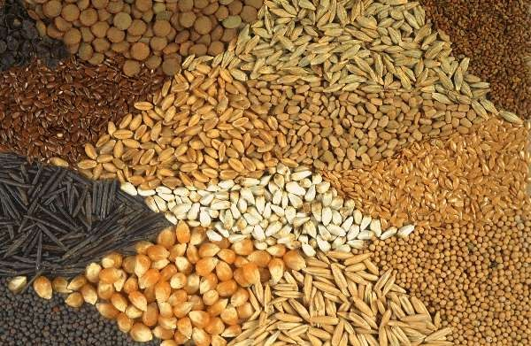
Unavailability of seeds
 Lack of seed industries
 Lack of seed production
 Improper seed quality
 Large money is spend on that industry

Slide 20
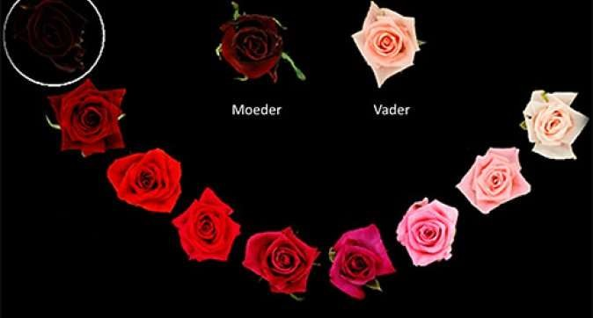
No breeder’s attestation
 No breeders and hybrid verities are at testified
 No proper department
 Lack of funding
 Lack of government’s attention

Slide 21
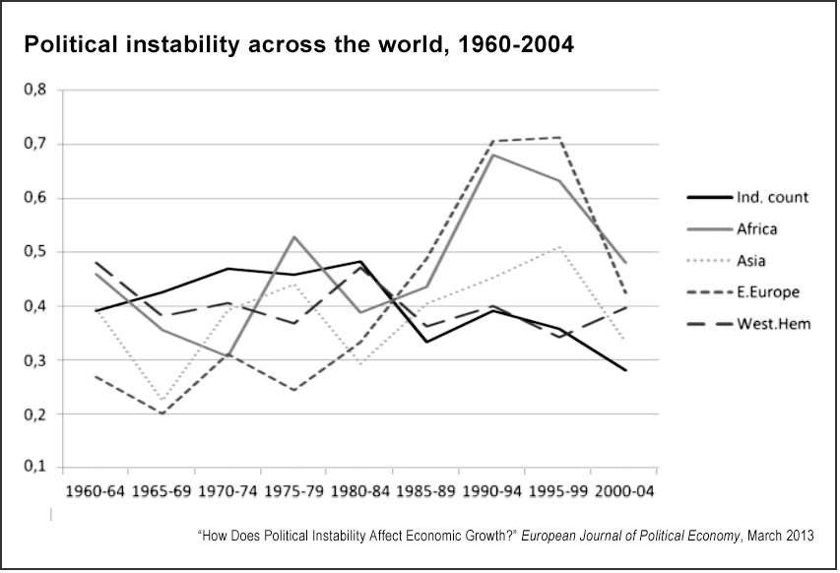
Political instability
 Not stable political situations
 Farmers are restricted to sell crops as raw materials
 Due to political unrest, no investments by people

Slide 22
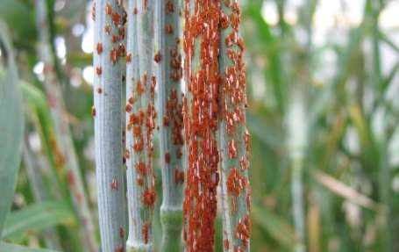
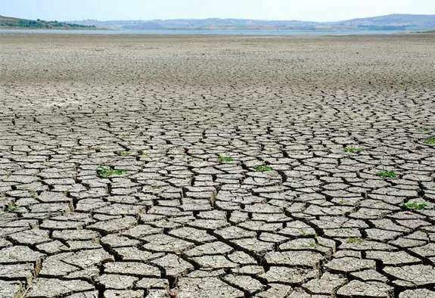
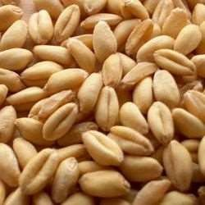
Other problems
 Various plant diseases
 Natural calamities
 Scarcity of (HYV) Seeds
 Underutilization of land

Slide 23
THANKS

