Slide 1
Hand ball
Court Measurements

Slide 2
International federation
IHF (international handball federation) is the international governing body of handball
All rules will be discussed according to IHF

Slide 3
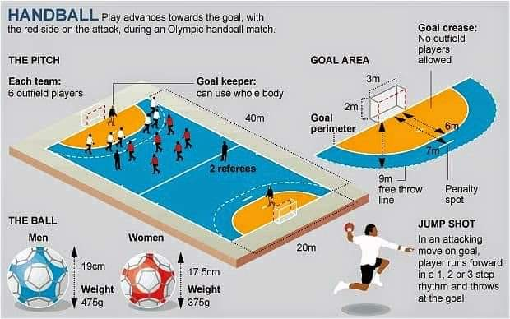
Hand ball court

Slide 4
Measurements
Court is rectangle
40m long (Side lines)
20m wide (Goal Lines)
Court has two goal areas & one playing area
The color of two goal areas & playing area is in contrast to each other
Safety Zone surrounding the court with the width of 1m from side line & 2m from goal line

Slide 5
Goal
one goal is placed at each side, placed in the center of each outer goal line
Goal must be firmly attached with floor or behind walls
It will be 3m wide & 2m high
Goal is consists on 2 goal posts (side bars) & one cross bar
Goal also has a net . It is attached at the back end of the net. It is used to stop the ball within the goal when it throw in it

Slide 6
Lines of the court
All lines are part of the court
Goal lines are 8cm wide within the goalposts, also called inner goal line
All other lines are 5cm wide including outer goal lines

Slide 7
Goal area
In front of each goal there is a goal area
It is 6m wide arc from center of inner goal line
It is also called 6m area

Slide 8
Free throw line
It is a broken line (doted line)
3m away from 6m line
All dots are 15cm in length
The distance between dots is also 15cm
It is also called 9m area

Slide 9
7m line
It is a one meter long line
It is in front of inner goal line
It is 7m away from inner goal line
It is used to take 7m throw

Slide 10
Goal keeper restricted line
It is also called 4m line
It is 15cm long
Marked at front to the inner goal line
It is 4m away from goal line
Goal keeper will stay behind that line when opponent team player taking the 7m throw

Slide 11
The center line
Connects the midpoints of two side lines
Substitution line
It extends 4.5m from center line at each side
Marked with 15cm inside & outside of side line

