Slide 1
Magnetism
Dr.Kanwal Fatima(PT)

Slide 2
What is Magnetism?
Magnetism is the force of
attraction or repulsion of a magnetic
material due to the arrangement
of its atoms,
particularly its electrons.

Slide 3
All magnetic phenomena result from forces between electric charges in motion.
Like repels like…
Opposites attract!

Slide 4
The ends of a magnet are where the magnetic effect is the
strongest. These are called “poles.” Each magnet has
2 poles – 1 north, 1 south.

Slide 5
No Monopoles Allowed
It has not been shown to be possible to end up with a single North pole or a single South pole, which is a monopole ("mono" means one or single, thus one pole).
S
N
Note: Some theorists believe that magnetic monopoles may have been made in the early Universe. So far, none have been detected.

Slide 6
Defining Magnetic Field Direction
Magnetic Field vectors as written as B
Direction of magnetic field at any point is defined as the direction of motion of a charged particle on which the magnetic field would not exert a force.
Magnitude of the B-vector is proportional to the force acting on the moving charge, magnitude of the moving charge, the magnitude of its velocity, and the angle between v and the B-field. Unit is the Tesla or the Gauss (1 T = 10,000 G).

Slide 7
Field Lines Around a Bar Magnet

Slide 8
Field Lines Around a Magnetic Sphere

Slide 9
Field Lines of Repelling Bars

Slide 10
Field Lines of Attracting Bars

Slide 11
Atoms themselves have magnetic properties due to the spin of the atom’s electrons.
Groups of atoms join so that their magnetic fields
✰ “domains”
They all are going in the same direction

Slide 12
When an unmagnetized substance is placed in a magnetic field,the substance can be comemagnetized.
This happens when the spinning electrons line up in the same direction.

Slide 13
An unmagnetized substance looks like this…

Slide 14
While a magnetized substance
like this…
Iron
Lodestone (Magnetite)

Slide 15
Making and Breaking Magnets
In most materials, if you add energy to the electrons, you can get them to move and realign
Can you think of ways to add energy to electrons?
How can you make a magnet?
How can you demagnetize a magnet?
What happens when you break a magnet?

Slide 16
Magnetic Field Vectors Due to a Bar Magnet
N
S

Slide 17
N
S

Slide 18
N
S

Slide 19
N
S

Slide 20
N
S

Slide 21
N
S

Slide 22
N
S

Slide 23
N
S

Slide 24
N
S

Slide 25
N
S

Slide 26
Magnetic Field Lines
The direction of the magnetic field at any point is tangent to the magnetic field line at that point.

Slide 27
The Earth is a magnet:
It exerts magnetic forces and is surrounded by a magnetic field that is strongest near the
North and South magnetic poles

Slide 28
Sometimes, the Earth’s magnetic poles flip.
MagneticNorthPole
This happens every half- million years or so.
MagneticSouthPole

Slide 29
William Gilbert, an English physician,
first proposed in
1600 that the earth itself is a magnet,
and he predicted that the Earth would be
found to have magnetic poles.

Slide 30
We use the Earth’s magnetic field to find direction.
The needle of a compass always points toward the magnetic south pole.
We call this direction “North” (remember, opposites attract)

Slide 31
Magnetism
The term magnetism comes from the name Magnesia, a coastal district of ancient Thessaly, Greece.
Unusual stones were found by the Greeks more than 2000 years ago. These stones, called lodestones, had the intriguing property of attracting pieces of iron.
Magnets were first fashioned into compasses and used for navigation by the Chinese in the 12th century.

Slide 32
Magnetic Forces
The force (F_{e}) between any two charged particles depends on the magnitude of the charge (q₁*q₂) on each and their distance of separation (r²), as specified in Coulomb’s law. F_{e}= k_{e}*q₁q₂/r²
But Coulomb’s law is not the whole story!
When the charged particles are moving with respect to each other, the electrical force between electrically charged particles depends also, in a complicated way, on their motion.
There is a force due to the motion of the charged particles that we call the magnetic force.

Slide 33
Magnetic Poles
Magnetic force between a pair of magnets
Force of attraction or repulsion between a pair of magnets depends on which end of the magnet is held near the other (N vs. S)
Strength of interaction depends on the distance between the two magnets.
AND, the magnitude of the magnets

Slide 34
Magnetic Poles
Magnetic poles
Give rise to magnetic force
Rule for magnetic forces between magnetic poles:
Like poles repel; opposite poles attract.
north pole (geographic north-seeking pole)
south pole (geographic south-seeking pole)
(Note the word “seeking” above)

Slide 35
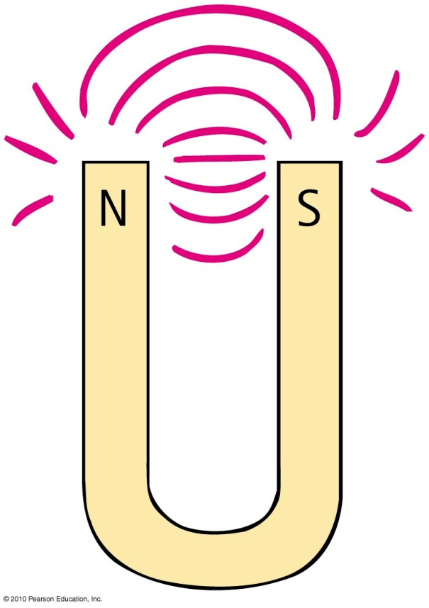
Magnetic poles (continued)
In all magnets—you can’t have one pole without the other
No single pole is known to exist
Example:
simple bar magnet—poles at the two ends
horseshoe magnet: bent U shape—poles at ends
Breaking a magnet in two produces two new magnets, each with one south and one north seeing pole

Slide 36
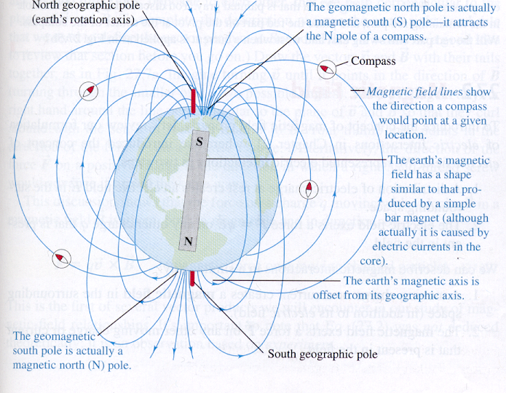
Permanent magnets always have two poles; a north seeking pole and a south seeking pole
Unlike poles attract each other
Like poles repel each other
What type of pole (N or S) is near the north pole?

Slide 37
Magnetic Forces
In this case a permanent magnet not only attracts these nails, but magnetizes other nails.
Thus magnetism can be induced by magnets

Slide 38
Magnetic Poles
Magnets attract metal objects by magnetic induction just like charged particles
The force produced by two magnets is proportional the strength of the magnets

Slide 39
Magnetic Fields

Slide 40
Magnetic Field
The magnetic field lines go from one pole to another
What you cannot see is that the field lines also exist inside the magnet and complete the loop

Slide 41
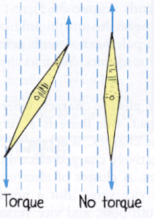
Magnetic Fields
Magnetic fields are similar to electric fields
Magnetic fields are ways to visualize what would happen to a magnet in the field
The force pulling the magnets pole will twist the magnet
(TORQUE)
Similarly an iron filing becomes magnetized and aligns itself with the magnetic field

Slide 42
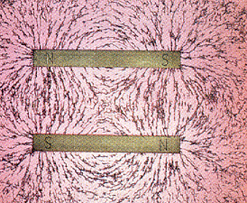
Magnetic Fields
Note how the two north seeking poles and south seeking poles repel each other in the left hand figure, but the opposite poles attract on the right

Slide 43
Magnetic Fields
Magnetism is created by moving charges
In permanent magnets the moving charges are electrons moving around the nucleus
The magnetic field is therefore due to the distortions that occur when electric fields are in motion
The magnetic field is relativistic. In other words the magnetic field depends on the motion of the charge with respect to the observer

Slide 44
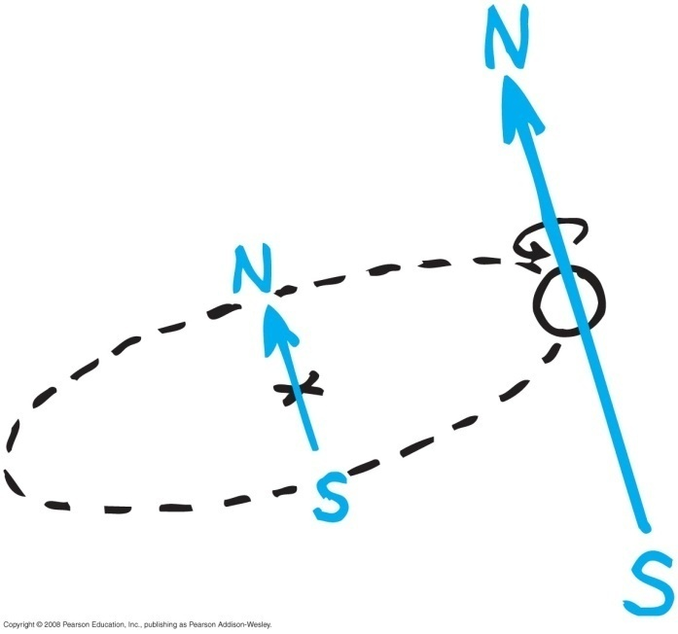
Magnetic fields (continued)
Produced by two kinds of electron motion
electron spin
main contributor to magnetism
pair of electrons spinning in same direction creates a stronger magnet
pair of electrons spinning in opposite direction cancels magnetic field of the other
electron revolution

Slide 45
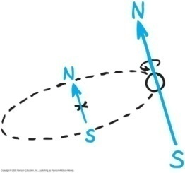
Magnetic Domains
Every atom has moving electrons
Groups of atoms may have their electrons move complementary to each which creates a magnetic field DOMAIN
3) When hot iron metal is in its liquid phase, the domains are continually moving around in random directions.
4)Typically, as the iron cools and becomes solid, the domains are “frozen” in an unorganized manner, where the domains will cancel each other out.
5) But, IF there is a strong magnetic field nearby when the metal is cooling, these domains will all align to the magnetic field creating a permanent magnet.

Slide 46
Magnetic Domains
Since the earth has a significant magnetic field, molten iron may become magnetized naturally as the molten iron cools.
This is what creates a lodestone

Slide 47
Magnetic Domains
Difference between permanent magnet and temporary magnet
Permanent magnet
alignment of domains remains once external magnetic field is removed
Temporary magnet
alignment of domains returns to random arrangement once external magnetic field is removed

Slide 48
Magnetic Domains
You can also create a permanent magnet by taking another magnet and stroking a piece of metal. After awhile the magnetic domains will align creating a permanent magnet

Slide 49
Electricity and Magnetism
Electric forces hold atoms and molecules together.
Electricity controls our thinking, feeling, muscles and metabolic processes.
Electricity and magnetism underpin much of our current technology (e.g. computers).
Electricity and magnetism are linked on a fundamental level.

Slide 50
Electric Motor
An electric motor, is a machine which converts electrical energy into mechanical (rotational or kinetic) energy.
A current is passed through a loop which is immersed in a magnetic field. A force exists on the top leg of the loop which pulls the loop out of the paper, while a force on the bottom leg of the loop pushes the loop into the paper.
The net effect of these forces is to rotate the loop.

Slide 51
Electromagnt
(Magnetism from Electricity)
An electromagnet is simply a coil of wires which, when a current is passed through, generate a magnetic field, as below.

Slide 52
Magnetic Properties of Matter
In other words….materials which produce magnetic fields with no apparent circulation of charge.
All substances - solid, gas, and liquid - react to the presence of a magnetic field on some level. Remember why?
How much they react causes them to be put into several material “types”.

Slide 53
Top Ten List
What We Will Learn About Magnetism
There are North Poles and South Poles.
Like poles repel, unlike poles attract.
Magnetic forces attract only magnetic materials.
Magnetic forces act at a distance.
While magnetized, temporary magnets act like permanent magnets.

Slide 54
Top Ten Continued
A charged particle experiences no magnetic force when moving parallel to a magnetic field, but when it is moving perpendicular to the field it experiences a force perpendicular to both the field and the direction of motion.
A current-carrying wire in a perpendicular magnetic field experiences a force in a direction perpendicular to both the wire and the field.

