Slide 2
NEUROMUSCULAR COORDINATION
Dr Atif Malik

Slide 3
CO ORDINATED MOVEMENT
Smooth, accurate and purposeful movement brought about by the integrated action of many muscles, superimposed upon the basis of efficient postural activity.
The muscle are grouped together as
Prime movers
Antagonists
Synergists
Fixators

Slide 4
CO-ORDINATED MOVEMENTS
Group Action of Muscles
Nervous Control
The Motor Pathway
Cerebral Cortex
Cerebellum
Kinesthetic Sensation

Slide 6
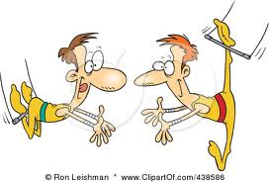

Slide 7
GROUP ACTION OF THE MUSCLE
A single muscle can work alone to produce a particular movement or to secure stability
Functionally, muscles work together in groups
Each muscle has some specific part to play
Integrated activity of many groups is required to produce efficient functional movement

Slide 8
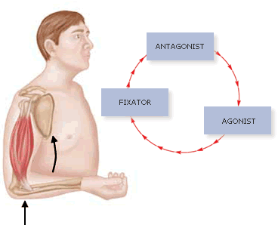
AGONIST (PRIME MOVERS)
They contract to provide force required to produce movement

Slide 9
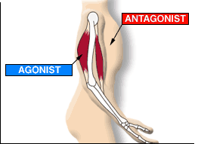
ANTAGONIST
Their action would oppose the action of agonists
Their activity is inhibited and relax to allow movement

Slide 10
SYNERGIST
Syn-Greek-With
They work with agonists
Provide suitable background of activity
Facilitate movement
Modify direction of movement
Control joints which are not involved (in case of 2 joint muscle)

Slide 11
FIXATORS
Stabilize the bone of origin
Increase the efficiency of agonist
Stabilize the body as a whole

Slide 12
NERVOUS CONTROL
This involves the following
The motor pathway
Cerebral cortex
Cerebellum
Kinesthetic sensation

Slide 13
NERVOUS CONTROL
THE MOTOR PATHWAY: action of muscle is determined by the afferent impulses reaching to it.
CEREBRAL CORTEX: voluntary movement is initiated in response to sensory stimulus. Initiation centers exist in the brain stem that alert the cerebral cortex that is responsible for planning the pattern of movement.

Slide 14
CEREBELLUM: It is receiving station of information. It delicately adjust all the information and result in harmonious interaction of muscles and conveys the pattern to the AHC by either extra pyramidal tracts or other pathway of the spinal cord
KINESTHETIC SENSATION: Afferent impulses arise from the proprioceptors situated in the muscle, tendons and joints. They record the position of limb. Some of the impulses reach the conscious level other end in spinal cord and cerebellum.

Slide 15
INCOORDINATION
Interference in the coordination process lead to the jerky, arrhythmic or inaccurate movement.
The exercises designed to overcome the problem are different according to the location of the lesion which is causing it.

Slide 16
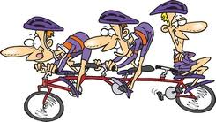
INCO-ORDINATION
In coordination results due to following
Weakness or flaccidity of muscles
Spasticity of the muscles
Cerebellar lesion
Loss of kinesthetic sensation

Slide 17
WEAKNESS OR FLACCIDITY OF MUSCLES
In this case lesion of the Lower motor neurons prevents the appropriate impulses from reaching the muscle

Slide 18
SPASTICITY OF THE MUSCLES
Lesion affecting the area of the cerebral cortex, or the upper motor neurons result in spasticity of the muscle so the response is abnormal.

Slide 19
CEREBELLAR LESION
This is known as the ‘CEREBELLAR ATAXIA’ it means ‘without order’.
There is marked hypotonicity of the muscle, tire easily, inadequate fixator action.
Movement is irregular, swaying and with intention tremors.

Slide 20
LOSS OF KINESTHETIC SENSATION
This is ‘SENSORY ATAXIA’ or in case of TABES DORSALIS, TEBATIC ATAXIA.
In this case patient is unaware of his body in space or position of joint.
The muscle are hypotonic and tire easily, they are unaware with sensation of fatigue.

