Slide 1
PROCESSOR STRUCTURE AND FUNCTION

Slide 2
Dealing with Branches:
One of the major problems in designing an instruction pipeline is assuring a steady flow of instructions to the initial stages of the pipeline. The primary impediment, as we have seen, is the conditional branch instruction. Until the instruction is actually executed, it is impossible to determine whether the branch
will be taken or not.

Slide 3
Approaches for dealing with conditional branches:
Branch prediction
Multiple streams
Prefetch branch target
Loop buffer
Delayed branch

Slide 4
1:BRANCH PREDICTION
Various techniques can be used to predict whether a branch will be taken. Among the more common are the following:
Predict never taken
Predict always taken
Predict by opcode
Taken/not taken switch
Branch history table

Slide 5
The first three approaches are static: they do not depend on the execution history up to the time of the conditional branch instruction.
The latter two approaches are dynamic: They depend on the execution history.
The first two approaches are the simplest. These either always assume that the branch will not be taken and continue to fetch instructions in sequence, or they always assume that the branch will be taken and always fetch from the branch target.
The predict-never-taken approach is the most popular of all the branch prediction methods.

Slide 6
Predict never taken:
These either always assume that the branch will not be taken and continue to fetch instructions in sequence

Slide 7
Predict always taken:
They always assume that the branch will be taken and always fetch from the branch target.

Slide 8
Predict by opcode:
The final static approach makes the decision based on the opcode of the branch instruction.
The processor assumes that the branch will be taken for certain branch opcodes and not for others

Slide 9
Taken/not taken switch:
Dynamic branch strategies attempt to improve the accuracy of prediction by recording the history of conditional branch instructions in a program.
For example, one or more bits can be associated with each conditional branch instruction
That reflect the recent history of the instruction. These bits are referred to as a taken/ not taken switch that directs the processor to make a particular decision the next time the instruction is encountered.
Typically, these history bits are not associated with the instruction in main memory. Rather, they are kept in temporary high speed storage.

Slide 10
One possibility is to associate these bits with any conditional branch instruction that is in a cache. When the instruction is replaced in the cache, its history is lost.
Another possibility is to maintain a small table for recently executed branch instructions with one or more history bits in each entry.
The processor could access the table associatively

Slide 11
1 bit prediction:
With a single bit, all that can be recorded is whether the last execution of this instruction resulted in a branch or not.
A shortcoming of using a single bit appears
in the case of a conditional branch instruction that is almost always taken, such as a loop instruction. With only one bit of history, an error in prediction will occur twice for each use of the loop: once on entering the loop, and once on exiting.

Slide 12
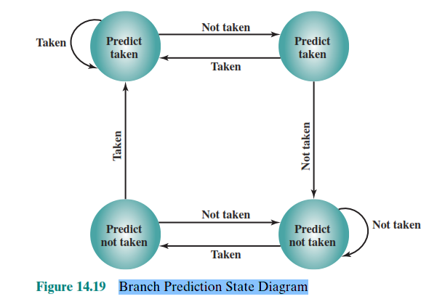
2 bit prediction:
If two bits are used, they can be used to record the result of the last two instances of the execution of the associated instruction.

Slide 13
Branch Prediction State Diagram:
Assume that the algorithm starts at the upper-left-hand corner of the flowchart. As long as each succeeding conditional branch instruction that is encountered is taken, the decision process predicts that the next branch will be taken. If a single prediction is wrong, the algorithm continues to predict that the next branch is taken. Only if two successive branches are not taken does the algorithm shift to the right-hand side of the flowchart. Subsequently, the algorithm

Slide 14
Branch Prediction State Diagram:
will predict that branches are not taken until two branches in a row are taken.
Thus, the algorithm requires two consecutive wrong predictions to change the prediction
decision.
The decision process can be represented more compactly by a finite-state machine, shown in Figure

Slide 15
Branch Prediction Flowchart:

Slide 16
Branch history table:
The branch history table is a small cache memory associated with the instruction fetch stage of the pipeline. Each entry in the table consists of three elements:
The address of a branch instruction
Some number of history bits that record the state
of use of that instruction,
information about the target instruction.

Slide 17
Branch history table:

Slide 18
Branch history table:
With the former strategy, the instruction fetch stage always fetches the next sequential address.
If a branch is taken,
some logic in the processor detects this and instructs that the next instruction be fetched from the target address (in addition to flushing the pipeline). The branch history table is treated as a cache. Each prefetch triggers a lookup in the branch history table.

Slide 19
Branch history table:
If no match is found,
the next sequential address is used for the fetch.
If a match is found, a prediction is made based on the state of the instruction: Either the next sequential address or the branch target address is
fed to the select logic.

Slide 20
Branch history table:
When the branch instruction is executed, the execute stage signals the branch history table logic with the result. The state of the instruction is updated to reflect a correct or incorrect prediction.
If the prediction is incorrect, the select logic is redirected to the correct address for the next fetch.

Slide 21
Branch history table:
When a conditional branch instruction is encountered that is not in the table, it is added to the table and one of the existing entries is discarded, using one of the cache replacement algorithms discussed in Chapter 4.

