Slide 1
HORT 308
MEDICINAL AND AROMATIC PLANTS

Slide 2
Calendula

Slide 3
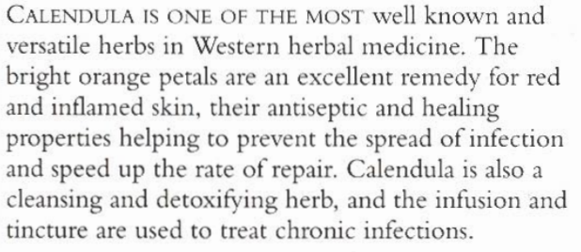
B.N Calendula officinalis Family: Compositae

Slide 4
Habitat and Cultivation
Native to Southern Europe
Now cultivated worldwide
Flowers harvested and dried in shade

Slide 5
Key Constituents
Triterpenes
Resins
Bitter glycosides
Volatile Oil
Sterols
Flavonoids
Mucilage
Carotones

Slide 6
Key Action
Anti inflammatory
Relives muscular spasms
Astringent
Prevents hemorrhaging
Heals wounds
Antiseptic
Detoxifying
Mildly estrogenic

Slide 7
Traditional and Current Uses
Therapeutic Properties: Antiseptic, antifungal, antibacterial, antiviral
Skin Remedies: Minor skin problems, cuts and scraps, wounds, burns, sunburns, acne, rashes, ringworm, athlete’s foot, soothes nipples that are sore from breast feeding
Digestive: Colic, ulcer, inflammation
Detoxifying: Treat toxicity that underlies fevers and infections, systemetic skin disorders
Gynecological: Mild estrogenic, reduce menstrual pain and regulate bleeding

Slide 8
Parts Used
Dried Petals
Dried Flower Heads

Slide 9
Key Preparation
Cream
Infusion
Ointment
Infused oil
Tincture

Slide 10
Chili

Slide 11
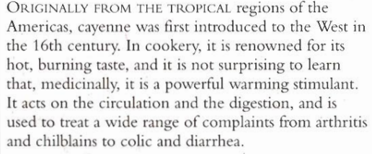
B.N Capsicum frutescens Family: Solanaceae

Slide 12
Habitat and Cultivation
Native to tropical USA
Now cultivated in tropics of Africa
Asia
India

Slide 13
Key Constituents
Capsaicin
Carotenoids
Flavonoids
Volatile oil
Steroidal saponins

Slide 14
Key Actions
Stimulant
Tonic
Carminative
Relives muscular spasms
Antiseptic
Increases sweating
Increase blood flow to the skin
Analgesic

Slide 15
Traditional and Current Uses
Analgesic and Antibiotic
Warming stimulant
External Uses: Skin, rheumatic & arthritis, remove waste, placed inside socks foe permanent cold feet
Internal Uses: Relives gas and colic, stimulate secretions of digestive juices, prevents infection, for gargles and sore throat

Slide 16
Parts Used
Fresh and Dried Fruit

Slide 17
Key Preparation
Powder
Infused oil
Tincture
Ointment
Tablets

Slide 18
Caution
Avoid in peptic ulcers
In Pregnancy and breast feeding

