Slide 1
PHYSICAL TRANSMISSION MEDIA

Slide 2
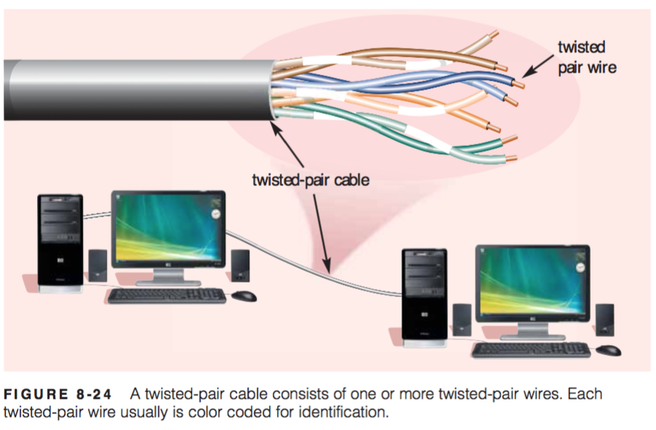
PHYSICAL TRANSMISSION MEDIA
Physical transmission media used in communications include twisted-pair cable, coaxial cable, and fiber-optic cable. These cables typically are used within or underground between buildings. Ethernet and token ring LANs often use physical transmission media.
Twisted-Pair Cable
One of the more commonly used transmission media for network cabling and telephone systems is twisted-pair cable. Twisted-pair cable consists of one or more twisted-pair wires bundled together (Figure 8-24). Each twisted-pair wire consists of two separate insulated copper wires that are twisted together. The wires are twisted together to reduce noise. Noise is an electri- cal disturbance that can degrade communications

Slide 3
Types Of Twisted-Pair Cables !!
The two commonly used types of twisted pair cables are as follows:
1. Unshielded twisted pair (UTP)
2. Shielded twisted pair (STP)
Shielded twisted pair:
STP cable has a metal foil or braided mesh covering that mainly encases each pair of insulated conductors. Although metal casing improves the quality of the cable by preventing the penetration of noise or the crosstalk , it is bulkier and more expensive.
This is known as the metal shield which is normally connected to ground so as to reduce the interference of the noise. But this makes the cable bulky and expensive. So practically UTP is more used than STP. The STP was developed by IBM and is used primarily for the IBM company only.
Twisted pairs can also be used for either analog or digital transmission. The bandwidth supported by the wire depends on the thickness of the wire and the distance to be travelled by a signal on it.
Twisted pairs support several megabits/sec for a few kilometers and are less costly .
Characteristics of STP Of Twisted Pair Cable !!
The twisted conductors are shielded by a braided mesh to reduce noise interference.
Low-cost medium and Support data rates up to several Mbps.

Slide 4
Unshielded Twisted Pair (UTP):
A twisted pair consists of two insulated conductors twisted together in the shape of a spiral as shown in figure . It can be shielded or unshielded. The unshielded twisted pair cables are generally very cheap and easy to install. But they are badly affected by electromagnetic noise interference.
In a balanced pair operation, the two wires carry equal and opposite signals and the destination detects the differences between the two . This is known as differential mode transmission.
The cables are typically made with copper wires measured at 22 or 24 AWG (American wire guage) with the coloured insulation.
Twisting of wires will reduce the effect of noise or external interference. The induced emf into the two wires due to the interference tends to cancel each other due to twisting. The number of twists per unit length will then determine the quality of cable. More twists thus mean better quality.
Characteristics Of Unshielded Twisted Pair (UTP):
1. These cables ensure less crosstalk and a higher quality of signal over longer distances. Therefore these cables are popularly used for high-speed computer communication.
2. The wires are not shielded and can support a data rate of several Mbps.
3. Used in applications like analog and digital telephony i.e LAN etc
4. Noise and electromagnetic interference are high.

Slide 5
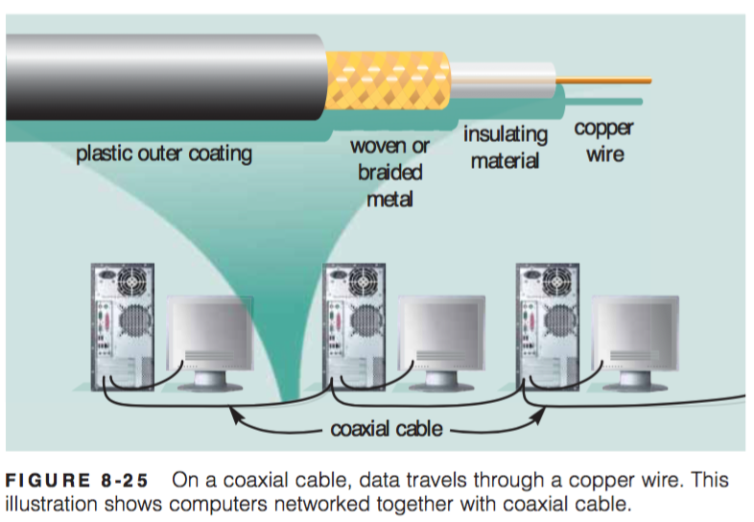
Coaxial Cable, often referred to as coax (pronounced KO-ax), consists of a single copper wire surrounded by at least three layers: (1) an insulating material, (2) a woven or braided metal, and (3) a plastic outer coating (Figure 8-25).
Cable television (CATV) network wiring often uses coaxial cable because it can be cabled over longer distances than twisted-pair cable. Most of today’s computer networks, however, do not use coaxial cable because other transmission media such as fiber-optic cable transmit signals at faster rates.

Slide 6
Coaxial cable types:
There are two main types of coaxial cables – ones with an impedance of 75 Ohm (Ω) and ones with an impedance of 50 Ohm.
Cables with 75 Ohm are mostly used for video signals, while 50 Ohm cables tend to be used for data and wireless communications.
In coaxial cables, Ohm refers to the impedance, which is the measure of resistance in the cable to the flow of electrical energy.
What’s RF coaxial cable?
RF coaxial cables are used to carry radio frequency signals. They’re the standard input cable on TVs and feature a single pin which plugs into the RF input on a device.
What’s RG-6 cable?
RG-6 cables have larger conductors, so they provide better signal quality. They have thicker dielectric insulation and are made with a different kind of shielding, allowing them to handle GHz level signals more effectively. As this type of cable is thin, it can also be easily installed in walls or ceilings.
What’s RG-59 cable?
A common cable in domestic settings, RG-59 cable is similar to the RG-6, but it has an even thinner centre conductor. This makes it a good choice for short runs and low-frequency transmissions.
What’s RG-11 cable?
RG-11 cable is easily identifiable as it’s thicker than other types of coaxial cable, which can make it more difficult to work with. However, it offers a lower attenuation level than RG-6 or RG-59, meaning it can carry data for longer distances.

Slide 7
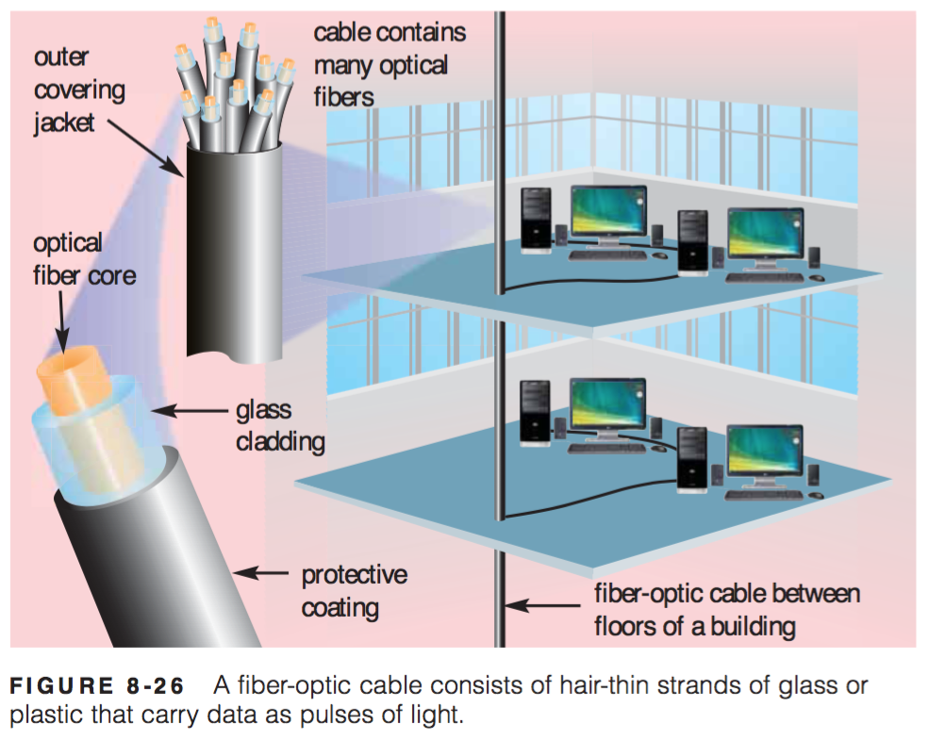
Fiber-Optic Cable
The core of a fiber-optic cable consists of dozens or hundreds of thin strands of glass or plastic that use light to transmit signals. Each strand, called an optical fiber, is as thin as a human hair. Inside the fiber-optic cable, an insu- lating glass cladding and a protective coating surround each optical fiber (Figure 8-26).
Fiber-optic cables have the following advantages over cables that use wire, such as twisted-pair and coaxial cables:
Capability of carrying significantly more signals than wire cables
Faster data transmission
Less susceptible to noise (interference) from other devices such as a copy machine
Better security for signals during transmission because they are less susceptible to noise
Smaller size (much thinner and lighter weight)
Disadvantages of fiber-optic cable are it costs more than twisted-pair or coaxial cable and can be difficult to install and modify. Despite these limitations, many local and long- distance telephone companies are replacing existing telephone lines with fiber-optic cables, enabling them to offer fiber Internet access to home and business users.

