Slide 1
Photosynthesis
Photosynthesis is an oxidation reduction process in which water is oxidized and carbon dioxide is reduced to carbohydrate.

Slide 2
Two types of photosynthetic
There are two types of photosynthetic processes: oxygenic photosynthesis and anoxygenic photosynthesis.
The general principles of anoxygenic and oxygenic photosynthesis are very similar, but oxygenic photosynthesis is the most common and is seen in plants, algae and cyanobacteria

Slide 3
Oxygenic photosynthesis
During oxygenic photosynthesis, light energy transfers electrons from water (H₂O) to carbon dioxide (CO₂), to produce carbohydrates.
In this transfer, the CO₂ is "reduced," or receives electrons, and the water becomes "oxidized," or loses electrons. Ultimately, oxygen is produced along with carbohydrates.
Oxygenic photosynthesis functions as a counterbalance to respiration by taking in the carbon dioxide produced by all breathing organisms and reintroducing oxygen to the atmosphere.

Slide 4
Anoxygenic photosynthesis
Anoxygenic photosynthesis uses electron donors other than water. The process typically occurs in bacteria such as purple bacteria and green sulfur bacteria, which are primarily found in various aquatic habitats.

Slide 5
Anoxygenic photosynthesis
"Anoxygenic photosynthesis does not produce oxygen — hence the name," said David Baum, professor of botany at the University of Wisconsin-Madison.
"What is produced depends on the electron donor. For example, many bacteria use the bad-eggs-smelling gas hydrogen sulfide, producing solid sulfur as a byproduct."

Slide 6
Oxygenic photosynthesis is written as follows:
6CO₂ + 12H₂O + Light Energy → C₆H₁₂O₆ + 6O₂ + 6H₂O
Here, six molecules of carbon dioxide (CO₂) combine with 12 molecules of water (H₂O) using light energy.
The end result is the formation of a single carbohydrate molecule (C₆H₁₂O₆, or glucose) along with six molecules each of breathable oxygen and water.

Slide 7
Similarly, the various anoxygenic photosynthesis reactions can be represented as a single generalized formula:
CO₂ + 2H₂A + Light Energy → [CH₂O] + 2A + H₂O
The letter A in the equation is a variable and H₂A represents the potential electron donor. For example, A may represent sulfur in the electron donor hydrogen sulfide (H₂S),

Slide 8
There are three basic classes of pigments
Chlorophyll
Carotenoids
Phycobilins

Slide 9
Chlorophyll is the main photosynthetic pigment
In photosynthesis of a green plant, light is collected primarily by chlorophylls, pigments that absorb light at a wavelength below 480 nm and between 550 and 700 nm
When white sunlight falls on a chlorophyll layer, the green light with a wavelength between 480 and 550 nm is not absorbed, but is reflected. This is why plant chlorophylls and whole leaves are green.

Slide 10
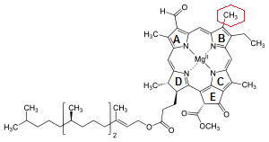

Slide 11
The basic structure is a ring made of four pyrroles, a tetrapyrrole, which is also named porphyrin.
Mg++ is present in the center of the ring as the central atom. Mg++ is covalently bound with two N-atoms and coordinately bound to the other two atoms of the tetrapyrrole ring.
A cyclopentanone (C₅H₈O)is attached to ring c.
At ring d a propionic acid (CH3CH2CO2H) group forms an ester with the alcohol phytol (C20H40O).
Phytol consists of a long branched hydrocarbon chain with one C-C double bond. It is derived from an isoprenoid, formed from four isoprene units (C₅H₈). This long hydrophobic hydrocarbon tail renders the chlorophyll highly soluble in lipids and therefore promotes its presence in the membrane phase. Chlorophyll always occurs bound to proteins.
In ring b, chl-b contains a formyl residue instead of the methyl residue in chl-a. This small difference has a large influence on light absorption.
Chlorophyll a= C55H72MgO5N4
Chlorophyll b= C55H70MgO6N4

Slide 12
Chromophore and Pigments
Chlorophyll molecules are bound to chlorophyll-binding proteins. In a complex with proteins the absorption spectrum of the bound chlorophyll may differ considerably from the absorption spectrum of the free chlorophyll.
Free absorbing substances are called chromophore (Greek, carrier of color) and the chromophore-protein complexes are called pigments. Pigments are often named after the wavelength of their absorption maximum. Chlorophyll-a700 means a pigment of chl-a with an absorption maximum of 700 nm.
Another common designation is P700; this name leaves the nature of the chromophore open

Slide 13
Carotenoids
are usually red, orange, or yellow pigments, and include the familiar compound carotene, which gives carrots their color.
Carotenoids cannot transfer sunlight energy directly to the photosynthetic pathway, but must pass their absorbed energy to chlorophyll.
For this reason, they are called accessory pigments. One very visible accessory pigment is fucoxanthin the brown pigment which colors kelps and other brown algae as well as the diatoms.

Slide 14
Phycobilins
Phycobilins are water-soluble pigments, and are therefore found in the cytoplasm, or in the stroma of the chloroplast.
They occur only in Cyanobacteria and Rhodophyta.
Bluish pigment phycocyanin, which gives the Cyanobacteria their name.
Reddish pigment phycoerythrin, which gives the red algae their common name

Slide 15
Light absorption excites the chlorophyll molecule
What happens when a chromophore absorbs a photon?
When a photon with a certain wavelength hits a chromophore molecule that absorbs light of this wavelength, the energy of the photon excites electrons to a higher energy level. This occurs as an “all or nothing” process.

Slide 16
According to the principle of energy conservation expressed by the first law of thermodynamics, the energy of the chromophore is increased by the energy of the photon, which results in an excited state of the chromophore molecule. The energy is absorbed only in discrete quanta, resulting in discrete excitation states.
The energy required to excite a chromophore molecule depends on the chromophore structure. A general property of chromophores is that they contain many conjugated double bonds, 10 in the case of the tetrapyrrole ring of chl-a. These double bonds are delocalized.

Slide 17
Figure 2.5 shows two possible resonance forms

Slide 18
After absorption of energy, an electron of the conjugated system is elevated to a higher orbit. This excitation state is termed a singlet.
Figure 2.6 shows a scheme of the excitation process.
As a rule, the higher the number of double bonds in the conjugated system, the lower the amount of energy required to produce a first singlet state.
For the excitation of chlorophyll, dark red light is sufficient, whereas butadiene, with only two conjugated double bonds, requires energy-rich ultraviolet light for excitation.
The light absorption of the conjugated system of the tetrapyrrole ring is influenced by the side chains. Thus, the differences in the absorption maxima of chl-a and chl-b mentioned previously can be explained by an electron attracting effect of the carbonyl side chain in ring b of chl-b

Slide 19
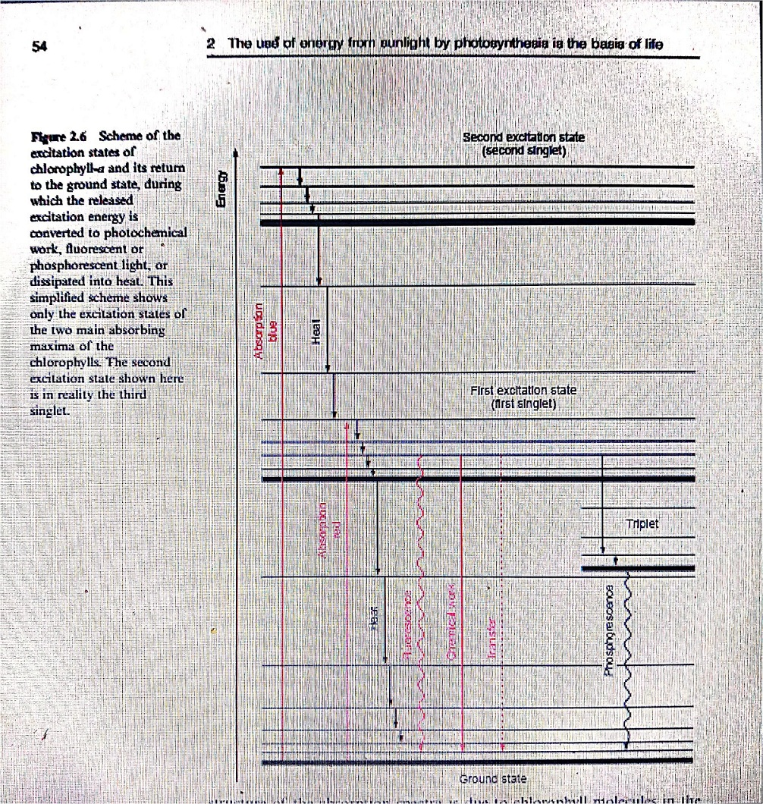

Slide 20
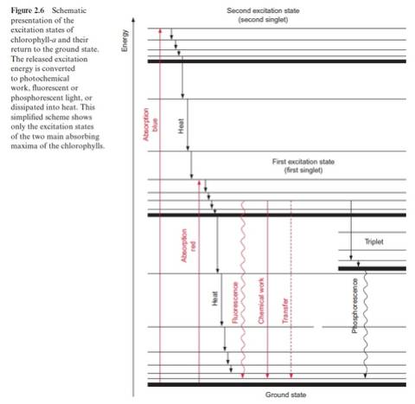

Slide 21
The spectra of chl-a and chl-b (Fig. 2.3) each have two main absorption maxima, showing that each chlorophyll has two main excitation states.
The two main excitation states of chlorophyll are known as the first and second singlet (Fig. 2.6).
The absorption maxima in the spectra are relatively broad. At a higher resolution the spectra can be shown to consist of many separate absorption lines.

Slide 22
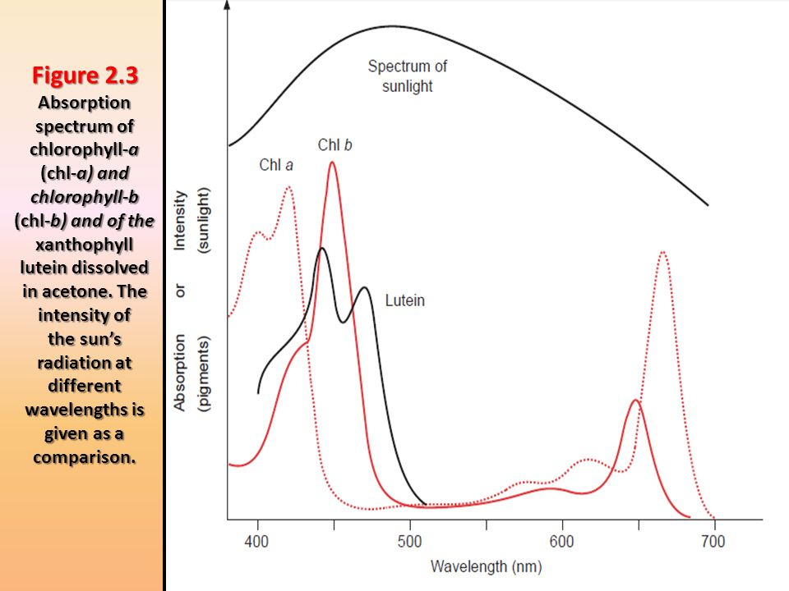

Slide 23
If a chlorophyll molecule absorbs light in the region of its absorption maximum in blue light, one of its electrons is elevated to the second singlet state. This second singlet state with a half-life of only 10-12 s is too unstable to use its energy for chemical work. The excited molecules lose energy in form of heat by rotations and vibrations until the first singlet state is reached.
This first singlet state can also be attained by absorption of a photon of red light, which contains less energy. The first singlet state is much more stable than the second one; its half-life amounts to 4 × 10-9 s.

Slide 24
The return of the chlorophyll molecule from the first singlet state to the ground state can proceed in different ways
1. The most important path for conversion of the energy released when the first singlet state returns to the ground state is its utilization for chemical work.
The chlorophyll molecule transfers the excited electron from the first singlet state to an electron acceptor and a positively charged chlorophyll radical chl+• remains. This is possible since the excited electron is bound less strongly to the chromophore molecule than in the ground state.
As an alternative, the electron deficit in the chl+• radical may be replenished by another electron donor [e.g.,water]

Slide 25
2. The excited chlorophyll can return to the ground state by releasing excitation energy in the form of light; this light emittance is named fluorescence.

Slide 26
3. It is also possible that the return from the first singlet to the ground state proceeds in a stepwise fashion via the various levels of vibration and rotation energy, by which the energy difference is completely converted to heat.
4. By releasing part of the excitation energy in the form of heat, the chlorophyll molecule can attain an excited state of lower energy, called the first triplet state.
This triplet state cannot be reached directly from the ground state by excitation. In the triplet state the spin of the excited electrons has been reversed.
As the probability of a spin reversal is low, the triplet state does not occur frequently, but in the case of a very high excitation, part of the chlorophyll can reach this state.

Slide 27
By emitting so-called phosphorescent light, the molecule can return from the triplet state to the ground state. Phosphorescent light is again lower in energy than the light required to attain the first singlet state.
The return from the triplet state to the ground state requires a reversal of the electron spin. As this is rather improbable, the triplet state, in comparison to the first singlet state, has a relatively long life (half-life 10-4 to 10-2 s.).

