Slide 1
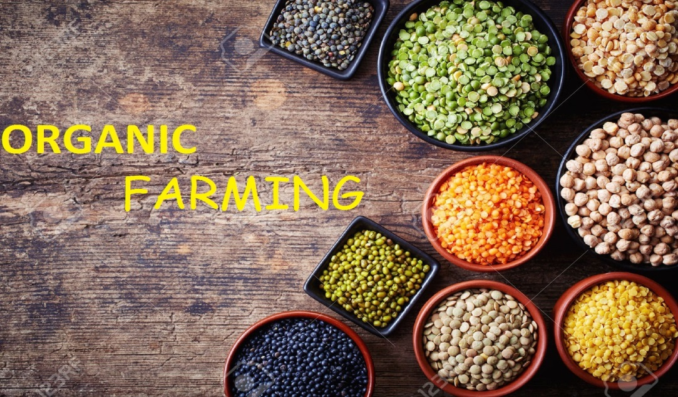
Components Of Organic Farming

Slide 2
Components of Organic Farming:
Major components are crop rotation, maintenance and enhancement of soil fertility.
Addition of organic manure and use of soil microorganisms, crop residues, bio-pesticide, biogas slurry, waste etc.
Vermi culture is found to be effective in enhancing the soil fertility and producing large numbers of crops in a sustainable manner.

Slide 3
Crop and Soil Management
Organic farming system encourages the use of rotations and measures to maintain soil fertility. Carefully managed soil with a high production of humus offer essential advantages with respect to water retention, soil erosion and animal life in the soil.
Green manuring reduce the leaching of nutrients and reduce soil erosion. A green cover through out most of the year is one of the main goals of such farming methods.
Depending on the green manure mixture or the legumes used for under sowing, there may be an increased soil organice matter and soil N2 as well as in other nutrients.

Slide 4
The various components of organic farming have been discussed in details below:
1. Crop rotation:
It is a systematic arrangement for the growing of different crops in a more or loss regular sequence on the same land covering a period of two years or more.
Soil fertility management, weed, insect and disease control.
Legumes are essential in any rotation and should cover 30 to 50 % of the land.
A mixed cropping, pasture and livestock system is desirable or even essential for the success of sustainable agriculture.

Slide 5
2. Crop Residue:
About 50% of the crop residues are utilized as animal fed, the rest could be very well utilized for recycling of nutrients.
Adequate care is required to use the residues after proper composting with efficient microbial inoculants. While the incorporation of crop residues e.g. Wheat and Rice straw, as such or inoculated with fungal species had beneficial effects on crop yields and important in physico-chemical properties of soil.

Slide 7
3. Organic manure:
The organic manure is derived from biological sources like plant, animal and human residues.
Organic manure act in many ways in augmenting crop growth and soil productivity.
The direct effect of organic manure relates to the uptake of humic substances or its decomposition products affecting favourably the growth and yield of plants.
Indirectly, it augments the beneficial soil microorganisms and their activities and thus increases the availability of major and minor plant nutrients.

Slide 8
a) Bulky organic manure:
It generally contains fewer amounts of plant nutrients as compared to concentrated organic manure. It includes FYM, compost and Green manure.

Slide 9
FYM:
It refers to the well-decomposed mixture of dung, urine, farm litter and left over or used up materials from roughages or fodder fed to the cattle.
The waste material of cattle shed consisting of dung and urine soaked in the refuse is collected and placed in trenches about 6 m long, 2 m wide and 1 m deep.
Each trench is filled up to a height of about 0.5 m above the ground level and plastered over with slurry cowdung and earth. The material is allowed to decompose undisturbed 3-4 months for anaerobic microorganism for completion of fermentation.
FYM becomes ready to apply after 3-4 months.
Well-rotted FYM contains 0.5% N, 0.2% P205 and 0.5% K2O.

Slide 11
Compost:
Large quantities of waste material are available as vegetable refuse, farm litter, such as weeds, stubble, bhusa, sugarcane trash.
Sewage sludge and animal waste in houses and in areas like human and industrial refuse; therefore, excreta can be converted into useful compost manure by conserving and subjecting these to a controlled process of anaerobic decomposition.
Compost is used in the same way as FYM and is good for application to all soils and all crops.

Slide 13
Green Manuring:
It is a practice of ploughing or turning into the soil undercomposed green plant tissues for the purpose of improving physical structure as well as fertility of the soil.
It consists of the growing of quick growing crop and ploughing it under to incorporate it into the soil.
The green manure crop supplies organic matter as well as additional nitrogen, particularly if it is a legume crop, which has the ability to fix nitrogen from the air with the help of its root-nodule bacteria.

Slide 14
A leguminous crop producing 25 tones of green matter per hectare will add about 60 to 90 kg of nitrogen when ploughed under.
This amount would equal an application of 3 to 10 tones of FYM on the basis of organic matter and its nitrogen contribution.
The green manure crops also exercise a protective action against erosion and leaching.
The most commonly used green manuring crops are: Sunhemp (Crotalaria juncea), Clusterbean (Cyamopsis tetragonoloba Cowpea (Vigna catjang, Vigna sinensis), Berseem (Trifolium alexandrium).

Slide 15
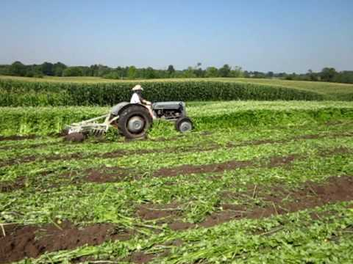

Slide 16
b) Concentrated Organic Manure:
Concentrated organic manures are those materials that are organic in nature and contain higher percentage of essential plant nutrients such as nitrogen, phosphorous and potash, as compared to bulky organic manures.
These concentrated manures are made from raw materials of animal or plant origin. The concentrated organic manures commonly used are oilcakes, blood meal, fishmeal, meat meal and horn and hoof meal.

Slide 17
Biofertilizers:
These are less expensive, eco-friendly and sustainable.
The beneficial microorganisms in the soil that are greater significance to horticultural situations are biological nitrogen fixers, phosphate solubilisers and mycorrhizal fungi.
They help in establishment and growth of crop plants and trees.
They enhance biomass production and grain yields by 10-20%.

Slide 18
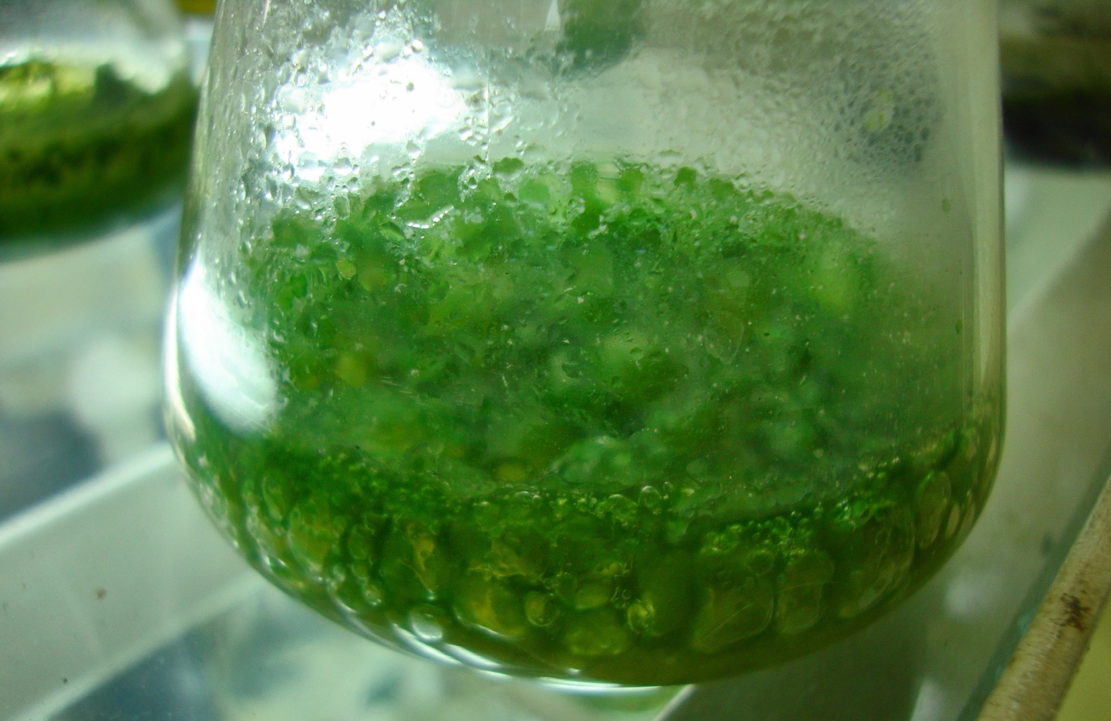
Types of Biofertilizers: There are two types of bio-fertilizers.
1. Symbiotic N-fixation: Rhizobium
2. Asymbiotic N-fixation:Azotobacter, Azospirillium, Azolla e.t.c.

Slide 19
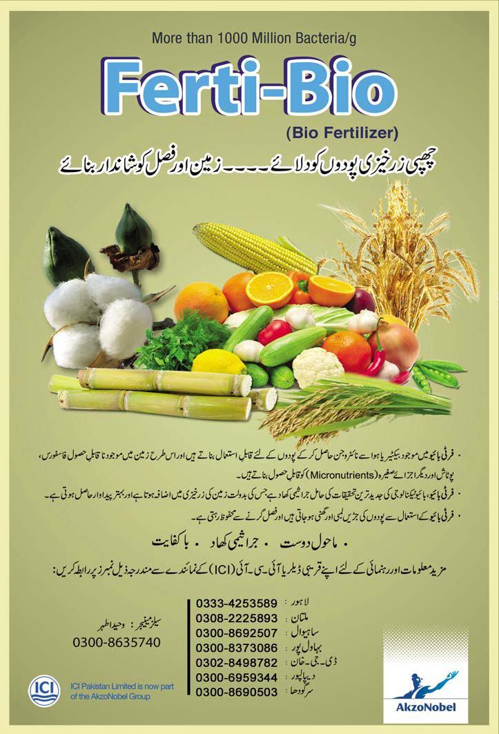

Slide 20
Bio-pesticide:
Botanical insecticides are ecologically and environmentally safer generally affect the behaviour and physiology of insects rather than killing them. Among the botanical pesticides investigated. Neem (Azadirachta indica) has justifiably received the maximum attention.
Some of the commonly used botanical Insecticides are Nicotine, Pyrethrum, Rotenone, Subabilla, Ryanin, Quassia, Margosa, Acorus, Tuba species e.t.c.

Slide 22
Vermicompost:
It is organic manure produced by the activity of earthworms.
It is a method of making compost with the use of earthworms that generally live in soil, eat biomass and excrete it in digested form.
It is generally estimated that 1800 worms which is an ideal population for one sq. meter can feed on 80 tones of humus per year.

Slide 23
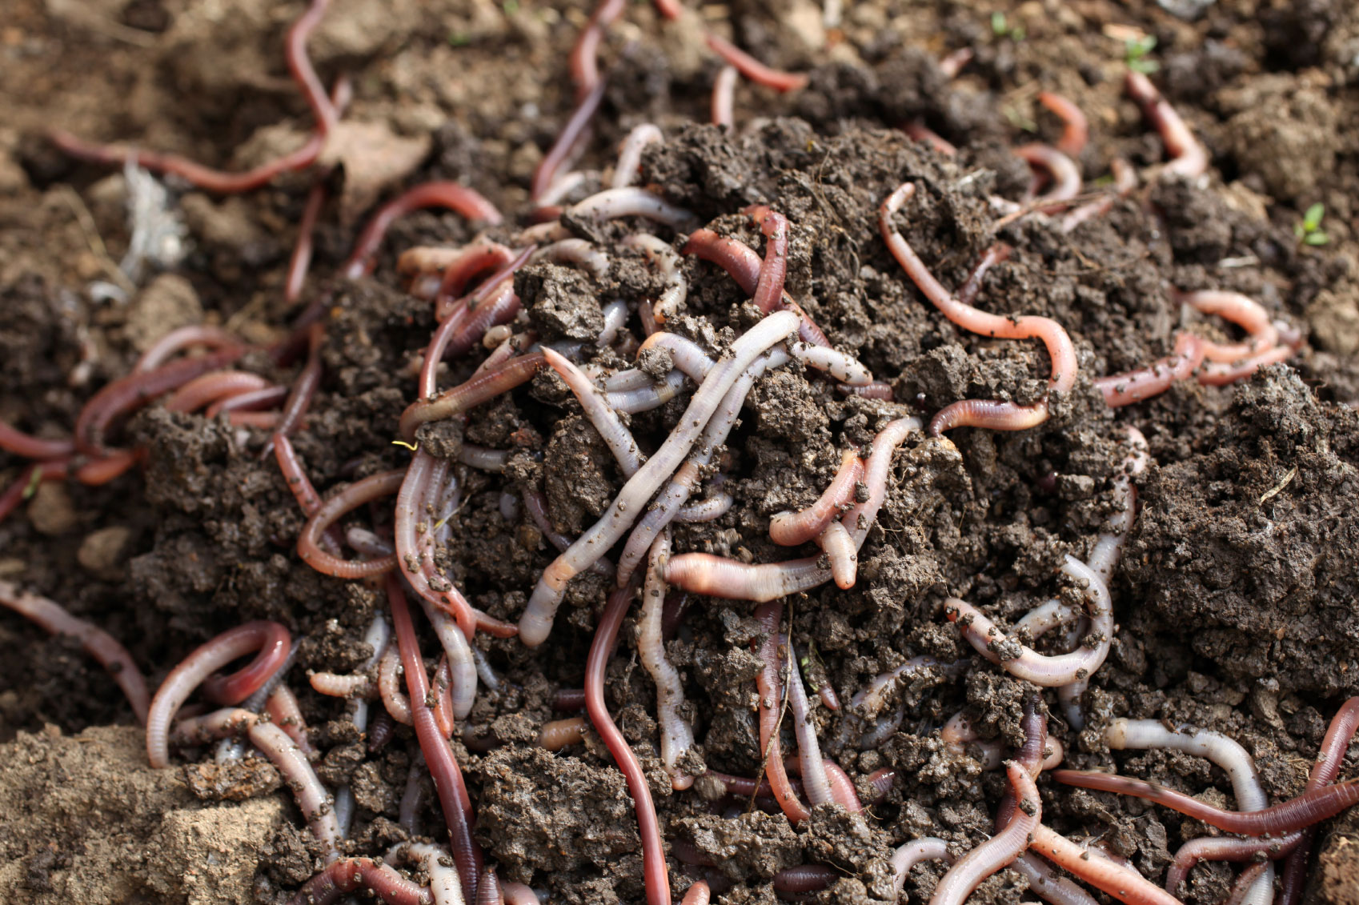

Slide 24
Weed Control:
Mechanical weed control:
Buried to 1-cm depth, and cutting at the soil surface are the most effective ways to control weed seedlings mechanically.
Mechanical weeders include cultivating tools such as hoes, harrows, tines and brush weeders.
Similarly flame weeding and mulching is used to supress and control the weed.

Slide 25
Disease Management
Diseases should be managed by
Selecting resistant variety.
Selecting healthy seed.
Application of suitable soil cultivation methods.
Suitable cropping system like mixed cropping system and crop rotation.
Organic matter fascilitates disease control.
Optimum spacing between plants.
Water management.

Slide 26
Thanks

