Slide 1
Haploid Culture

Slide 2
Introduction:
• Haploid culture are known to be culture the anther/pollen and ovary/ovule of plants.
• Make sporophyte with the help of gametophyte.
• One set of chromosome
• Recessive mutation is easily detectable

Slide 3
History:
• Bergner discover first in 1921.
• In 1964 Guha and Maheshwari find the way to produce the first haploid.
• Further in 1967 Bourgin and Hitsch improve the methodology.

Slide 4
Androgenises:
• Plant is prepared by male gametophyte.
• Develop by two ways
Direct
Indirect
• Anther culture
• Pollen culture

Slide 6
Anther culture
• Simple culture
• In-vivo no specific condition are required.
The original technique of anther culture developed by Guha and Maheshwari (1964, 1966).
The technique involves excising closed flower buds which have anthers containing uninucleate microspores.

Slide 7
At this stage, microspores are most suitable for the induction of androgenesis.
The excised flower buds are surface-sterilised and anthers are removed.
Absolute care is to be taken to avoid injury to the anthers which are subsequently cultured on agar-solidified or liquid medium.
The cultures are incubated at 24-27°C using light of about 2000 lux for 14 h per day.

Slide 8
Depending upon the plant species, it takes 3-8 weeks for pollen plantlets to regenerate from anthers.
After a month of incubation, the microspores either develop into embryos or calli emerging through anther lobes.
Subsequently, these calli can be transferred to the regeneration medium.
In some cases, some pollen grains develop into embryos and others into calli within the same anther.
The pollen plantlets at about a height of 12-14 cm are hardened and then transferred to the soil.

Slide 9
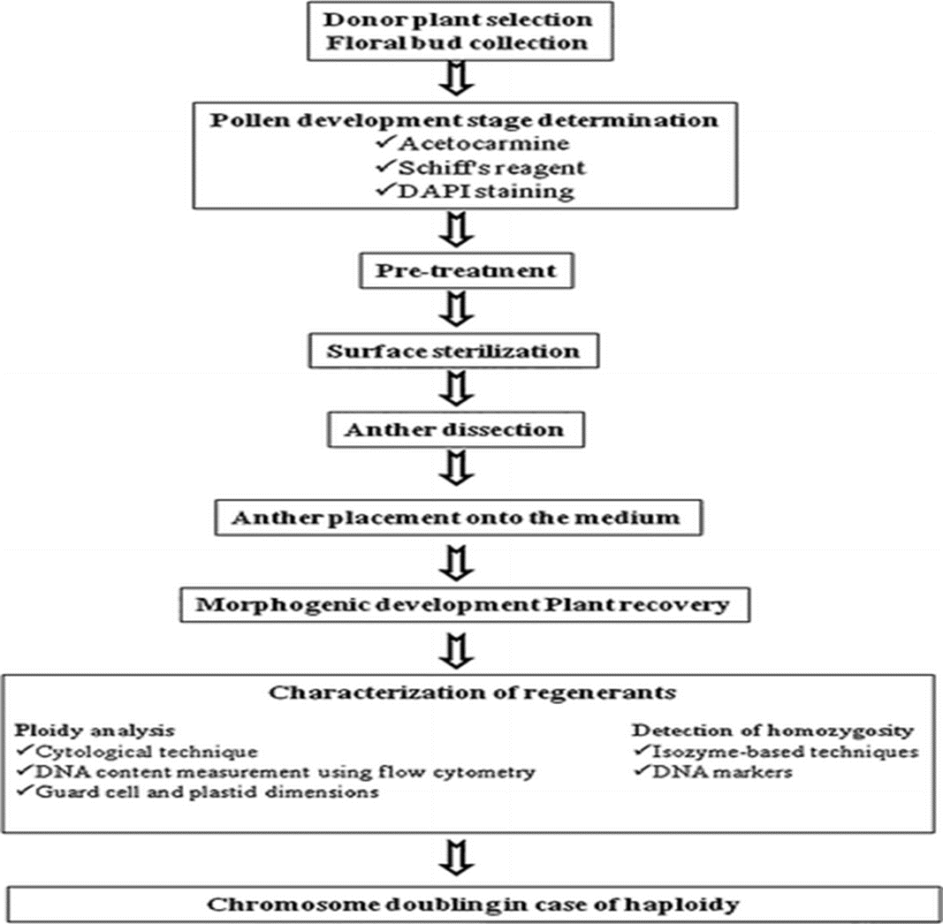

Slide 10
Pollen culture
• Can be genetically modified before culturing.
• Improve productivity
• Exogenous treatment is effectively applied.
• Best study of cellular and subcellular changes.
Flower buds (50-75) were removed from donor plants older than 6 weeks.
Bud length was 2-4 mm, only those in this range could produce embryos.

Slide 11
The buds were placed in test tubes and surface sterilized in 4.5 sodium hypochlorite with one drop of Tween-20 for 15 min, followed by three five minute washes with sterile, distilled water.
Ten milliliters of microspore suspension was dispensed into 100x15 mm sterile Petri dish. The dishes were then wrapped with double layers of parafilm.
Every test was repeated at least three times. The microspores were incubated in the dark for an initial period of three days at 32°C, followed by three weeks of dark culture at 25°C.

Slide 12
General procedures
Collection of materials
• Disinfection
• Excision
• Culture
• microspore development analysis
• Handling of haploid plantlets

Slide 13
Factors:
• Condition of donor plants
• Stage of microspore development
• Pre-treatments :Temperature and light for callus culture induction
• Media containing NAA and BAP

Slide 14
Floral buds of Asparagus densiflorus.
(a) Flowers with orange colored anther
(b) Anthers placed in modified liquid MS medium containing NAA (2.0 mg/1) and BAP (1.0 mg/1)
(c) Callus initiation in above said medium
(d) , (e) and (f) Developing haploid callus line.
(g) Somatic metaphase plate showing haploid numbers of chromosome

Slide 15
Gynogenesis
Development in which the embryo contains only maternal chromosomes due to activation of an egg by a sperm that degenerates without fusing with the egg nucleus. Regeneration rates are quite low and usually only one or few embryos developed.
Used when anthogenesis protocol fail in some species.
• Low yield, lack of developed protocol, production of diploid.

Slide 16
Ovary culture
• Unopened mature unfertilized flower bud is used.
• By histological study appropriate stage of ovary is determined.
• Proper sterilization protocol is used.

Slide 17
Ovary culture
Two Process:
Induction Process.
Regeneration process.
Incubate the cultures for 16hours at 25֯ C.
After 2 weeks, haploid plantlets grow.
haploid production is very low(1-5% )

Slide 18
Ovule culture
No need to be sterilized.
• Two methods are used
filter paper support system.
vermiculite support technique
• Haploid production on onion and sugar beet

Slide 19
General gynogenesis procedure
Unfertilized ovary/ovule used.
• explant is collected several days before from anthesis.
• Sterilization done according to specie
• During removal of ovule from ovary care must be taken.

Slide 20
Other factors
• Genotype
• Stage of microspore development
• Media
• Temperature and light

Slide 21
Dihaploidizatioin of Haploid Plants:
• For the production of diploid plant, two methods are used.
• Colchicine treatment and endomitosis

